Slide 1
MPI_ERRORS_ARE_FATAL & MPI_ERRORS_ABORT (and other error handler stuff)
Fault Tolerance Working Group
June 2016 MPI Forum

Slide 2
Background
Section 8.3 is imprecise about where MPI_ERRORS_ARE_FATAL is applied.
The first and second sentences are contradictory (MPI_ABORT accepts a communicator argument)
The second sentence is more permissive for FT implementations and good software engineering.

Slide 3
Motivation
Allows the application to clean itself up after an error.
Flush state to disk, close files, etc.
Step 0 for any FT solution
Could be part of ULFM, but this is more generic.
Allows very basic FT implementations and applications
Without these changes, if any communicator uses MPI_ERRORS_ARE_FATAL, all use it.
Even if users don’t want FT, they still might want to clean up reliably
Have some users at BSC who would already like to see this available

Slide 4
Changes Summary – Issue 1
MPI_ERRORS_ARE_FATAL causes all connected processes to abort (as if called by MPI_ABORT).
Better define how communicators inherit error handlers for each communicator creation function.
Windows all inherit their error handler from MPI_WIN_NULL
Mirrors files
General text cleanup to have definitions in a single place.
ADVICE: HQI should detect aborts correctly

Slide 5
Changes Summary – Issue 3
Add new error handler MPI_ERRORS_ABORT which aborts only a communicator
Define MPI_COMM_SELF as default communicator for error handlers (instead of MPI_COMM_WORLD)

Slide 6
Burden on Implementations
Must provide MPI_ERRORS_ABORT
In practice, could be the same as MPI_ERRORS_ARE_FATAL
Change error handler propagation for windows
Minor change to inherit from MPI_WIN_NULL
Can still abort all processes if that’s what the implementation wants to do
Implementations that choose to do better now have clear instructions
Optional:
Improve MPI_ABORT to only abort a subcommunicator

Slide 7
Read Through Changes
https://github.com/mpi-forum/mpi-standard/pull/1

Slide 8
Straw Vote #1 How are error handlers inherited?
No communicator inheritance except for DUP. Intercomm_create changes to not inherit. Everything gets MPI_ERRORS_ARE_FATAL.
All objects inherit from MPI_XXX_NULL (no exceptions).
Existing proposal. Communicators inherit from each other. Windows and Files inherit from MPI_XXX_NULL.
Ryan suggestion: Don’t use MPI_XXX_NULL. Instead use MPI_XXX_something_else

Slide 9
Straw Vote #2 Are you comfortable with the reading as is (mod minor text changes mentioned)?
Yes
No

Slide 10
Backup Slides

Slide 11
Objection from Bordeaux
Rolf pointed out a backward compatibility issue
An application is catching its own errors via MPI_ERRORS_RETURN on MPI_COMM_WORLD, but does not change MPI_ERRORS_ARE_FATAL on MPI_COMM_SELF.
A simple error (MPI_ALLOC_MEM) would abort in this model where it did not before.
The forum considered this problem and straw voted to break backward compatibility here.
We looked at it in the working group and came up with alternatives, but all required adding a bunch of new semantics. (Discussion on issue)

Slide 12
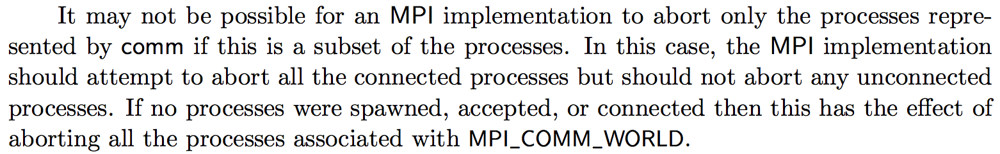
Previous Objections
This prevents the application from handling an exception safely! (MPI_SEND kills apps)
If you want to be safe, set your error handler to MPI_ERRORS_RETURN on communicators that you want to keep alive.
Completing MPI_SEND does not imply that the message has been received (or that the receiver is alive).
This has a large burden on implementations!
This is just as optional as FT has always been. Feel free to abort.

Slide 13
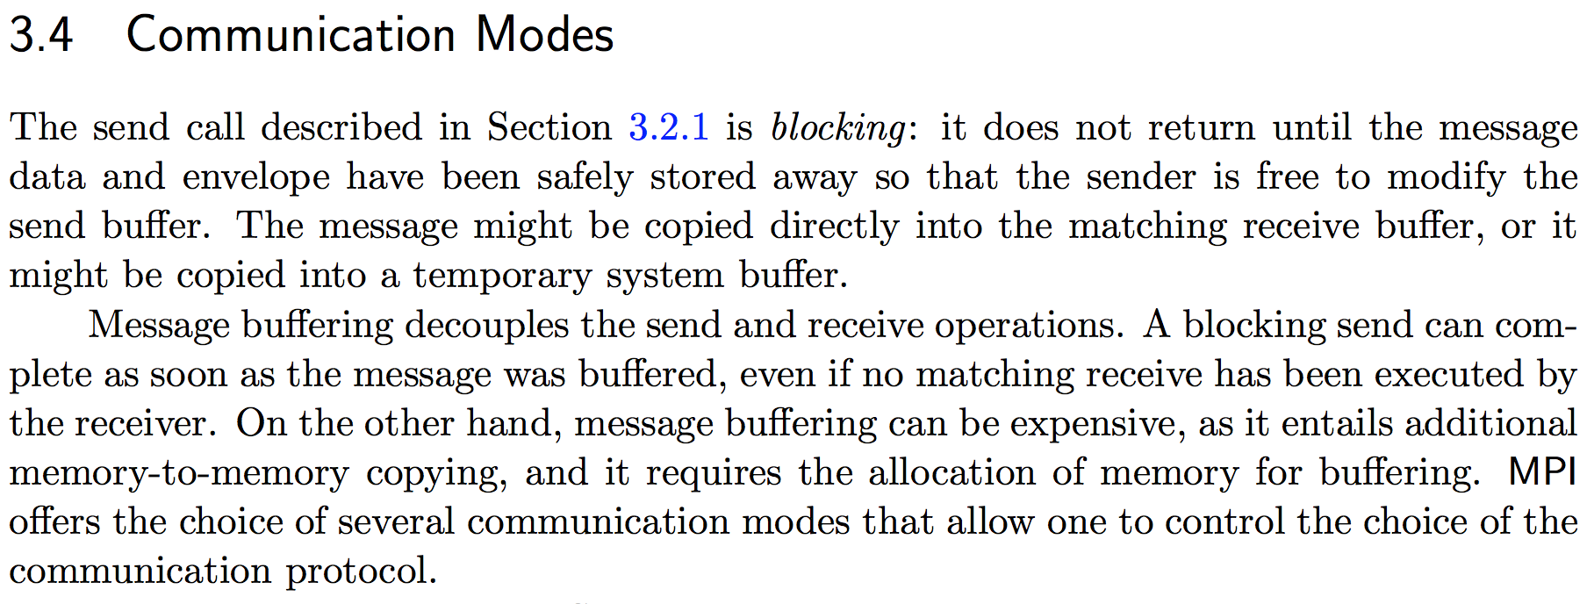
Why MPI_Send can succeed when the receiver is dead
Returning from MPI_Send does not imply that the message is received, only buffered somewhere.

