Slide 1
MPI_ERRORS_ARE_FATAL & MPI_ERRORS_ABORT (and other error handler stuff)
Fault Tolerance Working Group

Slide 2
Background
Section 8.3 is imprecise about where MPI_ERRORS_ARE_FATAL is applied.
The first and second sentences are contradictory (MPI_ABORT accepts a communicator argument)
The second sentence is more permissive for FT implementations and good software engineering.

Slide 3
Motivation
Allows the application to clean itself up after an error.
Flush state to disk, close files, etc.
Step 0 for any FT solution
Could be part of ULFM, but this is more generic.
Allows very basic FT implementations and applications
Without these changes, if any communicator uses MPI_ERRORS_ARE_FATAL, all use it.
Even if users don’t want FT, they still might want to clean up reliably
Have some users at BSC who would already like to see this available

Slide 4
Changes Summary – Issue 1
MPI_ERRORS_ARE_FATAL causes all connected processes to abort (as if called by MPI_ABORT).
Better define how communicators inherit error handlers for each communicator creation function.
Windows all inherit their error handler from MPI_WIN_NULL
Mirrors files
General text cleanup to have definitions in a single place.
ADVICE: HQI should detect aborts correctly

Slide 5
Changes Summary – Issue 3
Add new error handler MPI_ERRORS_ABORT which aborts only a communicator
Define MPI_COMM_SELF as default communicator for error handlers (instead of MPI_COMM_WORLD)

Slide 6
Burden on Implementations
Must provide MPI_ERRORS_ABORT
In practice, could be the same as MPI_ERRORS_ARE_FATAL
Change error handler propagation for windows
Minor change to inherit from MPI_WIN_NULL
Can still abort all processes if that’s what the implementation wants to do
Implementations that choose to do better now have clear instructions
Optional:
Improve MPI_ABORT to only abort a subcommunicator

Slide 7
Error Handler Inheritance
New
Error Handlers Always Inherit
Error Handlers Never Inherit
Error handlers are defined by their parents
Simplest for users
Special cases for windows and files
More or less current practice
Safest with libraries
More work for error handling codes
No opportunity to prevent errors during certain times

Slide 8
Error Handler Inheritance
New
Combine the two!
Error Handlers Always Inherit
Error Handlers Never Inherit
Error handlers are defined by their parents
Simplest for users
Special cases for windows and files
More or less current practice
Safest for libraries
More work for error handling codes

Slide 9
Error Handler Inheritance
New
Default is that error handlers do not inherit from parents
Allow users to change this behavior by setting an info key on the communicator
Windows and files still can’t inherit
Set the communicator info key errhandler_inheritance to “none” or “parent”
“none” – All new communicators use MPI_ERRORS_ARE_FATAL initially.
“parent” – All new communicators use the error handler of their parent communicator (as defined in the functions’ respective definitions).
Add new error handler assignment function to specify how error handlers should be inherited from each other (as part of greenfield).

Slide 10
Other Changes
New
Removed changes to Chapter 2 example of errors
Combine two issues back to one?
Initial rationale was that issue #3 was for backward incompatible changes and #1 was everything else.
With the new error handler discussion, pretty much everything is backward incompatible. Is it still worth separating?

Slide 11
Read Through Changes
https://github.com/mpi-forum/mpi-standard/pull/1

Slide 12
Straw Vote #1 How are error handlers inherited?
No communicator inheritance except for DUP. Intercomm_create changes to not inherit. Everything gets MPI_ERRORS_ARE_FATAL.
All objects inherit from MPI_XXX_NULL (no exceptions).
Existing proposal. Communicators inherit from each other. Windows and Files inherit from MPI_XXX_NULL.
Ryan suggestion: Don’t use MPI_XXX_NULL. Instead use MPI_XXX_something_else

Slide 13
Straw Vote #2 Are you comfortable with the reading as is (mod minor text changes mentioned)?
Yes
No

Slide 14
Backup Slides

Slide 15
Objection from Bordeaux
Rolf pointed out a backward compatibility issue
An application is catching its own errors via MPI_ERRORS_RETURN on MPI_COMM_WORLD, but does not change MPI_ERRORS_ARE_FATAL on MPI_COMM_SELF.
A simple error (MPI_ALLOC_MEM) would abort in this model where it did not before.
The forum considered this problem and straw voted to break backward compatibility here.
We looked at it in the working group and came up with alternatives, but all required adding a bunch of new semantics. (Discussion on issue)

Slide 16
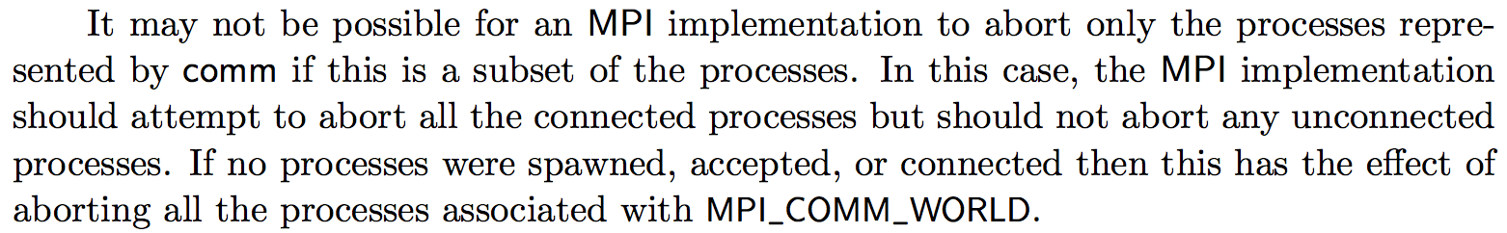
Previous Objections
This prevents the application from handling an exception safely! (MPI_SEND kills apps)
If you want to be safe, set your error handler to MPI_ERRORS_RETURN on communicators that you want to keep alive.
Completing MPI_SEND does not imply that the message has been received (or that the receiver is alive).
This has a large burden on implementations!
This is just as optional as FT has always been. Feel free to abort.

Slide 17
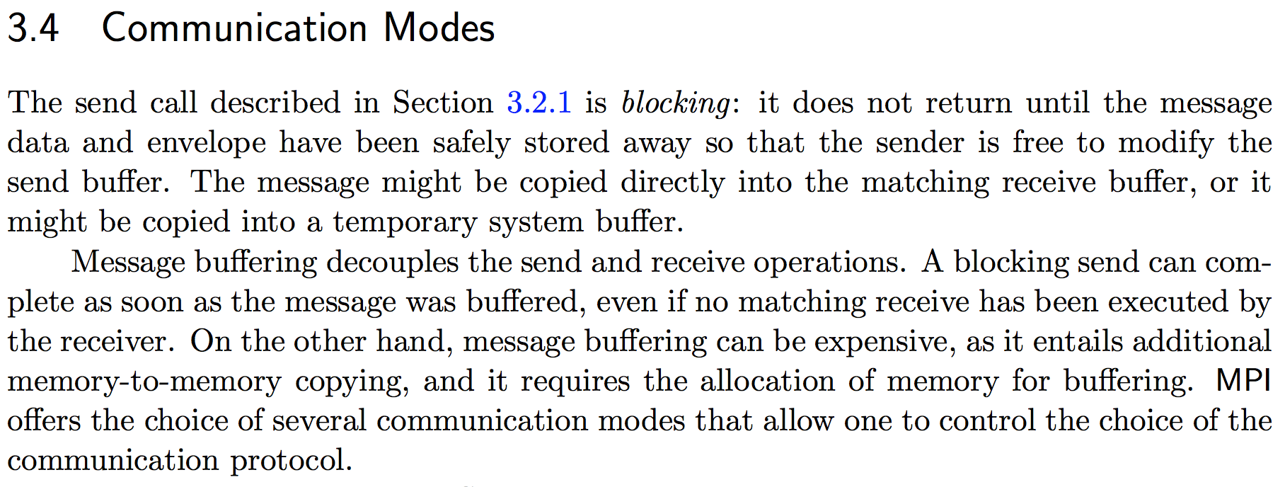
Why MPI_Send can succeed when the receiver is dead
Returning from MPI_Send does not imply that the message is received, only buffered somewhere.

