Slide 1
ULFM Discussions
FTWG
2016-04-26

Slide 2
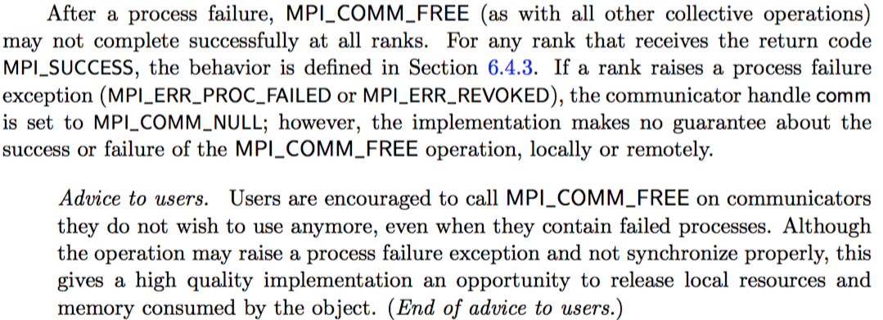
How do you disconnect after a failure?
There isn’t currently any text about how you can disconnect yourself or other processes after a process failure
MPI_COMM_DISCONNECT is a collective
Should we add language similar to what we have for MPI_COMM_FREE?

Slide 3
What does ULFM look like with Sessions?
We’ve discussed whether ULFM should change based on MPI Sessions in their current form
Seem to have decided that it makes sense to stay “as is” for now
How does this change if Sessions were to expand to include Windows and Files?
If you can create a Window or File directly from a set, you no longer have a communicator that you can use to rebuild the object.
Now it might make more sense to have the set itself be able to handle the failure.

Slide 4
What do you need for Replace
Collective
Resolve overlaps with another attempt to replace (if a process is in multiple sets)
How do you fix all sets everywhere?
If you have a centralized place to lookup sets, this is possible, but not scalable.
Well known handle identifiers (names) for the communicators/windows/files

Slide 5
MPI_SET_SHRINK (Static Sets)
MPI_Set_shrink( IN MPI_Session *session, IN char *input_set OUT char *output_set);
The output set is a copy of input_set without the failed processes

Slide 6
MPI_SET_SHRINK (Dynamic Sets)
MPI_Set_shrink( IN MPI_Session *session, IN char *input_set);
The makeup of input_set changes after the shrink call is done (collective among all processes in input_set).

