Slide 1
Problem solving for (crime) prevention
Image: Unsplash

Slide 2



Slide 3

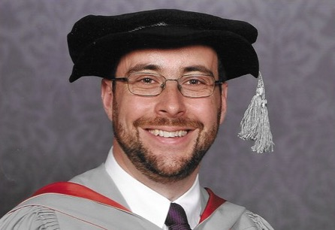
My career in two pictures

Slide 4
Effective problem solving

Slide 5
The SARA process
Scanning: define the problem
Analysis: understand the problem in detail
Response: take action to solve the problem
Assessment: work out if the problem is solved

Slide 6
S
Fights on a high street on Friday and Saturday nights
A
Fights start as disputes over taxis between people exiting two local nightclubs
R
Short term: police patrols to intervene in disputes
Medium term: taxi marshals paid for by night clubs
Long term: separate taxi ranks for the two night clubs
A
Monitoring of number of calls for fights and related crimes (e.g. assaults, affray) recorded

Slide 7
How not to do SARA
S A R A
Ignore the problem
S A R A
Try to respond without defining or understanding the problem
S A R A
Define the problem, but don’t take time to understand it
S A R A
Don’t assess whether or not the problem has been solved

Slide 8
Scanning define the problem

Slide 9
The more specific the problem, the easier it will be to solve

Slide 10
vehicle crime
theft of vehicles
theft from vehicles
taking without consent
damage to vehicles
excess speed
off-road driving
no insurance
drink driving
parking offences
tax-disc fraud
dumping vehicles

Slide 11
The funnel approach
specific problem
Make a problem easier to solve by progressively making it more specific

Slide 12
Robbery
Commercial robbery
Personal robbery
Off-licence robbery
Cash-in-transit robbery
…
Home invasion
Delivery driver robbery
Phone robbery
…
Outside Tube stations
Outside schools
Late at night
…

Slide 13
Phone robberies outside schools
Phone robberies outside two secondary schools at school finishing time
Phone robberies within 200m of two secondary schools at school finishing time by offenders from a local gang

Slide 14
Ask the CHEERS questions
Who in the community is affected by it?
What specific harm is created by it?
What do the public expect the police to do?
What events contribute to the problem?
When and where does the problem repeat?
How are the events similar?

Slide 15
Analysis define the problem

Slide 16
Analysis for problem solving finds out why the problem is the way it is

Slide 17
Analysis: think VOLTAGE
Victims: what makes them vulnerable?
Offenders: why are they committing this crime?
Locations: why is the problem concentrated here?
Times: why do the incidents happen when they do?
Attractors: what attracts crime to these places?
Groups: what groups are involved, directly or indirectly?
Enhancers: what factors facilitate crime in this setting?

Slide 18
Don’t rely just on crime data
Calls for service
Social services
Schools
A&E
Ambulance service
Local authorities
Business Improvement Districts
Fire service
Stops
Intel
Local councillors
Neighbourhood team knowledge

Slide 19
Repeat offending
Journey to crime
Facilitators
Social networks
Intelligence interviews
Repeat victimization
Near-repeat victimization
Victim–offender overlap
offenders
targets
Hotspots
Temporal analysis
Risk terrain modelling
places

Slide 20
Hypothesis testing: why is the problem like it is?
Summarise the problem
Choose 3–5 alternative hypotheses to test
See which fits the evidence
Choose hypothesis that best fits the evidence
Source: Chainey, S. 2012. Improving the explanatory content of analysis products using hypothesis testing. Policing 6(2):108–121.

Slide 21
If OCGs are driving metal theft locally …
some metal thieves would have previously been involved in offences associated with OCGs
police intelligence would suggest some metal thieves are involved in OCGs
some metal thieves would use sophisticated methods to steal metal

Slide 22
every person charged/cautioned for metal theft by British Transport Police

Slide 23
Only 1.3% of known offenders had any suspected links to OCGs

Slide 24
Response take action to solve the problem

Slide 25
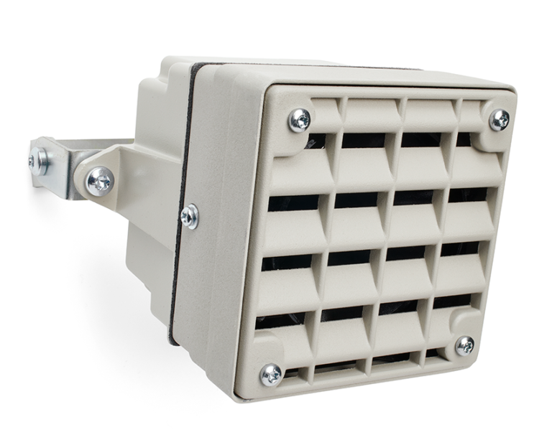

Respond ethically

Slide 26
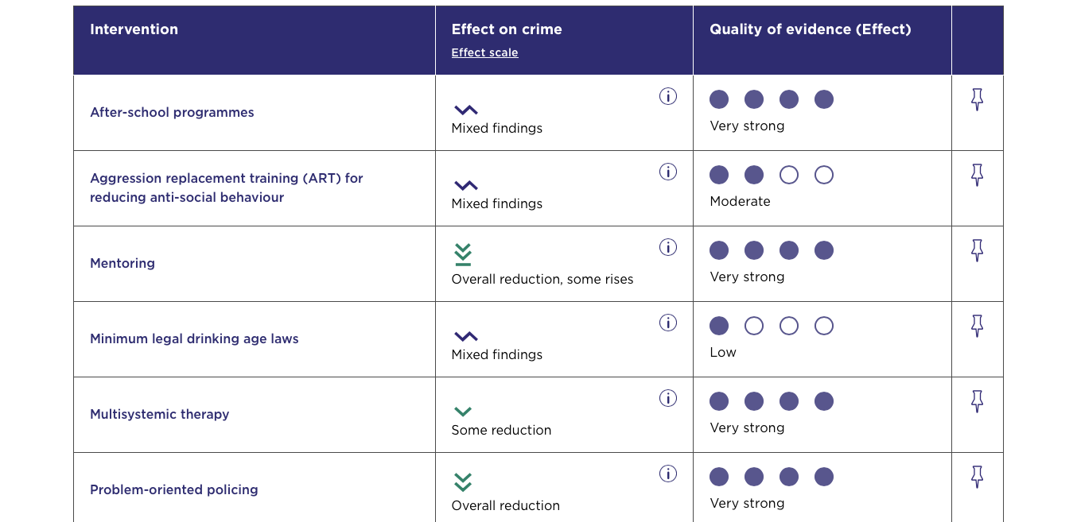
Use existing evidence College of Policing Crime Reduction Toolkit

Slide 27
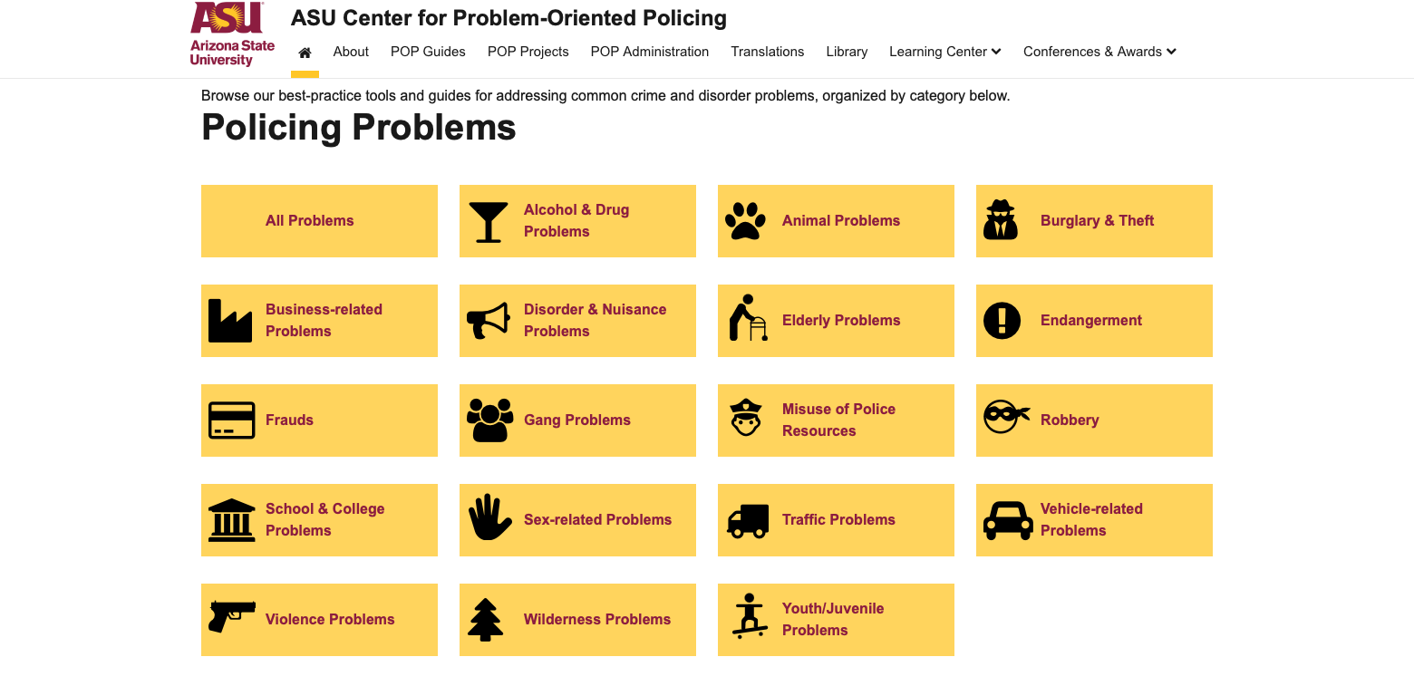
Use existing evidence Center for Problem-Oriented Policing

Slide 28
Leverage concentrations of crime
Focus on places when most crimes happen in a few places
e.g. night-time economy violence
Focus on stopping offenders when a few people commit most offences
e.g. ATM burglaries
Focus on protecting targets when a few targets are repeatedly victimized
e.g. cash-in-transit robberies
offenders
targets
places

Slide 29

Make use of practical psychology
The easier something is to do, the more people will do it, so make offending harder
People prioritise short-term outcomes over long-term ones, so don’t rely on punishment
Most people are bad at intuitively estimating risk

Slide 30

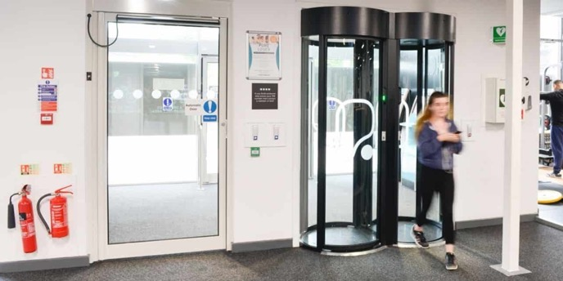
Recognise changing situations works better than trying to change people
Images: ISC Events and Meesons

Slide 31
Find ways to change situations by …
increasing effort for offenders
increasing risks of getting caught
removing excuses offenders tell themselves
reducing rewards offenders expect
reducing provocations for offending

Slide 32
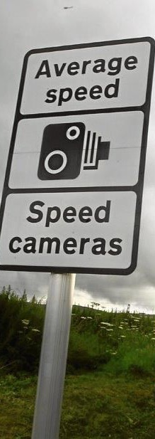
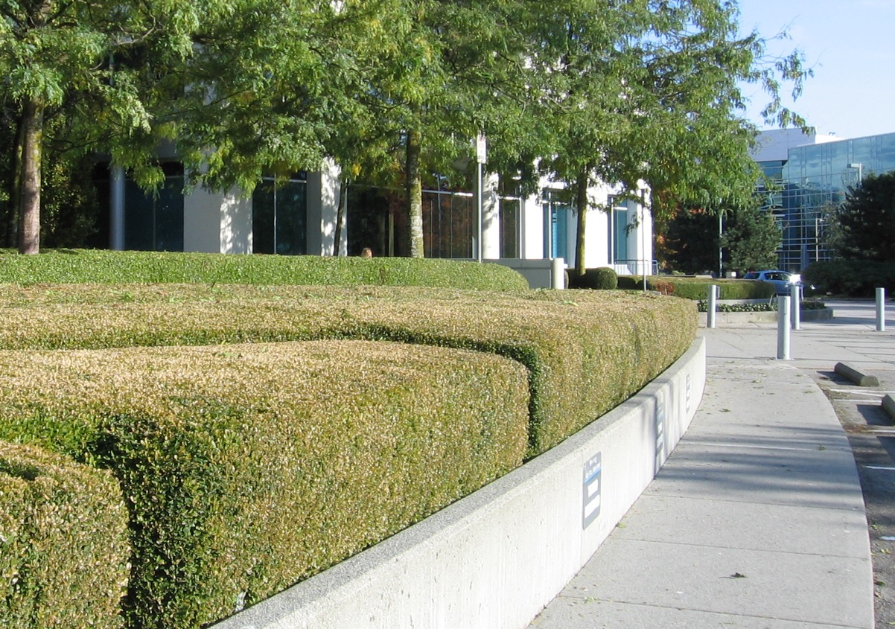

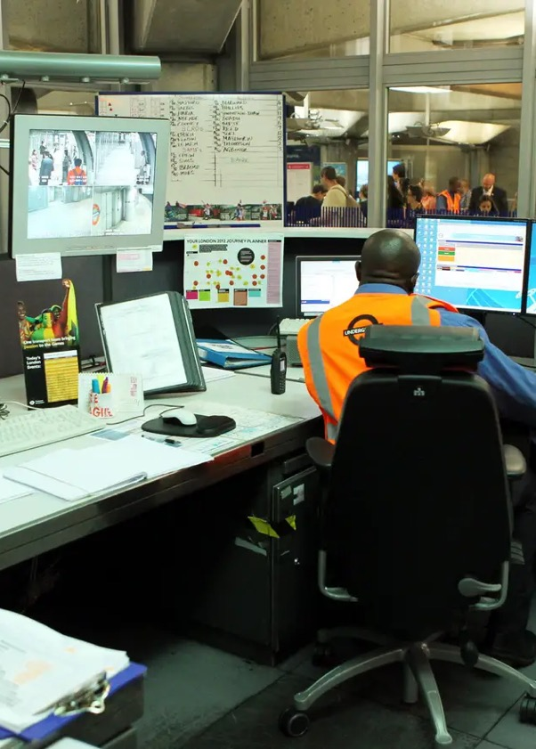
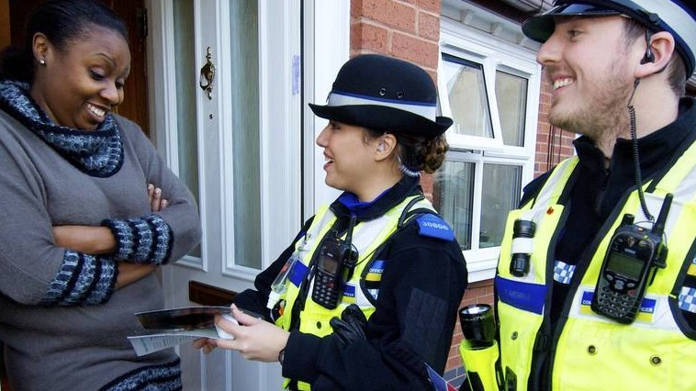
Increasing the (apparent) risk
Extend guardianship
Assist natural surveillance
Reduce anonymity
Use place managers
Try formal surveillance

Slide 33
Have a short-term and a long-term response
Priority: rapid implementation
scanning
short-term response
analysis
response
long-term response
Priority: sustainability

Slide 34
Recognise police alone typically cannot deliver sustainable solutions
Public sector
Private sector
Third sector
Local authority, fire service, highways, health, etc.
Businesses, business improvement districts, etc.
Charities, community groups, etc.

Slide 35
Apply pressure if shifting/sharing responsibility doesn’t work
Formal request to higher management
Use leverage, e.g. licensing powers
Call public attention to an organisation's lack of action
Withdraw/limit police services, if legal and ethical
Take civil/criminal legal action

Slide 36
What has to happen for my plan to work?
Action
Mechanism
Effect
Corner shop moves expensive whisky behind counter
Shoplifters cannot reach expensive whisky
Less expensive whisky is stolen

Slide 37
What has to happen for my plan to work?
Action
Mechanism
Effect
CCTV
?
Less expensive whisky is stolen

Slide 38
What might stop my plan from working?
Corner shop moves expensive whisky behind counter
Shoplifters cannot reach expensive whisky
Less expensive whisky is stolen

Slide 39
Assessment work out if the problem is solved

Slide 40
Why assess?
To see if further action is needed
To identify unforeseen consequences
To learn for the future (and help others learn)
To check for implementation failure

Slide 41
What to assess?
Crime reduction
Demand reduction
Change in perceptions
Increased detections
Faster processing
Harm reduction

Slide 42
How to assess
★★☆☆☆
Before vs after comparison
★★★☆☆
Before vs after compared to a control area
★★★★☆
Before vs after in multiple places, compared to multiple control areas
Randomised controlled trial
★★★★★

Slide 43
Assessing success is difficult, even for experts
Long-term decline
One-off decrease
Break in long-term increase
No trend, high noise

Slide 44
Beware regression to the mean
one-off crime spike leads to police activity
crime goes back to ‘normal’ on its own

Slide 45
Leading problem solving

Slide 46
Lead on embedding problem solving
Give staff time for problem solving
Expect results to take time
Try different approaches
Devolve ownership when possible
Be visible in encouraging problem solving
Have an implementation plan

Slide 47
Create a culture that drives problem solving
Integrate problem-solving into basic training
Routinely consider problem solving in tactical meetings
Encourage constructive internal/external criticism
Refresher training for key personnel
Create a problem solvers’ network
Embed problem solving in promotions and appraisal

Slide 48
Expect to have to overcome challenges
Pressure of other work
Changes of personnel
Limited analytical capacity
Bureaucratisation of problem solving
Loss of focus over time
Loss of political support

Slide 49
Keep the focus on sustained achievement, not processes
★☆☆☆☆
“We completed 3 problem-solving plans”
★★☆☆☆
“We held 3 days of action”
★★★☆☆
“We temporarily suppressed the problem using patrols”
“We worked with partners to reduce crime – and it stayed down after we’d moved on”
★★★★★

Slide 50
Don’t accept poor-quality problem solving
Reactive policing rebadged as problem solving
Responses focused only on enforcement
Responses not backed by analysis
Problems that are too general
Problems that don't meet CHEERS criteria

Slide 51

Slides + links to resources
lesscrime.info/talk/durham-pop-2025
Get in touch matthew.ashby@ucl.ac.uk

Slide 52
Problem solving for (crime) prevention
Image: Unsplash

