Slide 1
Spreadsheet Basics
Computer Technology

Slide 2
Spreadsheet Basics
Open Word. Find the Excel 2013 Spreadsheet Basics Worksheet in the Shared drive.
Fill in the answers while viewing this presentation
Make sure that you review the presentation until you know the spreadsheet basics and terminology

Slide 3
What is a spreadsheet?
Spreadsheets are:
Applications that track, analyze, and chart numeric information
Used by business, industry, education, and individuals to make financial decisions
Accounting documents
Also called worksheets
Excel is an electronic spreadsheet program

Slide 4

The four major parts of Excel are:
Worksheets
Enter, calculate, manipulate, and analyze data such as numbers and text. The term worksheet usually means the same thing as spreadsheet.
Charts
Pictorially represent data. Create two- and three- dimensional charts
3. Databases
Databases manage data. Sort data, search for specific data and select data that satisfy a criteria
4. Web Support
Save workbooks or worksheets in HTML format to be viewed and manipulated using a browser

Slide 5
Excel Workbook
When Excel starts, a new blank workbook is created called Book1
Excel file – saved as workbook
Contains worksheets – individuals pages in the workbook
Contains 1 worksheet by default
More worksheets can be added to the workbook
Maximum # of worksheets is limited by available computer memory

Slide 6

Take a look at the Excel Window

Slide 7
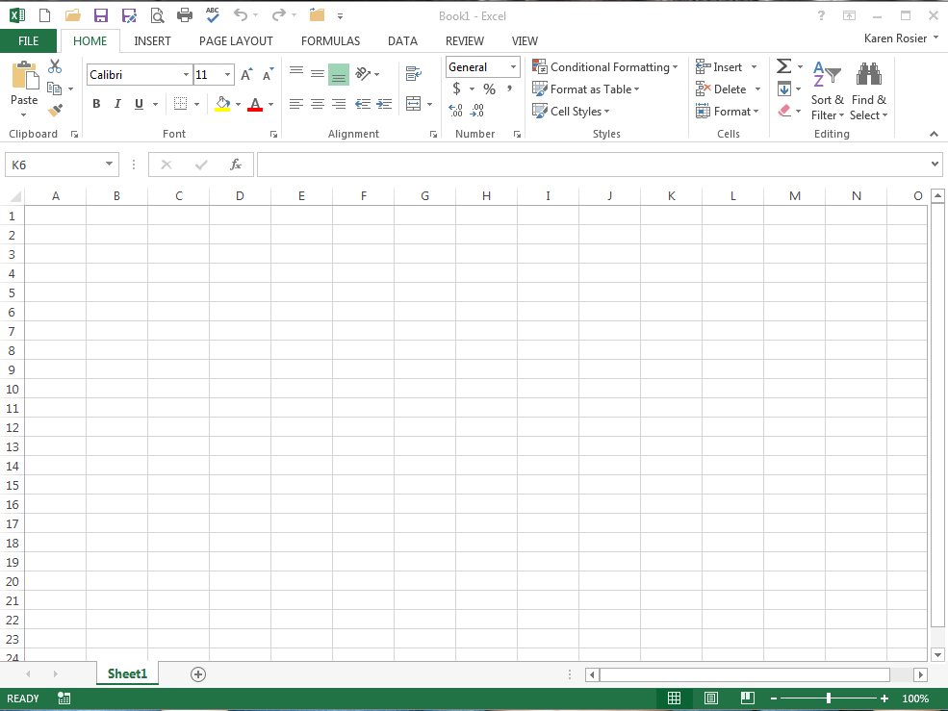
This is the EXCEL window
Open Word. Find the Excel 2013 Window Worksheet in the Shared drive and label the parts using the next slide.

Slide 8
Quick Access Toolbar
Title Bar
File
Tab
Top –Level
Tabs
Ribbon
Formula Bar
Groups
Name Box
Active Cell
Column
Maximize Button
Gridlines
Row
Cell D10
Zoom
Scroll Bars
Sheet Tab
View Buttons

Slide 9
Excel Definitions
Rows - Horizontal information, labeled 1, 2, 3
Columns - Vertical information, labeled A, B, C
.XLSX - Automatic Excel document extension
.xlsx is saved on each Excel workbook file
Cell Addresses - the coordinates of the intersecting column and row
A1, F10, H233 are examples of cell addresses
For example: A1 is the 1st cell (left side) at the top row of the worksheet grid
Cell References - Use cell references in formulas

Slide 10
Excel Definitions
Name Box - displays active cell address
Located at top left in the Excel window
For example: B35
The active cell is in column B, row 35
Formula Bar - displays the active cell entry
Cells can contain:
Labels or text
Values or numbers
Formulas or functions
Range - Two or more cells or a group of cells
B3:D3 is a range of cells
This range of cells includes cells B3 through D3

Slide 11
Review this Presentation until you understand the Excel basics!!!

Slide 12
The END

