Slide 1
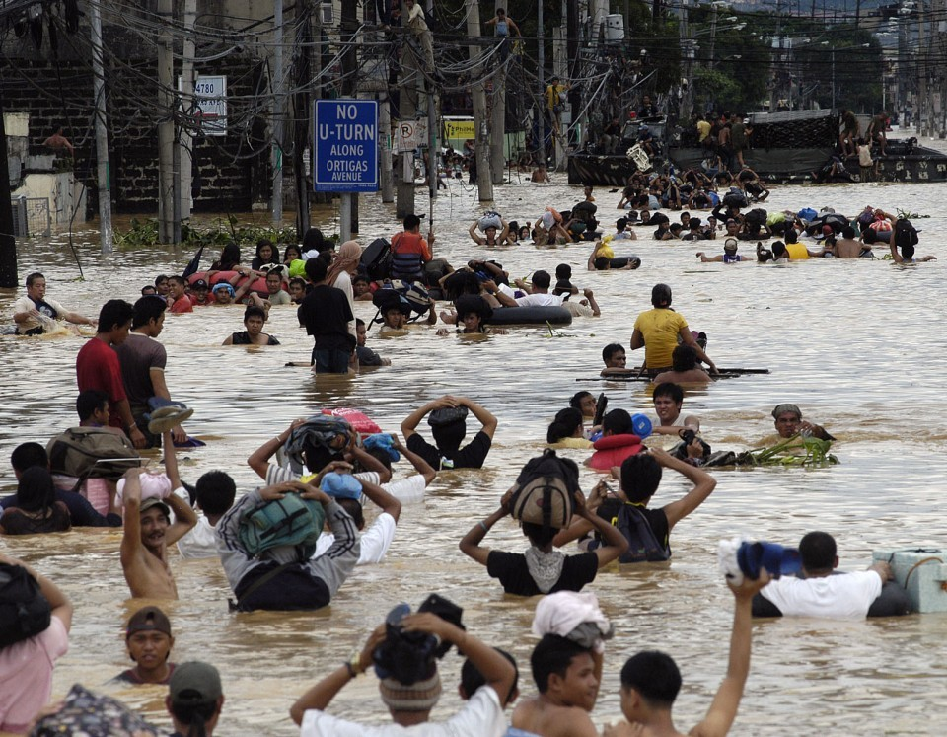
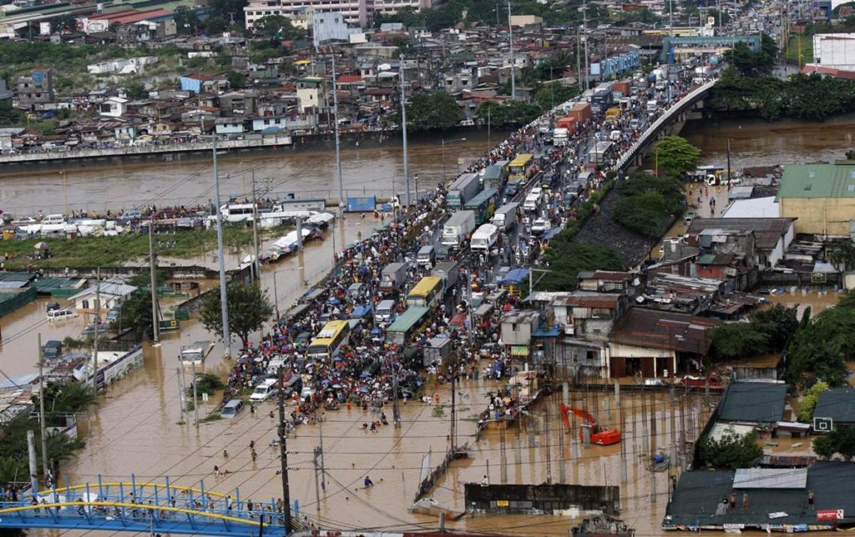
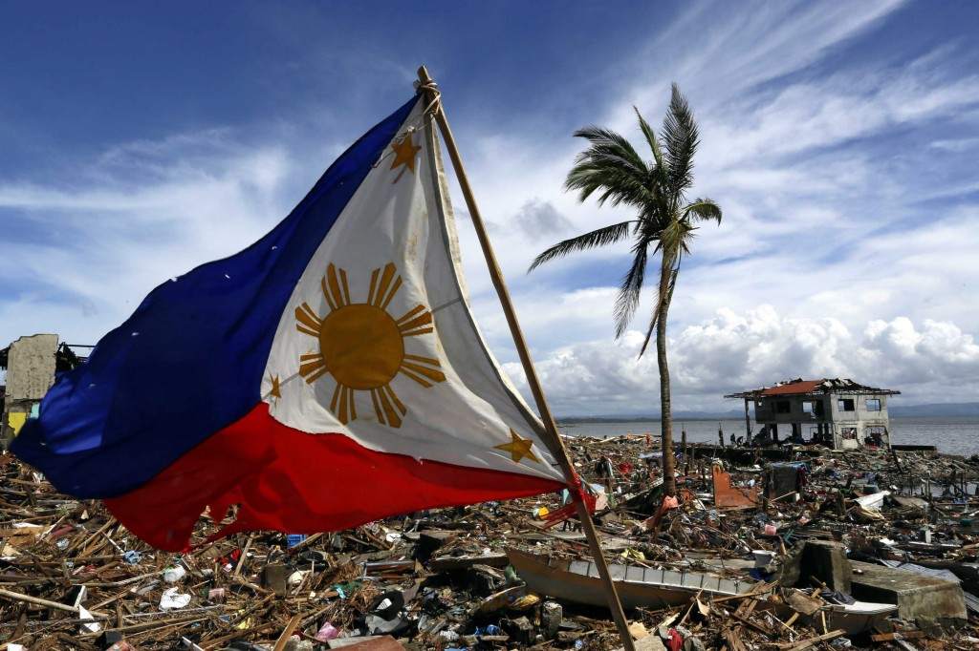
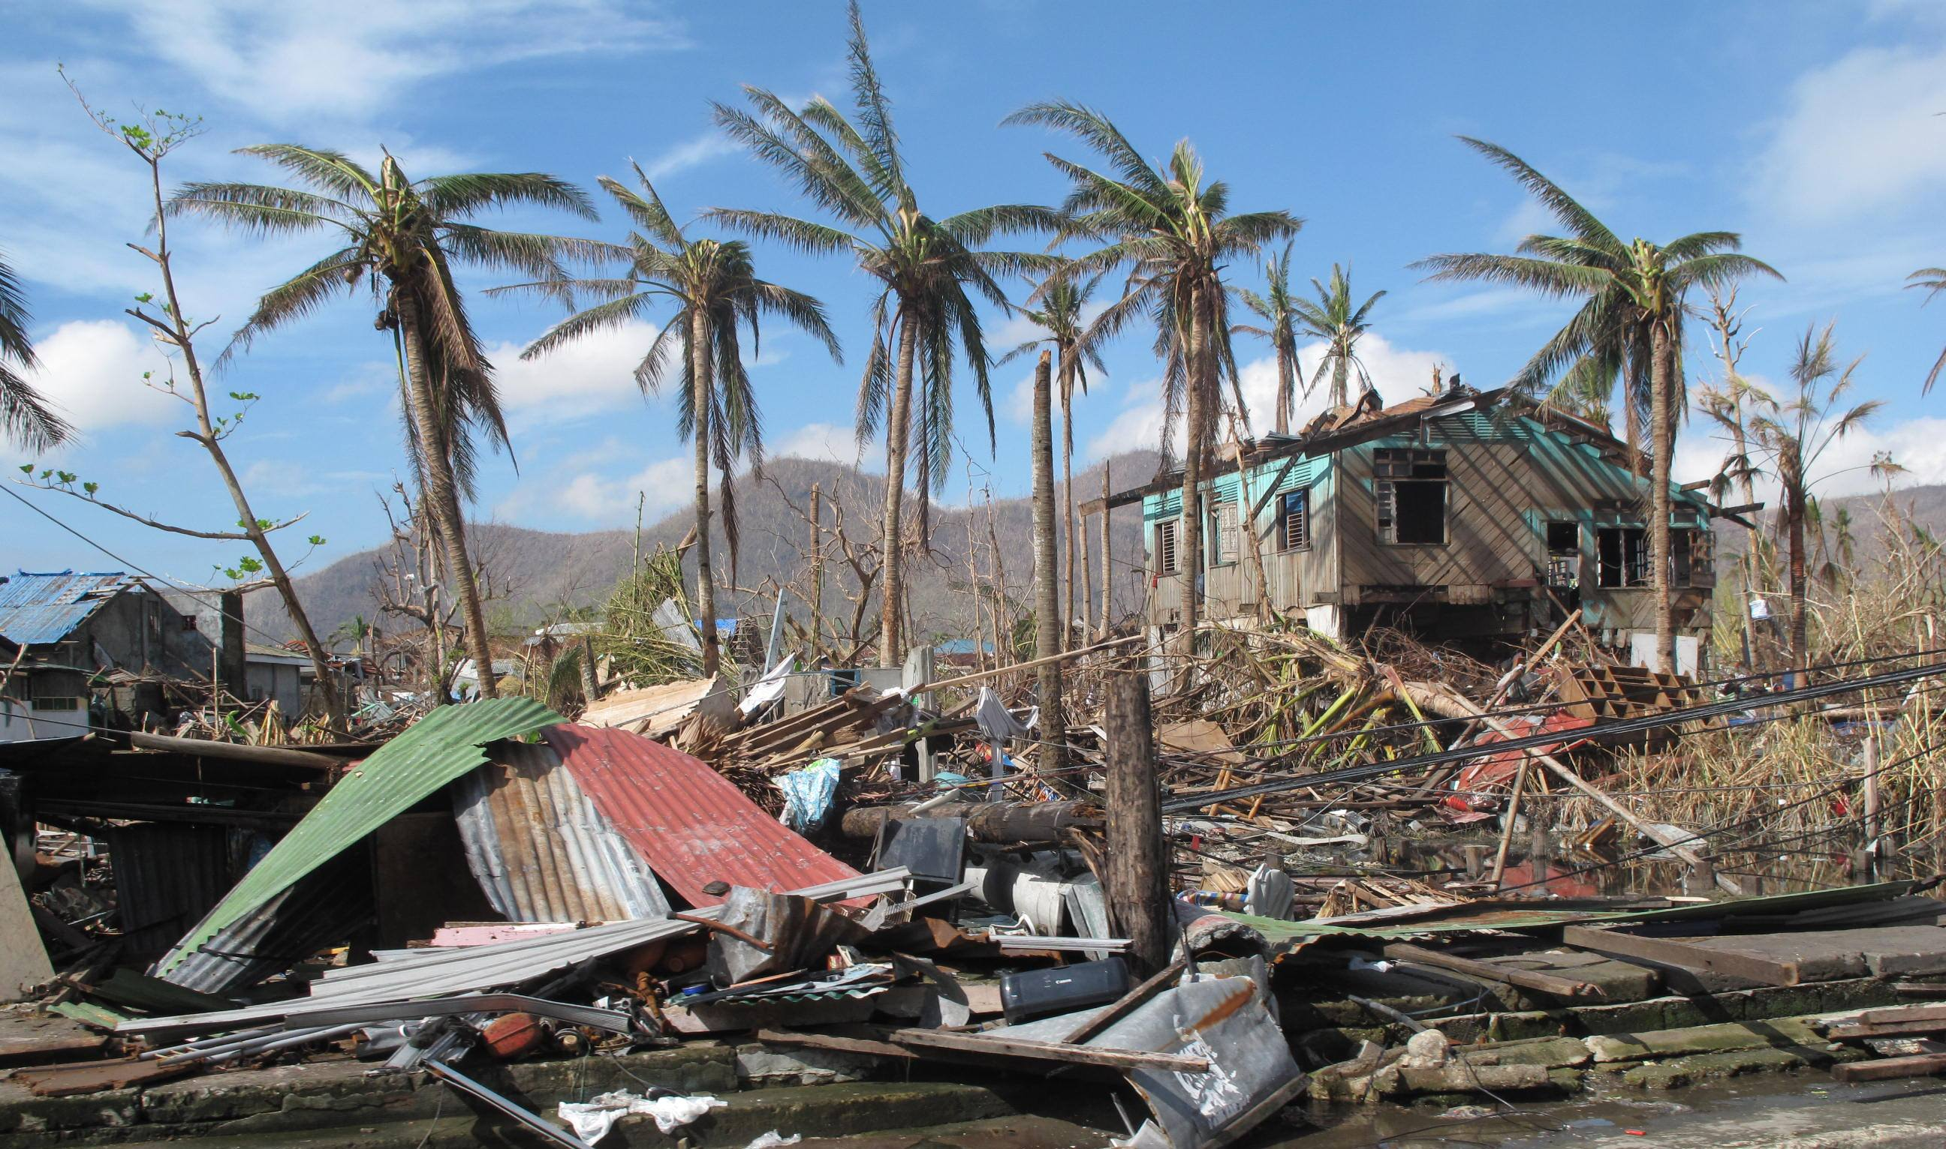
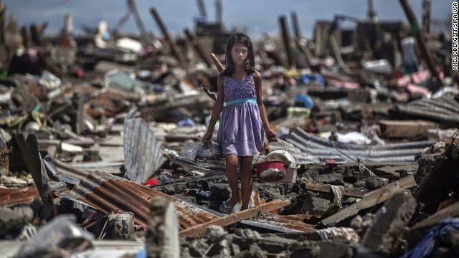

Slide 2

Disasters frequently hit the 7,107 islands of the Philippines
and the authoritative power to handle the said disasters is
assigned to the NDRRMC also known as the
National Disaster Risk Reduction and Management Council

Slide 3
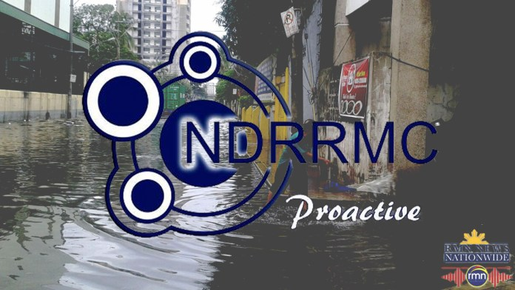
The NDRRMC is divided into 12 cluster groups, namely

Slide 4












Education
Emergency Telecom
Food and Non-Food Items
International Humanitarian Relations
Camp Coordination and Camp Management
Law and Order
Logistics
Water, Sanitation, and Health
Management of the Dead and Missing
Protection
Psycho Spiritual Integration
Search, Rescue, and Retrieval

Slide 5
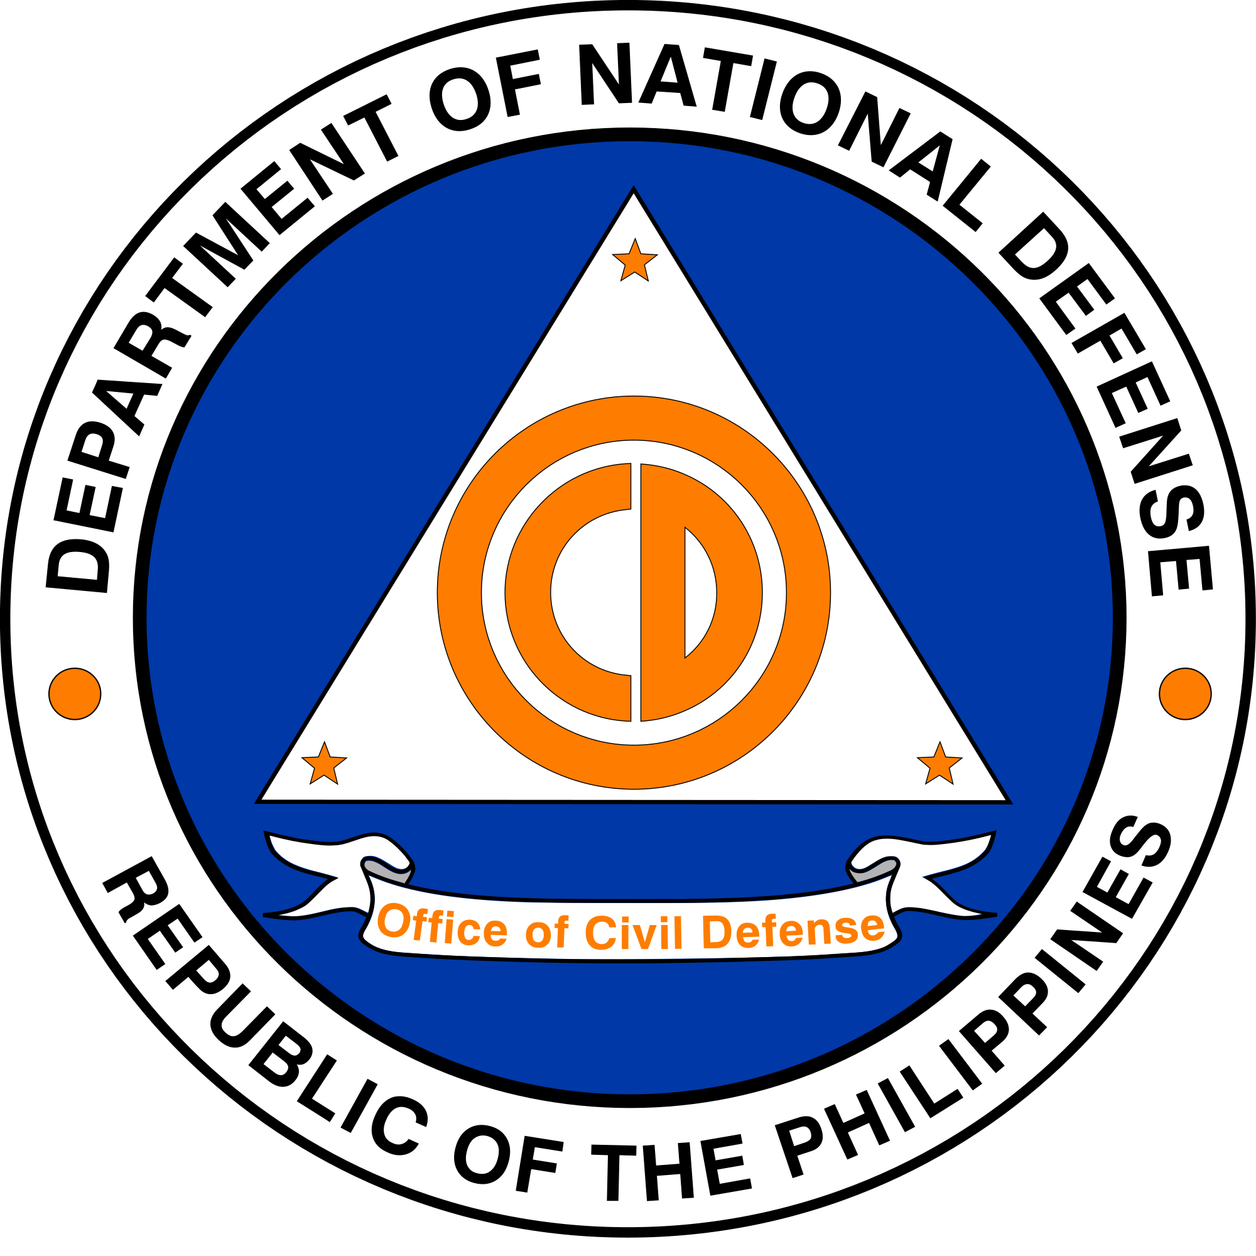
Logistics Cluster
The Logistics Cluster is spearheaded by the
Office of Civil Defense. They handle the following services:

Slide 6




Logistics Cluster
Transportation, Warehousing, Inventorying, and the
Tracking of all deployed items.

Slide 7
Logistics Cluster
With that, we aim to digitize the services they handle, through
developing a website. We now bring you the website
that will revolutionize the way how OCD performs
the aforementioned services.

