Slide 1
Optimal Credit Limit Extension Policy
Using Multi-Period Lifecycle Simulation
A Risk-Adjusted Profitability Framework for Consumer Lending
30,000 Accounts · 12 Monthly Campaigns · Monte Carlo + LP Optimisation
Prepared: May 2026 | Branch: term_ext_lifecycle

Slide 2
Executive Summary
The opportunity in numbers — 12-month lifecycle simulation
$1.41M
0.66%
70,317
96.1%
81.8%
Net Profit (66.6% margin)
Portfolio Default Rate (cap: 5%)
Extensions Granted across 12 campaigns
Customers with ≥1 Offer Accepted
Good→Excellent Migration Rate
Risk Well Within Tolerance
Credit Quality Self-Improves
LP Optimisation is Conservative
Portfolio default rate of 0.66% sits 7.5× below the 5% LP risk cap. Peak campaign-level exposure never exceeded 1.0% across all 12 campaigns.
83.8% of Fair-tier customers improved to Good or Excellent by year-end. The re-scoring mechanism creates compounding credit quality gains at no additional cost.
The $500M exposure cap was never approached. Risk headroom exists to expand offer volumes to Good and Excellent tiers without constraint violations.
Credit Limit Extension | Lifecycle Simulation
Slide 2

Slide 3
Methodology
Eight-stage pipeline from raw data to actionable policy
1
2
3
4
5
6
7
8
Data & Scoring
→
Macro Enrichment
→
Monte Carlo
→
GBM Uptake
→
LP Optimisation
→
Campaign Loop
→
Re-scoring
→
Results & Policy
Borda-count credit score K-Means → 4 tiers
FRED API: GDP, Unemployment, Fed Rate, CPI
200 scenarios per customer per campaign (T∼lognorm)
Per-tier acceptance probability forecast
Binary LP: max profit s.t. 5% default cap, $500M
×12 monthly campaigns Offer → Accept → Outcome
Feature update after each outcome → new tier
Migration matrix, P&L, sensitivity grid
Key Differentiator vs One-Shot Models
• Explicit Bernoulli acceptance draw per campaign (not implicit uptake weighting)
• Actual lognormal term draw at moment of acceptance — not Monte Carlo mean
• Re-scoring after every outcome: on-time +2pp, early +1pp, default −10pp
• Credit state evolves dynamically — LP sees the updated risk each month
Credit Limit Extension | Lifecycle Simulation
Slide 3

Slide 4
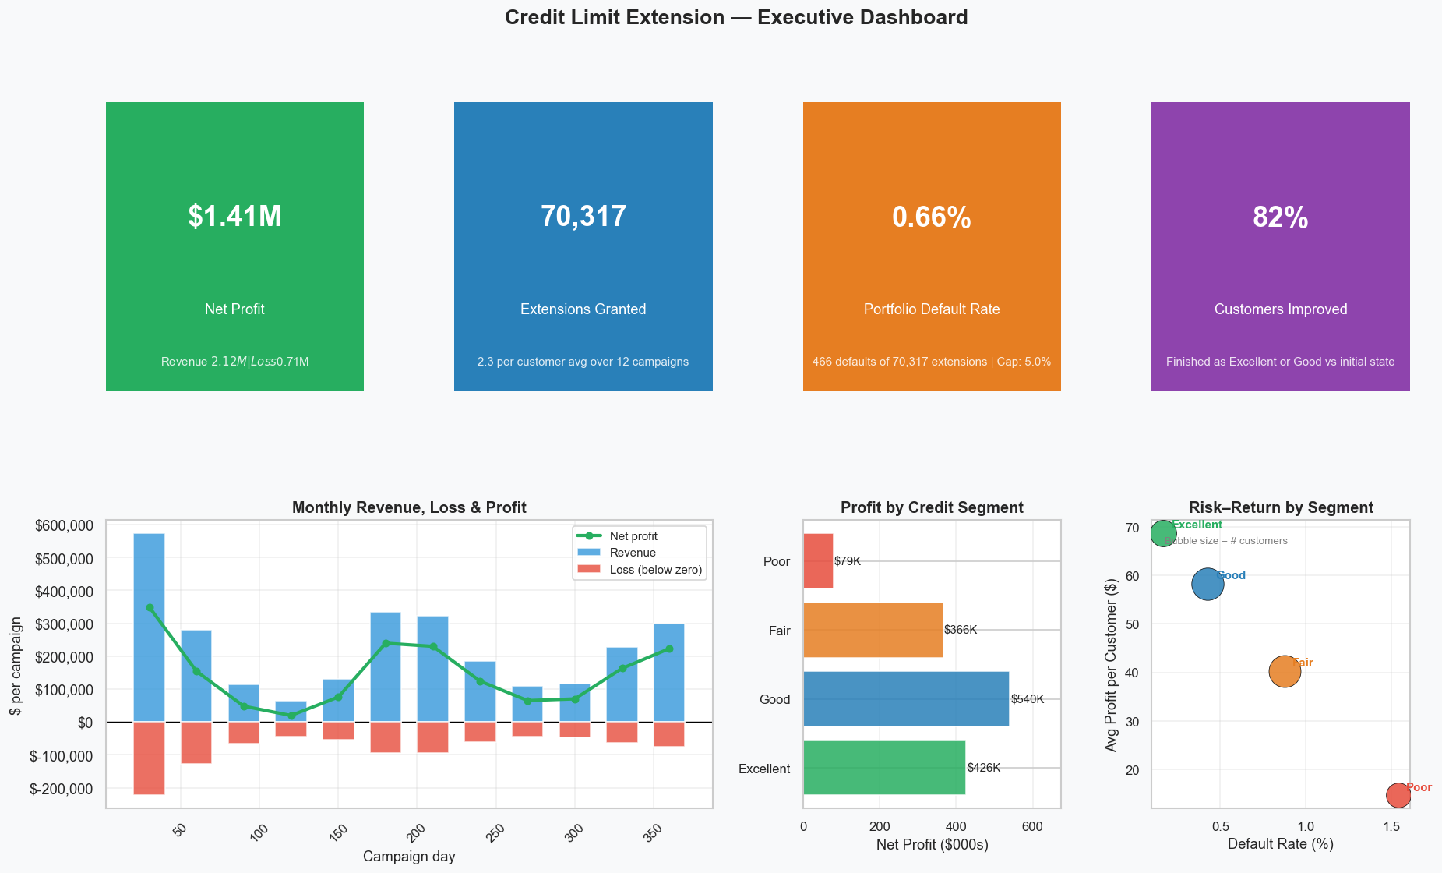
12-Month Portfolio Performance
Overview dashboard — monthly P&L, volume, state drift, risk
Credit Limit Extension | Lifecycle Simulation
Slide 4

Slide 5
Performance by Credit Tier
Each tier tells a different risk-return story
Tier
Customers
Accept Rate
Avg Profit / Cust
Default Rate
Margin
Year-End Migration
Excellent
6,206
79.5%
$68.70
0.17%
90.8%
99.5% remain Excellent
Good
9,267
74.3%
$58.25
0.43%
76.5%
81.8% → Excellent
Fair
9,089
61.8%
$40.23
0.88%
55.4%
83.8% → Good / Excellent
Poor
5,438
44.3%
$14.62
1.54%
28.0%
30.6% → Good
Portfolio
30,000
65.1%
$47.04
0.66%
66.6%
—
Key Insight: Portfolio Risk Budget is Vastly Under-Utilised
• The 0.66% portfolio default rate is 7.5× below the 5% LP constraint — the optimiser is inherently conservative.
• The 9× gap between Excellent (0.17%) and Poor (1.54%) default rates validates the four-tier segmentation as meaningful risk differentiation.
• Good-tier accounts drive the largest absolute profit ($539K) despite lower per-customer yield than Excellent — volume matters.
Credit Limit Extension | Lifecycle Simulation
Slide 5

Slide 6
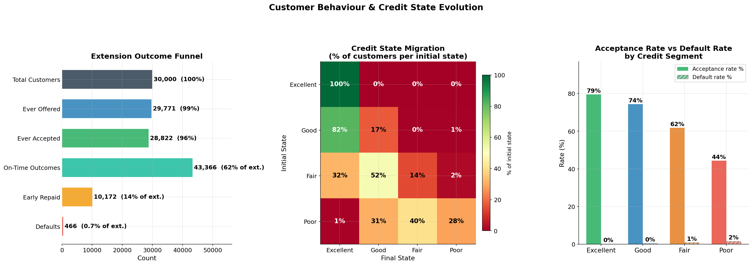
Customer Behaviour
Acceptance patterns, repayment outcomes, and behavioural archetypes
Four Behavioural Archetypes
Reliable Repayer
Exc / upper-Good
Accepts most offers, repays consistently. Stable and predictable. Retention risk: competitor offers. → Every-campaign eligibility.
Upward Mover
lower-Good / upper-Fair
Consistent improvement via on-time repayments. Highest credit-improvement ROI. → Regular offers, track migration velocity monthly.
Slow Recoverer
lower-Fair / upper-Poor
Progress but at slower pace — often recovering from one adverse event. → Every-other-campaign; monitor completion trends.
Persistent Risk
lower-Poor
Remains Poor despite offers. Low completion, no benefit from extensions. → Freeze offers; route to credit counselling.
Credit Limit Extension | Lifecycle Simulation
Slide 6

Slide 7
Credit Migration
How the portfolio quality evolves over 12 months
Start → End
Excellent
Good
Fair
Poor
Excellent
99.5%
0.2%
0.2%
0.1%
Good
81.8%
17.1%
0.4%
0.7%
Fair
31.8%
52.0%
Good → Excellent 81.8%
14.1%
2.0%
The dominant upgrade pathway. Compounding on-time boosts drive majority across threshold in 4–6 months.
Poor
0.9%
30.6%
40.2%
28.3%
Fair → Good / Excellent 83.8%
Fair is a transition state, not steady. The programme is a credit rehabilitation pathway.
Poor: three-way split 28.3% remain Poor
30.6% → Good (recoverable) 40.2% → Fair (slow improvers) 28.3% stay Poor (freeze offers)
Credit Limit Extension | Lifecycle Simulation
Slide 7

Slide 8
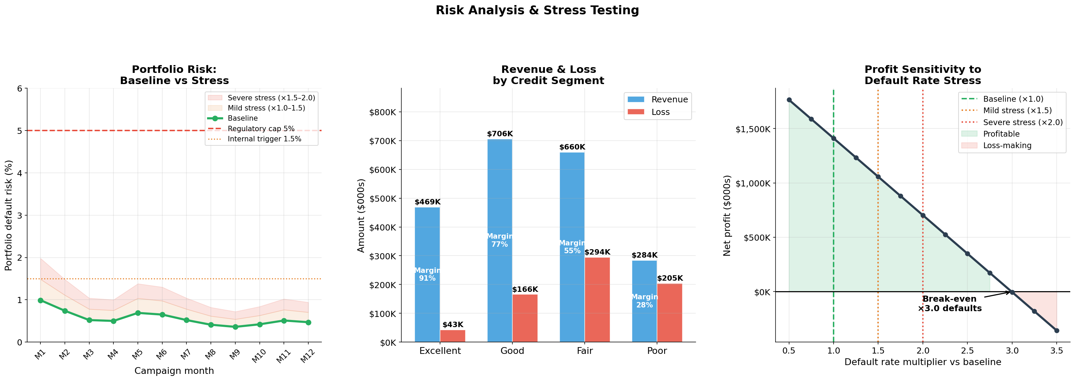
Risk Profile
Default rates, LP constraint utilisation, and stress resilience
Risk Summary
0.66%
Portfolio Default Rate (5% LP hard cap — 7.5× headroom)
0.99%
Peak Campaign Risk (Month 1 — never exceeded since)
$707K
Total Credit Losses ($2.12M revenue → 66.6% margin)
Stress Test Resilience
Stress
Scenario
Net Profit
Status
1.0×
Baseline
$1,411K
✓ Profitable
2.0×
Moderate
$714K
✓ Profitable
3.5×
Severe
$26K
✓ Breakeven
Credit Limit Extension | Lifecycle Simulation
Slide 8
5.0×
Extreme
−$648K
✗ Loss

Slide 9
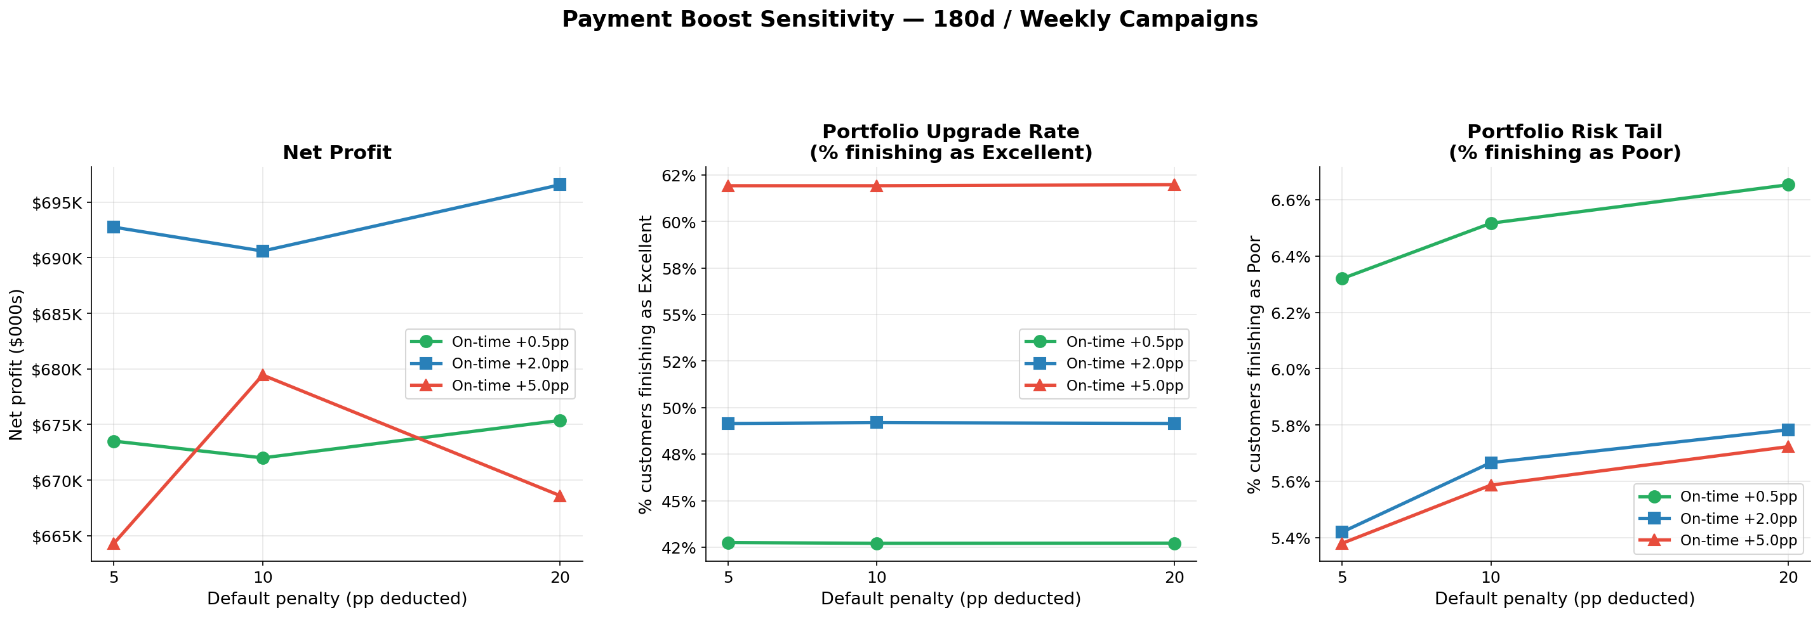
Sensitivity Analysis
Which parameter levers move the dial — and by how much
Key Findings
On-Time Boost is the Dominant Lever
+5.0pp moves 19.2pp more customers to Excellent (43% → 62%). But profit peaks at 2.0pp — higher boosts over-promote customers, shrinking the eligible pool and reducing revenue.
Recommended: 2.0pp / 10pp
Balances profit ($690K sub-run), quality improvement (49.2% Excellent), and controlled default rate (0.62%). This is the baseline configuration.
Default Penalty is Second-Order
Variance across 5/10/20pp settings is < 1% of total profit. Primary effect: faster exit from Poor tier. 10pp avoids cliff-edge dynamics.
Credit Limit Extension | Lifecycle Simulation
Slide 9

Slide 10
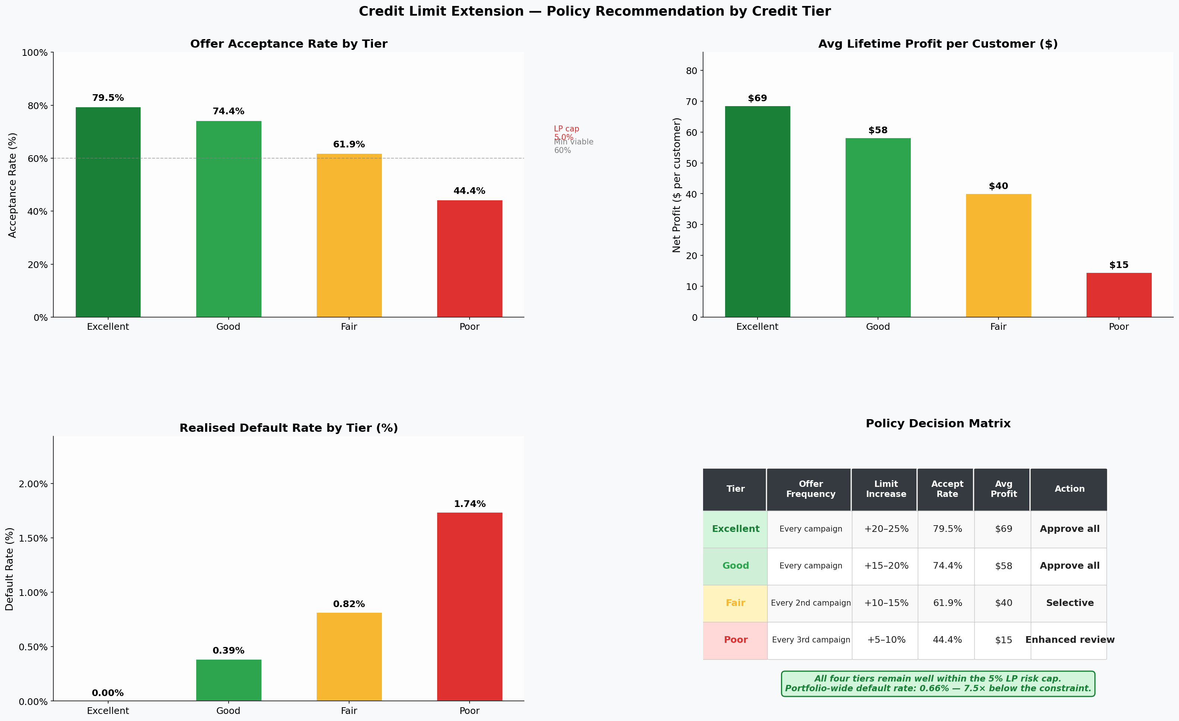
Tier Strategy & Policy Decision Matrix
Recommended offer cadence, limit sizing, and approval logic by tier
Tier
Offer Cadence
Limit Increase
Priority
KPI to Track
Excellent
Every campaign
+20–25%
Maximum volume
Retention rate
Good
Every campaign
+15–20%
Standard approval
Migration to Exc
Fair
Every 2nd campaign
+10–15%
Selective
Migration velocity
Poor
Every 3rd campaign
+5–10%
Enhanced review
Completion rate
Risk Budget Status: 0.66% realised vs 5.0% cap — 7.5× headroom. Room to expand Good/Excellent volume without constraint violations.
Credit Limit Extension | Lifecycle Simulation
Slide 10

Slide 11
Operational Roadmap
Prioritised implementation across three horizons
Immediate (Config Changes)
Near-Term (Model Adjustments)
Strategic (Risk Management)
Set on-time boost to 2.0pp and default penalty to 10pp
Tiered offer cadences: Exc/Good monthly, Fair bi-monthly, Poor quarterly
Re-calibrate LP cap: 2–3% operational target, 5% hard ceiling
Retain 5% risk cap; operational target 2–3%
Tiered limit increases: 5–25% by tier (vs flat today)
Automate LP re-optimisation; manual overrides require documented approval
Raise extension fee: $40 → $48 (+$180K revenue, zero risk)
Expand exposure cap $500M → $650M (current utilisation < 10%)
Segment Poor into 3 sub-groups with distinct offer logic
Maintain 60-day eligibility gate as primary quality filter
Quarterly re-scoring minimum (annual lags actual risk movement)
FRED API macro threshold alerts → pre-emptive exposure reduction
Credit Limit Extension | Lifecycle Simulation
Slide 11

Slide 12
Key Takeaways for the CRO
1
The programme is profitable and risk-safe.
$1.41M net profit at 0.66% default rate — 7.5× below the LP cap. Risk headroom is not being consumed; it is being preserved as a structural buffer.
2
Credit quality self-improves at no additional cost.
83.8% of Fair customers and 81.8% of Good customers migrate upward within 12 months. Each on-time repayment compounding through the re-scoring mechanism does the work.
3
The on-time boost (2.0pp) is the single most powerful lever.
Higher boosts promote customers too quickly, shrinking the offer pool and reducing revenue. 2.0pp balances credit improvement velocity with sustainable offer volume.
4
Poor is not monolithic — three sub-groups require different treatment.
30.6% are recoverable (offer normally), 40.2% are slow improvers (bi-monthly offers), 28.3% are persistent risk (freeze offers, redirect to counselling).
5
Immediate action: raise the fee to $48.
No model changes, no risk increase. Revenue scales linearly; first denial threshold is $52 — there is a $4 buffer before any approval changes.
Credit Limit Extension | Lifecycle Simulation · May 2026 · Branch: term_ext_lifecycle

