Slide 1
Update on Electron-Induced SEUs
Michael P. King
This work is supported by:
Defense Threat Reduction Agency Basic Research Program
NASA Electronic Parts and Packaging Program

Slide 2
ARACOR 4100 – X-ray Spectrum
Average energy of 10-keV with 50-keV max energy
Presence of Al attenuator modifies initial X-ray spectrum
Prominent 10 keV lines absent from attenuated spectrum
Selectively passes high energy range of X-ray spectrum
Photon flux of 1.5×10¹² cm⁻² sec⁻¹
Notes:
NEED FIGURE; TALK TO IMAGES; MENTION DOSE RATE – PURPOSE OF ATTENUATOR

Slide 3
Electron Upsets in 28 nm and 45 nm SRAMs
28 nm and 45 nm SRAMs tested with supply voltage between 0.35 V – 0.8 V
Upset cross-section normalized by SRAM cell area
Tested several device variants including dual- and triple-well with similar results
No measurable parametric degradation
Notes:
electron sensitivity is observed within 10% of nominal bias conditions for test chip A, indicating that electron effects may be observable in more sensitive present-generation ICs, and in future technology nodes for nominal supply volt- age.

Slide 4
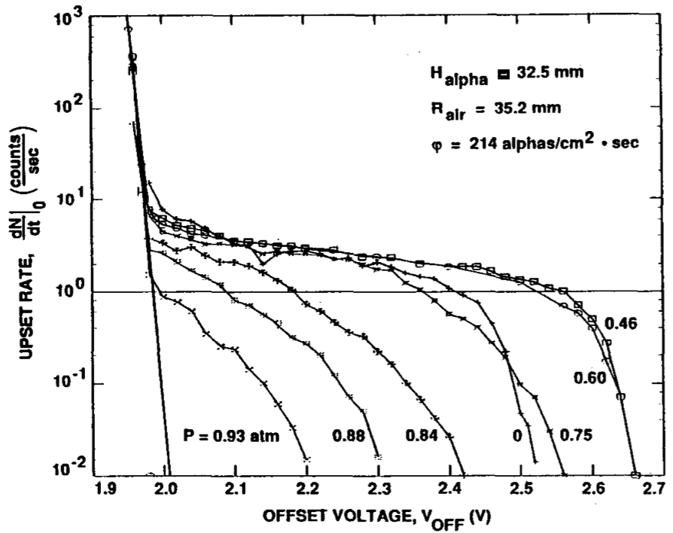
SEU Cross-Section Bias Dependence I
Measured SEU cross-section bias dependence for alpha particles in vacuum and air
Exhibits an exponential dependence
Slope depends on the incident alpha particle LET
Buehler, et al., IEEE TNS, Dec., 1990.
Notes:
electron sensitivity is observed within 10% of nominal bias conditions for test chip A, indicating that electron effects may be observable in more sensitive present-generation ICs, and in future technology nodes for nominal supply volt- age.

Slide 5
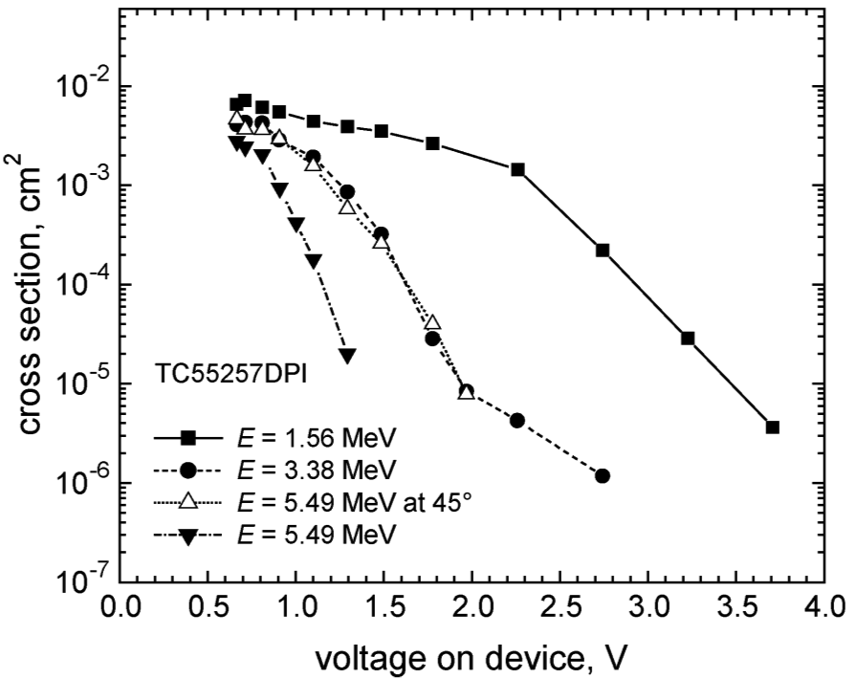
SEU Cross-Section Bias Dependence II
Measured SEU cross-section bias dependence for alpha particles
Exhibits an exponential dependence consistent with Buehler et al.
Higher LET alphas result in larger SEU cross-section, and smaller slope than lower LET alphas
Showed similar trend for heavy-ions
Barak, et al., IEEE TNS, Dec., 2004.
Notes:
electron sensitivity is observed within 10% of nominal bias conditions for test chip A, indicating that electron effects may be observable in more sensitive present-generation ICs, and in future technology nodes for nominal supply volt- age.

Slide 6
Comparison with Protons and Muons I
Sensitivity to muons and protons under nominal bias conditions
Electron-Induced SEUs observed within 10% of nominal supply voltage
SEU cross-section bias dependence higher for electrons than protons or muons
Shows trends consistent with the work of Buehler, Barak, and others
Notes:
electron sensitivity is observed within 10% of nominal bias conditions for test chip A, indicating that electron effects may be observable in more sensitive present-generation ICs, and in future technology nodes for nominal supply volt- age.

Slide 7
Comparison with Protons and Muons II
Sensitivity to muons and protons under nominal bias conditions
SEU cross-section bias dependence higher for electrons than protons or muons
Shows trends consistent with the work of Buehler, Barak, and others
Notes:
electron sensitivity is observed within 10% of nominal bias conditions for test chip A, indicating that electron effects may be observable in more sensitive present-generation ICs, and in future technology nodes for nominal supply volt- age.

Slide 8
MRED Simulation of X-rays on 45 nm SRAMs
Sensitive volume geometry consistent with 45 nm SRAM (330nm×675nm×500nm)
Simulated irradiation with full ARACOR X-ray spectrum and 1 MeV protons from the Pelletron
Shows higher cross-section for protons than electrons
Illustrates the SEU cross-section bias dependence difference

Slide 9
Simulation versus Experimental Results
Sensitive volume geometry consistent with 45 nm SRAM (330nm×675nm×500nm)
Extrapolated estimated norm. cross-section for applied bias conditions
Simple static sensitive volume geometry
Q = CV critical charge estimates
Within a factor of 2-5 for all bias conditions

Slide 10
Jovian Env. – GIRE2 – Electron Spectrum
Simulated differential electron flux at for the Europa tour of the Juno spacecraft mission of the Jovian environment
Much more energetic than the near-Earth environment

Slide 11
Electron Flux Spectrum with Shielding
Calculated energy loss for three shielding thicknesses
Europa environment has higher flux of >20 MeV electrons than Jovian env.
Shielding attenuates large energy range of electrons

Slide 12
Electron-Induced SEU Event Rates
SEU Event Rates in the Jovian and Europa environments for shielding thicknesses of 100, 730, and 870 mils Al
At or near nominal supply voltage, shielding appears to have little impact on SEU event rates
SEUs potentially a big problem for electronics in quiescent/power save mode
Higher flux of >20 MeV electrons accounts for some difference in SEU event rates under reduced bias conditions
Rate depends strongly on sensitive volume geometry and critical charge
Notes:
Simulation results demonstrate the rare nature of electron-induced SEU events in the space radiation environ- ment, indicating that many years of flight time may elapse before the observation of such an event
In con- trast, protons dominate the high-energy deposition portion of the event spectrum due to higher LET near their stopping range and contributions from nuclear reactions that also con- tribute to the event rate.

Slide 13
Comparison of Electron and Proton Event Rates
SEU Event Rates in the Europa environments for shielding thicknesses of 100, 730, and 870 mils Al
Proton error rates higher than electrons at nominal supply voltage conditions
Increased shielding results in slightly higher proton error rates
Electron error rates estimated to be higher than protons at reduced bias conditions
Notes:
Simulation results demonstrate the rare nature of electron-induced SEU events in the space radiation environ- ment, indicating that many years of flight time may elapse before the observation of such an event
In con- trast, protons dominate the high-energy deposition portion of the event spectrum due to higher LET near their stopping range and contributions from nuclear reactions that also con- tribute to the event rate.

