Slide 1
XFormsDB
An XForms-Based Framework for Simplifying Web Application Development
Markku Laine <markku.laine@gmail.com>
Master’s Thesis Presentation
March 9, 2010

Slide 2
Presentation Outline
Part I Introduction
Part II Background
Part III The XFormsDB Markup Language
Part IV The XFormsDB Framework
Part V Sample Web Application: XFormsDB Blog
Part VI Conclusions
Page <number>

Slide 3
Part I
Introduction
Page <number>

Slide 4
Introduction
Developing even simple multi-user Web applications is a complex task
The author has to master many programming languages and paradigms
  Client side: (X)HTML+CSS+JavaScript
  Server side: PHP/J2EE/Ruby on Rails
  Database: SQL/Object-Relational Mapping (ORM)
The bulk of Web content authors are non-programmers
Page <number>
Notes:
The nature of the World Wide Web is constantly changing: static --> dynamic Web pages
Results of this trend: improved Web, increased complexity
Main reasons for the complexity: (1) dynamic Web pages are often generated on the fly; (2) dynamic Web pages often contain a mixture of markup languages, client-side scripting code, and server-side function calls; and (3) the high number of tools, technologies, and techniques.
Web content authors: HTML+CSS plus a little bit of JavaScript and maybe PHP

Slide 5
The Main Research Question
Is it possible to extend the XForms markup language in such a way that users can build useful, highly interactive multi-user Web applications quickly and easily using purely declarative languages?
Page <number>
Notes:
How to simplify Web application development?
Means for reducing the complexity: (1) Unify the client and server programming under a single model, (2) reduce the number of technologies used/needed, (3) prefer declarative programming over imperative programming, and (4) utilize pre-existing skill set of the bulk of Web content authors (non-programmers).

Slide 6
Part II
Background
Page <number>

Slide 7
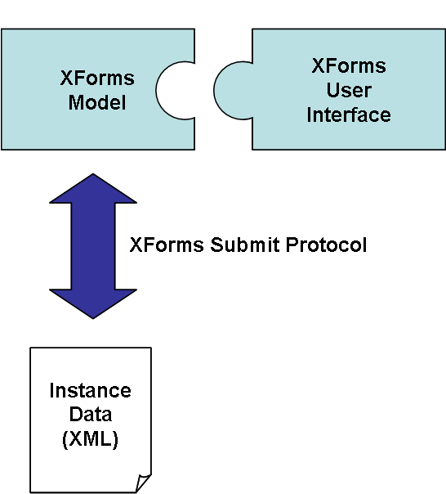
XForms
An XML-based forms technology and the successor to HTML forms
  A high-level declarative language for defining rich Web user interfaces
  Client-side technology
  Turing complete
W3C Recommendation since 2003
Architecture
  Based on Model-View-Controller (MVC)
  Instance Data (XML)
  XForms Model
  XForms User Interface
  XForms Submit Protocol
Page <number>
Notes:
Overcomes the problems with HTML forms, such as the need for scripting, accessibility problems
Instance Data (XML): Form data
XForms Model: Non-visual part of a form; Validation, constraints, calculations
XForms User Interface: Form controls
XForms Submit Protocol: Defines how XForms sends and receives Instance Data (XML) to and from the server

Slide 8
Example: An XHTML+XForms Document
<?xml version="1.0" encoding="UTF-8"?>
<html xmlns="http://www.w3.org/1999/xhtml" xmlns:ev="http://www.w3.org/2001/xml-events" xmlns:xforms="http://www.w3.org/2002/xforms">
<head>
<title>Mailing List</title>
<xforms:model>
<xforms:instance id="form-instance">
<form xmlns=""><email /></form>
</xforms:instance>
<xforms:bind nodeset="instance( 'form-instance' )/email" type="xforms:email" required="true()" />
<xforms:submission id="form-submission" ref="instance( 'form-instance' )" resource="/form-handler"
method="post" replace="none">
<xforms:load resource="thankyou.xhtml" ev:event="xforms-submit-done" />
<xforms:load resource="error.xhtml" ev:event="xforms-submit-error" />
</xforms:submission>
</xforms:model>
</head>
<body>
<h1>Mailing List</h1>
<p>
<xforms:input ref="instance( 'form-instance' )/email"><xforms:label>Email:</xforms:label></xforms:input>
<xforms:submit submission="form-submission"><xforms:label>Subscribe</xforms:label></xforms:submit>
</p>
</body>
</html>
Page <number>

Slide 9
Part III
The XFormsDB Markup Language
Page <number>

Slide 10
Overview
An extension to the XForms markup language
  A pure superset of XForms 1.1
Naturally extends XForms with common server-side and database related functionalities
  Can be thought of as "XForms Server Pages"
  Functionalities include, among others: querying and updating (with or without data synchronization) data stored in data sources, error handling, state maintenance as well as authentication and access control
  Easily extensible, i.e., new server-side functionalities can be easily added to the language
Page <number>

Slide 11
Example: An XHTML+XFormsDB Document
<?xml version="1.0" encoding="UTF-8"?>
<html xmlns="http://www.w3.org/1999/xhtml" xmlns:ev="http://www.w3.org/2001/xml-events" xmlns:xforms="http://www.w3.org/2002/xforms" xmlns:xformsdb="http://www.tml.tkk.fi/2007/xformsdb">
<head>
<title>Mailing List</title>
<xforms:model>
<xforms:instance id="form-instance">
<form xmlns=""><email /></form>
</xforms:instance>
<xforms:bind nodeset="instance( 'form-instance' )/email" type="xforms:email" required="true()" />
<xforms:bind nodeset="instance( 'form-request-instance' )/xformsdb:var[ @name = 'email' ]"
calculate="instance( 'form-instance' )/email" />
<xformsdb:instance id="form-request-instance">
<xformsdb:query datasrc="mailing-list-data-source" doc="mailing_list.xml">
<xformsdb:expression resource="xq/form_handler.xq" />
<xformsdb:var name="email" />
</xformsdb:query>
</xformsdb:instance>
<xformsdb:submission id="form-submission" requestinstance="form-request-instance"
expressiontype="all" replace="none">
<xforms:load resource="thankyou.xhtml" ev:event="xforms-submit-done" />
<xforms:load resource="error.xhtml" ev:event="xformsdb-request-error" />
</xformsdb:submission>
</xforms:model>
</head>
...
Page <number>

Slide 12
Part IV
The XFormsDB Framework
Page <number>

Slide 13
Overview
Implements the XFormsDB markup language
A Java-based, generic server-side component
  Provides the integration services to heterogeneous data sources as well as common server-side functionalities
Bundled with
  An XForms processor (Orbeon Forms)
  A native XML database (eXist-db)
An extremely powerful XForms/REST/XQuery (XRX) framework
  Allows for the rapid development of entire Web applications using a single document and under a single programming paradigm
Page <number>

Slide 14
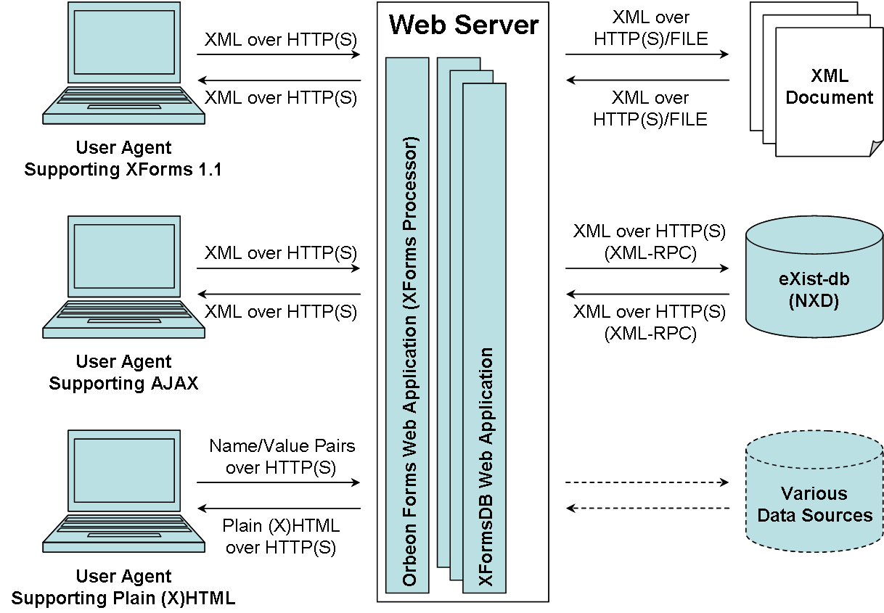
High-Level Architecture
Page <number>

Slide 15
Part V
Sample Web Application: XFormsDB Blog
Page <number>

Slide 16
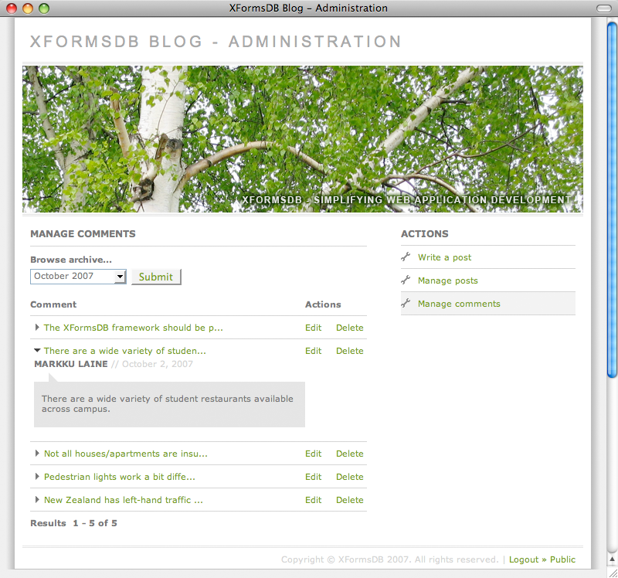
XFormsDB Blog
An online journal Web tool for publishing personal contents
Three (3) separate Web pages and six to ten (6-10) main views
~3000 lines of code
  9% related to XFormsDB & XQuery
Normal response times
LIVE demo
Page <number>
Notes:
A simplified version of publicly available software

Slide 17
Part VI
Conclusions
Page <number>

Slide 18
Results
The XFormsDB markup language
  Naturally extends the XForms markup language to include common server-side and database related functionalities
  New server-side functionalities can be easily added to the language
  For users who are already familiar with XForms, the language is relatively easy to learn
The XFormsDB framework
  Supports most common browsers and heterogeneous data sources
  Includes built-in support for synchronized updates
  Allows for the rapid development of entire Web applications using a single document and under a single programming model
Page <number>

Slide 19
Future Work
Refine the syntax of the XFormsDB markup language
Implement support for a subset of XML Binding Language (XBL) 2.0 on the server side
  Allows the use of highly reusable components
Implement a Web-based visual tool for developing XFormsDB Web applications
  Makes the technology accessible to non-technical users
Add built-in support for OpenID authentication
  Users could use an existing account to sign in to XFormsDB Web applications
Improve current transaction support
  Grouping of synchronized updates
Page <number>
Notes:
Improve performance through caching

Slide 20
Thank You!
Questions? Comments?
<markku.laine@gmail.com>
Page <number>

