Slide 1
XFormsDB
An XForms-Based Framework for Simplifying Web Application Development
Markku Laine <markku.laine@gmail.com>
Master’s Thesis Presentation with Details
March 9, 2010

Slide 2
Presentation Outline
Part I Introduction
Part II Background
Part III The XFormsDB Markup Language
Part IV The XFormsDB Framework
Part V Sample Web Applications
Part VI Conclusions
Page <number>

Slide 3
Part I
Introduction
Page <number>

Slide 4
Introduction
Developing even simple multi-user Web applications is a complex task
The author has to master many programming languages and paradigms
  Client side: (X)HTML+CSS+JavaScript
  Server side: PHP/J2EE/Ruby on Rails
  Database: SQL/Object-Relational Mapping (ORM)
The bulk of Web content authors are non-programmers
Page <number>
Notes:
The nature of the World Wide Web is constantly changing: static --> dynamic Web pages
Results of this trend: improved Web, increased complexity
Main reasons for the complexity: (1) dynamic Web pages are often generated on the fly; (2) dynamic Web pages often contain a mixture of markup languages, client-side scripting code, and server-side function calls; and (3) the high number of tools, technologies, and techniques.
Web content authors: HTML+CSS plus a little bit of JavaScript and maybe PHP

Slide 5
The Main Research Question
Is it possible to extend the XForms markup language in such a way that users can build useful, highly interactive multi-user Web applications quickly and easily using purely declarative languages?
Page <number>
Notes:
How to simplify Web application development?
Means for reducing the complexity: (1) Unify the client and server programming under a single model, (2) reduce the number of technologies used/needed, (3) prefer declarative programming over imperative programming, and (4) utilize pre-existing skill set of the bulk of Web content authors (non-programmers).

Slide 6
Part II
Background
Page <number>

Slide 7
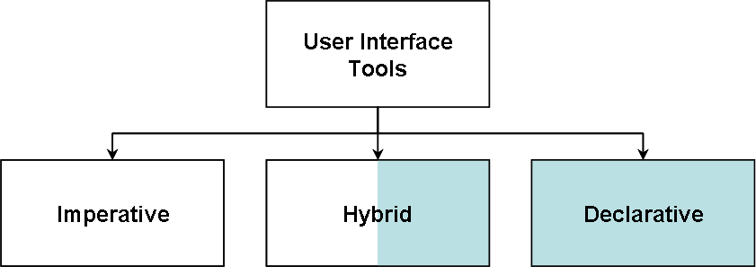
Classification of User Interface Tools
Imperative
  Describes how things should be done
  Java Applets (1995)
  Google Web Toolkit (2006)
Hybrid
  A combination of declarative and imperative constructs
  AJAX (2005) — The current Web
Declarative
  Describes what should be done
  W3C HTML (1992)
  W3C XForms (2003)
Page <number>

Slide 8
XForms
An XML-based forms technology and the successor to HTML forms
  A high-level declarative language for defining rich Web user interfaces
  Not compatible with HTML 4 forms
  Client-side technology
W3C Recommendation since 2003
The latest version: XForms 1.1
  W3C Recommendation since October 2009
  New and improved action handlers
  More powerful action processing facilities for executing conditional actions and iterations
  Turing complete
Page <number>
Notes:
Overcomes the problems with HTML forms, such as the need for scripting, accessibility problems

Slide 9
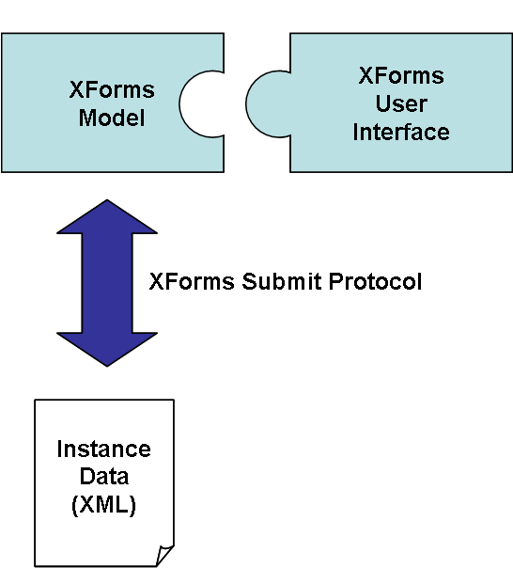
XForms Architecture
Instance Data (XML)
  Form data
XForms Model
  Non-visual part of a form
  Validation, constraints, calculations
XForms User Interface
  Form controls
XForms Submit Protocol
  Defines how XForms sends and receives Instance Data (XML) to and from the server
Page <number>

Slide 10
Example: An XHTML+XForms Document
<?xml version="1.0" encoding="UTF-8"?>
<html xmlns="http://www.w3.org/1999/xhtml" xmlns:ev="http://www.w3.org/2001/xml-events" xmlns:xforms="http://www.w3.org/2002/xforms">
<head>
<title>Mailing List</title>
<xforms:model>
<xforms:instance id="form-instance">
<form xmlns=""><email /></form>
</xforms:instance>
<xforms:bind nodeset="instance( 'form-instance' )/email" type="xforms:email" required="true()" />
<xforms:submission id="form-submission" ref="instance( 'form-instance' )" resource="/form-handler"
method="post" replace="none">
<xforms:load resource="thankyou.xhtml" ev:event="xforms-submit-done" />
<xforms:load resource="error.xhtml" ev:event="xforms-submit-error" />
</xforms:submission>
</xforms:model>
</head>
<body>
<h1>Mailing List</h1>
<p>
<xforms:input ref="instance( 'form-instance' )/email"><xforms:label>Email:</xforms:label></xforms:input>
<xforms:submit submission="form-submission"><xforms:label>Subscribe</xforms:label></xforms:submit>
</p>
</body>
</html>
Page <number>

Slide 11
Related Work
XForms/REST/XQuery (XRX)
  A simple and elegant zero translation Web application architecture
  XForms (on the client side), REST (interfaces), and XQuery (on the server side)
  Somewhat limited without XQuery extensions
eXist-db
  A native XML database with broad support for standards, technologies, and APIs
  Based on the XRX architecture
  Provides common server-side functionalities through XQuery extension modules
  Does not integrate seamlessly with XForms
Orbeon Forms
  A framework for building XML-centric Web applications based on MVC architecture
  Extends XForms with user interface controls and convenience features
  Provides common server-side functionalities through its XML processors
Page <number>
Notes:
XRX: Uses XQuery not just as a database language but as an application language
XRX: For instance, how to store something in the session?
eXist-db: XQuery Server Pages (XQSP)
eXist-db: Somewhat similar to JavaServer Pages (JSP)

Slide 12
Part III
The XFormsDB Markup Language
Page <number>

Slide 13
Overview
An extension to the XForms markup language
  A pure superset of XForms 1.1
Naturally extends XForms with the most common server-side and database related functionalities
  Can be thought of as "XForms Server Pages"
  Functionalities include, among others: querying and updating (with or without data synchronization) data stored in data sources, error handling, state maintenance as well as authentication and access control
  Easily extensible, i.e., new server-side functionalities can be easily added to the language
Page <number>

Slide 14
Language Extensions
The XFormsDB namespace URI
  http://www.tml.tkk.fi/2007/xformsdb
The xformsdb:instance Element
  A wrapper for all XFormsDB-related requests to be submitted
The XFormsDB-related Requests
  xformsdb:state, xformsdb:login, xformsdb:logout, xformsdb:user, xformsdb:query, xformsdb:file, and xformsdb:cookie
  New XFormsDB-related requests can be easily added
The xformsdb:submission Element
  For submitting XFormsDB-related requests
The xformsdb-request-error Event
  Dispatched as an indication of a failure of an XFormsDB-related request submission and/or execution process
Page <number>

Slide 15
Language Extensions (cont.)
The xformsdb:secview Element
  Provides role-based access control
The xformsdb:include Element
  Provides an inclusion mechanism to facilitate modularity
The xformsdb_users.xml Document
  Realm, i.e., contains usernames and passwords that identify valid users of a Web application, plus an enumeration of the list of roles associated with each valid user
The xformsdb_files.xml Document
  Contains the metadata about files associated with a Web application
Page <number>

Slide 16
Example: An XHTML+XFormsDB Document
<?xml version="1.0" encoding="UTF-8"?>
<html xmlns="http://www.w3.org/1999/xhtml" xmlns:ev="http://www.w3.org/2001/xml-events" xmlns:xforms="http://www.w3.org/2002/xforms" xmlns:xformsdb="http://www.tml.tkk.fi/2007/xformsdb">
<head>
<title>Mailing List</title>
<xforms:model>
<xforms:instance id="form-instance">
<form xmlns=""><email /></form>
</xforms:instance>
<xforms:bind nodeset="instance( 'form-instance' )/email" type="xforms:email" required="true()" />
<xforms:bind nodeset="instance( 'form-request-instance' )/xformsdb:var[ @name = 'email' ]"
calculate="instance( 'form-instance' )/email" />
<xformsdb:instance id="form-request-instance">
<xformsdb:query datasrc="mailing-list-data-source" doc="mailing_list.xml">
<xformsdb:expression resource="xq/form_handler.xq" />
<xformsdb:var name="email" />
</xformsdb:query>
</xformsdb:instance>
<xformsdb:submission id="form-submission" requestinstance="form-request-instance"
expressiontype="all" replace="none">
<xforms:load resource="thankyou.xhtml" ev:event="xforms-submit-done" />
<xforms:load resource="error.xhtml" ev:event="xformsdb-request-error" />
</xformsdb:submission>
</xforms:model>
</head>
...
Page <number>

Slide 17
Part IV
The XFormsDB Framework
Page <number>

Slide 18
Overview
Implements the XFormsDB markup language
A Java-based, generic server-side component
  Provides the integration services to heterogeneous data sources as well as common server-side functionalities
Bundled with
  An XForms processor (Orbeon Forms)
  A native XML database (eXist-db)
An extremely powerful XForms/REST/XQuery (XRX) framework
  Allows for the rapid development of entire Web applications using a single document and under a single programming paradigm
Page <number>

Slide 19
Key Features
Support for different types of user agents
  XForms 1.1, AJAX, and plain (X)HTML
Support for different types of data sources
  XML documents and eXist-db (NXD)
  Can be extended to support for other types of data sources (e.g., relational databases)
Query and update data stored in data sources
  Query expressions based on XPath and XQuery
  Update expressions with data synchronization (XPath) or without data synchronization (XQuery Update)
Error handling
  Error message with error code and error description is sent to the user agent
  Detailed information about the occurred error is written to a log file on the server
Page <number>

Slide 20
Key Features (cont.)
Session management
  Cookies and URL rewriting
State maintenance
  In-memory session object (XML Instance Data) and parameters in URL
Authentication and access control
  User authentication
  Role-based authorization
  Login and logout
Reuse of code fragments
  <xformsdb:include resource="..." />
Page <number>

Slide 21
Key Features (cont.)
File management
  Upload, download, list, delete, and update files stored in XFormsDB
Security
  Role-based views
  Secured users, queries, and files
  Hashed passwords
Page <number>

Slide 22
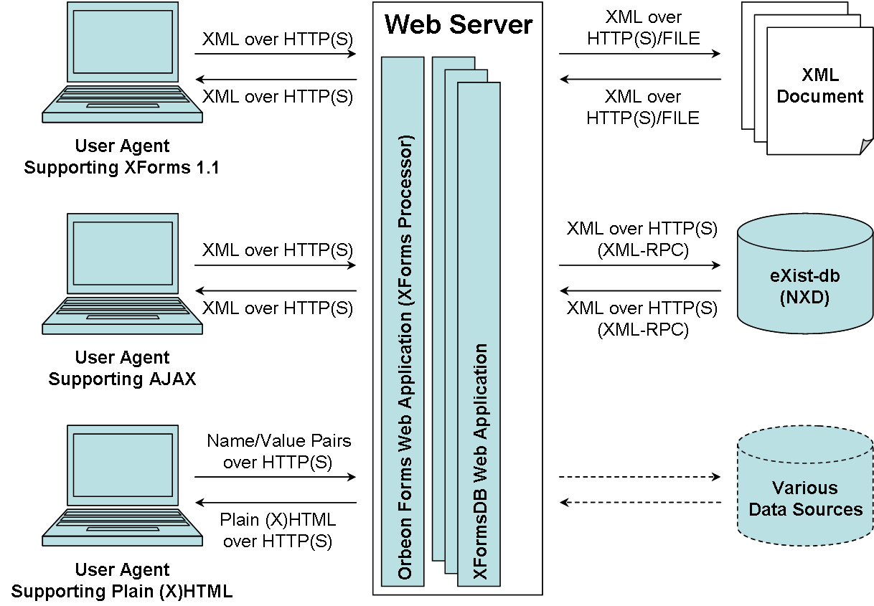
High-Level Architecture
Page <number>

Slide 23
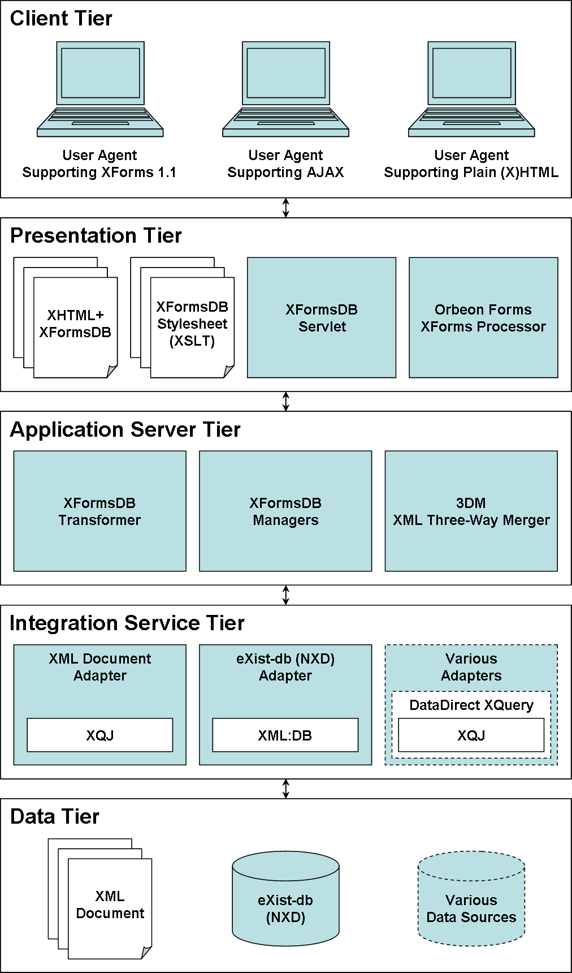
Modules and Tiers
Five logical tiers
  Client Tier
  Presentation Tier
  Application Server Tier
  Integration Service Tier
  Data Tier
Support for other types of data sources (e.g., relational databases) can be easily added as well
  DataDirect XQuery Middleware
Page <number>

Slide 24
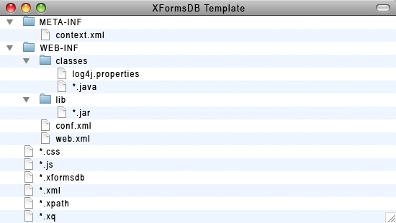
Web Application Directory Structure
Page <number>

Slide 25
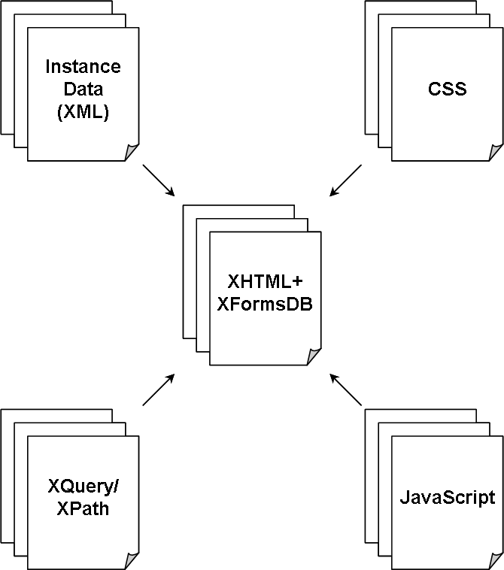
Web Page Components
The main Web standards and technologies used are
  XHTML for document structure
  XForms for user interaction
  XFormsDB for data access and common server-side tasks
  XML for data model and interchange
  CSS for visual layout and presentation
  XQuery and XPath for querying data
  JavaScript for animation and additional interaction
Page <number>

Slide 26
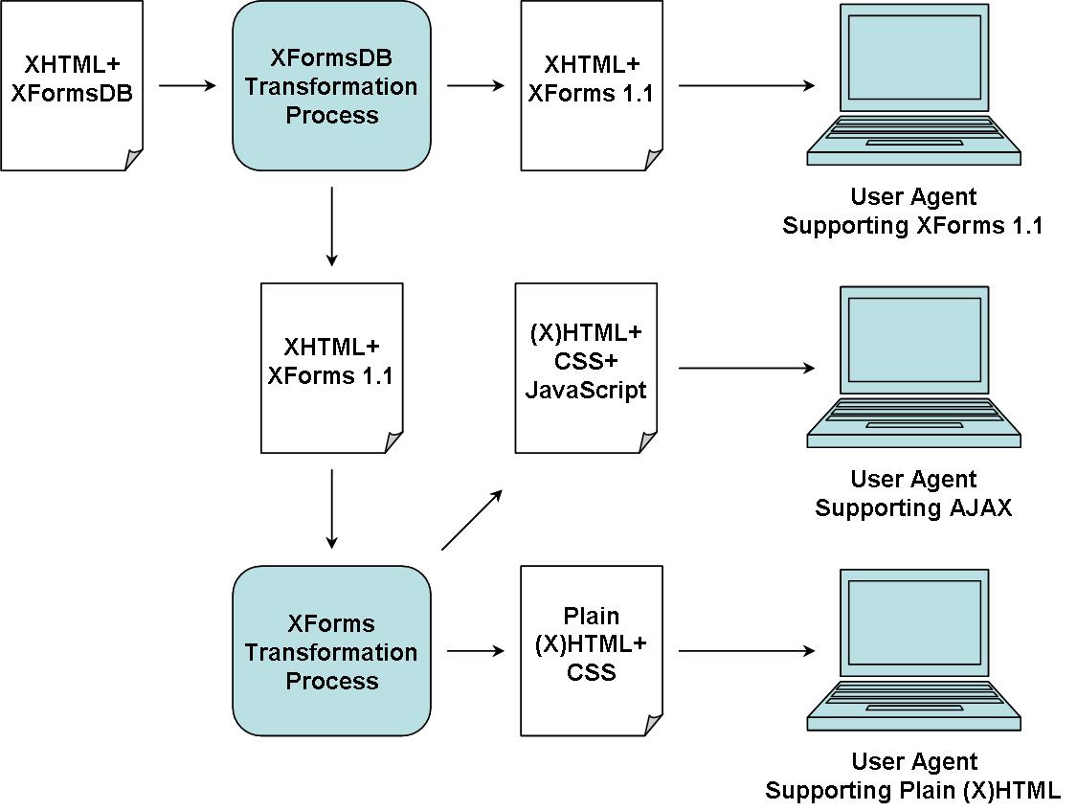
Transformation Processes
Two separate server-side transformation processes
  XHTML+XFormsDB to XHTML+XForms 1.1
  XHTML+XForms 1.1 to (X)HTML+CSS+JavaScript or plain (X)HTML+CSS
Page <number>

Slide 27
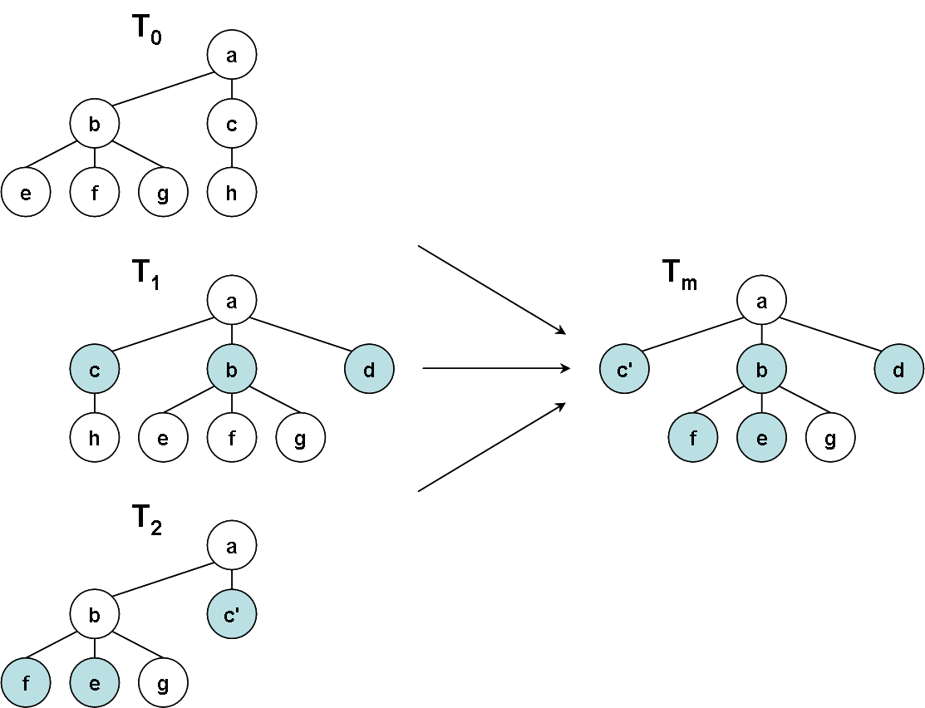
Data Synchronization
Data synchronization
  Built-in support for synchronized updates
  Uses 3DM, a middleware for performing three-way merging of XML documents
  Detects and handles update, insert, and delete operations as well as moves and copies of entire subtrees
  In case of a merge conflict, an appropriate error message is reported back to the form
Page <number>

Slide 28
Part V
Sample Web Applications
Page <number>

Slide 29
Overview
Personal Information Management (PIM)
  A simple Web application for storing, browsing, and managing information about your personal contacts
  Consists of a single Web page
  Key features: sorting data, internationalization, and data access
Blog
  An online journal or diary Web tool for publishing personal contents
  A simplified version of publicly available software
  Contains three Web pages and multiple complex data source queries
  Key features: a real-life Web application of today
Page <number>

Slide 30
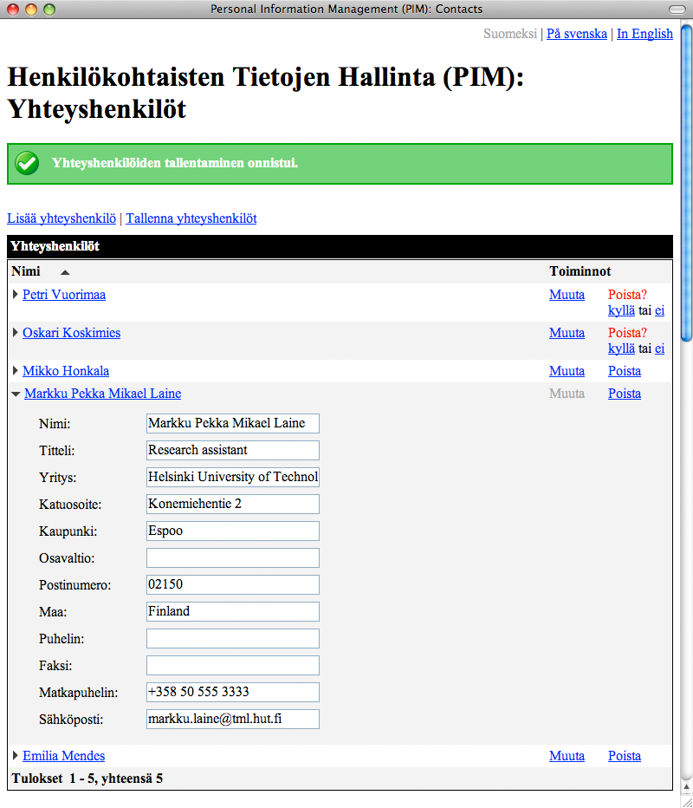
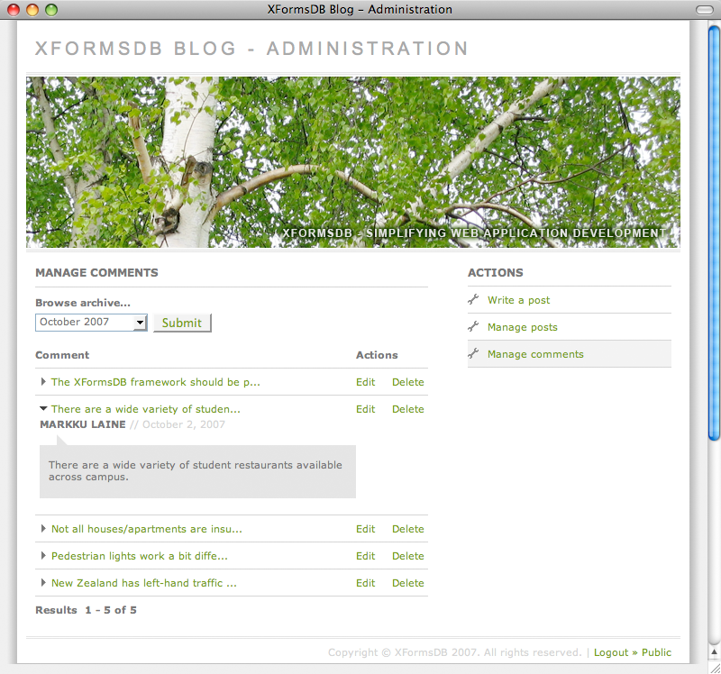
Screenshots
Page <number>

Slide 31
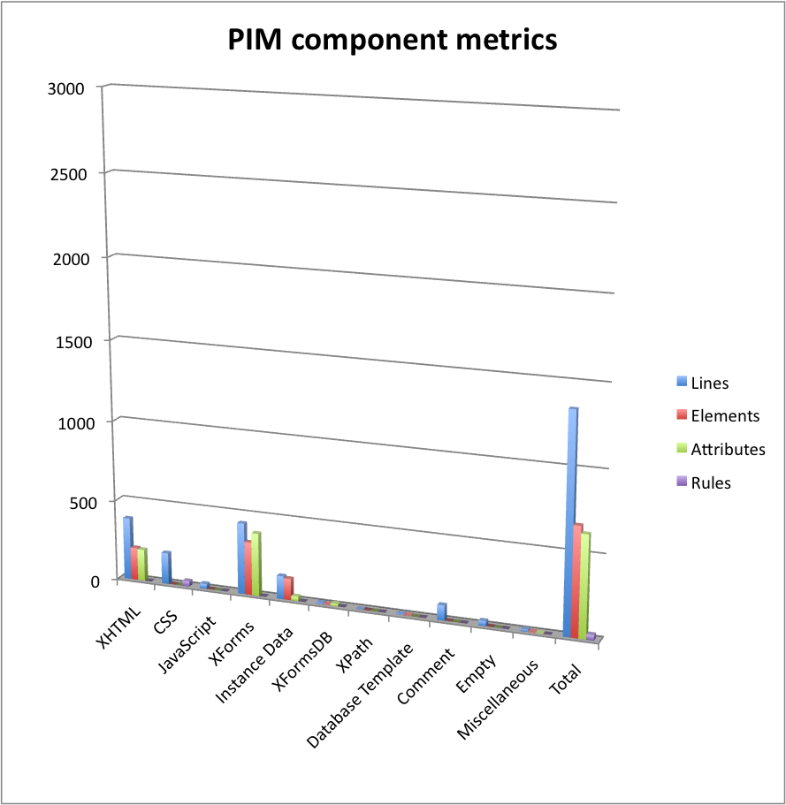
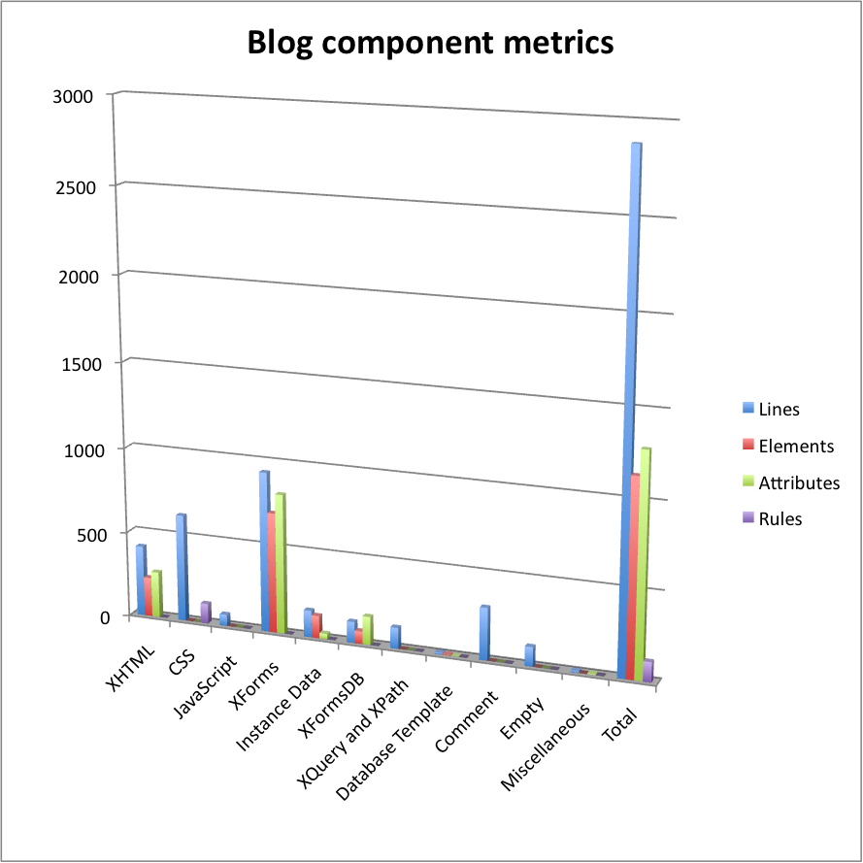
Metrics
Page <number>

Slide 32
Metrics (cont.)
Personal Information Management (PIM)
  Response size metrics (front page): Requests - 17 and Size - 154.3 kB (Empty cache), Requests - 12 and Size 13.0 kB (Primed Cache)
  Response time metrics (front page): Time - 2.2 s (Empty Cache), Time - 1.3 s (Primed Cache)
  The sizes of the WAR files: 37.9 kB (Lite version) and 17.6 MB (Standalone version)
Blog
  Response size metrics (front page): Requests - 17 and Size - 486.8 kB (Empty cache), Requests - 12 and Size 4.1 kB (Primed Cache)
  Response time metrics (front page): Time - 2.1 s (Empty Cache), Time - 1.2 s (Primed Cache)
  The sizes of the WAR files: 406.1 kB (Lite version) and 17.9 MB (Standalone version)
Page <number>

Slide 33
Part VI
Conclusions
Page <number>

Slide 34
Results
The XFormsDB markup language
  Naturally extends the XForms markup language to include the most common server-side functionalities
  New server-side functionalities can be easily added to the language
  For users who are already familiar with XForms, the language is relatively easy to learn
The XFormsDB framework
  Supports most common browsers and heterogeneous data sources
  Includes built-in support for synchronized updates
  Allows for the rapid development of entire Web applications using a single document and under a single programming model
Page <number>

Slide 35
Future Work
Refine the syntax of the XFormsDB markup language
Implement support for a subset of XML Binding Language (XBL) 2.0 on the server side
  Allows the use of highly reusable components
Implement a Web-based visual tool for developing XFormsDB Web applications
  Makes the technology accessible to non-technical users
Add built-in support for OpenID authentication
  Users could use an existing account to sign in to XFormsDB Web applications
Improve current transaction support
  Grouping of synchronized updates
Page <number>
Notes:
Improve performance through caching

Slide 36
Thank You!
Questions? Comments?
<markku.laine@gmail.com>
Page <number>

