Slide 1
Fitness4All Location Prospecting Study
Data Science Capstone Project
Margaret Platt
February 10th, 2020

Slide 2
Introduction
Fitness4All is a family-owned business founded in south New Jersey in 2009, offering workout equipment and personalized training plans to clients. Facilities are comfortable, bright and clean; fees are lower than would be found at more upscale facilities in urban centers
Having created several profitable operations in the last ten years, the company would like to expand its operations into the State of Pennsylvania and has asked for a survey of potential locations with the following guidelines:
The company’s owner believes that the Townships with the best prospects for profitability have a population of between 20,000 and 50,000 (as these are often overlooked by major national chains)
The study should examine the degree of competition for commercial gym facilities which already exists in potential Townships
The study should look for locations which share demographic characteristics with the New Jersey locations which have already proved successful

Slide 3
Approach
The key steps in the analysis are described below (see Appendix I for details on information sources):
Identified & reviewed the geographic locations of PA Townships with a population between 20,000 – 50,000
Use a statistical technique (K-means clustering) to compare NJ and PA counties based on demographic information, in order to identify PA counties which most resemble the NJ counties where Fitness4All NJ locations have already been successful
Leveraged the vendor Foursquare (which provides information on venue locations for many major companies, including Uber and Apple) to identify competitor gym facilities and complimentary amenities in short-listed PA Townships
Used the above information to further refine the shortlist, and demonstrate how Foursquare data can be used to investigate specific potential sites within focus Townships

Slide 4
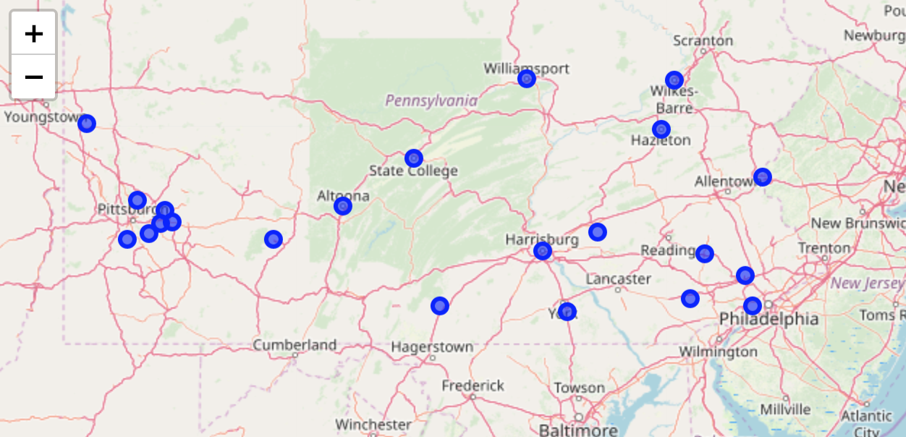
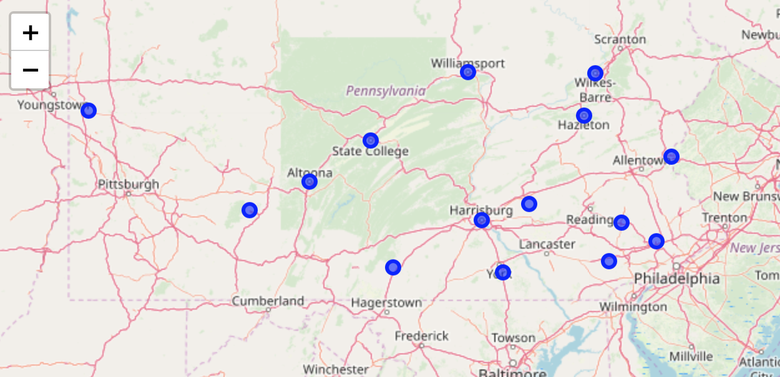
Findings
The initial search for Township locations produced 22 possible locations with the right size populations….
Observing that some of these were really city suburbs (not our target market) we refined the short-list to 15….

Slide 5
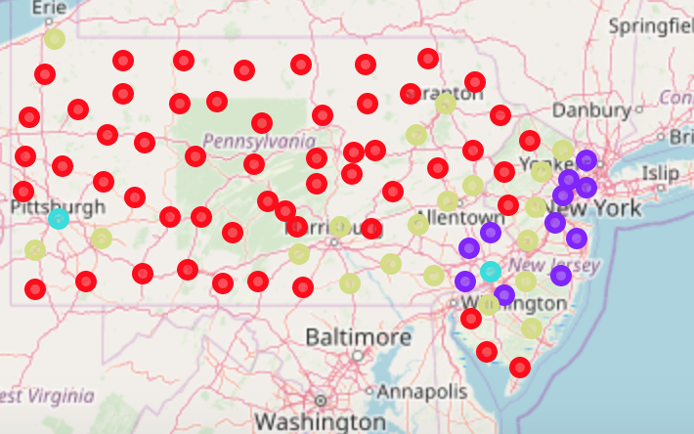
Findings
Using the K-means clustering technique applied to PA county demographic information, we identified 4 different groupings of location…
Cluster | Nickname | Characteristics
Blue Cluster | "Major urban centers" | i.e. Philadelphia, Pittsburgh
Purple Cluster | "Commuter belt communities" | Relatively young population, ethnically diverse, high percentages of college education and high income households
Gold Cluster | "Middle America" | Average values on most atttributes, towns generally too far west for commute to New York and Philadelphia
Red Cluster | "Older, small town communities" | Highest proportion of over 55s, lowest levels of college education and higher income households, generally in western PA and south NJ

Slide 6
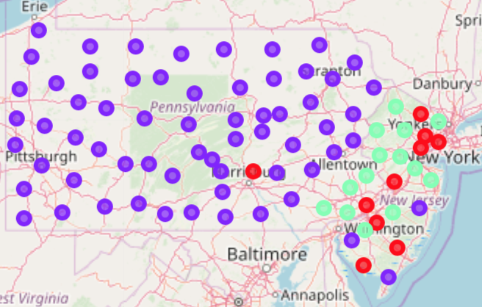
Findings
In the prior analysis, results were unduly influenced by population size (“number of households”) which is not a demographic variable. So we repeated the analysis omitting this feature….
Cluster | Nickname | Characteristics
Red Cluster | Young & diverse | Relatively young population, ethnically diverse, median score among clusters for high-income households and levels of college education
Purple Cluster | Older, less diverse, less affluent | Highest proportion of over 55s, least ethnically diverse, lower incidence of college education & high-income households
Green Cluster | Higher income and education | Median score among clusters for age groupings and ethnicity; significantly higher levels of college education and high income households

Slide 7
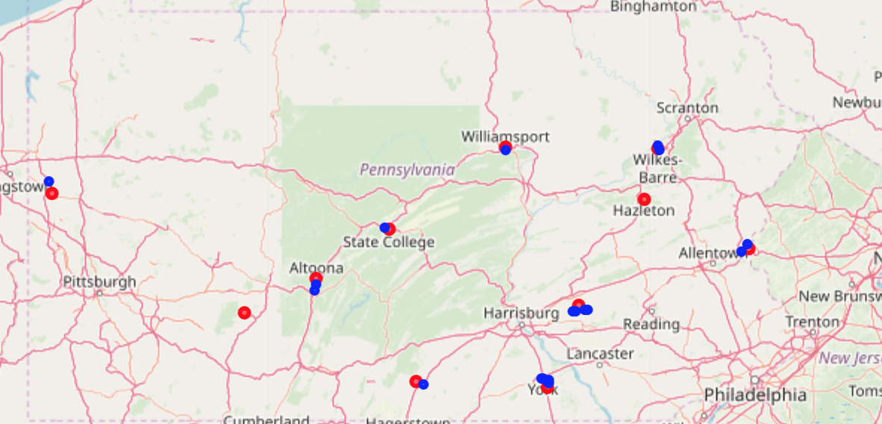
Findings
Clustering findings indicate that PA locations most like our existing NJ locations can be found in the ‘Purple’ cluster
We used this information to further refine our PA prospect locations, and then used Foursquare information to map existing locations to a map of PA
Note: there were no existing gym facilities detected in Hazleton and Johnstown!

Slide 8
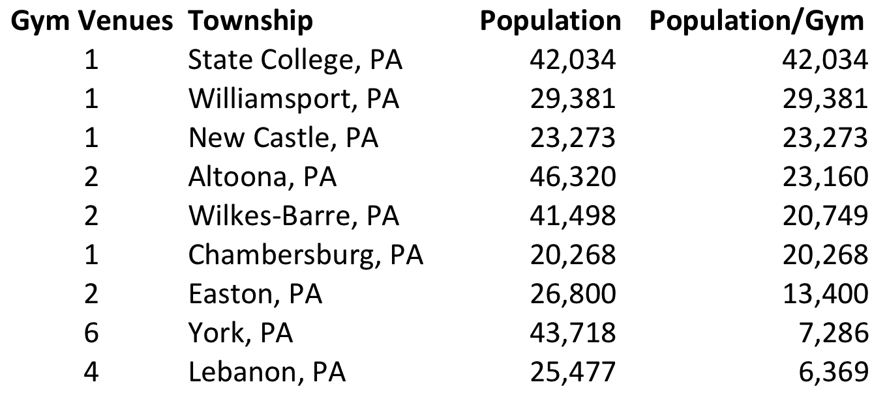
Findings
For the remaining 9 short-listed locations, we could compute a measure of competitive intensity by dividing the Township population by the number of existing gym facilities, to create a ranked list of the most relatively under-served Townships
Clustering findings indicate that PA locations most like our existing NJ locations can be found in the ‘Purple’ cluster
We used this information to further refine our PA prospect locations, and then used Foursquare information to map existing locations to a map of PA

Slide 9
Conclusion & Recommendation
Based on the information found in this study, we conclude that there are several locations which offer potential business opportunities in Fitness4All’s target segment
We recommend further exploration of Hazleton and Johnstown, as locations currently offering the least competition. In addition, the management team may want to investigate Townships from the priority list on the prior slide
Fitness4All may also at some point wish to further leverage the insights of the demographic information with market research to determine service feature and pricing strategies would meet the needs of client segments in a broader range of communities
Finally, Appendix II illustrates how Fitness4All might conduct a preliminary search for an optimal site in any given Township using FourSquare information

Slide 10
Appendix – Input Data
A baseline list of possible PA Townships and their populations were derived from information available at: https://en.wikipedia.org/wiki/List_of_populated_places_in_Pennsylvania
US census data provides key demographics for each county in NJ and PA (this data seems not to be available at a Township level). We used the ‘City and County’ Data Book’ (2007 edition) for demographic data, which is available at: https://www.census.gov/library/publications/2010/compendia/databooks/ccdb07.html
We also use Foursquare location data to explore existing locations in short-listed Townships i.e. to discover competitor facilities and complimentary amenities, leveraging a publicly-available developer API

Slide 11
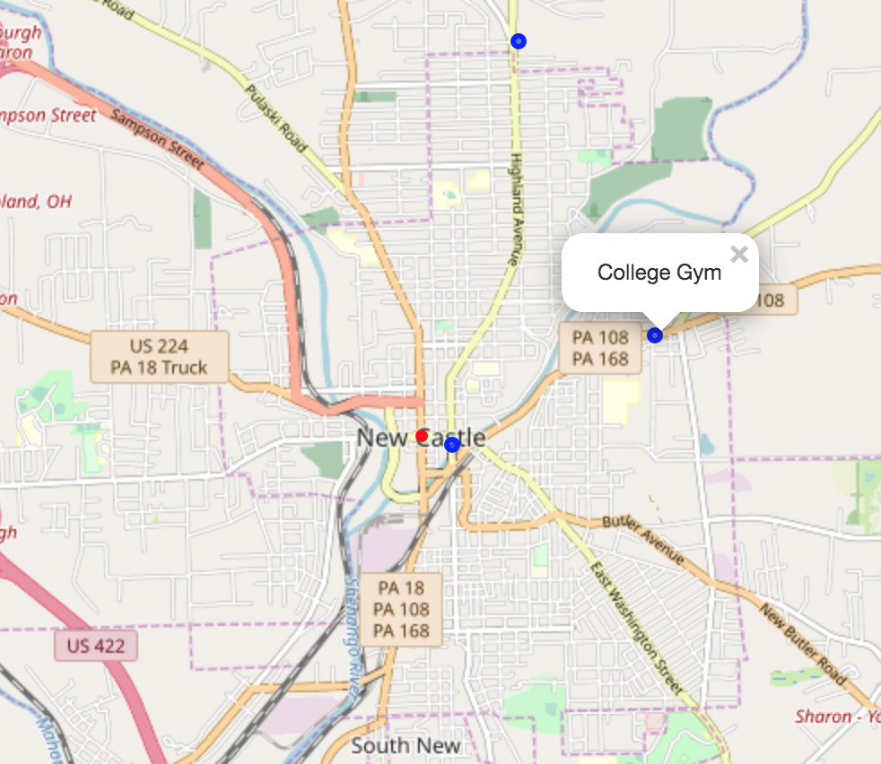
Appendix II – Site Search Illustration
The map at left was produced by plotting venue data from Foursquare onto a Folium map
It shows a single existing gym facilities venue some ways out of town (which is classified as a College Gym, so potentially not available or attractive to our client segment)
The map also shows two coffee shop locations – one in the centre of town – which may be attractive co-locations

