Slide 1
Virtual Wind Tunnel
Set Tunnel Conditions
Wind Speed: High
Temperature: Medium
Humidity: Medium
Set Airfoil Shape
Rotate Shape
Simulate >>

Slide 2
Virtual Wind Tunnel
Set Tunnel Conditions
Low
Medium
High
Wind Speed
Low
Medium
High
Temperature
Low
Medium
High
Humidity
Next >>

Slide 3
Virtual Wind Tunnel
Set Airfoil Shape
Draw Your Own Shape
Next >>

Slide 4
Virtual Wind Tunnel
Draw Your Own Shape
<Pencil Icon>
<Eraser Icon>
Clear Screen
Next >>

Slide 5
Virtual Wind Tunnel
Rotate Shape
Next >>

Slide 6
Virtual Wind Tunnel
Running…
40%

Slide 7
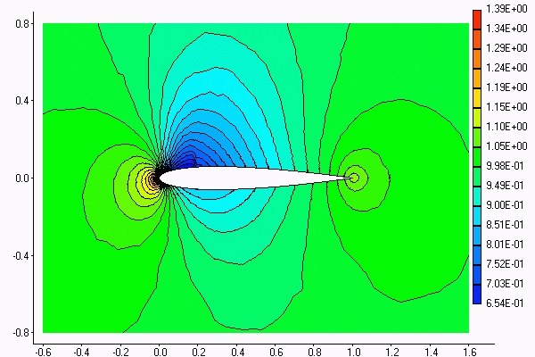
Virtual Wind Tunnel
Results
Tweet Results
Lift: 1.895
Drag: 0.643
Email Results
Mach Number
Pressure
New Sim >>

