Slide 1
10 best HTML5 practices
( for happy and long life)
& ModuleBU on github
Goal:
I'll make you a better web developer
In thee next 10 minutes.
(and a test)

Slide 2
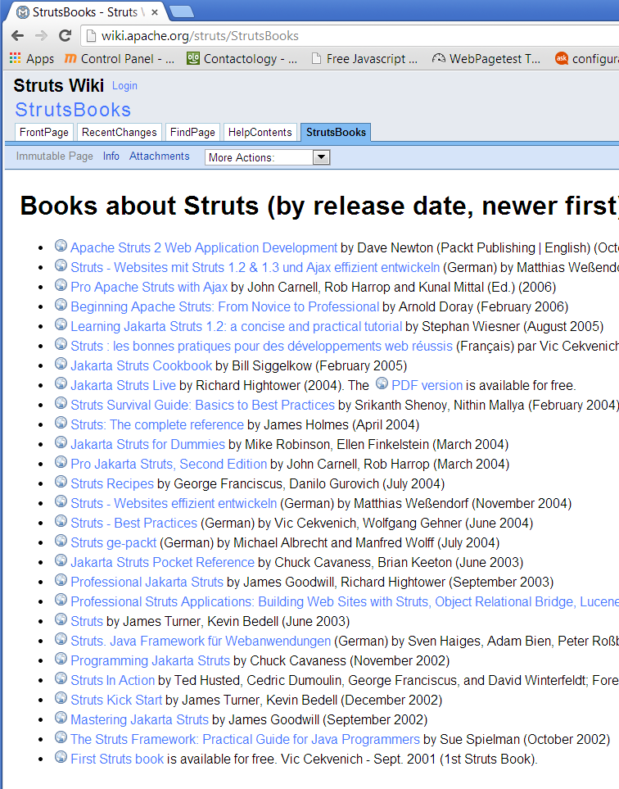
Who am I?

Slide 3
10 HTML5 good practices?
#6. DOM UI
1: Speed
2: IDE
3: Compiler
4: Loader
5: SEO deep link
6
7: Pro animation
8: Ajax(?MVC)
9. UI & Cross platform
10: Deployment

Slide 4
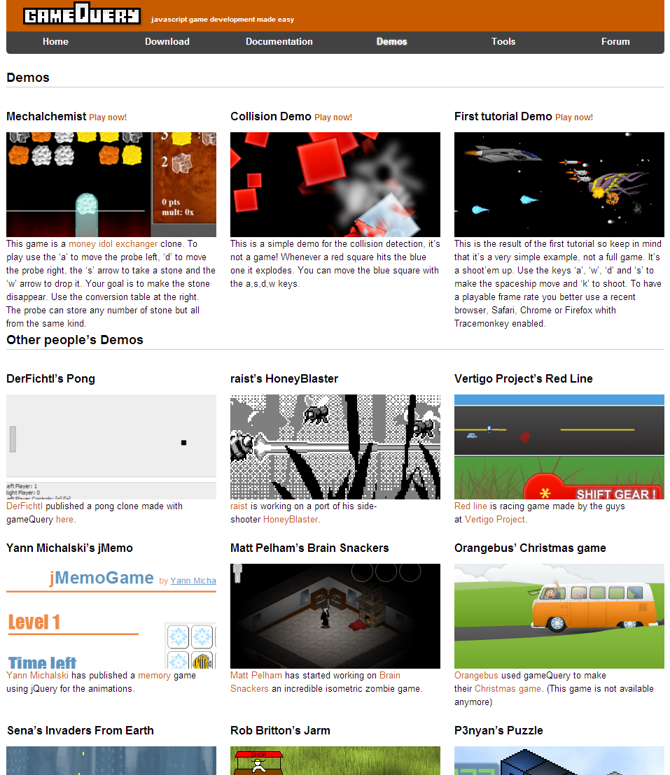
#6

Slide 5
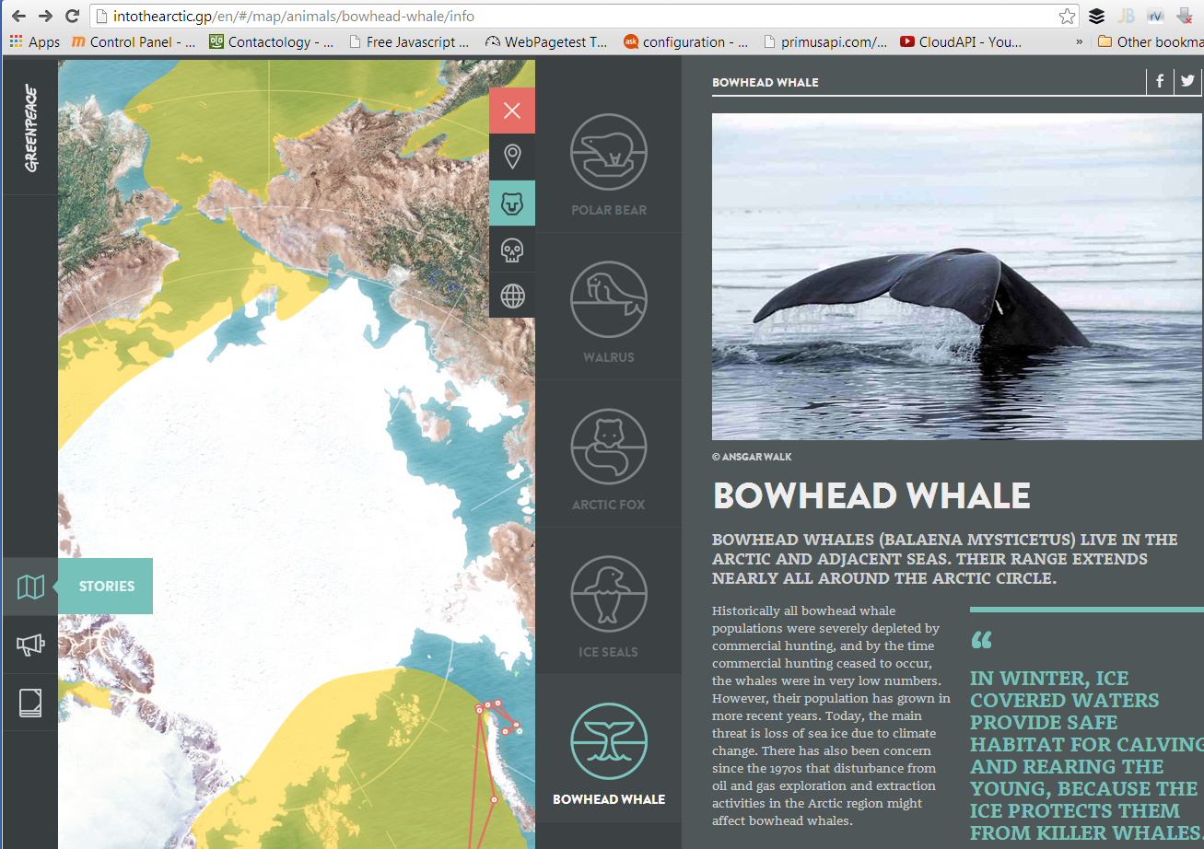

Slide 6
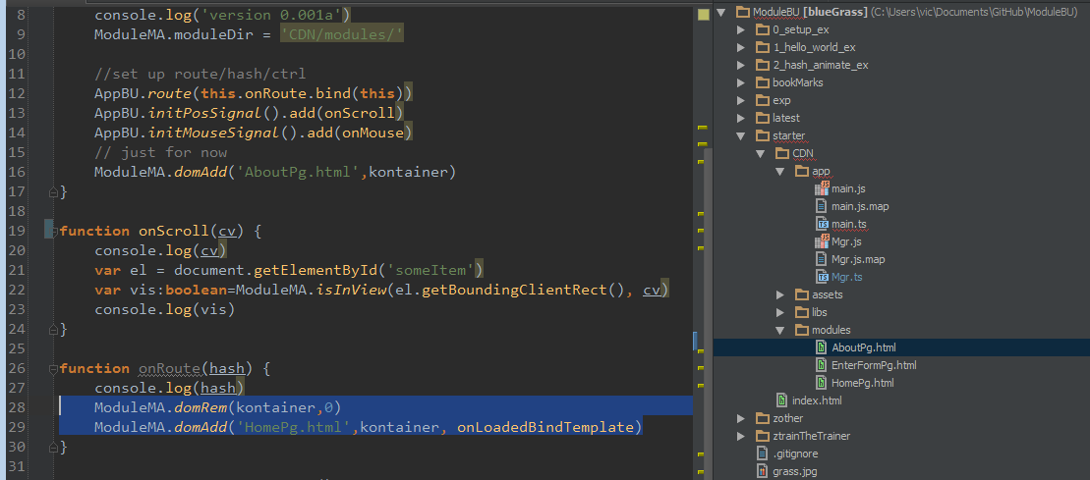

Slide 7
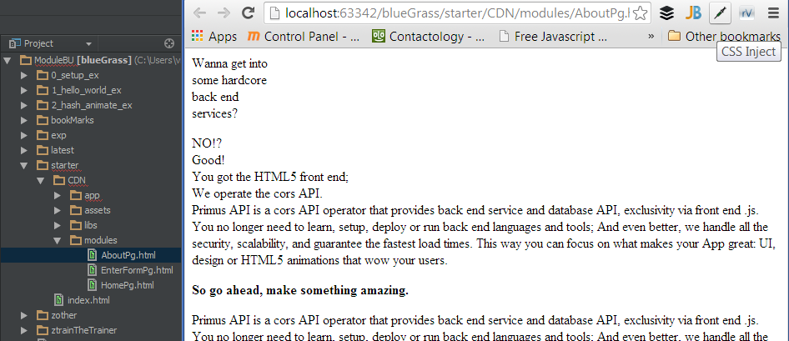

Slide 8
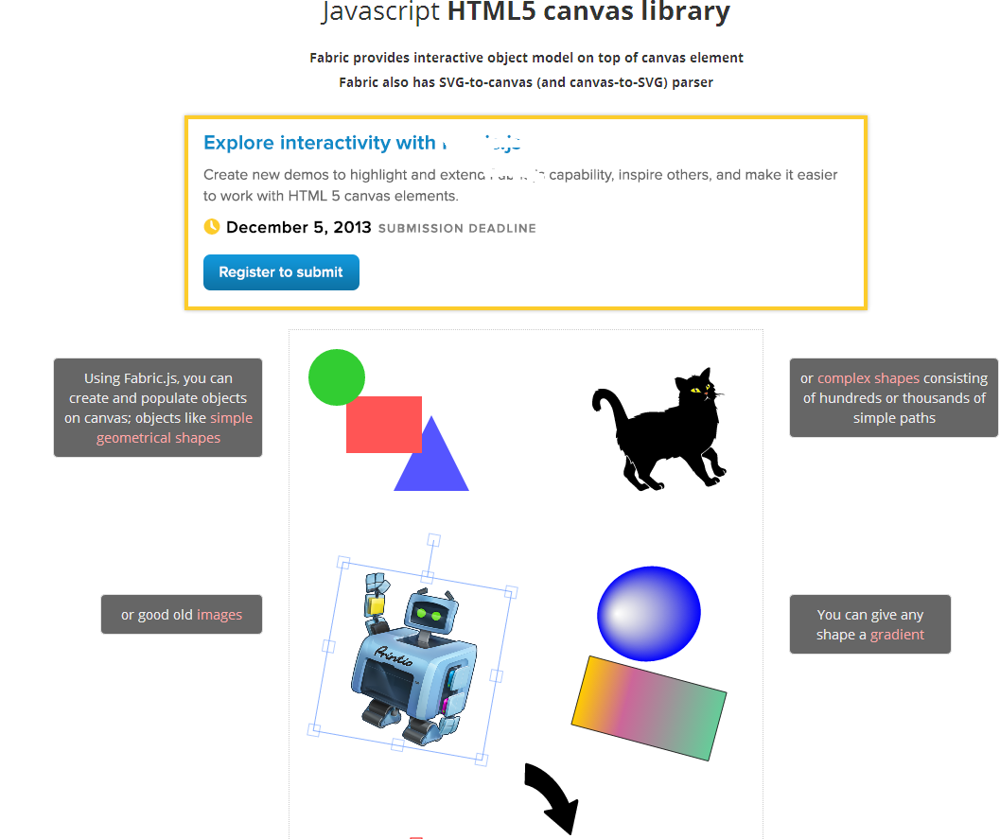
(bad) alternative is .js DOM | canvas or non modular app

Slide 9
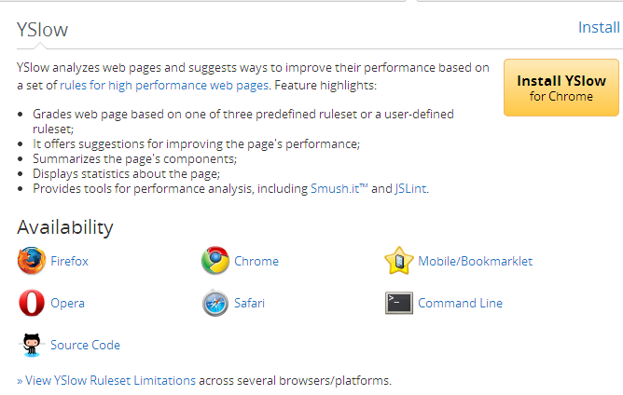
#1. CDN

Slide 10
(bad) alternative: PHP

Slide 11
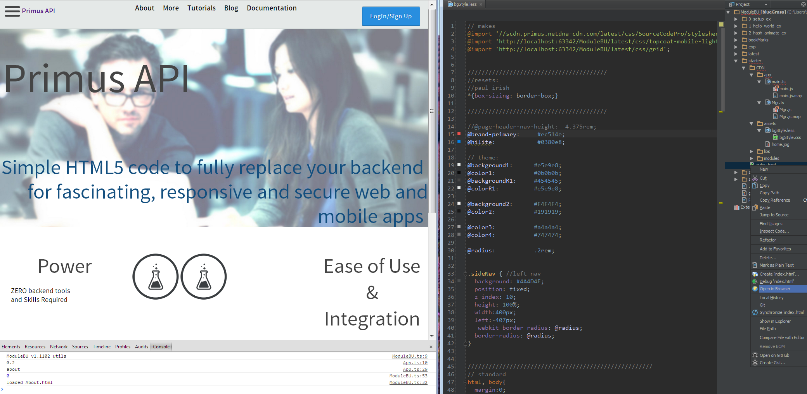
#2 WebStorm

Slide 12
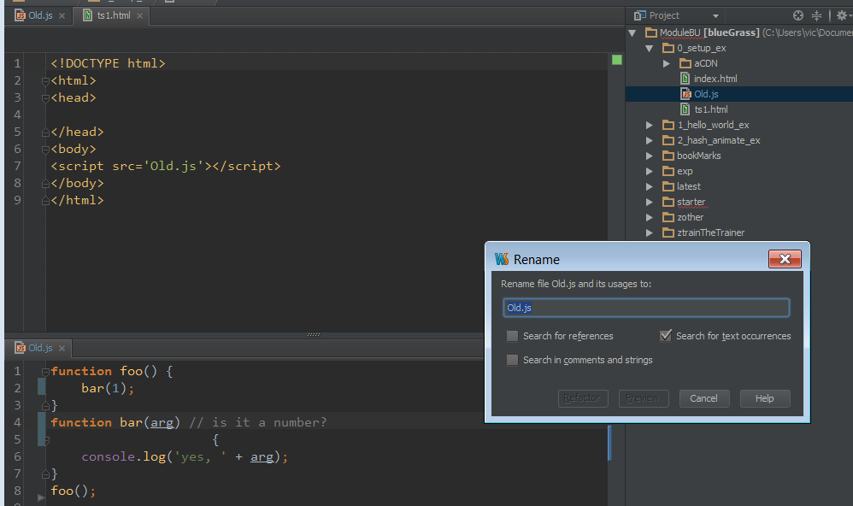
#3. TypeScript/Less

Slide 13
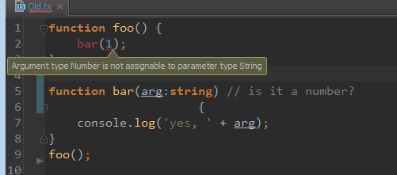

Slide 14
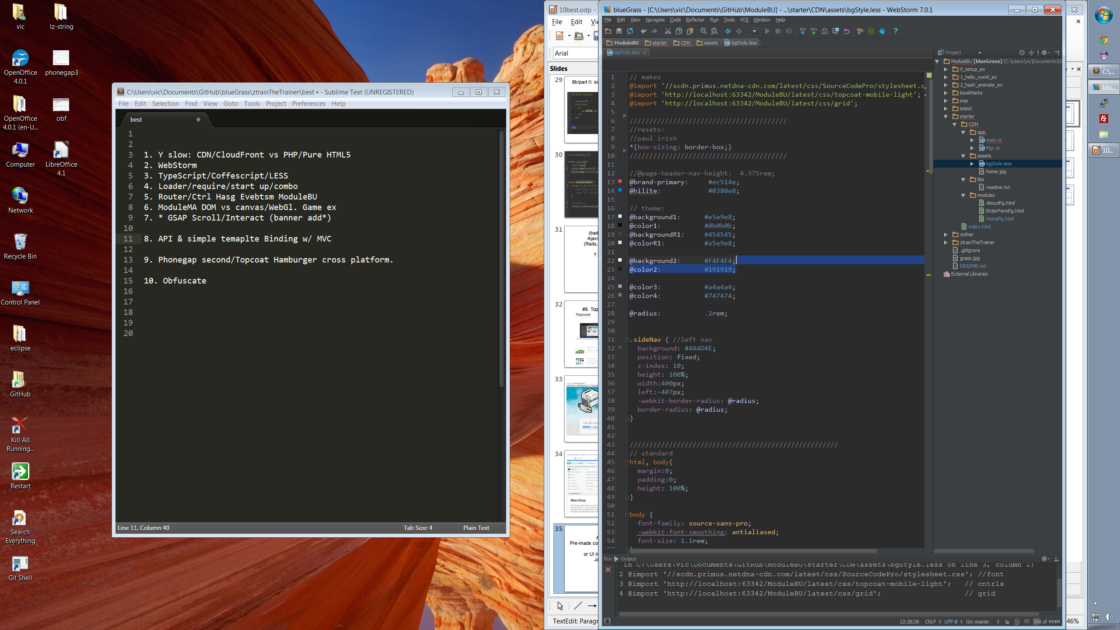

Slide 15
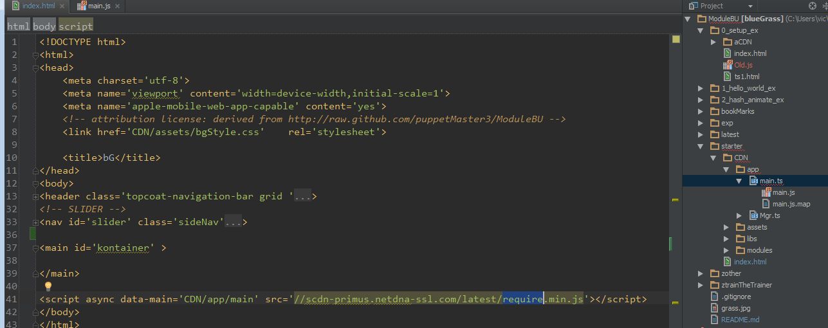
#4. Loader

Slide 16
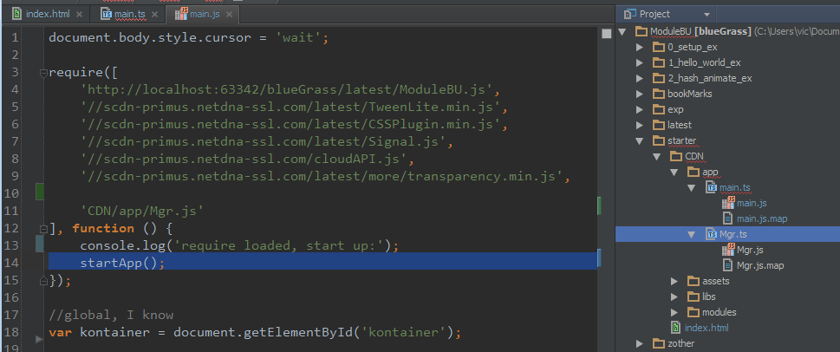

Slide 17
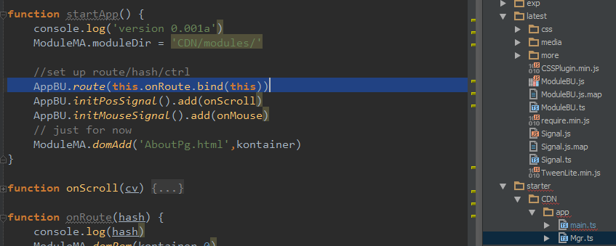
#5. App Buss / Router/Hasher/SEO
(more like entity/system)

Slide 18
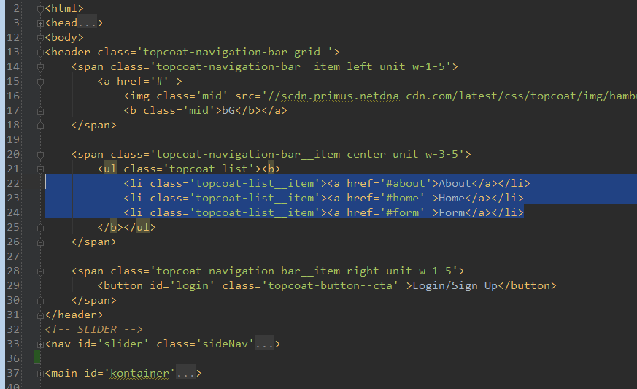

Slide 19
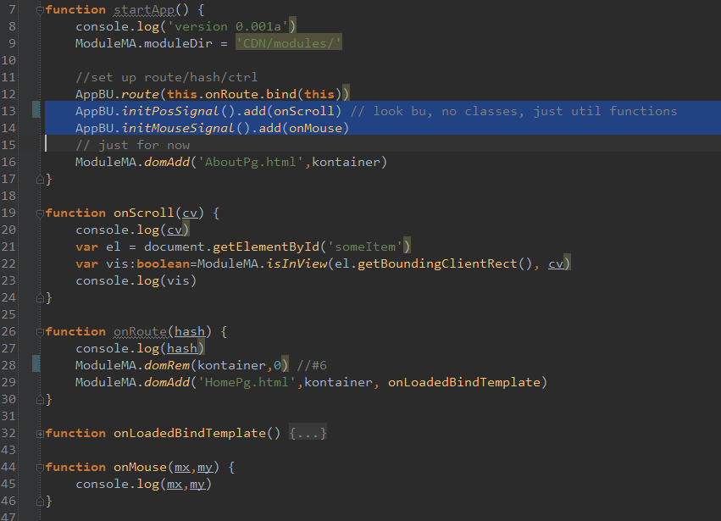

Slide 20
(bad) alternative: not SPA

Slide 21
#6
?

Slide 22
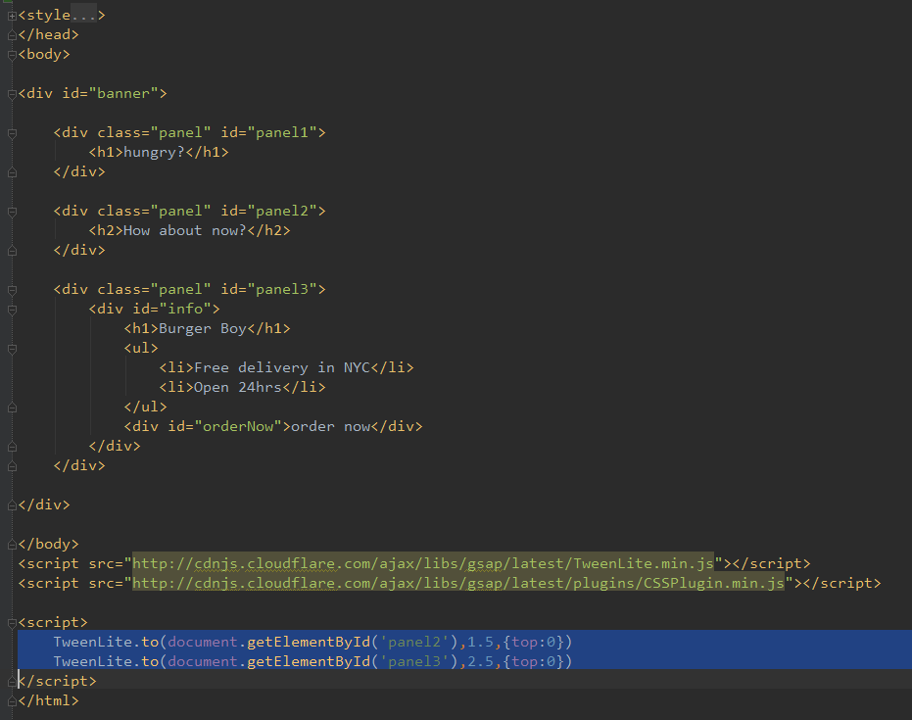
#7. GSAP/Greensock

Slide 23
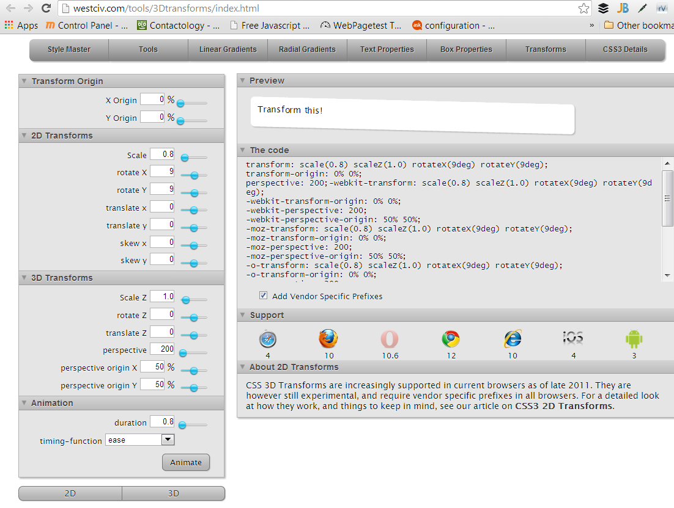

Slide 24
(bad) alternative: static site w/ CSS FX sprinkled

Slide 25
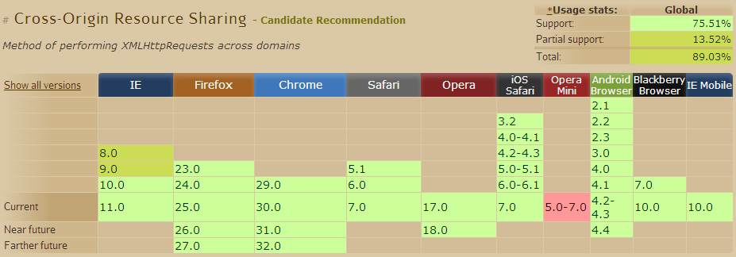
#8. API

Slide 26
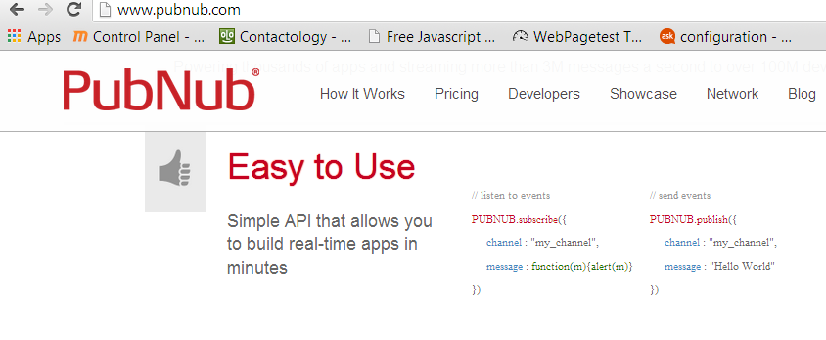

Slide 27
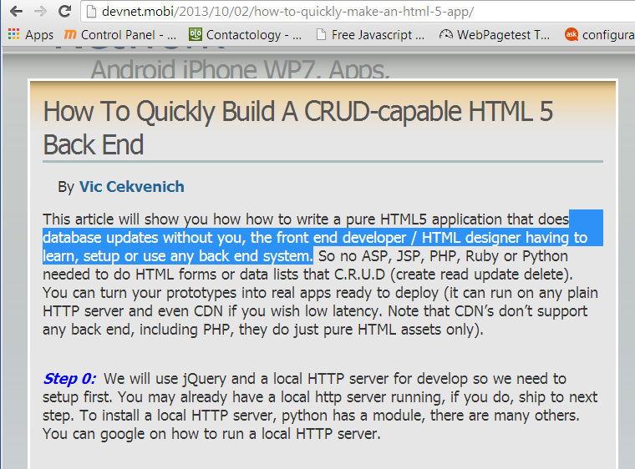

Slide 28
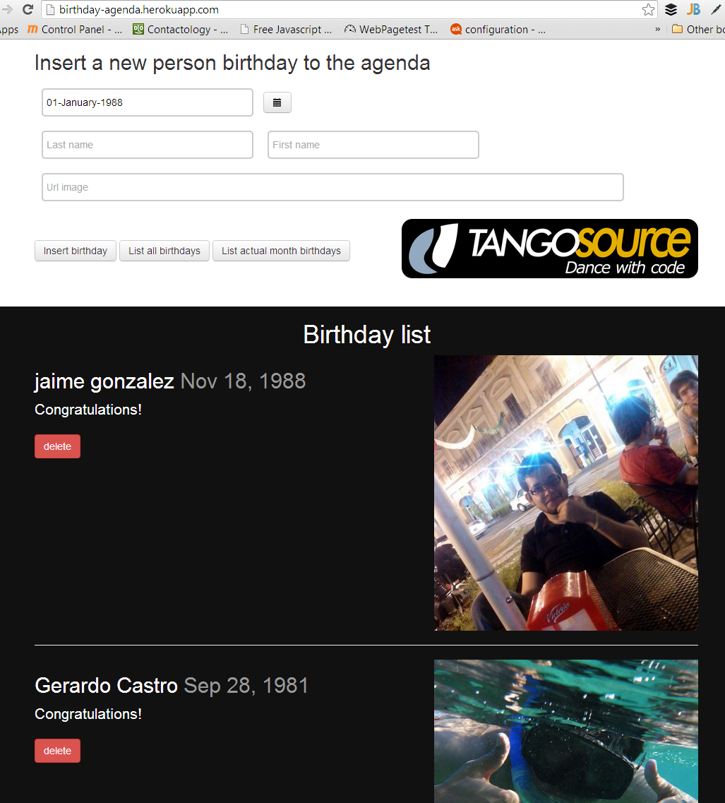

Slide 29
10 HTML5 good practices!
1: Speed: CDN/Server
2: WebStorm
3. TypeScript/Less
3: Loader/Require.js
5: Router/Hasher AppBU
6: ModuleMA DOM add/rem modules
7: GSAP/Greensock
8: API/Cors(?Simple template binding)
9.
10.

Slide 30
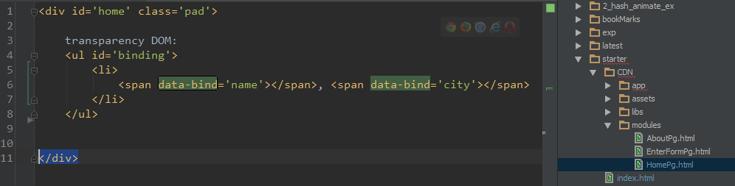
8b/part II: simple template binding w/o MVC

Slide 31
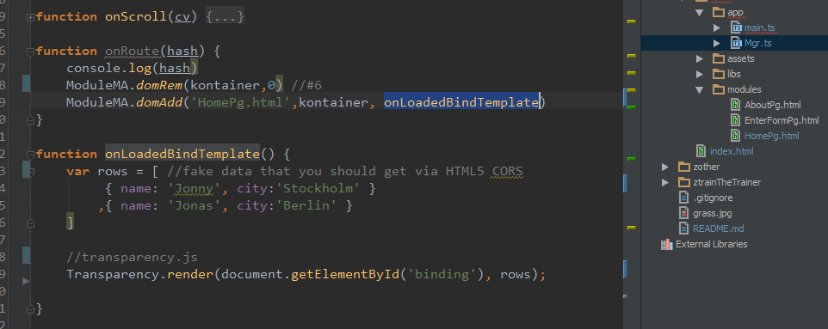

Slide 32
(bad) alternatives: Ajax/RESP/JSONP
(Rails, Spring, Python)
? heavy MVC

Slide 33
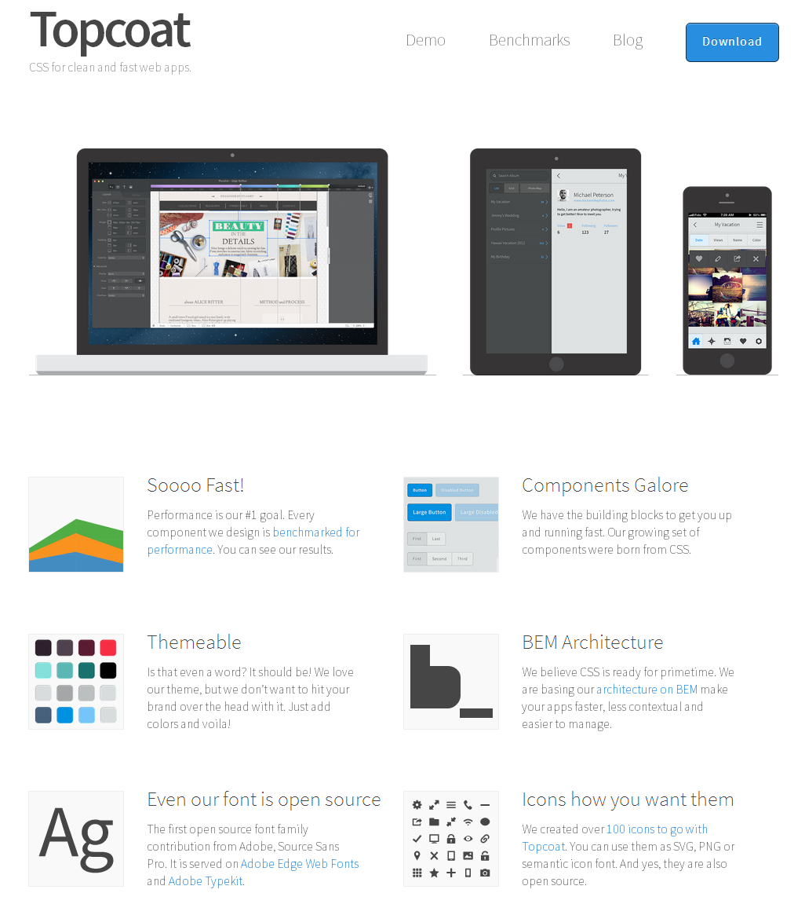
#9. Topcoat + Phonegap

Slide 34
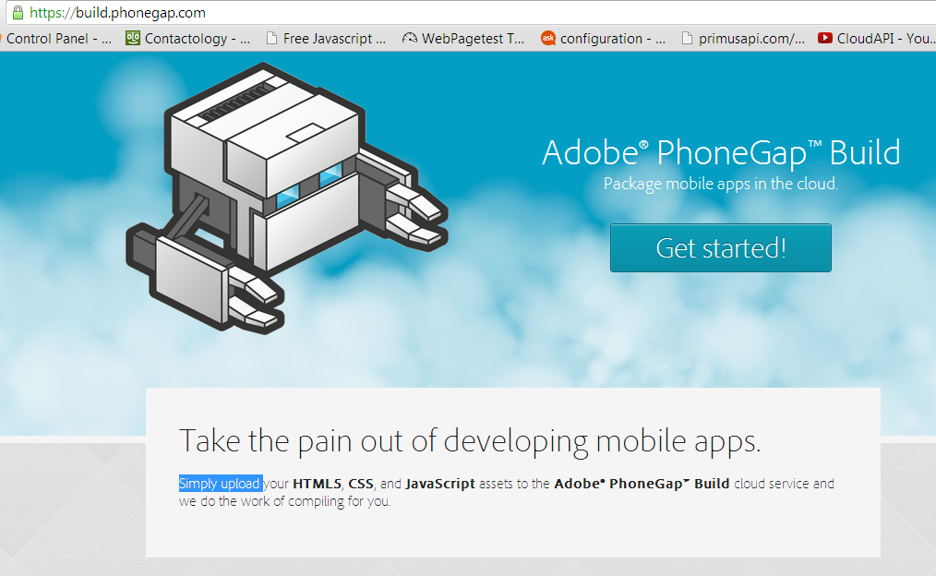

Slide 35
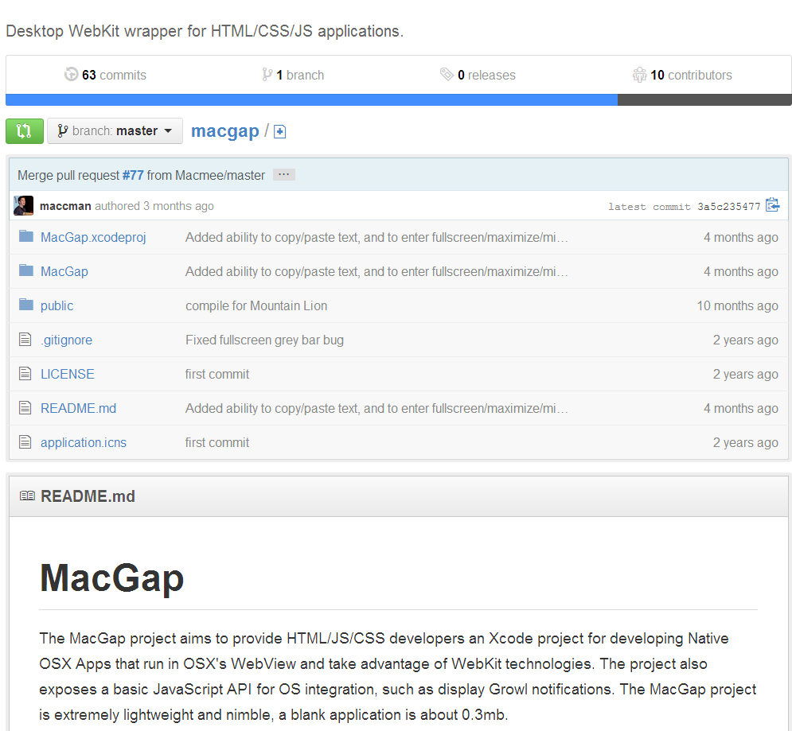

Slide 36
Alternative:
Pre-made components such as YUI
+ or UI in Objective C or
Java/Andorid

Slide 37
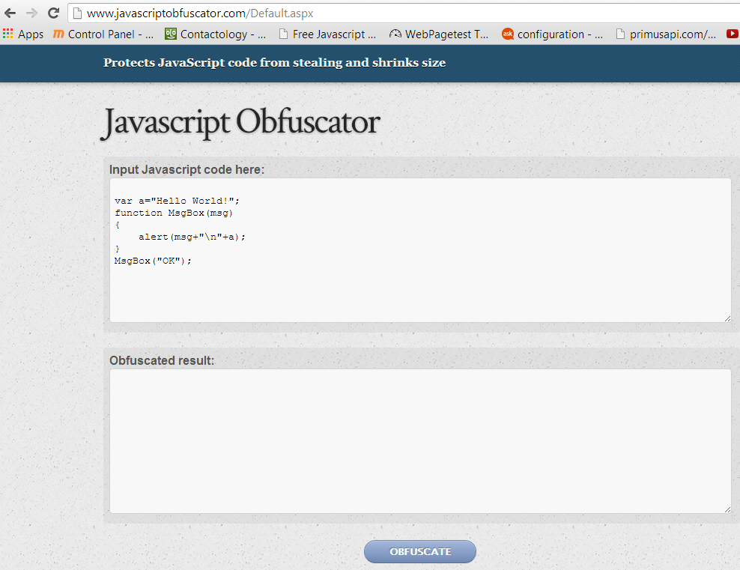
#10 Obfuscate pro(paid) work

Slide 38
10 HTML5 good practices!
1: Speed: CDN/Server
2: WebStorm
3. TypeScript/Less
3: Loader/Require.js
5: Router/Hasher AppBU
6: ModuleMA DOM add/rem modules
7: GSAP/Greensock
8: API/Cors(?Simple template binding)
9. Phonegap second (UI)
10: Deploy obfuscated

Slide 39
Github ModuleBU (A.A.)
@puppetMaster3
PrimusAPI.com

