Slide 1
10 best HTML5 practices
( for magic UI)
Goal: I'll make you a better web developer
In the next 20 minutes.
License: Attribution Assurance
https://github.com/puppetMaster3/ModuleBU

Slide 2
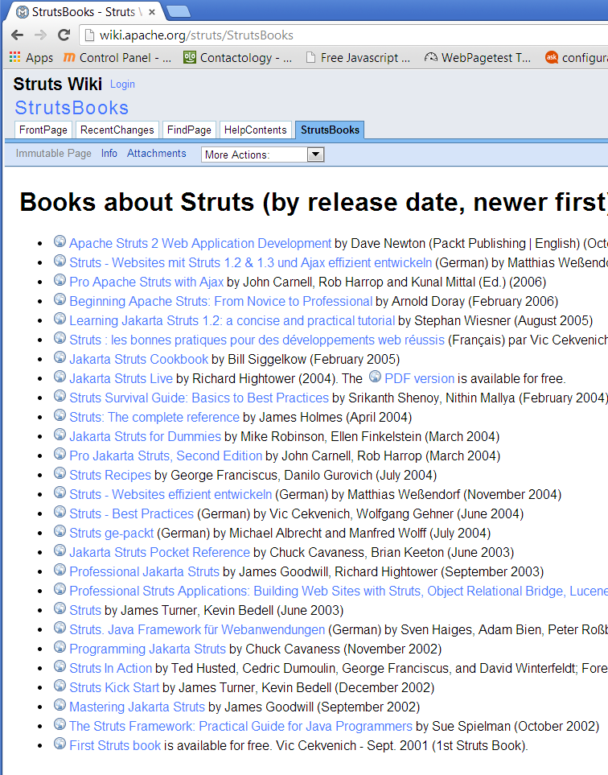
Who am I?

Slide 3
10 HTML5 good practices?
#6. DOM UI
1: Speed
2: IDE
3: Compiler
4: Loader
5: SEO deep link
6
7: Pro animation
8: Ajax(?MVC)
9. UI & Cross platform
10: Deployment

Slide 4
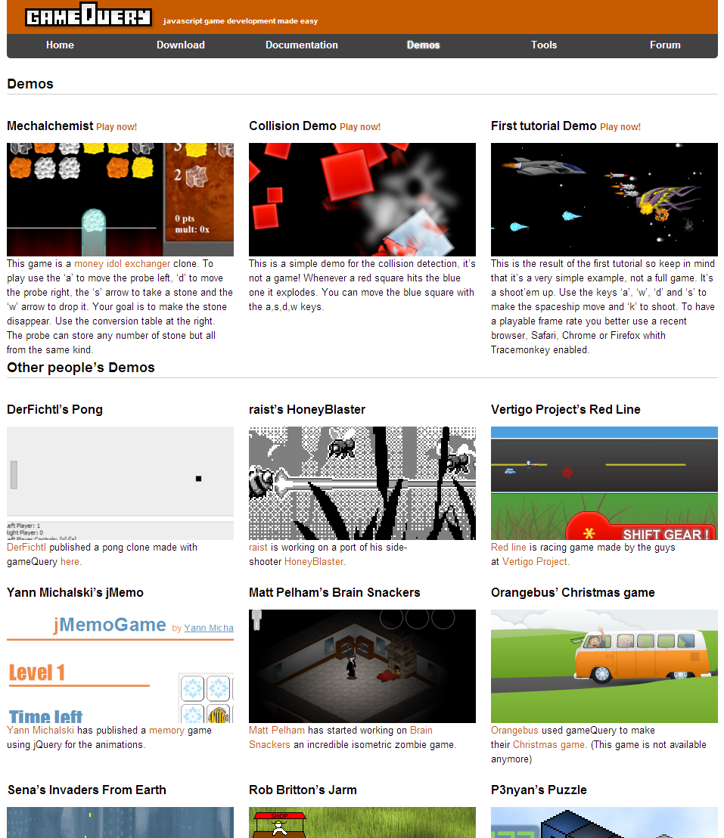
#6

Slide 5
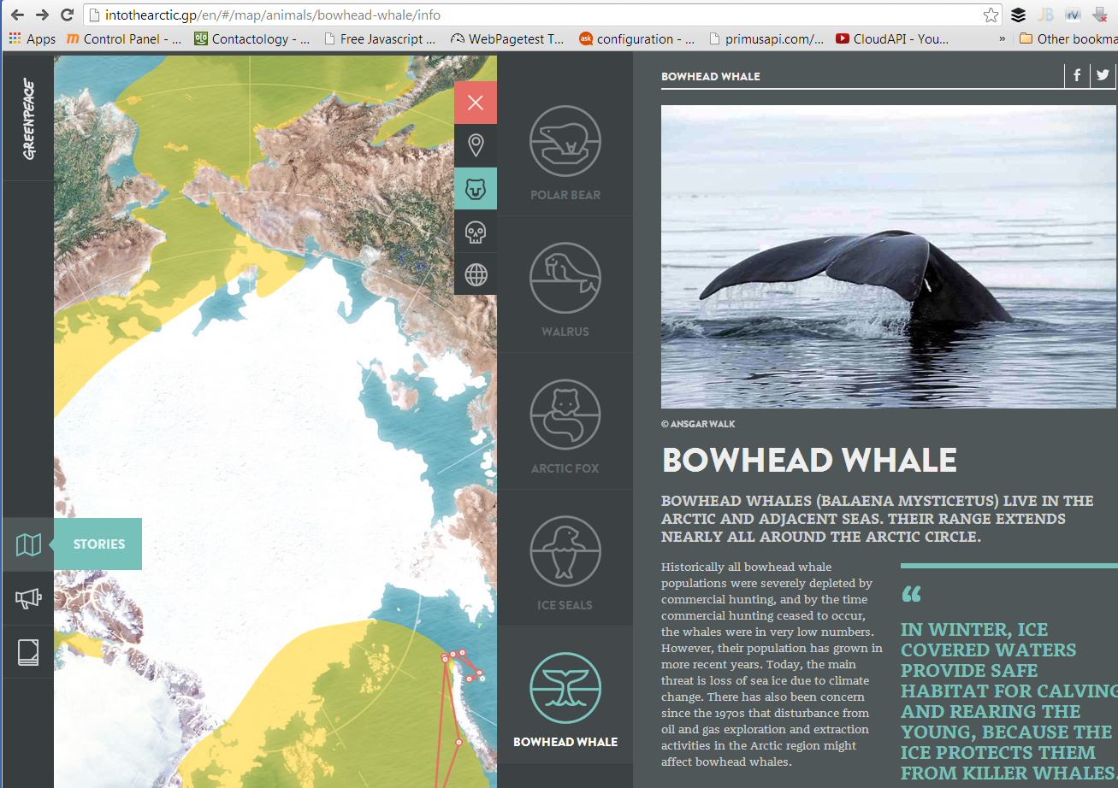

Slide 6
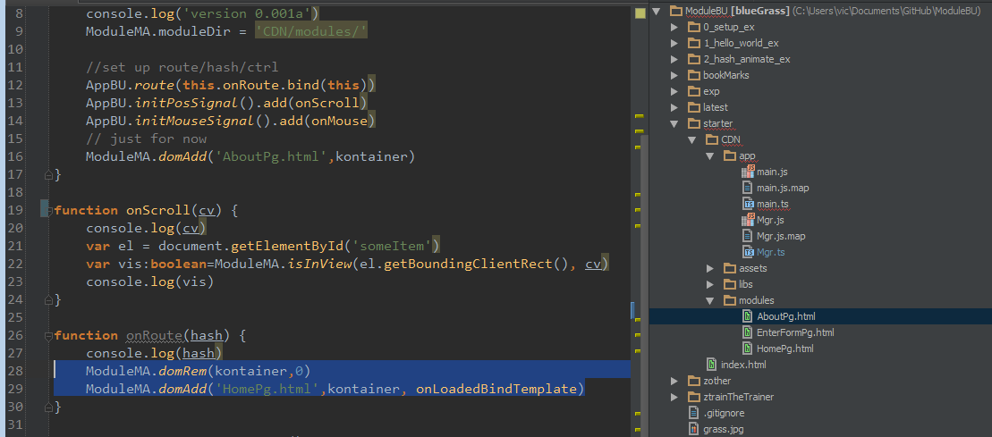

Slide 7
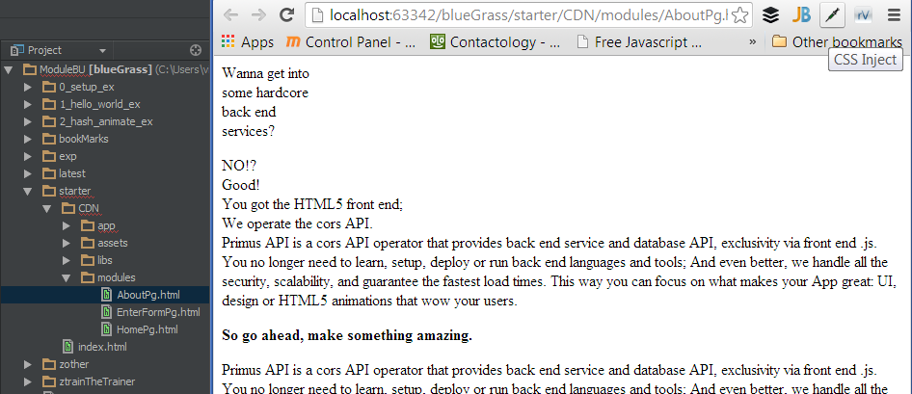

Slide 8
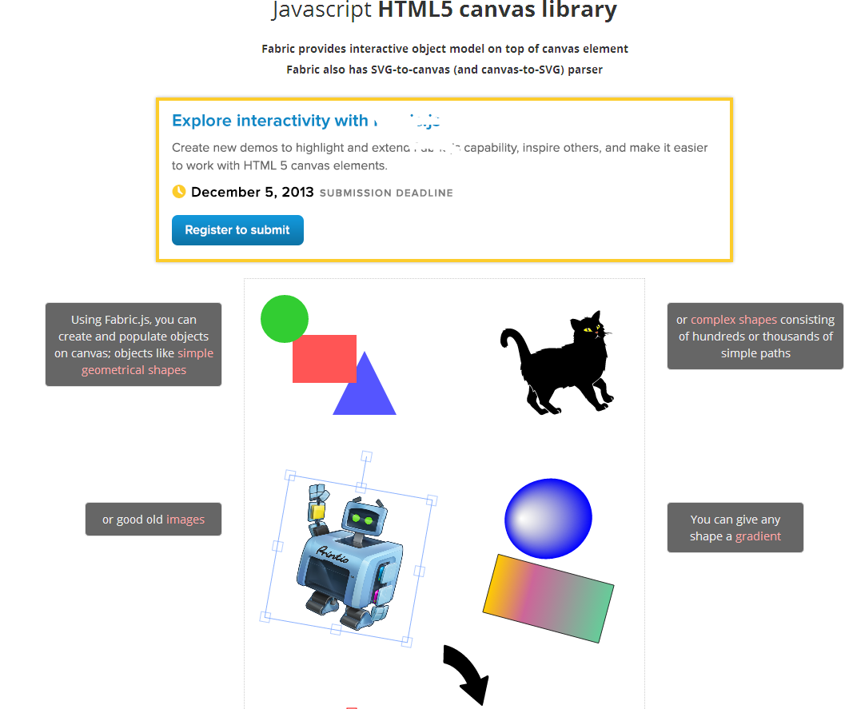
(bad) alternative is .js components, canvas or non modular app

Slide 9
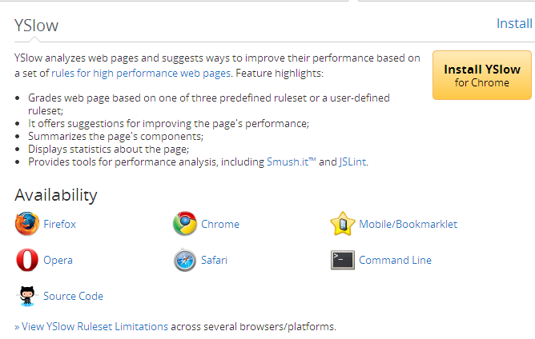
#1. CDN

Slide 10
(bad) alternative: PHP or non-CDN

Slide 11
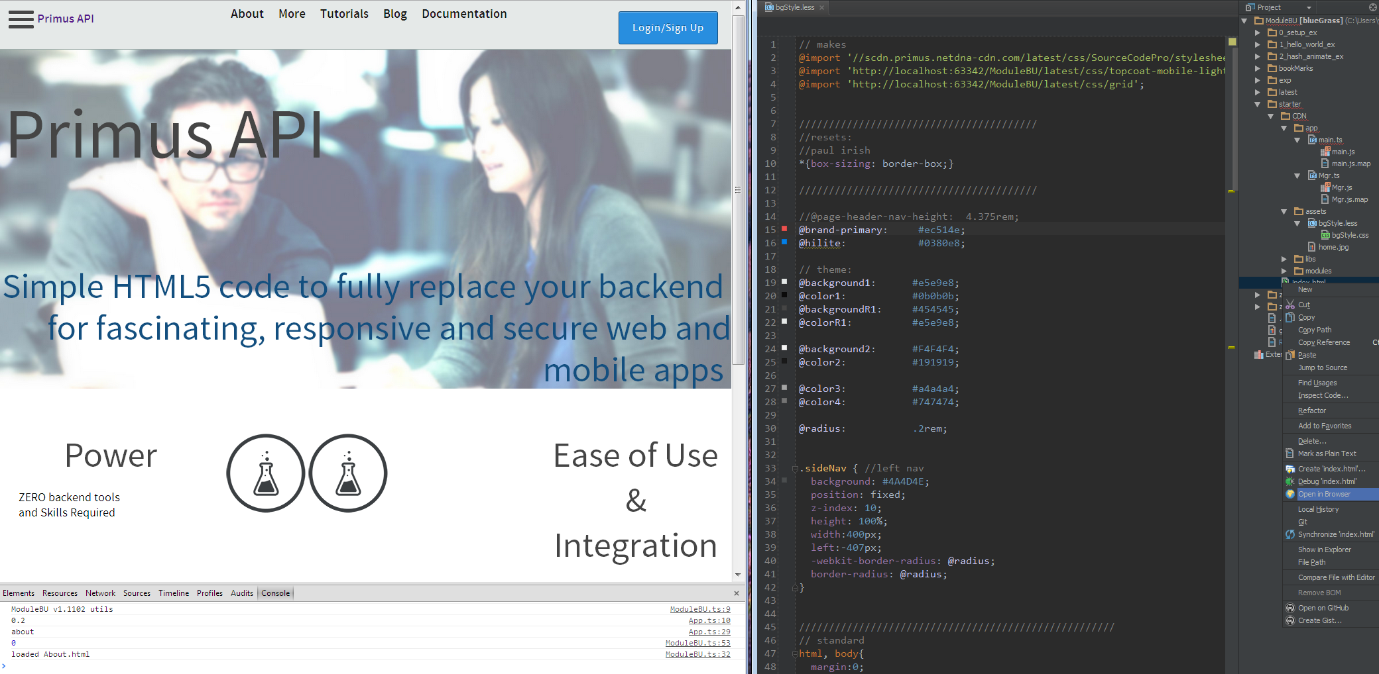
#2 WebStorm

Slide 12
(bad) alternative: work in file system or text editor

Slide 13
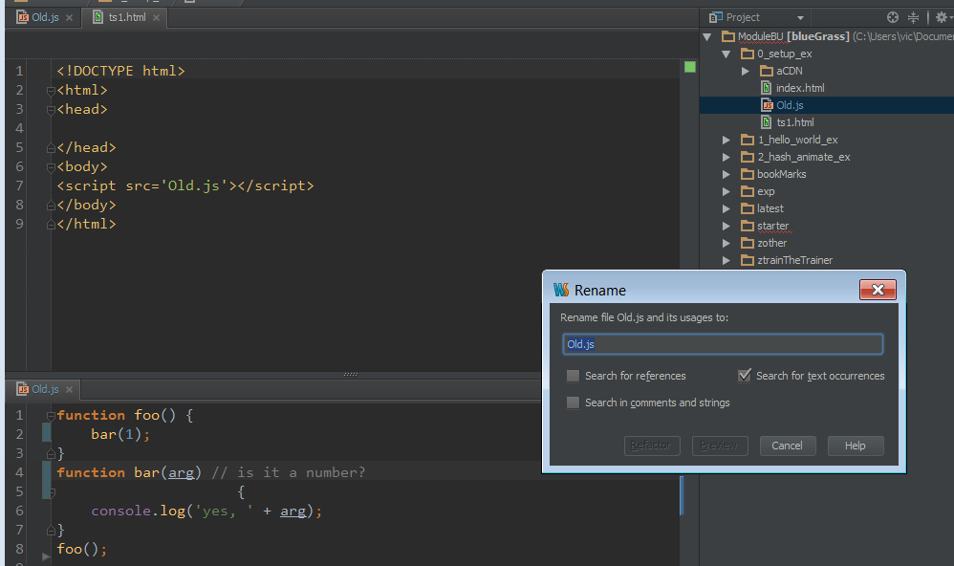
#3. TypeScript/Less

Slide 14
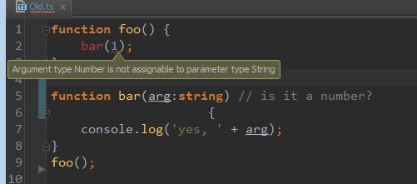

Slide 15
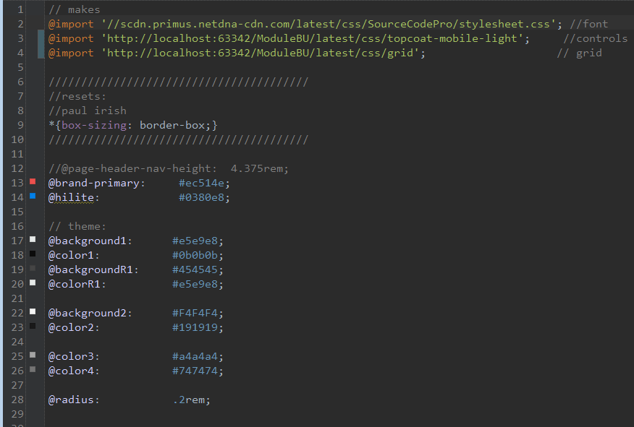

Slide 16
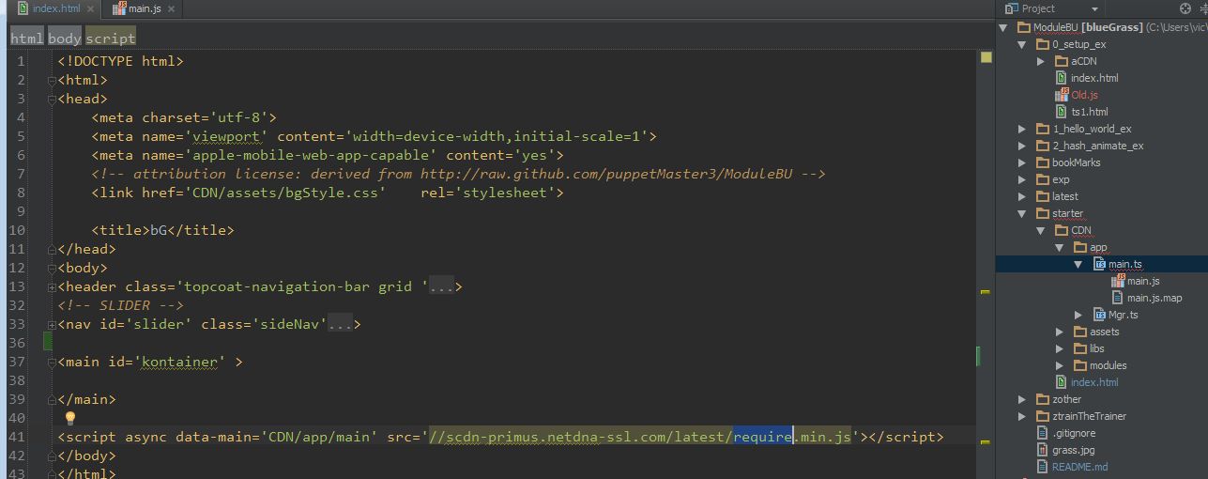
#4. Loader

Slide 17
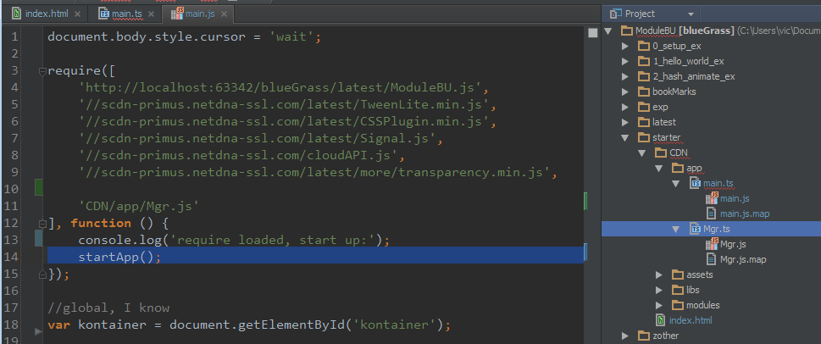

Slide 18
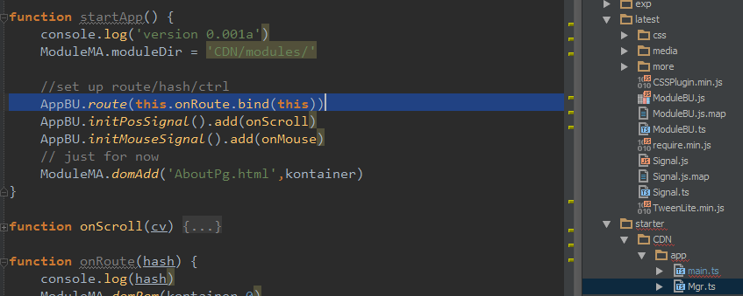
#5. App Buss / Router/Hasher/SEO
(more like entity/system)

Slide 19
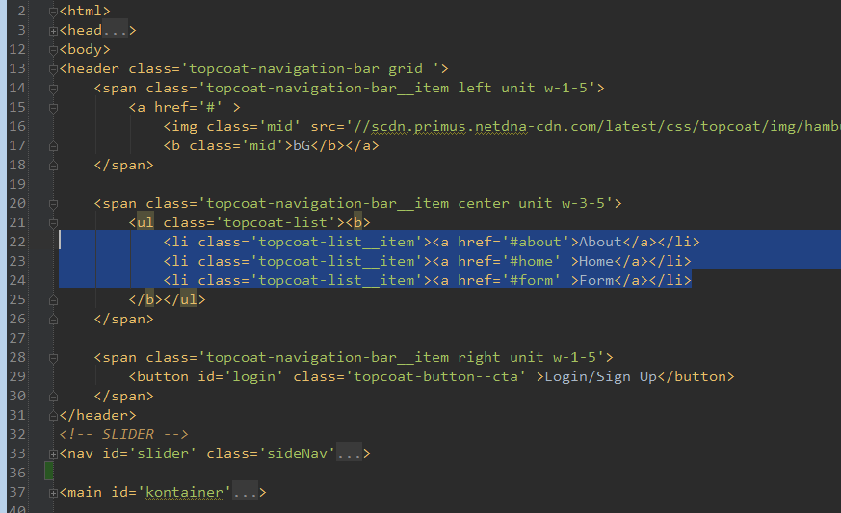

Slide 20
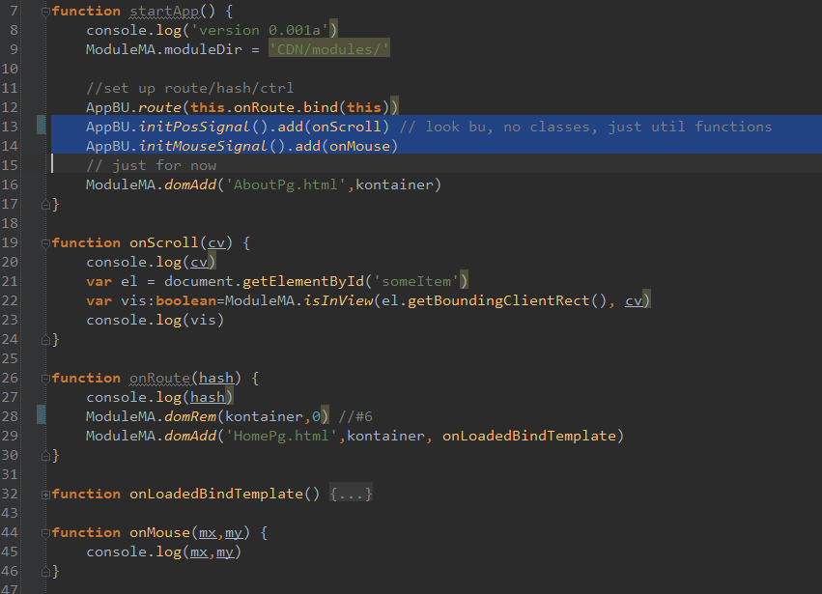

Slide 21
(bad) alternative: not SPA

Slide 22
#6
?

Slide 23
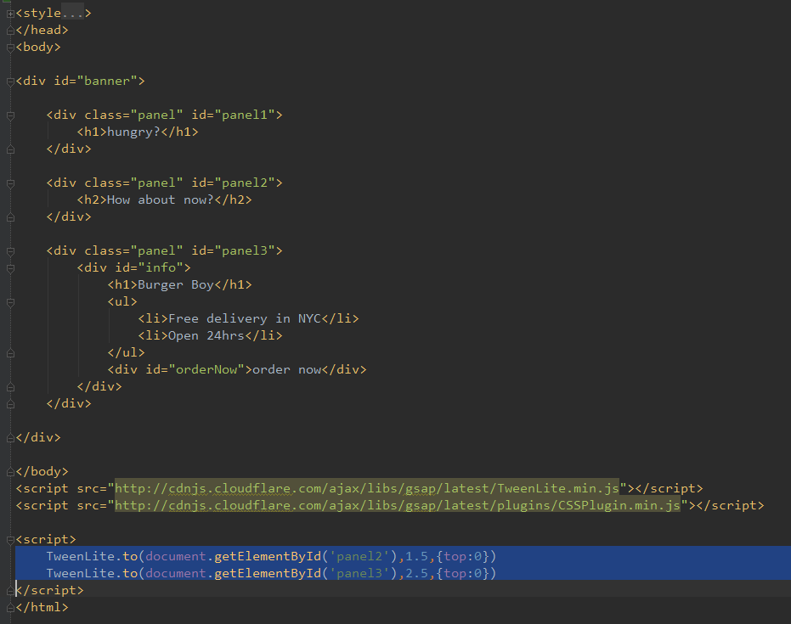
#7. Animation Lib

Slide 24
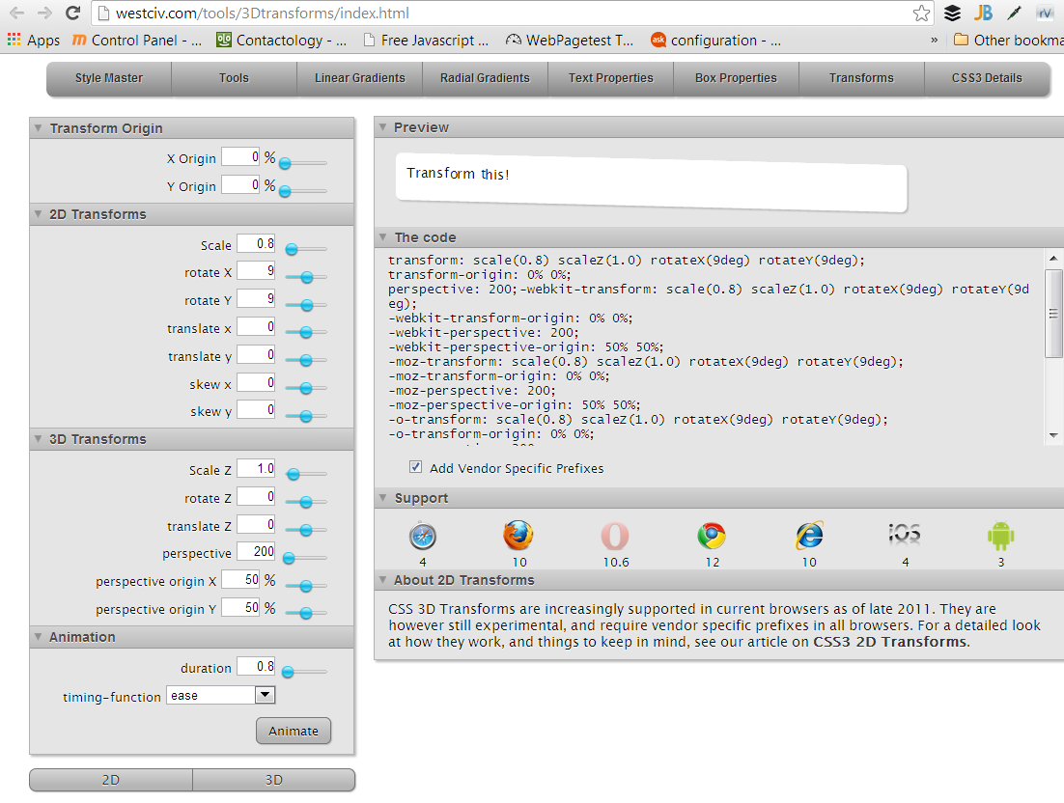

Slide 25
Animation choices:
Animate.css
Classes.js
Bonzo.js
GSAP/Greensock
  Uses:
  Sliders
  Scroll
  Creative!

Slide 26
(bad) alternative: static site or not using a CSS animation lib
Bad: sprinkle FX, non-creative

Slide 27
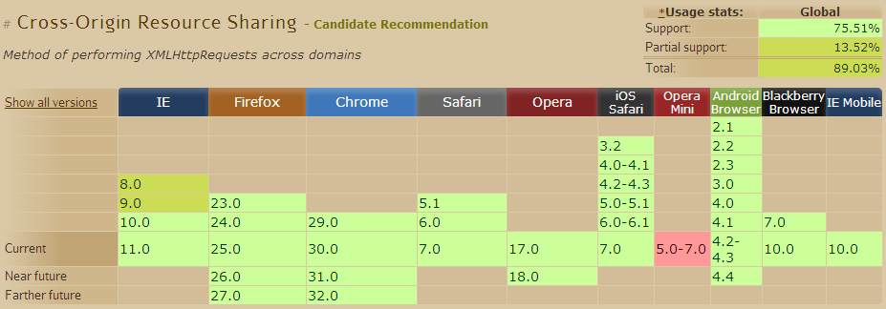
#8. BaaS/API

Slide 28
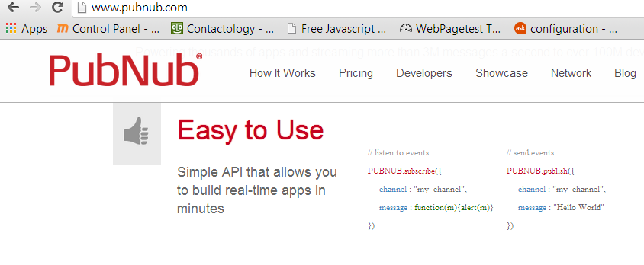

Slide 29
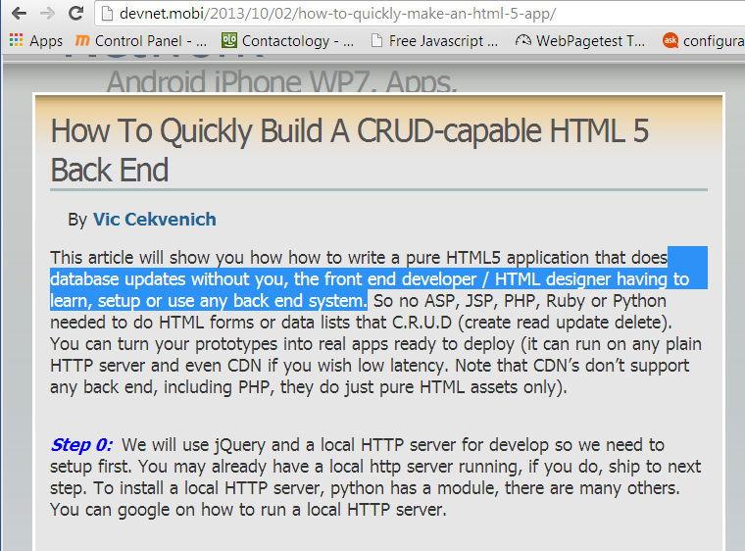

Slide 30
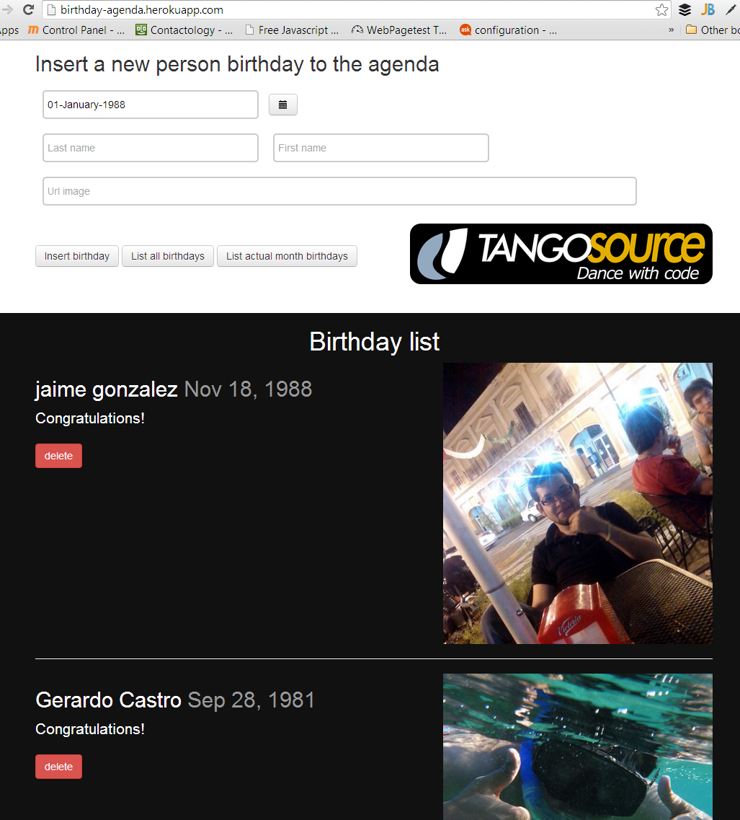

Slide 31
10 HTML5 good practices!
1: Speed: CDN/Server
2: WebStorm
3. TypeScript/Less
3: Loader/Require.js
5: Router/Hasher AppBU
6: ModuleMA DOM add/rem modules
7: Animation Lib
8: BaaS/API/CORS + simple binding
9.
10.

Slide 32
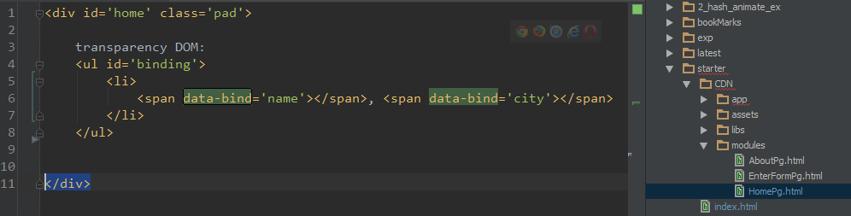
8b/part II: simple template binding w/o MVC ex:

Slide 33
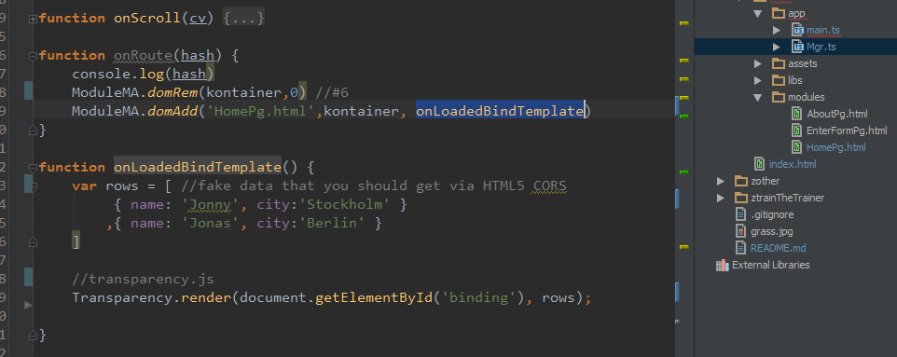

Slide 34
(bad) alternatives: Ajax/JSONP or not using BaaS
(helps w/ CDN)
Nothing in HTML5 warns that your are doing HTML4.

Slide 35
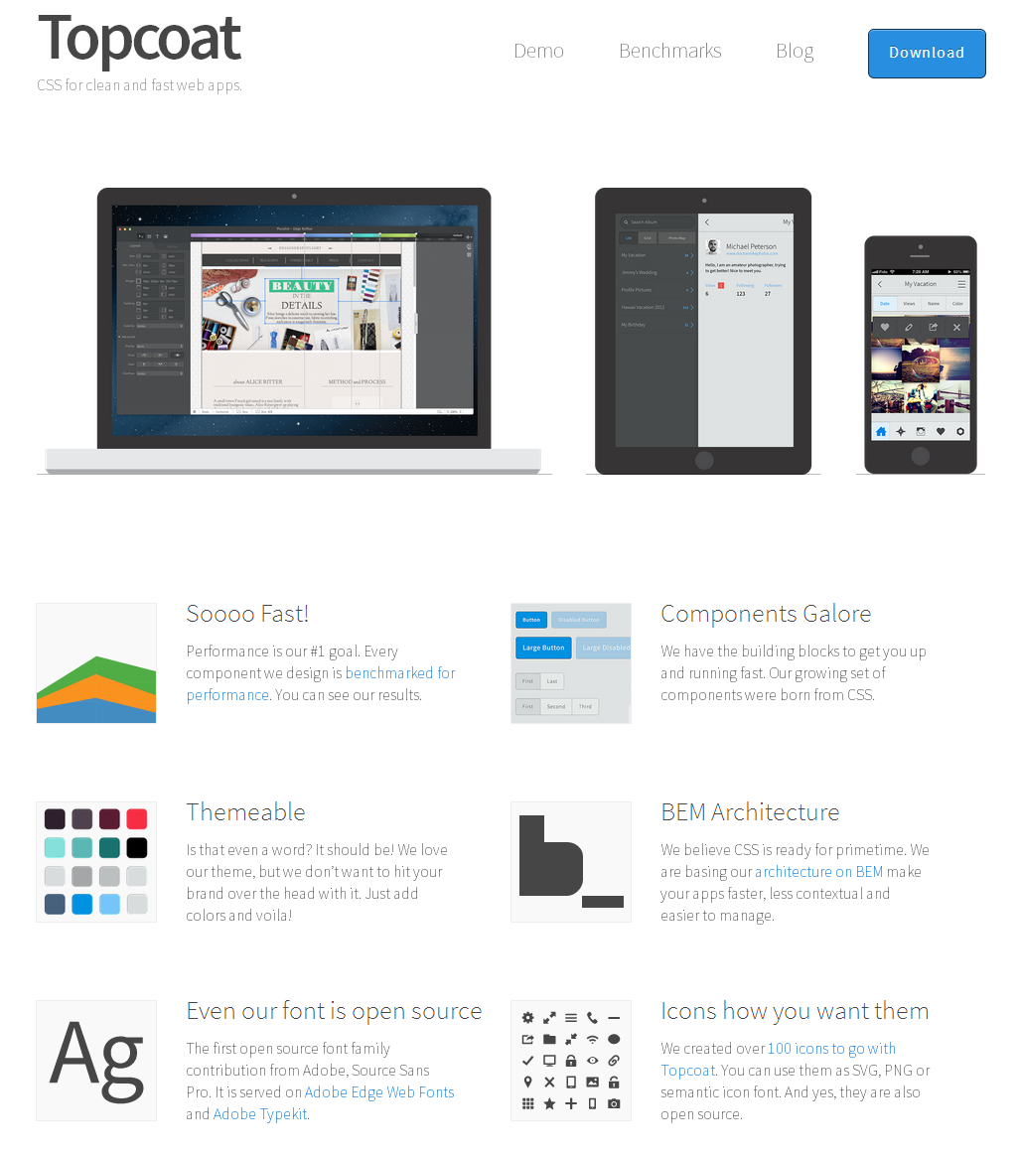
#9. Topcoat + Phonegap

Slide 36
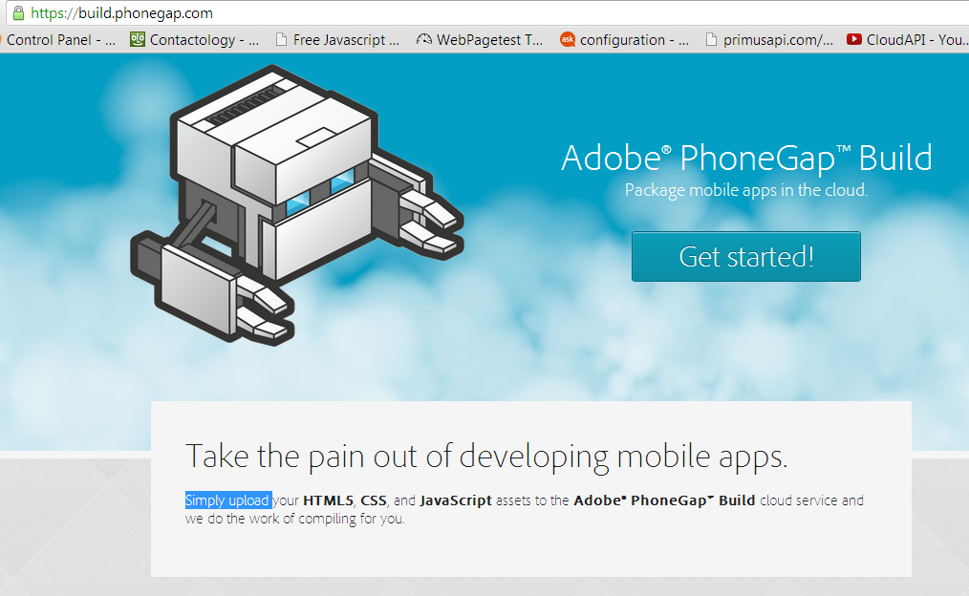

Slide 37
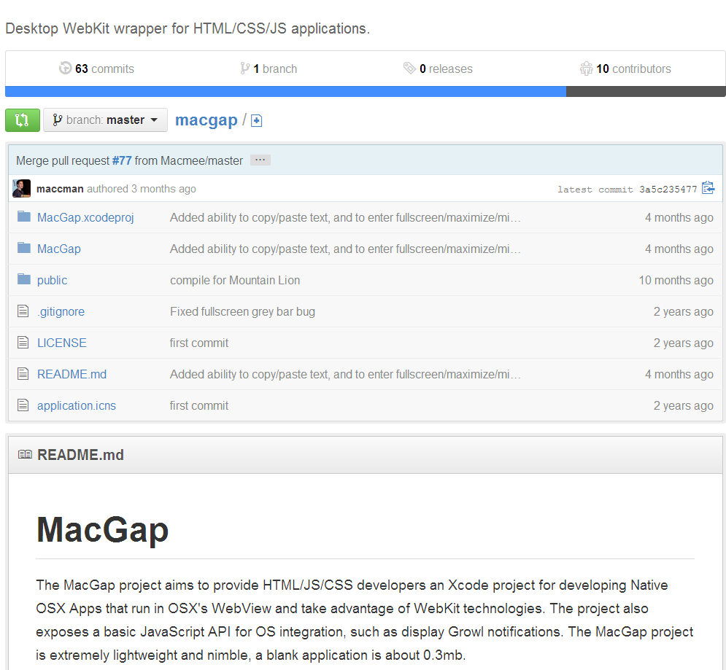

Slide 38
(bad) alternative:
Pre-made components such as YUI
+ or UI in Java/Andorid or such.

Slide 39
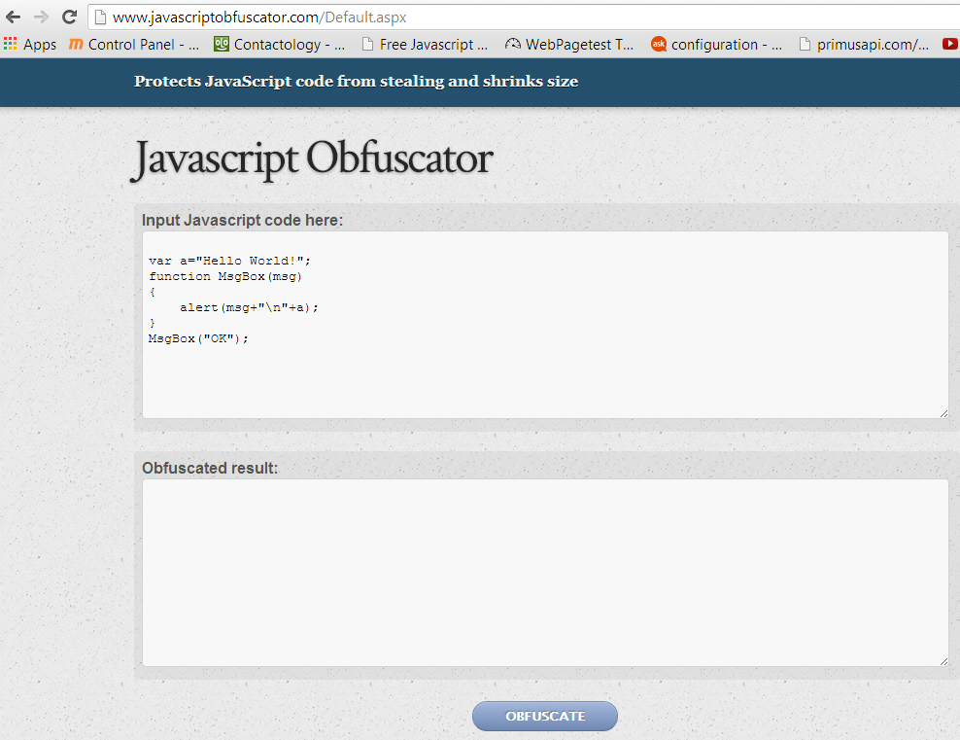
#10 Obfuscate pro(paid) work

Slide 40
http://github.com/puppetMaster3/ModuleBU
Alternative frameworks:
  Ratchet
  IUI
  Semantic UI
  Cardinal

Slide 41
http://github.com/puppetMaster3/ModuleBU
License: Attribution Assurance
@puppetMaster3
PrimusAPI.com

Slide 42
10 HTML5 good practices!
(http://github.com/puppetMaster3/ModuleBU)
1: Speed: CDN/Server
2: WebStorm
3. TypeScript/Less
3: Loader/Require.js
5: Router/Hasher AppBU
6: ModuleMA DOM add/rem modules
7: Animation Lib
8: BaaS/API/CORS + simple binding
9. Phonegap second
10: Deploy obfuscated

