Slide 1
10 best HTML5 practices
( for magic UI)
Goal: I'll make you a better web developer
In the next 20 minutes.
License: Attribution Assurance
https://github.com/puppetMaster3/ModuleBU

Slide 2
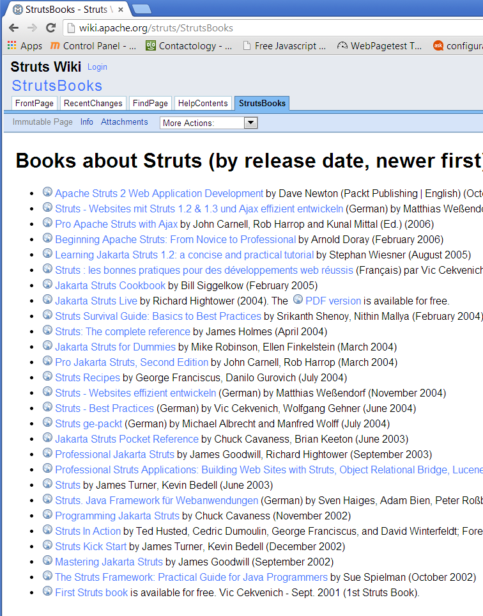
Who am I?

Slide 3
10 HTML5 good practices?
#6. DOM UI
1: Speed
2: IDE
3: Compiler
4: Loader
5: SEO deep link
6
7: Pro animation
8: Ajax(?MVC)
9. UI & Cross platform
10: Deployment

Slide 4
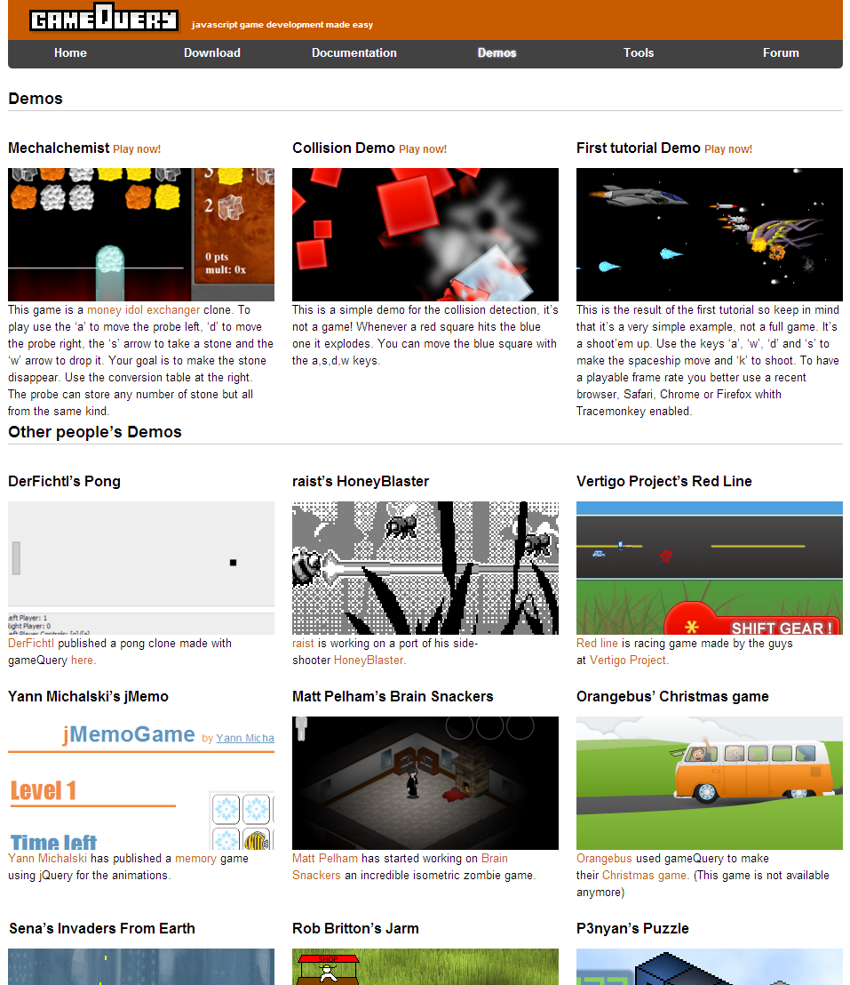
#6

Slide 5
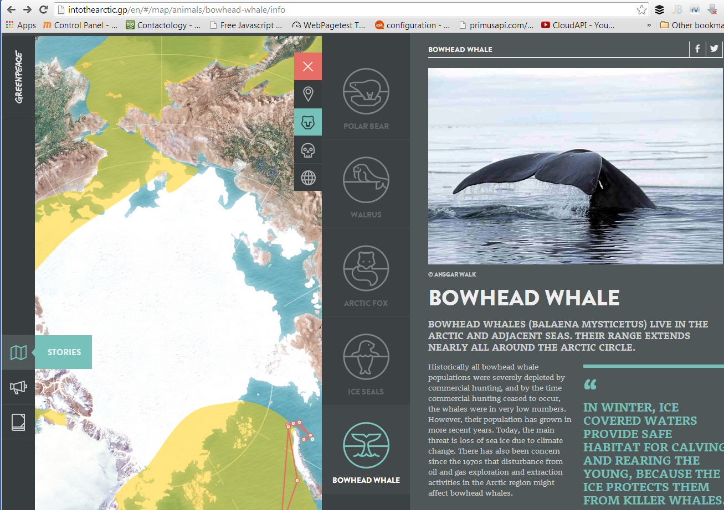

Slide 6
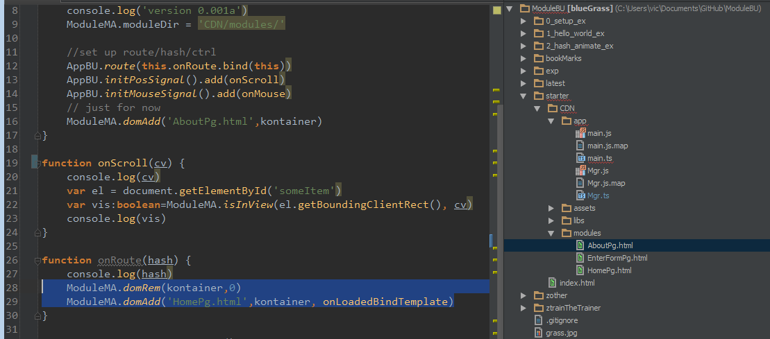

Slide 7
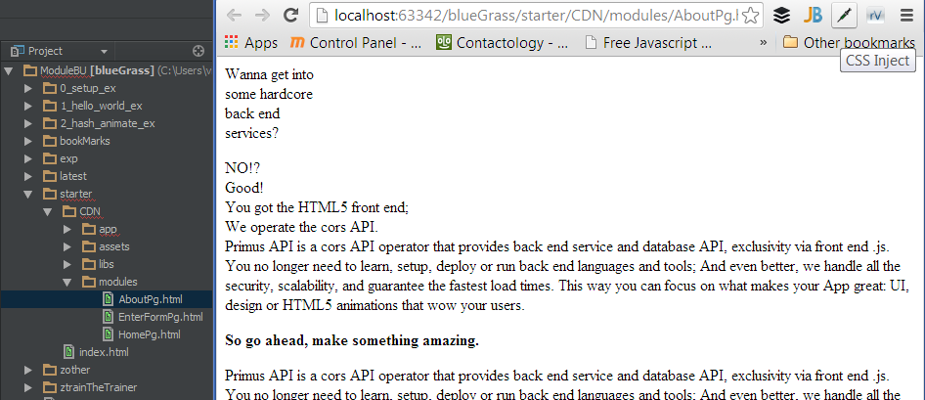

Slide 8
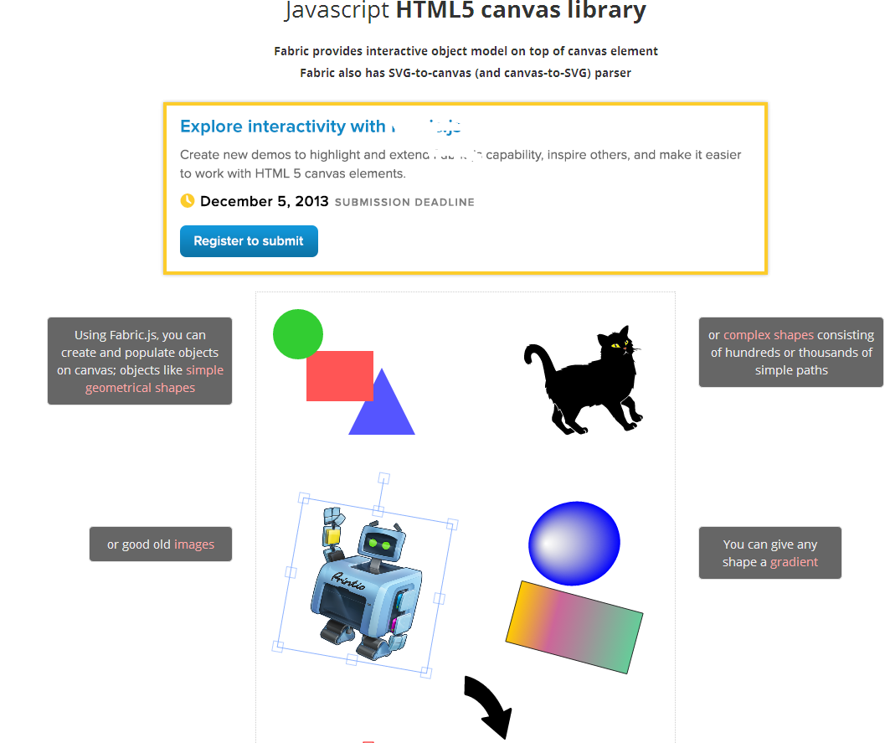
(bad) alternative is .js components, canvas or non modular app

Slide 9
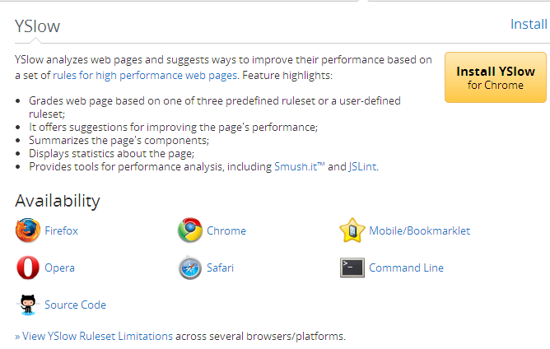
#1. CDN

Slide 10
(bad) alternative: PHP or non-CDN

Slide 11
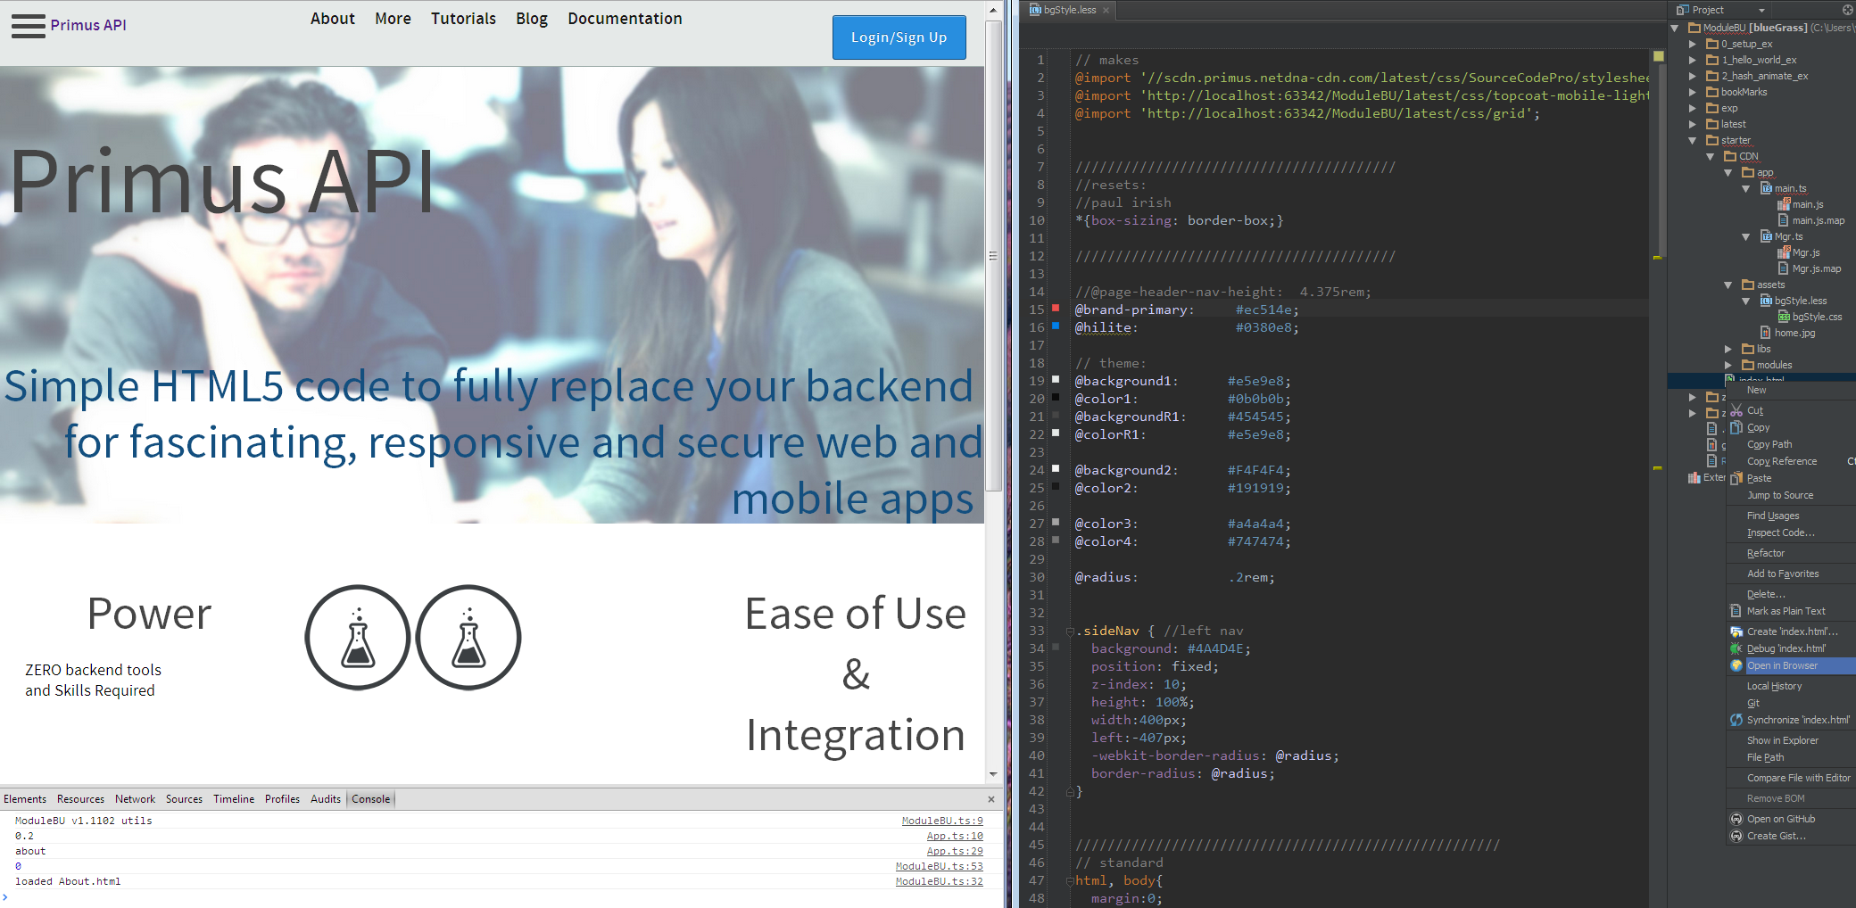
#2 WebStorm

Slide 12
(bad) alternative: work in file system or text editor

Slide 13
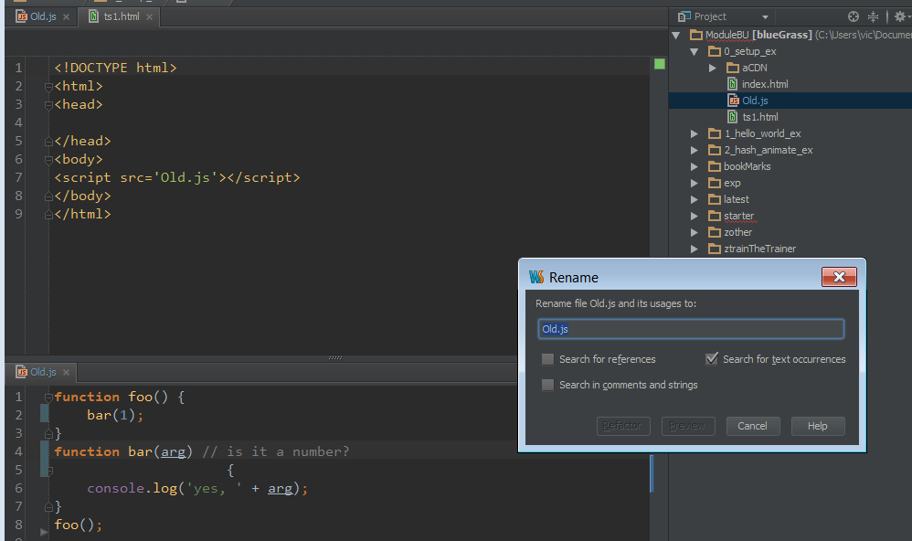
#3. TypeScript/Less

Slide 14
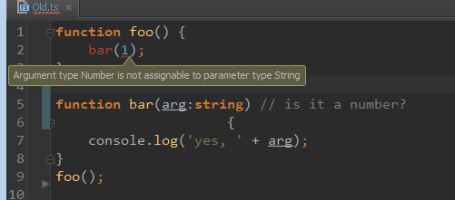

Slide 15
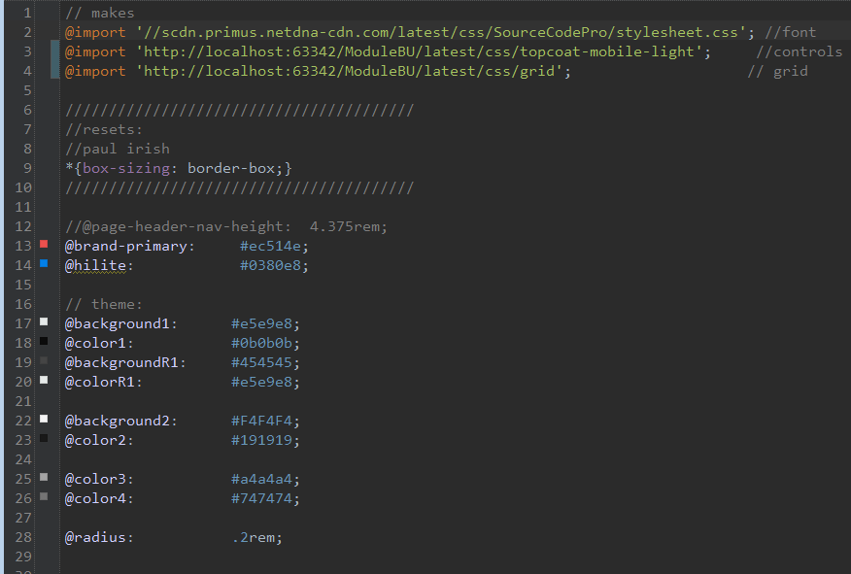

Slide 16
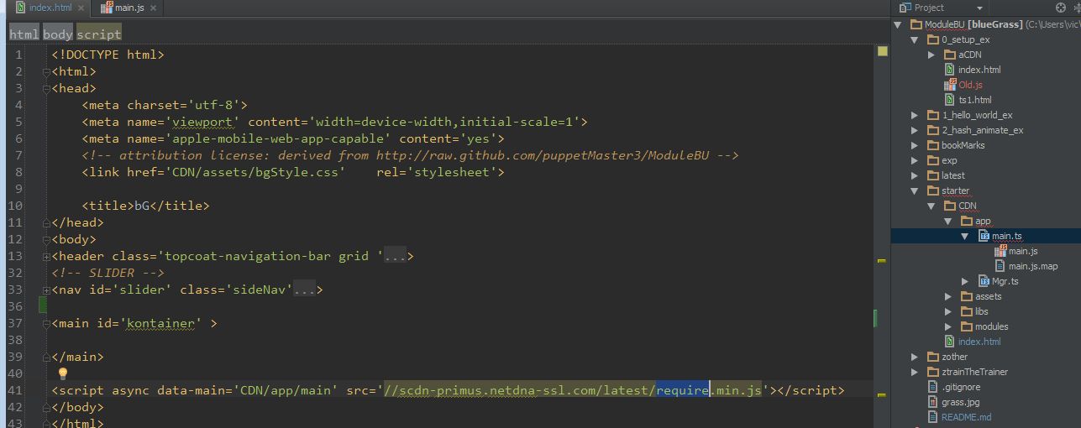
#4. Loader

Slide 17
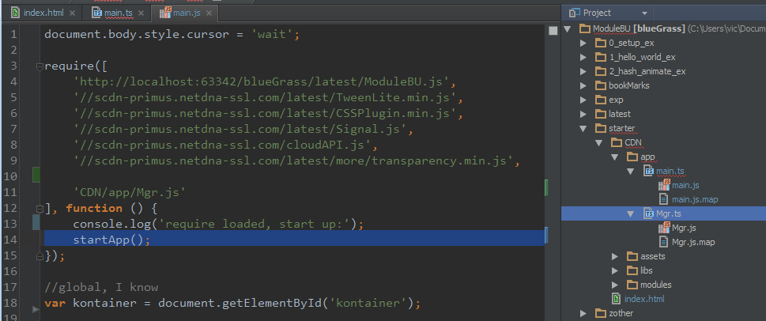

Slide 18
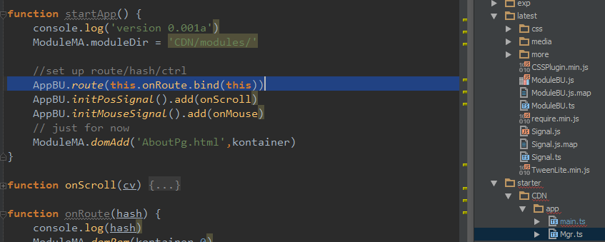
#5. App Buss / Router/Hasher/SEO
(more like entity/system)

Slide 19
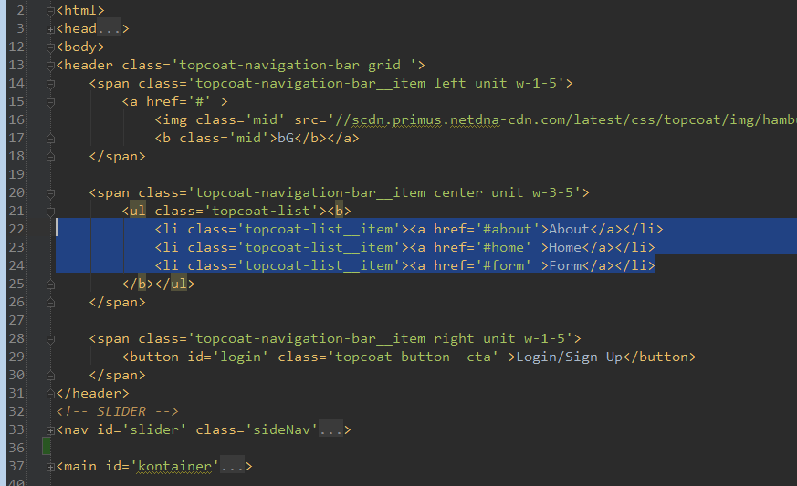

Slide 20
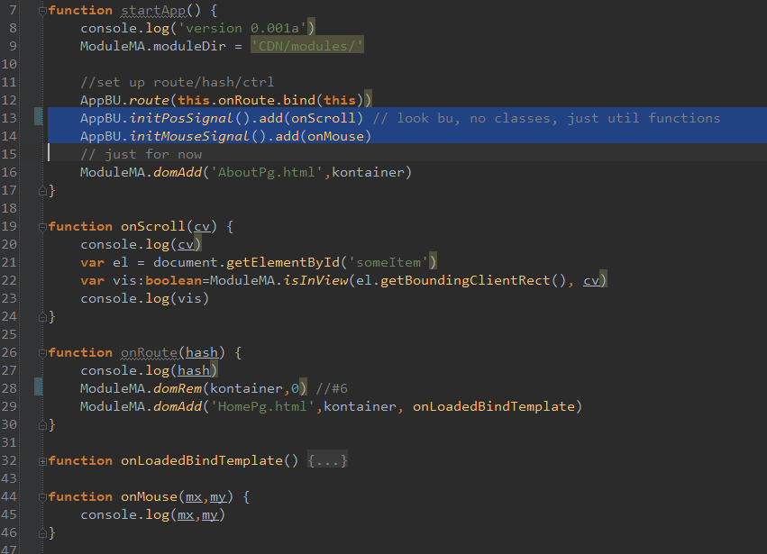

Slide 21
(bad) alternative: not SPA

Slide 22
#6
?

Slide 23
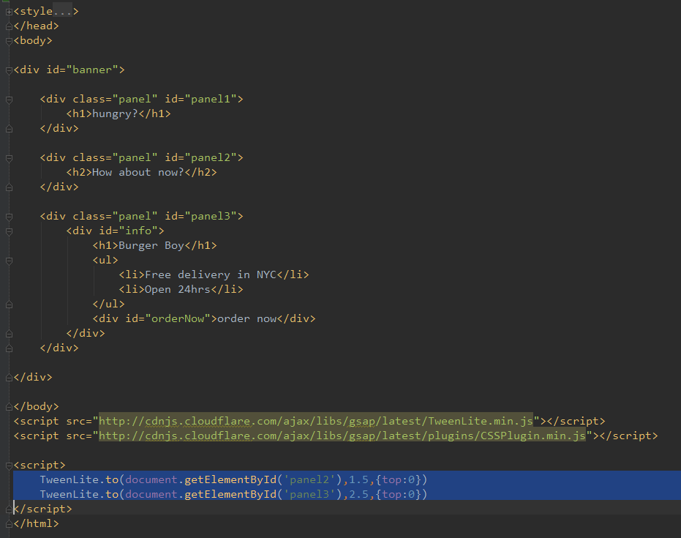
#7. GSAP/Greensock

Slide 24
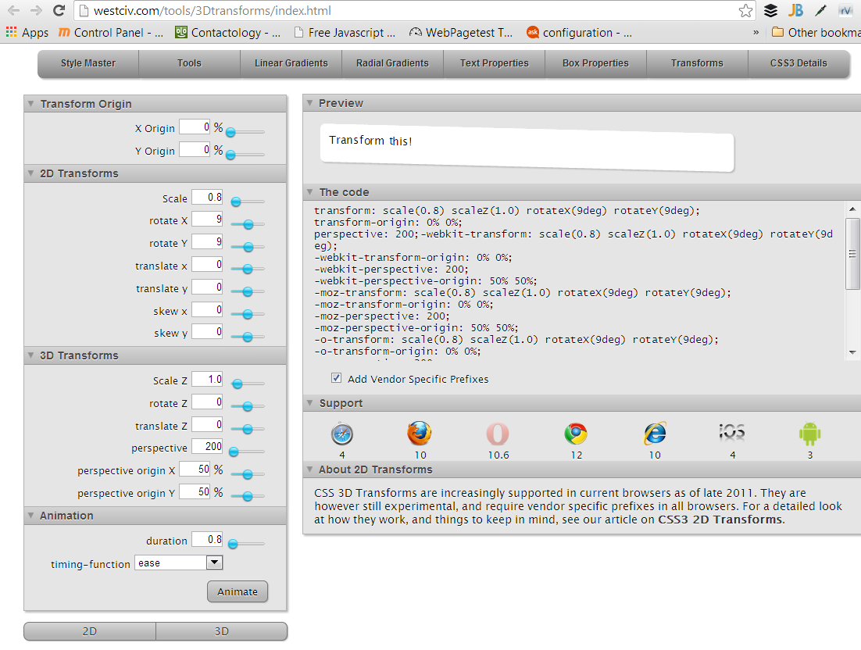

Slide 25
(bad) alternative: static site or not using a CSS animation lib

Slide 26
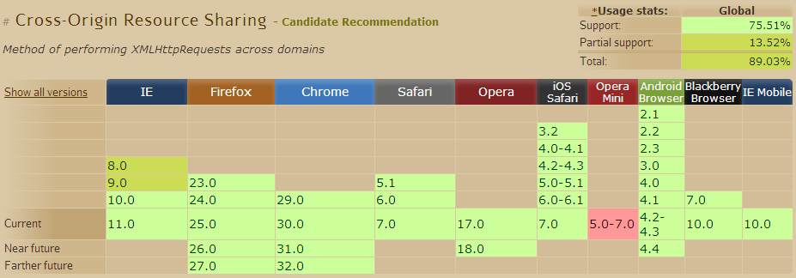
#8. API

Slide 27
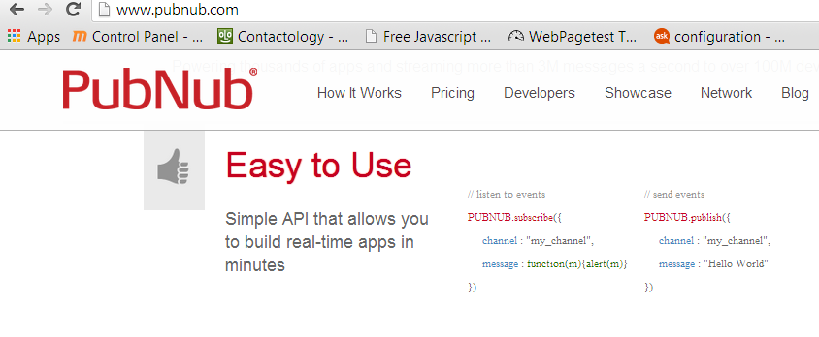

Slide 28
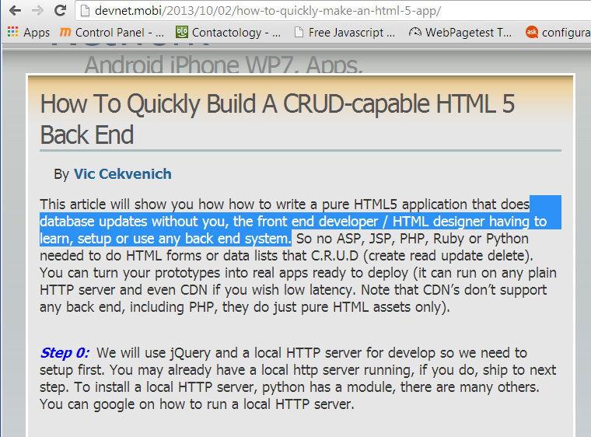

Slide 29
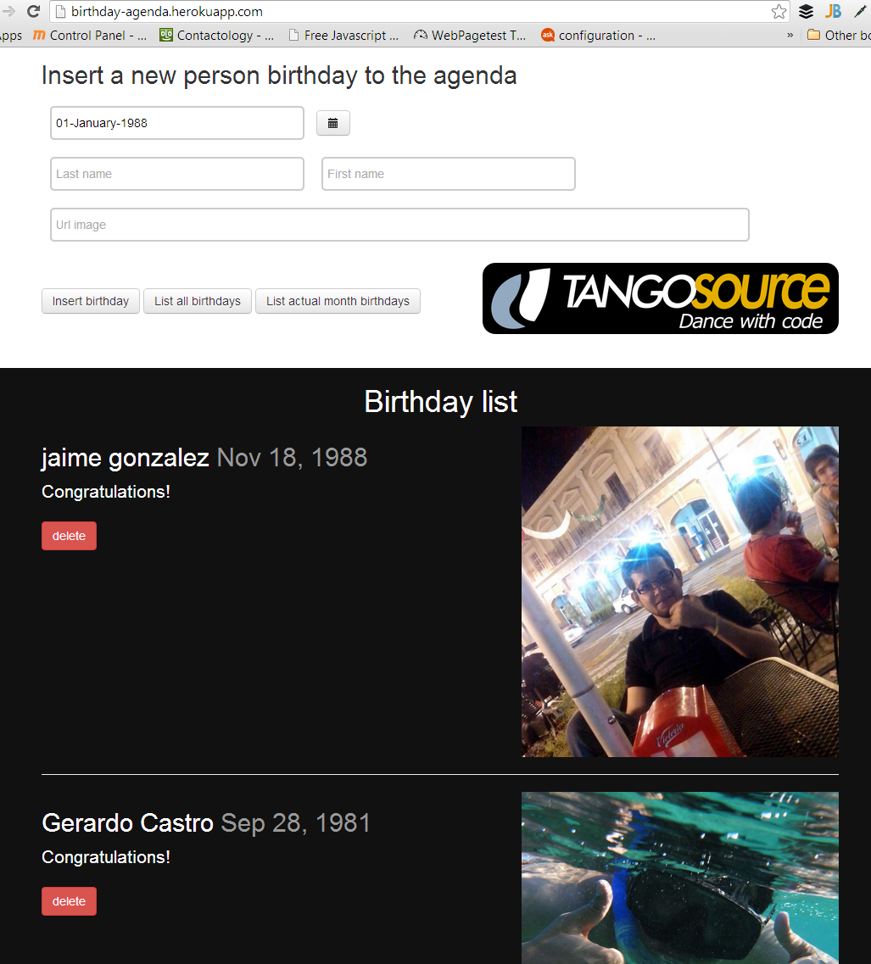

Slide 30
10 HTML5 good practices!
1: Speed: CDN/Server
2: WebStorm
3. TypeScript/Less
3: Loader/Require.js
5: Router/Hasher AppBU
6: ModuleMA DOM add/rem modules
7: GSAP/Greensock
8: API/Cors(?Simple template binding)
9.
10.

Slide 31
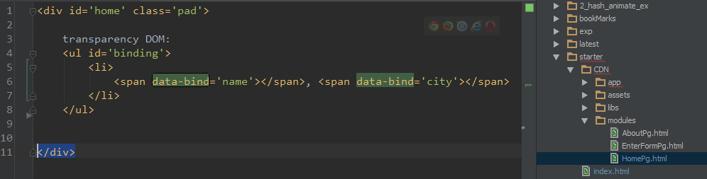
8b/part II: simple template binding w/o MVC ex:

Slide 32
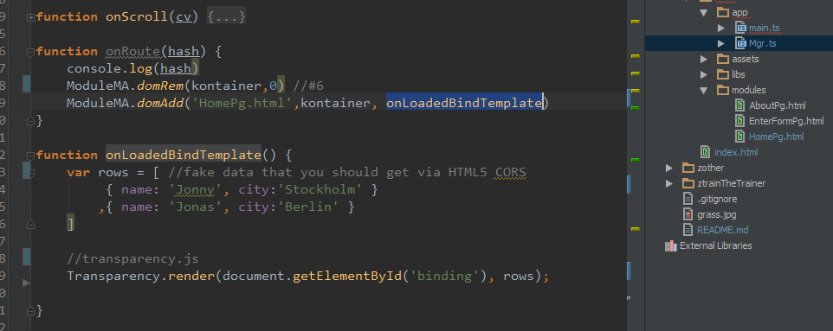

Slide 33
(bad) alternatives: Ajax/RESP/JSONP
Nothing in HTML5 warns that your are doing HTML4 still.

Slide 34
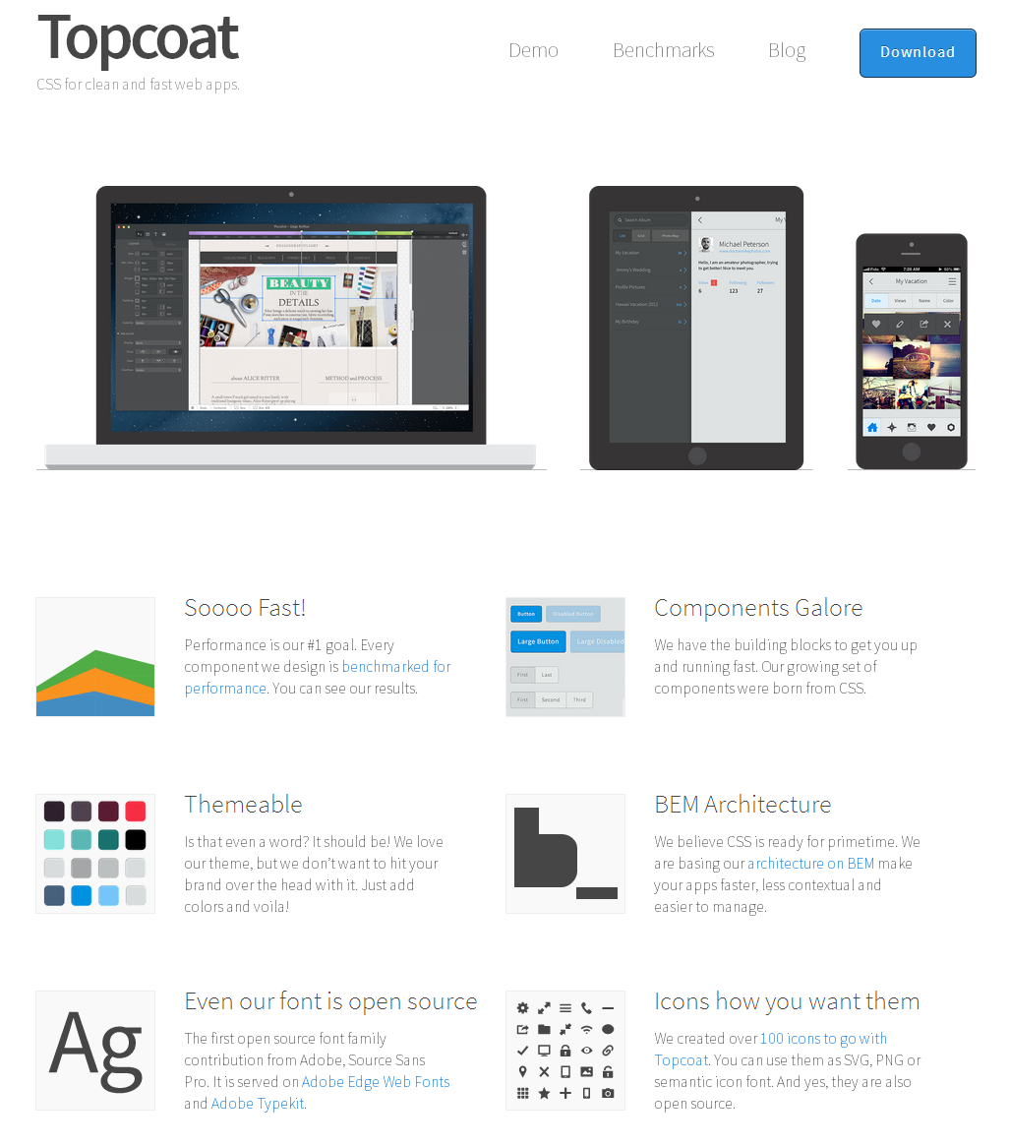
#9. Topcoat + Phonegap

Slide 35
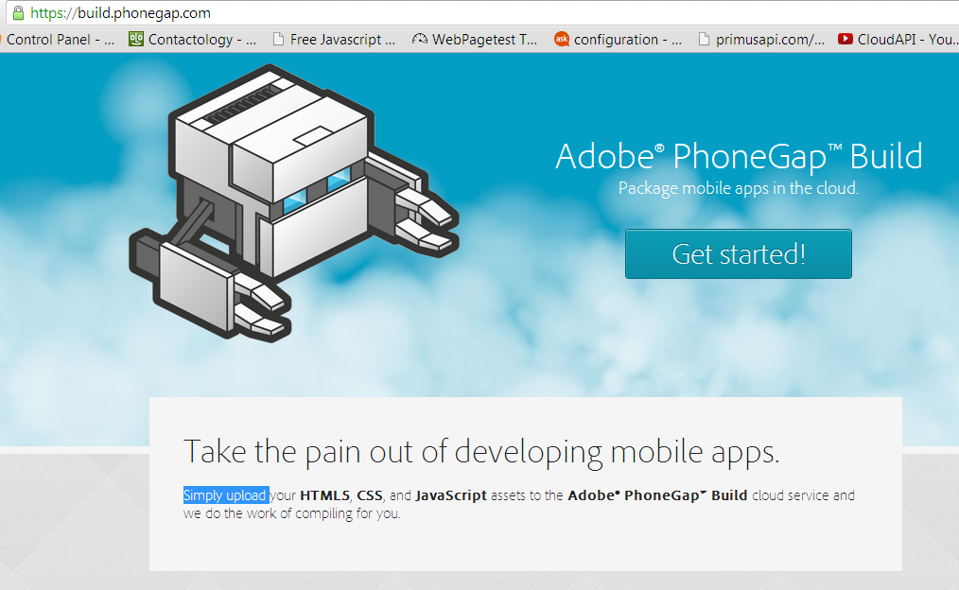

Slide 36
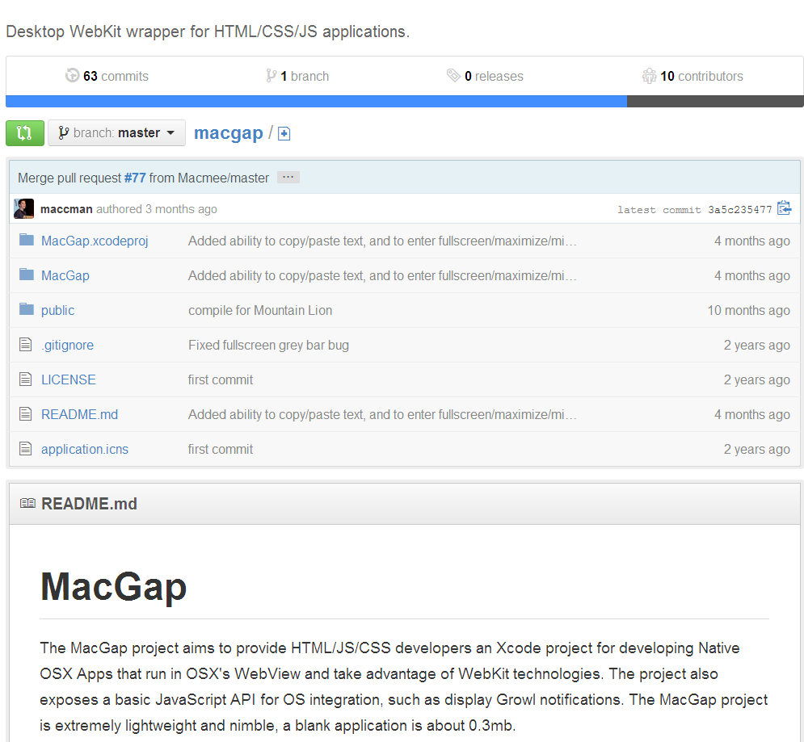

Slide 37
(bad) alternative:
Pre-made components such as YUI
+ or UI in Java/Andorid or such.

Slide 38
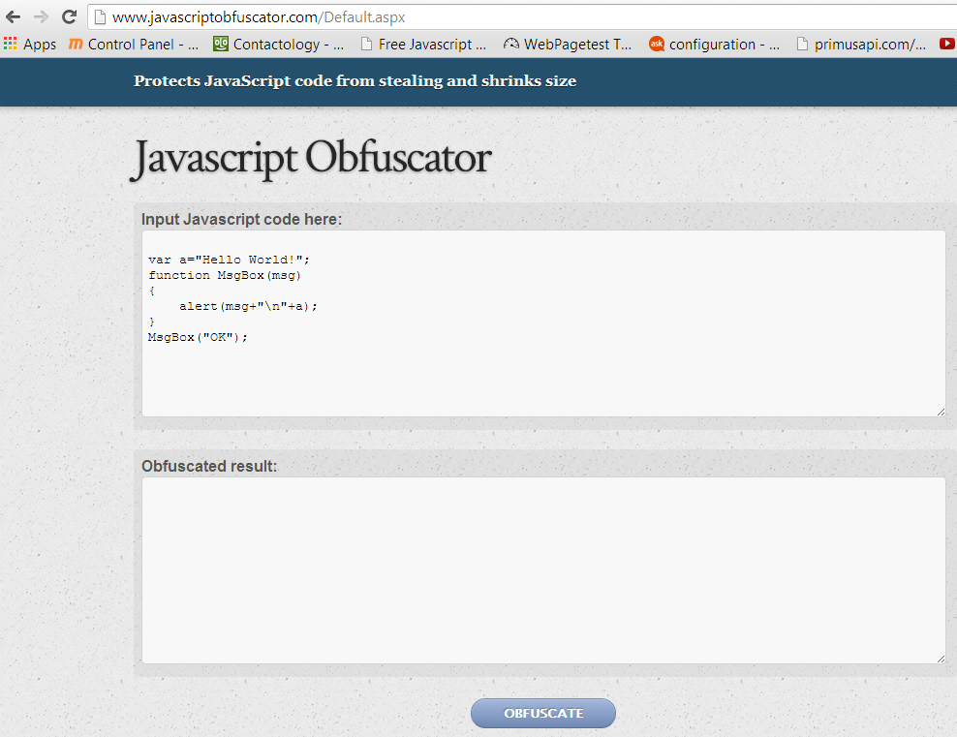
#10 Obfuscate pro(paid) work

Slide 39
http://github.com/puppetMaster3/ModuleBU
License: Attribution Assurance
@puppetMaster3
PrimusAPI.com

Slide 40
10 HTML5 good practices!
(http://github.com/puppetMaster3/ModuleBU)
1: Speed: CDN/Server
2: WebStorm
3. TypeScript/Less
3: Loader/Require.js
5: Router/Hasher AppBU
6: ModuleMA DOM add/rem modules
7: GSAP/Greensock
8: API/Cors(?Simple template binding)
9. Phonegap second (UI)
10: Deploy obfuscated

