Slide 1
Digital Signature Algorithm
27720161153023 pEI mING

Slide 2
Digital Signature
A digital signature is a mathematical scheme for demonstrating the authenticity of digital messages or documents. A valid digital signature gives a recipient reason to believe that the message was created by a known sender (authentication), that the sender cannot deny having sent the message (non-repudiation), and that the message was not altered in transit (integrity).

Slide 3
DSA
The Digital Signature Algorithm (DSA) is a Federal Information Processing Standard for digital signatures. In August 1991, the National Institute of Standards and Technology (NIST) proposed DSA for use in their Digital Signature Standard (DSS) and adopted it as FIPS 186 in 1993.

Slide 4
DSA
DSA-Digital Signature Algorithm is a variant of Schnorr and ElGamal signature algorithms, which is DSS (Digital Signature Standard) by NIST in the United states.
In a simple way, DSA is a more advanced verification method that is used as a digital signature. Not only the public key, the private key, but also the digital signature. Private key encryption generates digital signature, public key authentication data and signature. If the data and signature do not match, the verification failure is considered! The function of digital signature is to check the data and not to be modified in the process of transmission. Digital signature is the upgrade of one-way encryption!

Slide 5
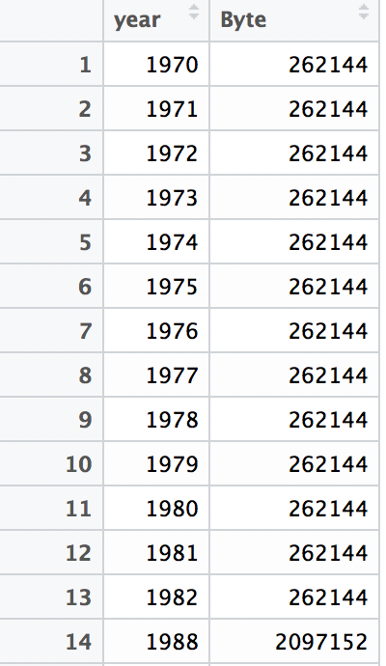
Json
Dataframe in R

Slide 6
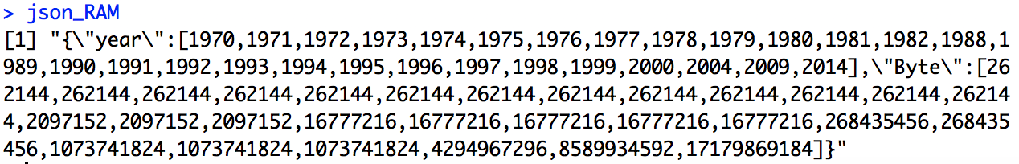
Json
library(rjson)
json_RAM <- toJSON(RAM_size,method = "C")

