Slide 1
Digital Signature Algorithm
27720161153023 pEI mING

Slide 2
DSA
The Digital Signature Algorithm (DSA) is a Federal Information Processing Standard for digital signatures. In August 1991, the National Institute of Standards and Technology (NIST) proposed DSA for use in their Digital Signature Standard (DSS) and adopted it as FIPS 186 in 1993.

Slide 3
DSA
DSA-Digital Signature Algorithm is a variant of Schnorr and ElGamal signature algorithms, which is DSS (DigitalSignature Standard) by NIST in the United states.
In a simple way, this is a more advanced verification method that is used as a digital signature. Not only the public key, the private key, but also the digital signature. Private key encryption generates digital signature, public key authentication data and signature. If the data and signature do not match, the verification failure is considered! The function of digital signature is to check the data and not to be modified in the process of transmission. Digital signature is the upgrade of one-way encryption!

Slide 4
DSA
The first part of the DSA algorithm is the public key and private key generation, which can be described as:
Choose a prime number q, which is called the prime divisor.
Choose another primer number p, such that p-1 mod q = 0. p is called the prime modulus.
Choose an integer g, such that 1 < g < p, g**q mod p = 1 and g = h**((p–1)/q) mod p. q is also called g's multiplicative order modulo p.
Choose an integer, such that 0 < x < q.
Compute y as g**x mod p.
Package the public key as {p,q,g,y}.
Package the private key as {p,q,g,x}.

Slide 5
DSA
The second part of the DSA algorithm is the signature generation and signature verification, which can be described as:
To generate a message signature, the sender can follow these steps:
Generate the message digest h, using a hash algorithm like SHA1.
Generate a random number k, such that 0 < k < q.
Compute r as (g**k mod p) mod q. If r = 0, select a different k.
Compute i, such that k*i mod q = 1. i is called the modular multiplicative inverse of k modulo q.
Compute s = i*(h+r*x) mod q. If s = 0, select a different k.
Package the digital signature as {r,s}.

Slide 6
DSA
To verify a message signature, the receiver of the message and the digital signature can follow these steps:
Generate the message digest h, using the same hash algorithm.
Compute w, such that s*w mod q = 1. w is called the modular multiplicative inverse of s modulo q.
Compute u1 = h*w mod q.
Compute u2 = r*w mod q.
Compute v = (((g**u1)*(y**u2)) mod p) mod q.
If v == r, the digital signature is valid.

Slide 7
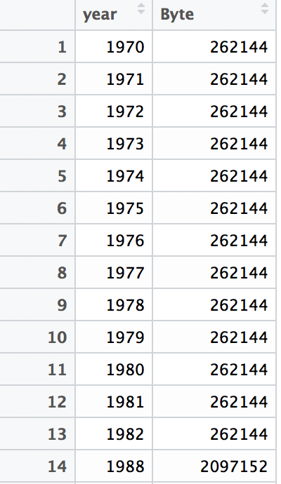
Json
Dataframe in R

Slide 8
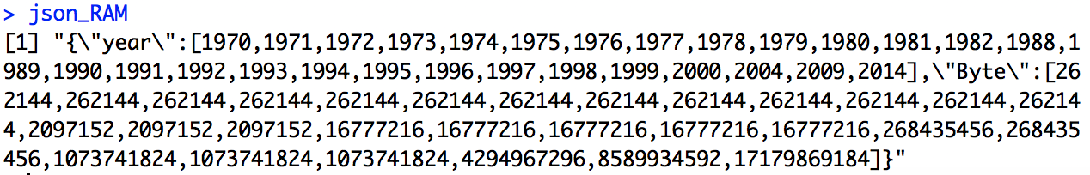
Json
json_RAM <- toJSON(RAM_size,method = "C")

