Slide 1
Therapeutic Effects of Prayer (Benson et al., 2006)
PAPER REVIEW
Group B
Volha Stehling
Nhat Minh Phuong Nguyen
Kashf Jahangir

Slide 2
CYMBA
PRODUCT OVERVIEW
Hypothesis
Receiving intercessory prayer or being certain of receiving intercessory prayer is associated (positively or negatively) with uncomplicated recovery after Coronary Artery Bypass Graft surgery.

Slide 3
Experiment Design
Group | Sample Size | Prayer | Status
1 | 604 | Received | Uncertain
2 | 597 | Did not receive | Uncertain
3 | 601 | Received | Certain
Experimental Design was appropriate:
Overcame previous studies
Randomized
Sufficient analysis
Blind setup
Control Group and Treatment Group

Slide 4
CYMBA
PRODUCT OVERVIEW
Method
Prayer observed for 14 days, starting from the night before the CABG
Follow up for 30 days was conducted
Primary Outcome: One or more complications within 30 days of CABG
Secondary Outcome: Major event or mortality
Subjects’ own plans to pray were undisturbed, maintaining ethical values

Slide 5
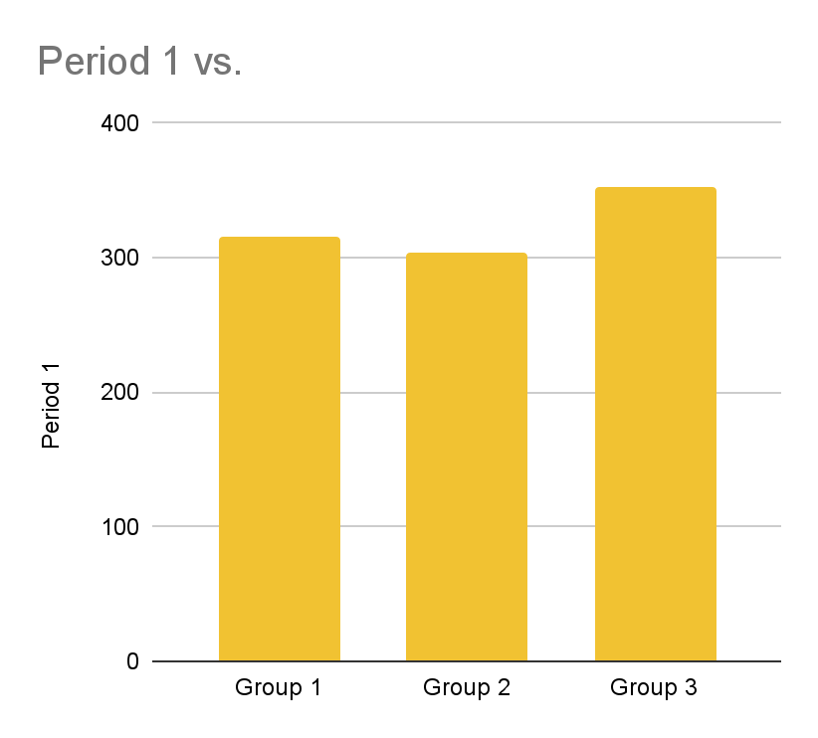
Results
Difference in recovery complications:
No significant difference between uncertain groups that did and did not receive prayer (Group 1 & 2)
Relative risk 1.02, 95% CI 0.92-1.15
Statistically significant difference between group certain and group uncertain about receiving prayer (Group 1,2 & Group 3)
Relative risk 1.14, 95% CI 1.02-1.28

Slide 6
Analysis & Conclusion
Appropriate analysis was conducted and appropriate conclusion was reached:
Use of risk ratios & intent-to-treat analysis
Ethical and practical considerations
Acknowledgement of additional research required to explain study outcome

Slide 7
Account of Research
The paper gave a good and thorough account of the research conducted:
Robust trial design
Extensive details of patients included and excluded from the research
Strong statistical backing
Acknowledgement of limitations
Exclusion of patients with high-risk or complex cardiac cases

