Slide 1
Therapeutic Effects of Prayer (Benson et al., 2006)
PAPER REVIEW
Group B
Volha Stehling
Nhat Minh Phuong Nguyen
Kashf Jahangir

Slide 2
CYMBA
PRODUCT OVERVIEW
Hypothesis
Receiving intercessory prayer or being certain of receiving intercessory prayer is associated (positively or negatively) with uncomplicated recovery after Coronary Artery Bypass Graft surgery.

Slide 3
Experiment Design
Group | Sample Size | Prayer | Status
1 | 604 | Received | Uncertain
2 | 597 | Did not receive | Uncertain
3 | 601 | Received | Certain
Experimental Design was appropriate:
Overcame previous studies
Randomized
Sufficient analysis
Blind setup
Control Group and Treatment Group

Slide 4
CYMBA
PRODUCT OVERVIEW
Method
Prayer observed for 14 days, starting from the night before the CABG
Follow up for 30 days was conducted
Primary Outcome: One or more complications within 30 days of CABG
Secondary Outcome: Major event or mortality
Subjects’ own plans to pray were undisturbed, maintaining ethical values

Slide 5
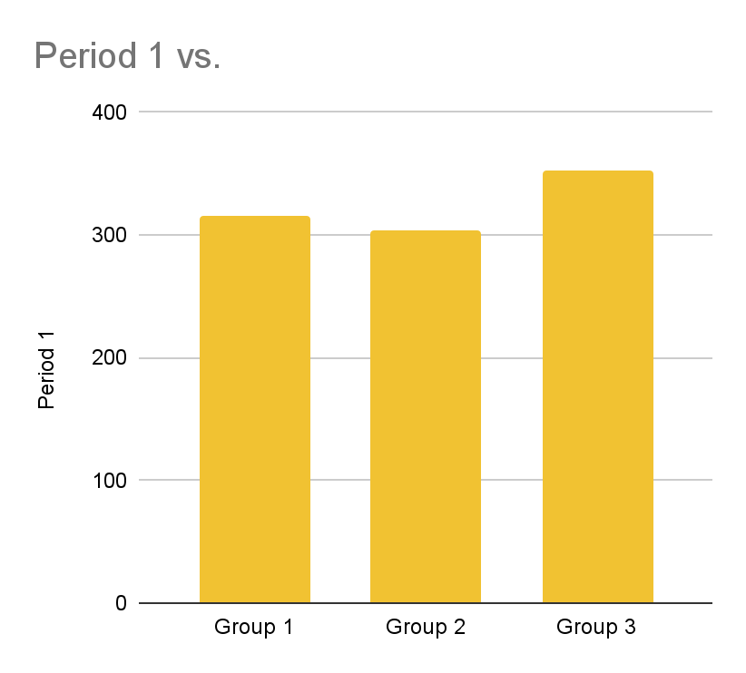
Results
Difference in recovery complications:
No significant difference between uncertain groups that did and did not receive prayer (Group 1 & 2)
Relative risk 1.02, 95% CI 0.92-1.15
Statistically significant difference between group certain and group uncertain about receiving prayer (Group 1,2 & Group 3)
Relative risk 1.14, 95% CI 1.02-1.28

Slide 6
Analysis & Conclusion
Appropriate analysis was conducted and appropriate conclusion was reached:
Use of risk ratios & intent-to-treat analysis
Ethical and practical considerations
Acknowledgement of additional research required to explain study outcome

Slide 7
Weaknesses of Research
The following design in the experiment could have weakened the research
Limited to a specific group of patients, which may not be very generalizable for other groups of patients.
Lack of diversity in prayer group
Lack of control on external prayer
Use of standard prayer phrase, which does reflect how intercessory prayer might actually be conducted

Slide 8
Account of Research
The paper gave a good and thorough account of the research conducted:
Robust trial design
Extensive details of patients included and excluded from the research
Strong statistical backing
Acknowledgement of limitations

