Slide 1
B & B
Bed and breakfast…..
Presented By
Team : Code Ninja’s

Slide 2
Code Ninjas
Riyamol Sara Jayan
Jagan
Nithin mp
Minnu Augustine
Aditya Vaka
Ananthakrishnan

Slide 3

Description
B&B is an app that facilitates college students to find their hostel at ease.
This app will provide the complete details of the hostel room.
Through B&B App, it will be easier for the students to have a complete overview of the room beforehand.
Students can choose their room based on ratings and other features.

Slide 4

App Features
Room Type
Room facility
Room Rent
Food Rate
Address

Slide 5

Modules
Hostel owner module
Student module

Slide 6
1. HOSTEL OWNER module
Different pages for hostel owner are:
Registration page(sign up)
Login page(sign in)
Page for adding his hostel

Slide 7
Hostel Owner - Registration
Owner will have to fill the fields mentioned below in Registration page -
Name
User name
Password
Email id
Phone number

Slide 8

Hostel Owner - Login page
After successful registration hostel owner can now able to login using,
Username
password

Slide 9
Hostel Owner - Create hostel page
Name
Room details - type
Number of vacant rooms
Address
Rate
Contact details

Slide 10

2.STUDENT Module
Different pages for students are:
Student registration page(sign up)
Student login page(sign in)
Hostal details page

Slide 11
Students - Registration Page
Student will need to provide
Student Name
E-mail id
Phone number
Username
Password

Slide 12
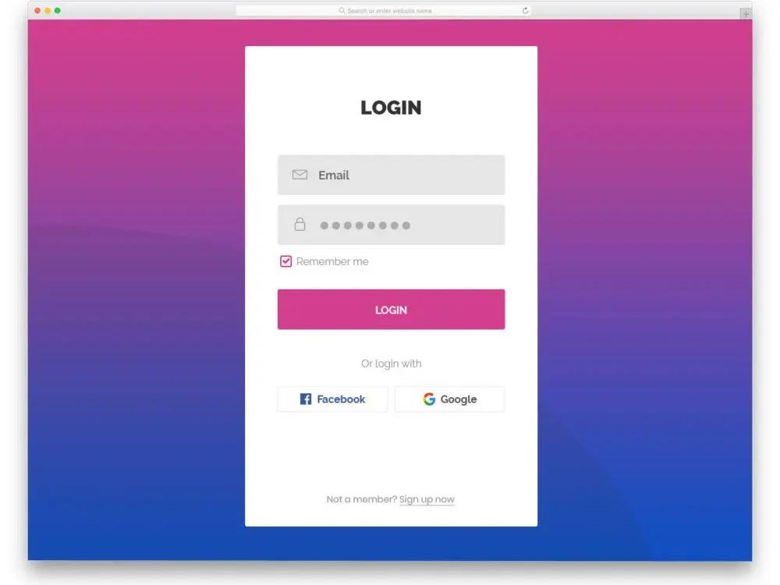
Student - Login Page
After successful registration, student can login with their username and password

Slide 13
Hostel details page
This page
Displays the list of hostels
Then on selecting a hostel
displays the details of that particular hostel - owner details, room types, contact info, rate etc.
Student can contact the respective hostel owner by phone

Slide 14
Pages
Home page / Login page
Registration Page - owner & student registration
Hostal creation page
Page displaying details of hostel
About us
Contact us

Slide 15
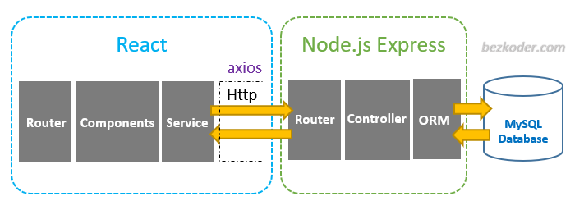
Technologies Used
React
Node JS
MongoDB
Express
Bcryptjs
Jsonwebtoken
Mongoose
Axios
MongoDB

Slide 16
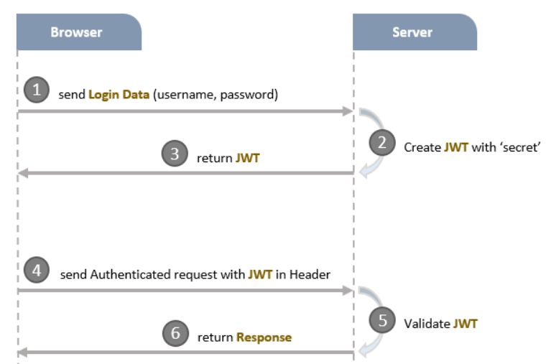
Token Based Authentication

Slide 17
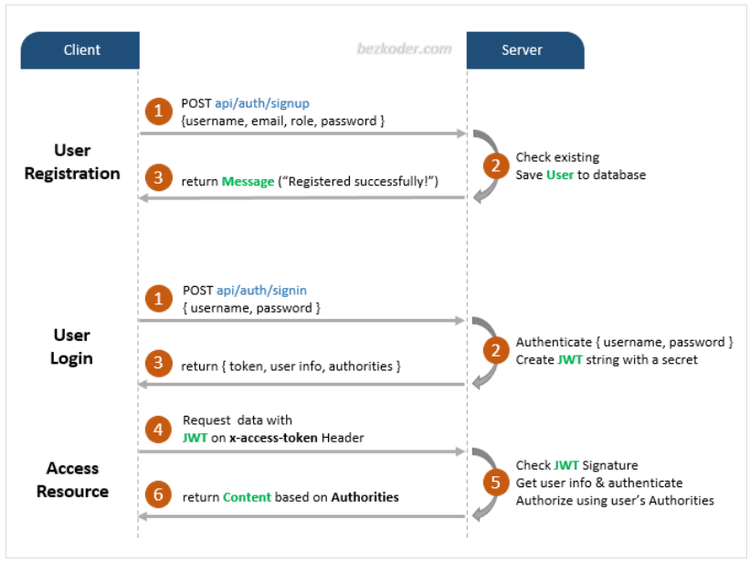
Flow for Signup & Login with JWT Authentication

Slide 18
An overview of Express app
Via Express routes, HTTP request that matches a route will be checked by CORS Middleware before coming to Security layer.
Security layer includes:
JWT Authentication Middleware: verify SignUp, verify token
Authorization Middleware: check User’s roles with record in database
An error message will be sent as HTTP response to Client when the middlewares throw any error, .
Controllers interact with MongoDB Database via Mongoose library and send HTTP response (token, user information, data based on roles…) to Client.

Slide 19
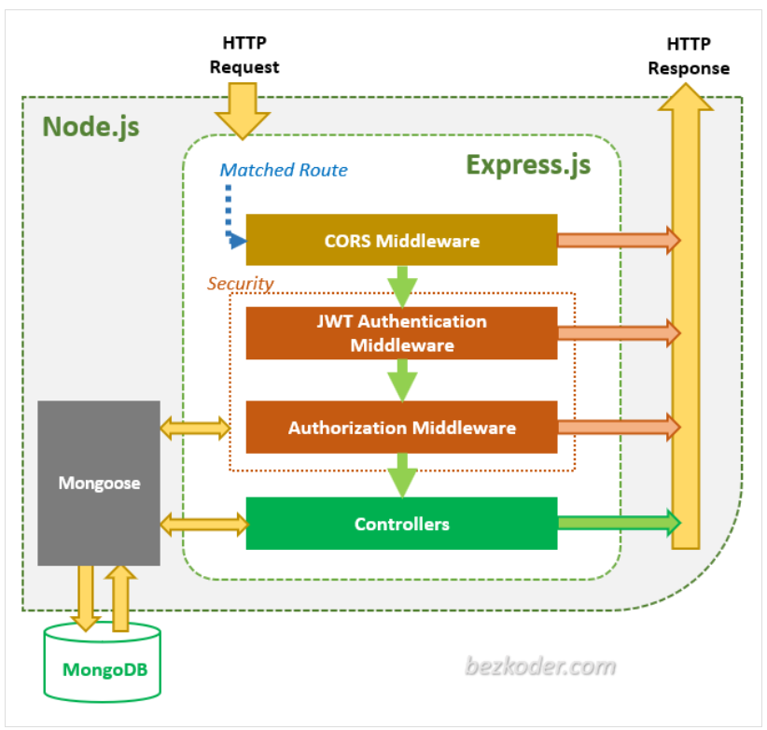
Node.js Express Architecture with Authentication & Authorization

Slide 20
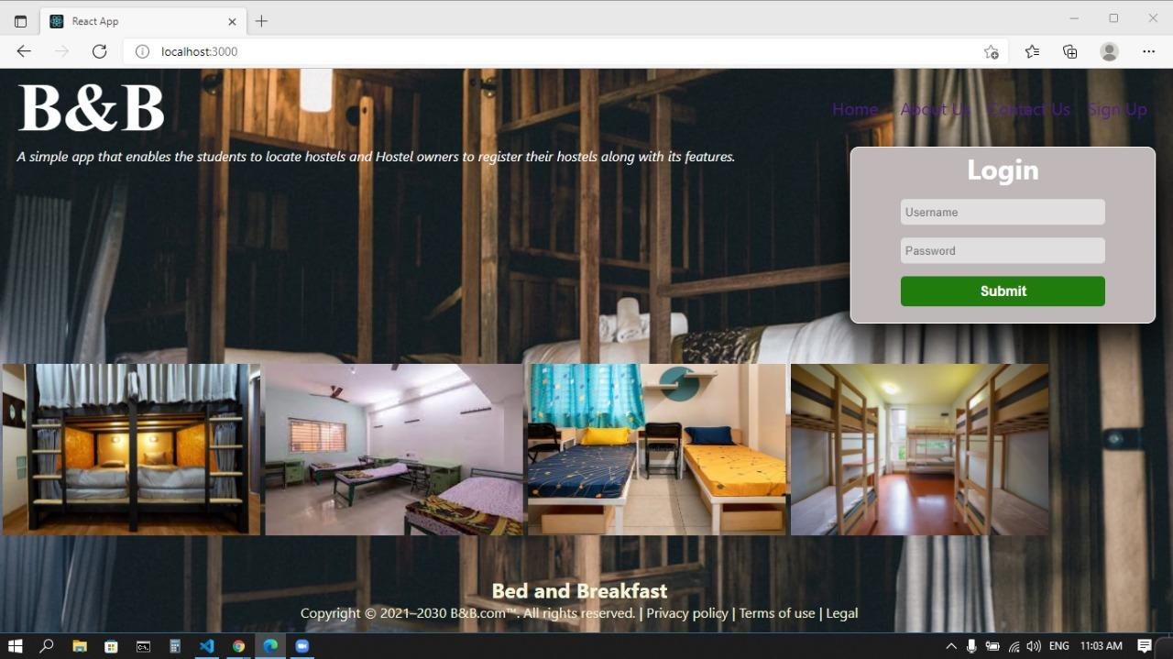

Slide 21
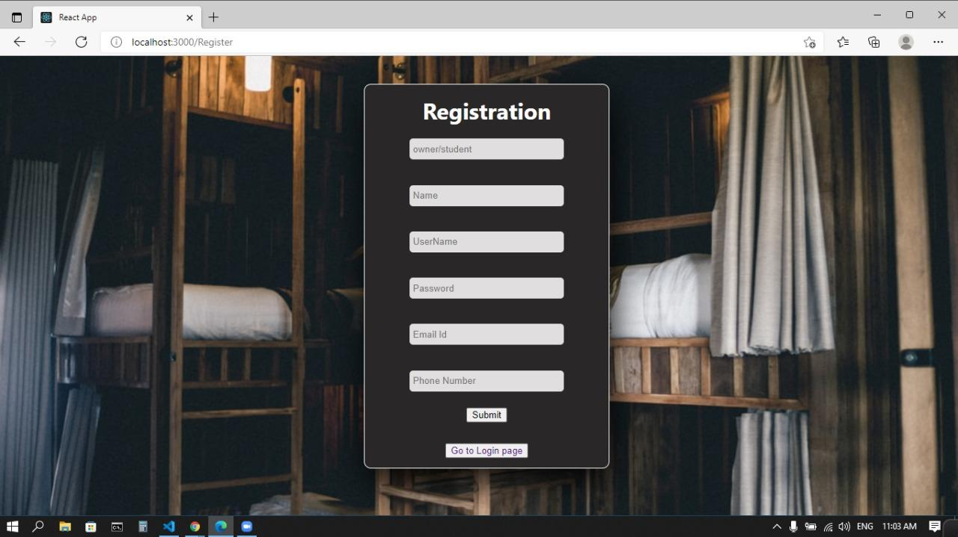

Slide 22
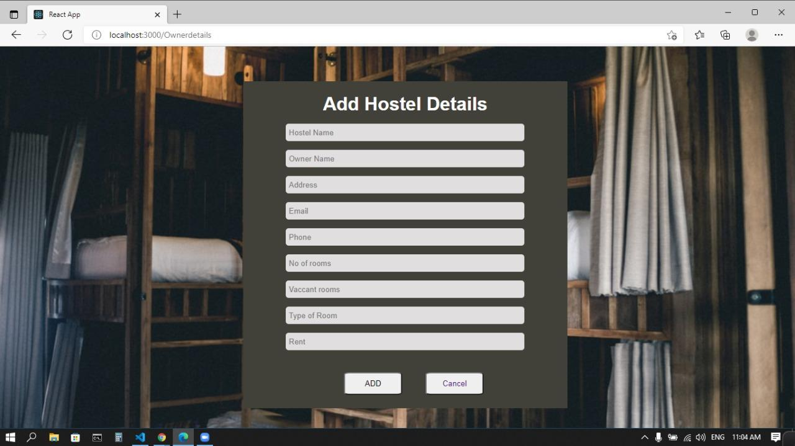

Slide 23
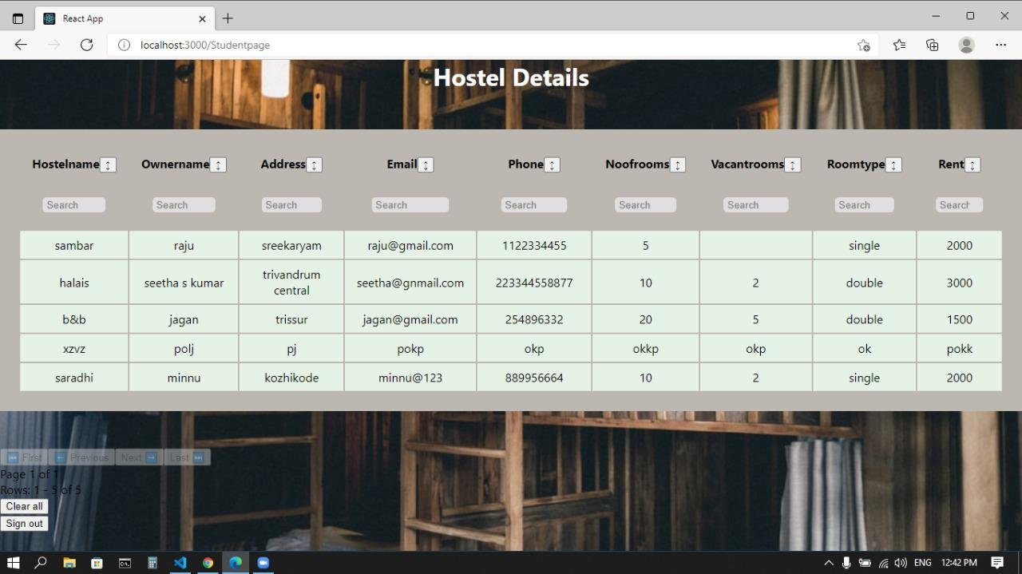

Slide 24

THANK YOU

