Slide 1
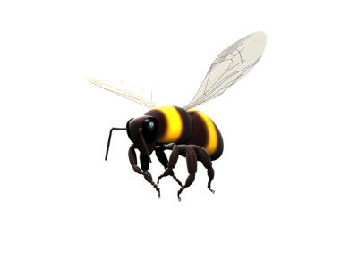


Bees Biz
Beebiana
Fabien
Karine
Marie
Martin
Vincent
Group 5
CSSS2013, Le Havre

Slide 2
Outline
Context
Research questions
Models & method
Simulation
Results
Focus, limitations
Discussion & perspectives

Slide 3
1. CONTEXT
Pastoral honey production in Romania
Beekeepers’ aim
  Maximize profit (honey harvest, market price)
  Minimize travel costs (distance, impact on bees)
  Flower fields need to be pollinated for reproduction

Slide 4
2. RESEARCH QUESTIONS
  Do different individual strategies account for significant changes in profit distribution among beekeepers ?
  What are the effects of competition between wild bees and domesticated bees on the ecosystem services over time ?
Notes:
Impact on profit distribution among beekeepers

Slide 5
Approach
Wild bees
Flowers
Flowers
Pollination
Bee-keepers
Pollination
Bee-keepers
Domesticated bees
Wild bees
Domesticated bees
Influence
Impact
Notes:
Multi-level multi-agent approach

Slide 6
Approach
Wild bees
Flowers
Pollination
Bee-keepers
Domesticated bees
Influence
Impact
Notes:
Multi-level multi-agent approach

Slide 7
3. MODELS & METHOD
Space
Romania, 41 counties (GIS)
Time
Discrete: 1 year (1 day = 1 tick)
Blooming season/s = 5 months

Slide 8
MODEL
“ beekeep-utility = honey-quant * (honey-price - prod-cost) - (travel-cost * distance) - moving-cost “
Agents = Beekeepers
Different number of beekeepers in the counties (starting location : centroid)
Different number of hives per beekeeper (min : 30 ; max : 60)
Number of bees in hives varies over time
1 single beekeeper per specific field (spot)
Plantations
4 types of flower fields randomly distributed in the counties
Different yields per type of flower

Slide 9
Beekeepers’ strategies
Blind
  Beekeepers share no information about the available fields
Informed
  Beekeepers share information about the available fields

Slide 10
Wild bees Regulation
Agents = field (spot)
Random location
Type of flower (acacia, lime, sunflower or polyflower)
Random number of wild hives/bees
Pollination score (wild + domesticated bees) is increased

Slide 11
4. SIMULATION
  Parameters
  Travel cost
  Maximum distance
  Season uncertainty
  Number of wild hives

Slide 12
5. RESULTS
(sensitivity analysis, parameters influence...)
A-Model
Optimal strategy
Distribution profit/ distance
B-Model
Positive retroaction
Combined results

Slide 13
6. FOCUS, LIMITATIONS
Problem :
Blind strategy is the best
Limitations
Of scale
  Calibration

Slide 14
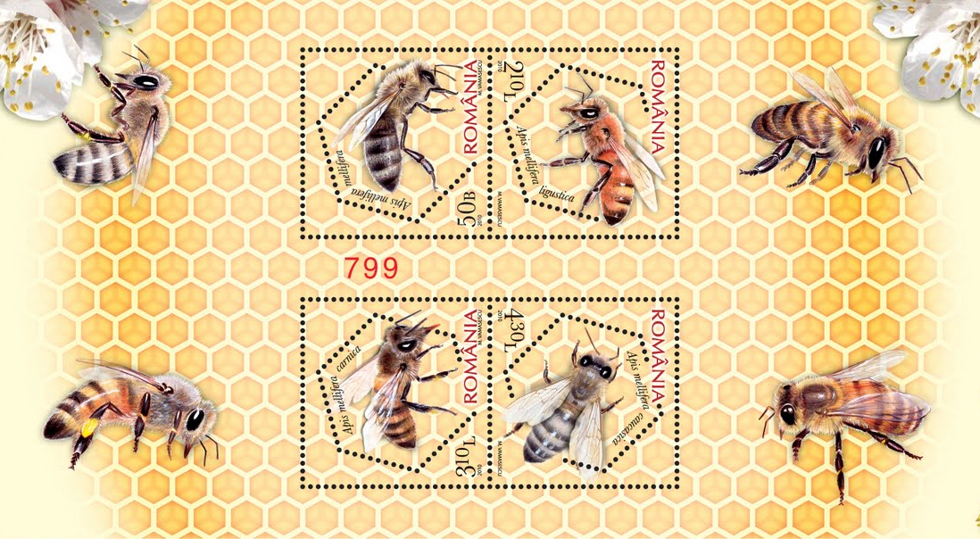
7. PERSPECTIVES & DISCUSSION
  Concentration on 1 resource (flower type)?
  Impact on resource sustainability
Startegy collective avec amis dans comté et d’(autre a lexereur

