Slide 1
What is Phaser?

Slide 2
What is Phaser?
◆ Desktop and Mobile HTML5 game framework
◆ A fast, free and fun open source framework for Canvas and WebGL powered browser games.

Slide 3
Why Phaser?

Slide 4
Why Phaser?
◆ it runs natively on your browser “look ma, no browser plugins!”

Slide 5
Why Phaser?
◆ code in JavaScript
◆ open source and actively developed
◆ extensive documentation
◆ a large community behind it
◆ and a truck load of examples

Slide 6
Let’s create a game!
“because we are cool”

Slide 7
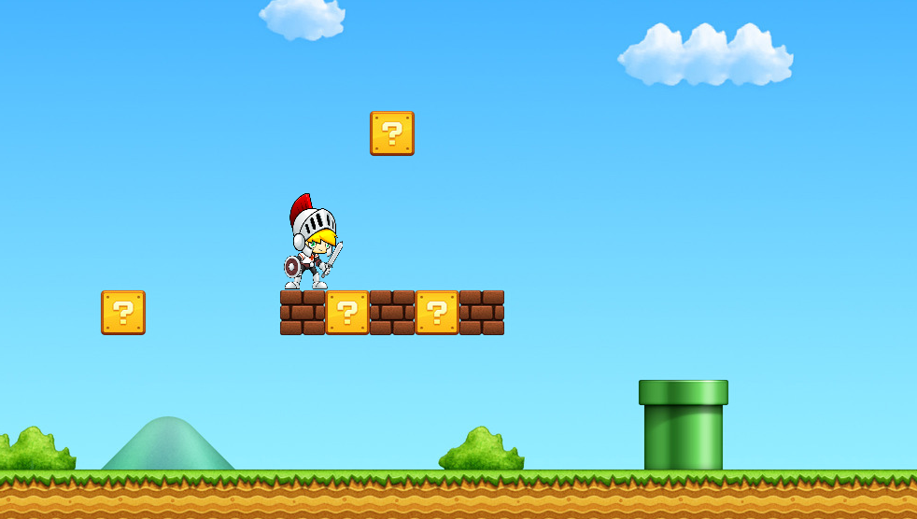
What we’ll need for our game
◆ Entry point to the game engine
◆ A way to add Tiles
◆ A way to add Game Objects
◆ Listen to Keyboard Input
◆ Detect Game Object collisions

Slide 8
The Classes that we’ll need
◆ Entry point to the game engine
Phaser.Game, Phaser.Loader
◆ A way to add Tiles
Phaser.Tilemap
◆ A way to add Game Objects
Phaser.Sprite, Phaser.AnimationManager
◆ Listen to Keyboard Input
Phaser.Input
◆ Detect Game Object collisions
Phaser.Physics.Arcade, Phaser.Physics.Arcade.Body

Slide 9
Phaser.Game
This is where the magic happens.
The Game object is the heart of your game, providing quick access to common functions and handling the boot process.

Slide 10
Phaser.Game default states
◆ preload
is where asset preloading is set
◆ create
is where game initializations are set
◆ update
is where the life of your game happens
◆ render
is where debugging infos are set

Slide 11
Phaser.Loader
The Loader handles loading all external content such as Images, Sounds, Texture Atlases and data files.
The Phaser.Game object has a default loader instance via the .load property

Slide 12
Phaser.Sprite
◆ to create our game objects
◆ almost all game elements/objects/characters will be Phaser.Sprite objects
Phaser.AnimationManager
◆ to animate our sprites (via adding frames)
◆ the Phaser.Sprite object has a default instance via sprite.animations

Slide 13
Phaser.Input
◆ handles input related events ex. mouse, touch, keyboard, gamepad
◆ so many ways to use and or access this class
◆ ex. via Phaser.Game game.input.keyboard

Slide 14
Phaser.Physics.Arcade, Phaser.Physics.Arcade.Body
◆ handles collisions and motion methods
◆ the default physics engine

Slide 15
Using the Physics Engine Phaser.Physics.Arcade, Phaser.Physics.Arcade.Body
◆ enable physics on the game objects
◆ call the collision checker and pass the colliding object s
◆ use any of the physics movement methods (instead of manually moving your sprites)

Slide 16
Listening to collision events
Phaser.Physics.Arcade, Phaser.Physics.Arcade.Body
◆ implement a collide callback on a collision check

