Slide 1
Casual Games

Slide 2
Grid/Tile Based Games
Often turn based
Easy to design, hard to master?
We define levels in JSON, and build an engine for showing/playing

Slide 3
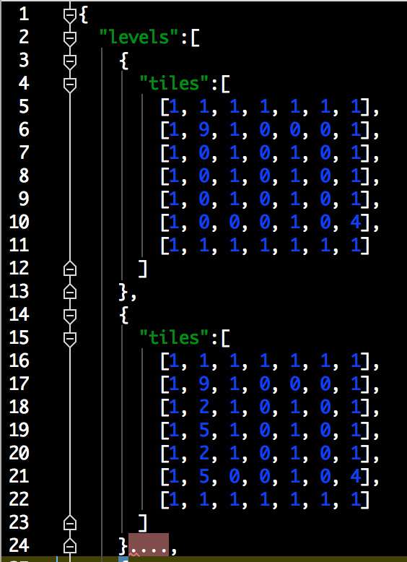
Example JSON
Where each number defines a block in the game e.g.
1: wall
2: Key
5: lock
0: floor
9: hero

Slide 4
Grid/Tile based Games #2
Then we loop through the JSON and build a multidimensional array of tiles (Sprites)
Each tile should know it’s type, row & col
Then we add the “hero”

Slide 5
Let’s do it
Example files are in fronter
gridBased1.zip, gridBased2.zip

Slide 6
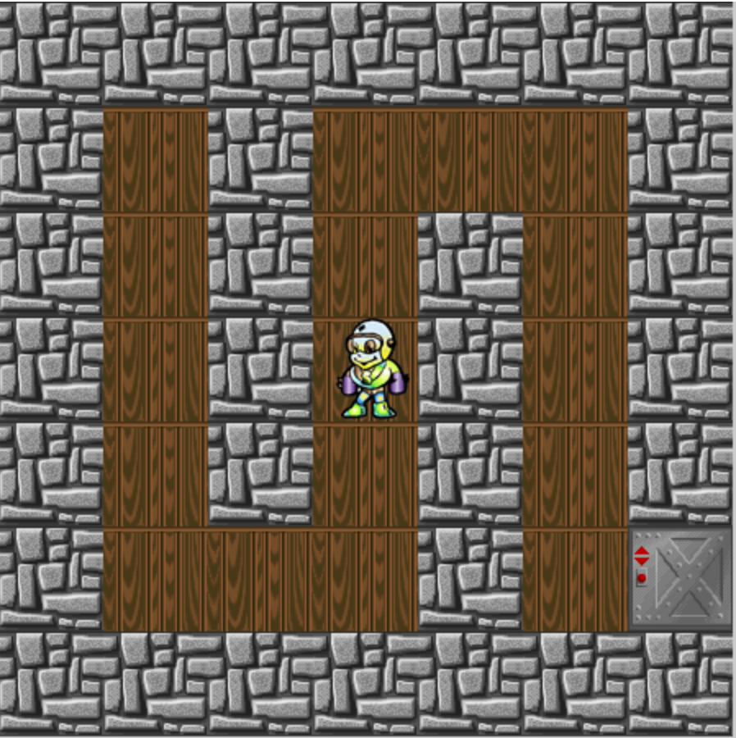
Grids, movement
See the arrays?
Rows / Cols
Our hero is at col: 3, row: 3
The door is at c:6, r:5
Can he go left? up? Why?

Slide 7
Movement, #2
Before moving our hero, we need to see if he actually can.
So moving left would mean:
row is the same
column is hero.column-1
so left could be something like:
moveTo(0, -1)
down would be
moveTo(1,0)

Slide 8
Let’s do it
Files are in fronter
gridBased3.zip

Slide 9
Completing a level
When we hit the door, we’ve won the level, so we load the next one
Reset all variables
clear the stage
anything else?
exercise files are in fronter, gridBased4.zip

