Slide 1

Model Deployment with Flask
LISUM02
19th January 2022
By,
Kelvin Mpofu
Submitted to:

Slide 2
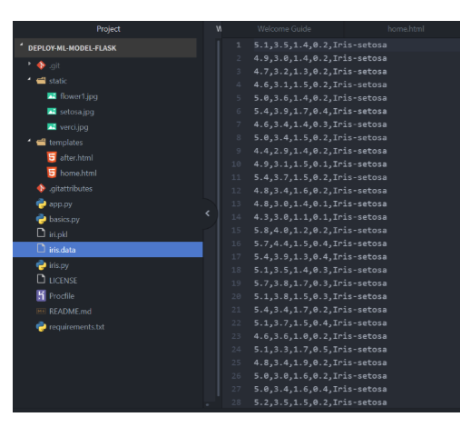

Tasks Involved
The data set consists of 50 samples from each of three species of Iris (Iris setosa, Iris virginica and Iris versicolor). Four features were measured from each sample: the length and the width of the sepals and petals, in centimeters.
Trained a support vector machine model to classify the different types of flowers based on their features
Finally, deployed Support vector machine model to a web-app using Flask API.
This way, we can predict potential customers using the web-app.

Slide 3
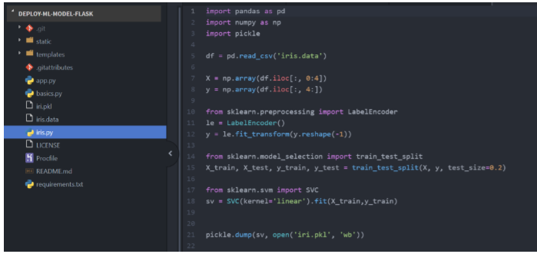
Model Validation
After splitting the data into train and test set, Support vector machine model was used for predicting on test set.
The model achieved a high accuracy of 82.5%.

Slide 4
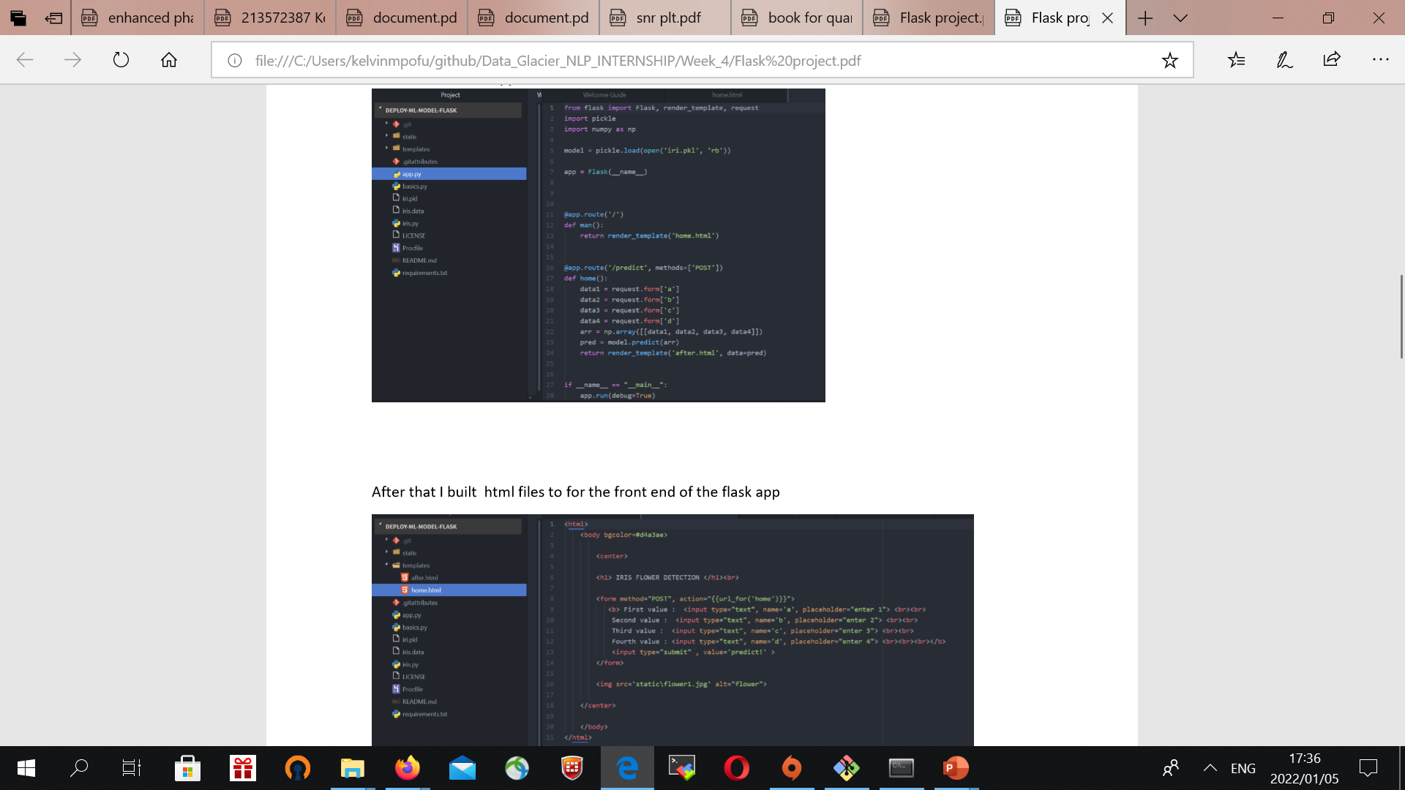
Saving Model & Creating Web-App using Flask API
The model was then trained on the whole dataset before saving the model to pickle format.
Pickling is done to convert python object to character object.
Next, created a python file to create the web app using Flask API module.

Slide 5
HTML

Slide 6
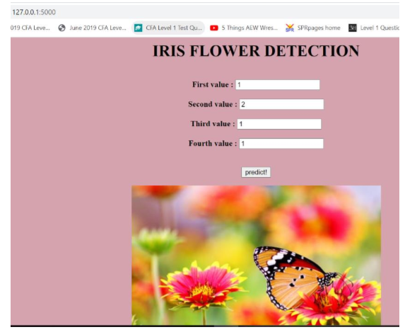
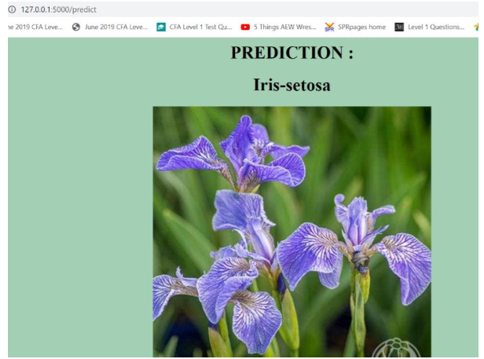
Model Deployment
Finally, created the web-app and deployed the model into the web-app.
Based on the model, we can now use the web application to predict the type of flower based on features.

Slide 7
The End

