Slide 1

G2M Case Study
Virtual Internship
15-AUG-2021

Slide 2
Background –G2M(cab industry) case study
XYZ is a private equity firm in US. Due to remarkable growth in the Cab Industry in last few years and multiple key players in the market, it is planning for an investment in Cab industry.
Objective : Provide actionable insights to help XYZ firm in identifying the right company for making investment.
The analysis has been divided into four parts:
Data Understanding
Forecasting profit and number of rides for each cab type
Finding the most profitable Cab company
Recommendations for investment

Slide 3
Data Exploration
24 Features( including 9 derived features)
Timeframe of the data: 2016-01-31 to 2018-12-31
Total data points :355,032
Assumptions:
Outliers are present in Price_Charged feature but due to
unavailability of trip duration details ,we are not treating this as outlier.
Profit of rides are calculated keeping other factors constant and only
Price_Charged and Cost_of_Trip features used to calculate profit.
Users feature of city dataset is treated as number of cab users in the city.
we have assumed that this can be other cab users as well(including Yellow and
Pink cab)
Cab_Data.csv
Customer_ID.csv
Transaction_ID.csv
City.csv
USholiday.csv
Final cab data

Slide 4
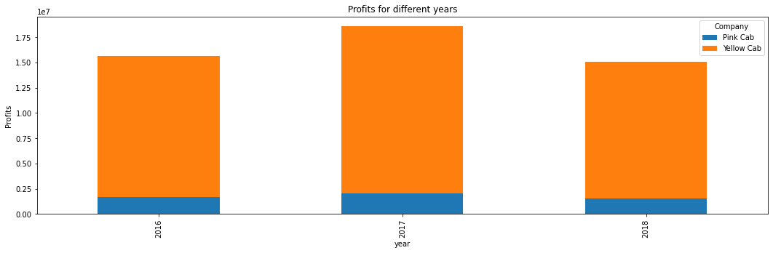
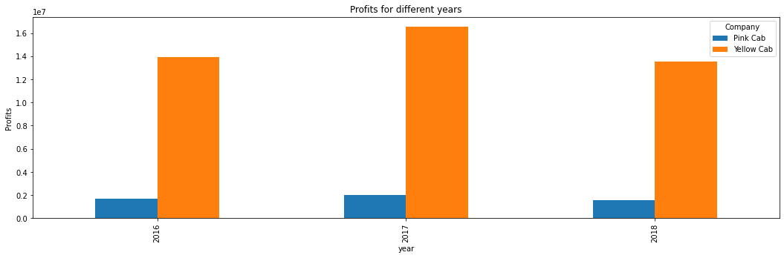
Profit Analysis

Slide 5
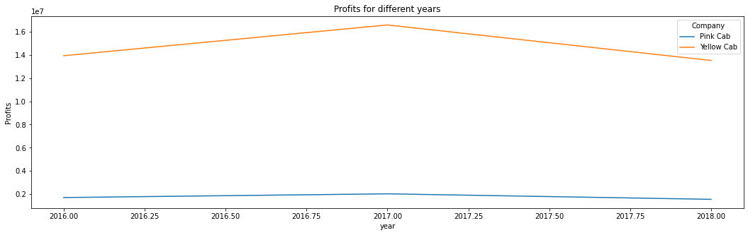
Yearly Profit Analysis

Slide 6
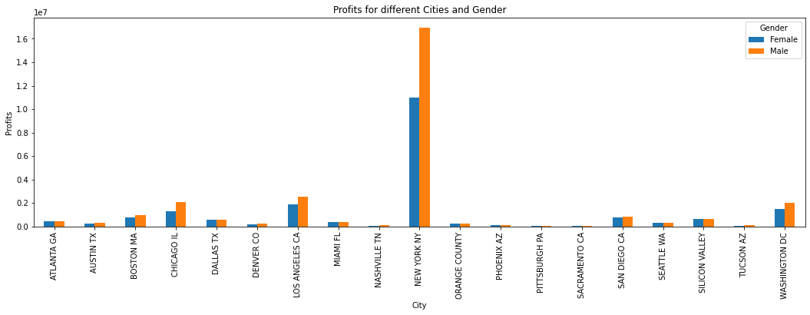
Profit and customer base Analysis Gender wise

Slide 7
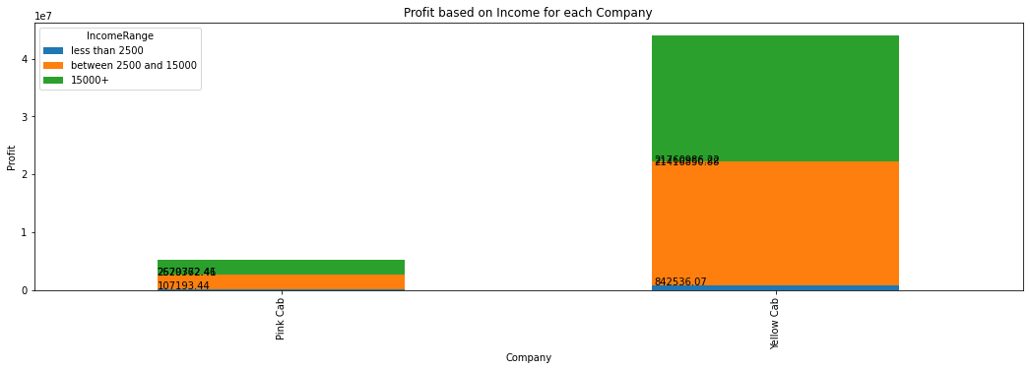
Income Class wise Profit and customer base Analysis
Middle class and high class contributes more in the profit as well as in the customer base of both the cabs

Slide 8
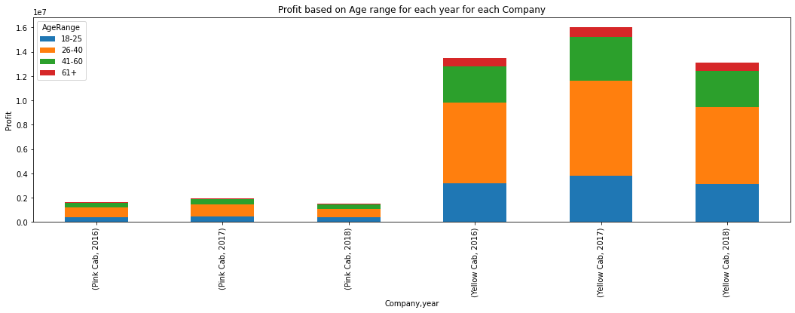
Age GroupWise Profit And Customer Base Analysis
For each company in different years

Slide 9
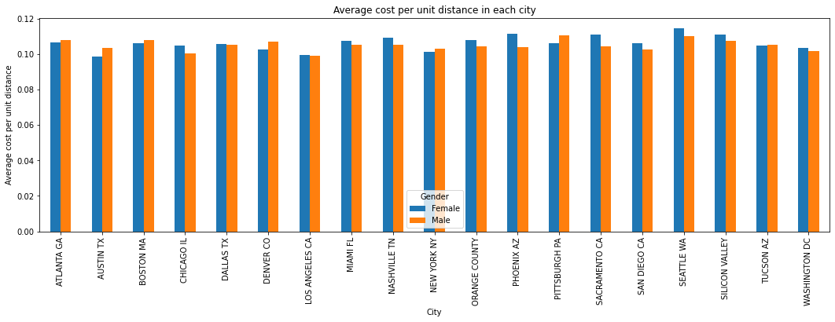
Average cost per unit distance in each city for males and females

Slide 10
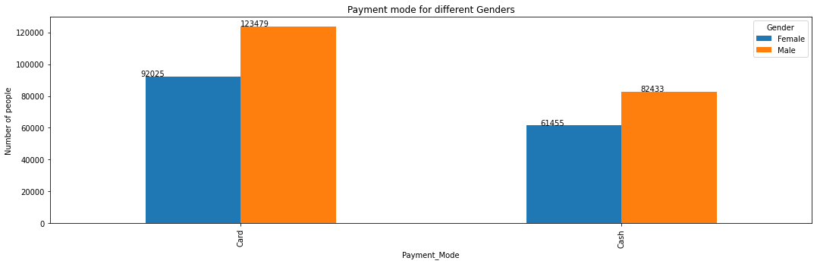
Payment modes for males and females

Slide 11
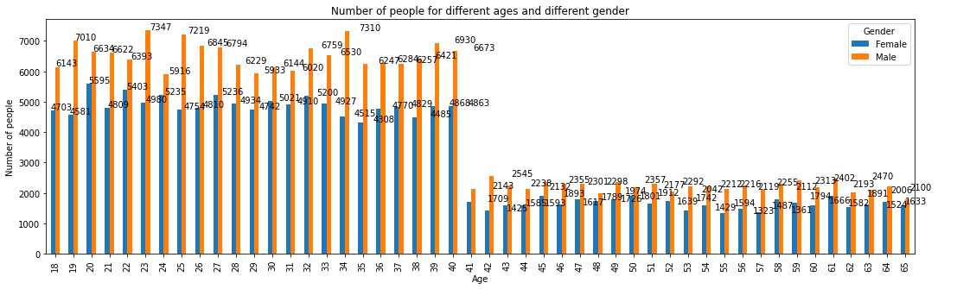
Ages and gender of different people

Slide 12
Recommendations
We have evaluated both the cab companies on following points and found Yellow cab better than Pink cab:
Customer Reach : Yellow cab has higher customer reach in 25 cities while Pink cab has higher customer reach in 4 cities. We have also observed that Yellow cab is doing good in covering other cab users as compared to Pink cab.
Age wise Reach : Yellow cab has customer in all age group and it’s been observed that it’s very popular in 18-60 age group
Average Profit per KM: Yellow cab’s average profit per KM is almost three times the average profit per KM of the Pink cab.
Income wise Reach :Both the cabs are very popular in high and medium income class but here also Yellow cab is performing better than Pink cab in offering their services to all the three income class group (low, medium and high)
On the basis of above point , we will recommend Yellow cab for investment.

Slide 13
Thank You

