Slide 1
Exploring Income Segregation
Alt: Extending "Dynamic Models of Segregation" to an infinite number of agents
Mitchell Pomery
Notes:
Hi, my name is Mitchell.
Racial segregation isn't the only sort of segregation that happens. There is also wealth segregation. My research extends on the model by Thomas C. Schelling to introduce the possibility for infinite different agents. These agents interact with each other based on wealth differences and the output is examined.

Slide 2
Progression
Initially wanted to simulate merging traffic
  High initial barriers to start seeing behaviour
  Complex logic
Then wanted to look at fluctuating rental prices
  Lots of control logic
  Got messy fast
  Realised I was just looking at peoples incomes moving around
Simplified it down to just incomes
Notes:
Getting to this topic was a journey. I started looking at merging traffic, as it's something that I find annoying. After trying to code it up and drawing several diagrams on a whiteboard I realised I was going nowhere fast.
I then moved to looking at fluctuating rental prices as people with different incomes moved around. This worked well until I got to the stage of trying to figure out who was going to move and where they were going to move to.
Towards the end of this I realised that all I was looking at was peoples incomes moving around, so I decided to strip back everything I could to make this more evident.

Slide 3
What does an income map look like?

Slide 4
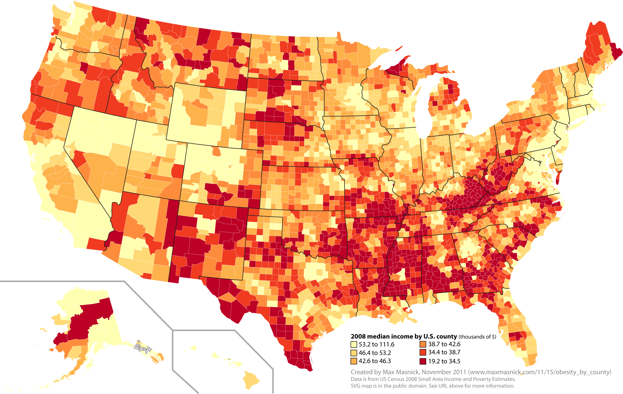
Notes:
As you can see, high incomes clump together. This map makes it apparant that racial segregation isn't the only type that exists, there is also income segregation.

Slide 5
Simulating
People assigned a random income
Move if unhappy
Unhappy if income differs from local average
Neighbourhood size to determine local area
Area Average = sum(surrounding)/len(surrounding)
Unhappy = abs(Area Average - My Income) < My Income * 0.25
Notes:
To simulate this I've used agent based modelling to create people in a city. People are assigned a random income and want to move if their income differs greatly from the surrounding area.
Have a neighbourhood size of 1, so look at 1 in either direction.
For the outside 500's the area average is 500, and the people are not unhappy.
For the interior 500's the area average is 425 and the people are not unhappy.
For the lone 350, the area average is 500, the person is unhappy and wants to move.

Slide 6
Example 1
500 500 500 500 350 500 500 500 500
Neighbourhood Size = 1
Looking at the 350:
Area Average = sum([500, 500])/len([500, 500])
= 500
Unhappy = abs(500 - 350) > 350 * 0.25
= True
Notes:
If we look at an infinite line of 500's, and use a neighbourhood size of 1.
For the outside 500's the area average is 500, and the people are not unhappy.
For the interior 500's the area average is 425 and the people are not unhappy.
For the lone 350, the area average is 500, the person is unhappy and wants to move.

Slide 7
Example 2
350 500 350 500 350 500 350 500 350
Neighbourhood Size = 2
For All People:
Area Average = 425
Unhappy = False
Notes:
If we change to use and infinite line of alternating 350's and 500's and use a neighbourhood size of 2 we see a completely different scenario
No matter which node we select, the area average is always the same and no one is unhappy.

Slide 8
Moving People
Two ways we can move people
  Find places they will be happy, move them there
  Move them somewhere random
Opted for moving them randomly
Notes:
How do we determine where to move people to?
We have two options, the computationally expensive placing them in optimal positions, and the cheap and easy random placements.
I opted for the random placement for a couple of reasons, easy to impliments, fast and it is more interesting to see patterns emerge from chaos at random.

Slide 9
Formatting Output
We are looking at thousands of people
All with a different income
Need to be able to tell incomes apart
Can use heatmapping
Notes:
We need to present the data in a nicely foratted way so that it is easy to see any patterns taht emerge. We need to know if someone is living at a location and what their income is. Being able to see all the information at once is very important, especially as we are dealing with thousabds of people.
A good way to do this is by using a heatmap.

Slide 10
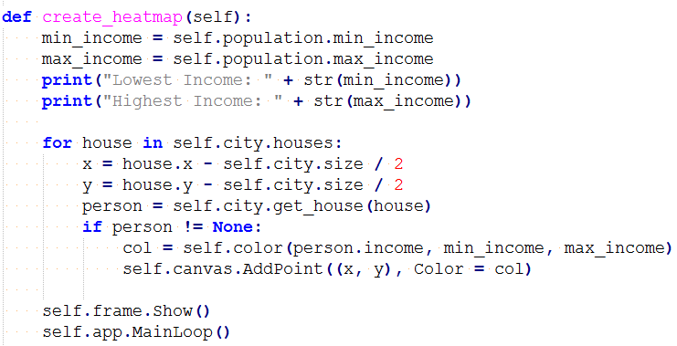
Creating The Heatmap
Notes:
Heatmaps are a simple concept. Each data point is placed on the screen in it's position and is assigned a colour depending on a defining value. In my case the defining value was the income. The code is as simple as iterating through every location, checking if someone is there, creating a colour for them and then adding them to the canvas for drawing.

Slide 11
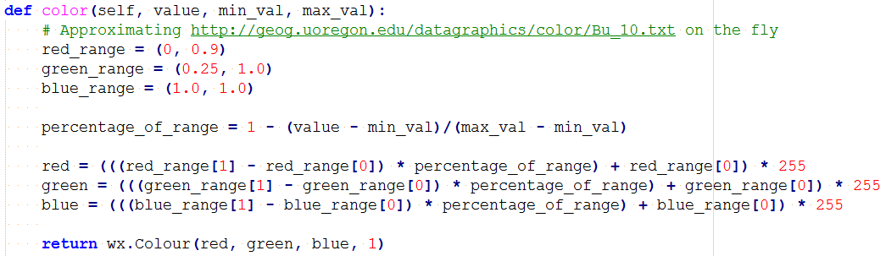
Determining Colours
Notes:
Calculating the colour is a bit more difficult. The way I did it was by converting from the income range to three seperate ranges; One for each red, green and blue. The red green and blue ranges are approximations of the ones used but the Geology Department at the Universtiy of Oregon, and work well to display my information.

Slide 12

Notes:
What does the data look like? Well it looks like this. This is after randomly placeing people on the map and then outputting where they are placed straight away.

Slide 13

Named Tuples
You may have noticed in the create_heatmap the following lines
`house` is a named tuple, meaning we can refer to it's content by name rather than index
Notes:
You may have noticed the following lines of code in the create_heatmap function. No I didn't go and create a Class just to store x and y values, I use named_tuples

Slide 14

Named Tuples
Increase Readability
Easy to create
Easy to use
Notes:
Creating a named tuple is as easy as writing one line of code. To then make a tuple to use it as if you were creating a new class.

Slide 15
Demo
Notes:
I haven't done python development on my laptop for several months, so it is unsurpirsing that this morning when I went to test my demo I was missing a couple of libraries and running and old version of python. Fortunately the last install completed while I was on my way to university.

Slide 16
The Demo Failed, Lets look at images!

Slide 17

The Demo Failed, Lets look at images!

Slide 18

The Demo Failed, Lets look at images!

Slide 19
Questions?

Slide 20
Thanks for listening

