Slide 1
Analyzing Amazon Sales data
UNIFIED MENTOR INTERNSHIP - PROJECT 1
BY
M POOJA

Slide 2
CONTENTS
Introduction
Problem Statement
Methodology Used
Inferences
Conclusion

Slide 3
INTRODUCTION
The Amazon sales data encompasses a comprehensive set of information capturing various facets of sales transactions. It includes details such as region, country, item type, sales channel, order priority, order date, order ID, ship date, units sold, unit price, unit cost, total revenue, total cost, and total profit. This rich dataset enables a thorough examination of sales trends, regional variations, and the impact of different factors on the overall profitability of the products. The data serves as a valuable resource for uncovering insights into customer preferences, market dynamics, and operational efficiency within the context of the Amazon retail platform. Analyzing this dataset can provide crucial business intelligence for optimizing strategies, reducing costs, and enhancing overall sales performance.

Slide 4
PROBLEM STATEMENT
Sales management has gained importance to meet increasing competition and the need for improved methods of distribution to reduce cost and to increase profits. Sales management today is the most important function in a commercial and business enterprise.
Do ETL: Extract-Transform-Load some Amazon dataset and find the Sales-trend -> month-wise, year-wise, yearly_month-wise
Find key metrics and factors and show the meaningful relationships between attributes.

Slide 5
METHODOLOGY USED
The Amazon sales data analysis was conducted using Python programming language within the Google Colab environment. The methodology involved several key steps.
Firstly, the dataset was imported and cleaned using existing library to ensure data integrity. The temporal aspects of the data, such as order dates, were processed to extract month, year, and yearly-month information for trend analysis.
Visualization techniques, primarily leveraging the matplotlib library, were employed to create insightful charts such as bar charts, pie charts, and trendline graphs to represent sales trends and key metrics.
Numpy was used for numerical operations, enhancing the efficiency of data manipulation.
Throughout the analysis, a combination of descriptive statistics and visualizations was employed to identify patterns, correlations, and meaningful relationships within the dataset.
The goal was to derive actionable insights for optimizing business strategies and improving overall sales performance in the Amazon marketplace.

Slide 6
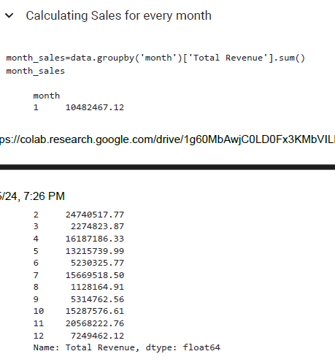
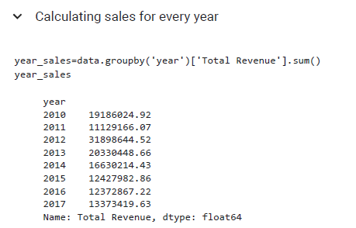
INFERENCES
SALES FOR EVERY MONTH
SALES FOR EVERY YEAR

Slide 7
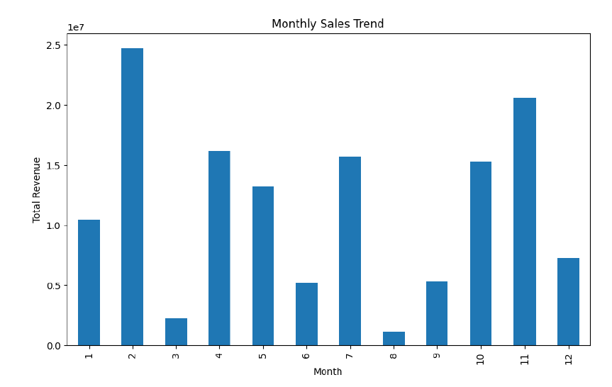
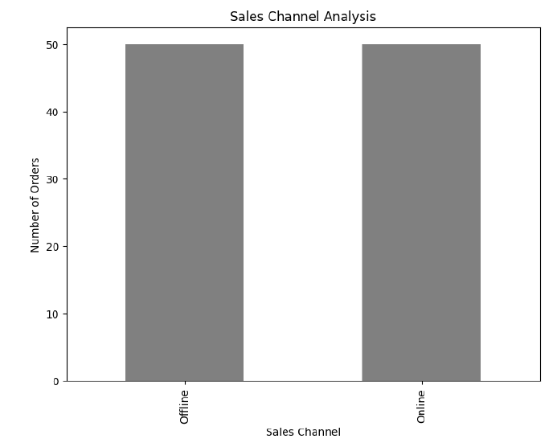
MONTHLY SALES TREND
SALES CHANNEL ANALYSIS

Slide 8

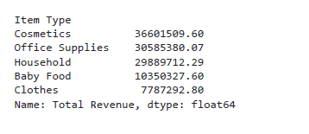


AVERAGE SALES REVENUE
TOP 5 DEMANDED ITEMS
AVERAGE PROFIT ATTAINED
MAXIMUM PROFIT ATTAINED
MINIMUM PROFIT ATTAINED

Slide 9
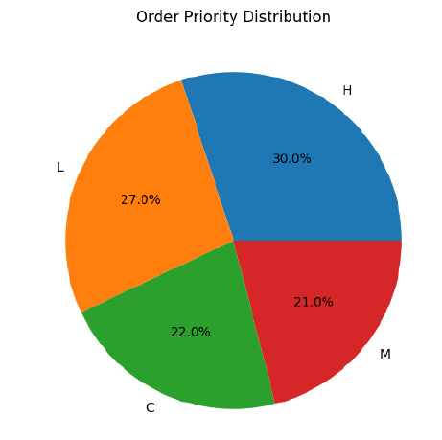
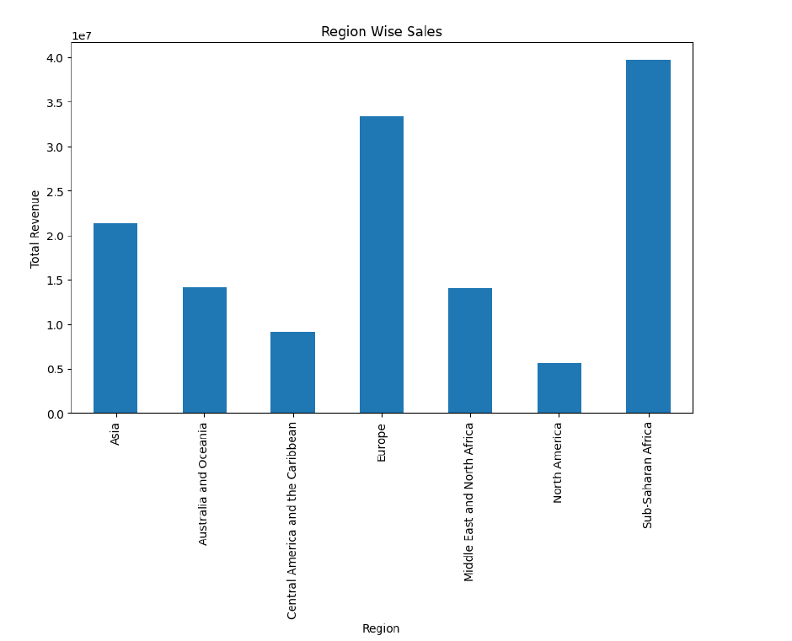
PRIORITY DISTRIBUTION
REGION WISE SALES ANALYSIS

Slide 10
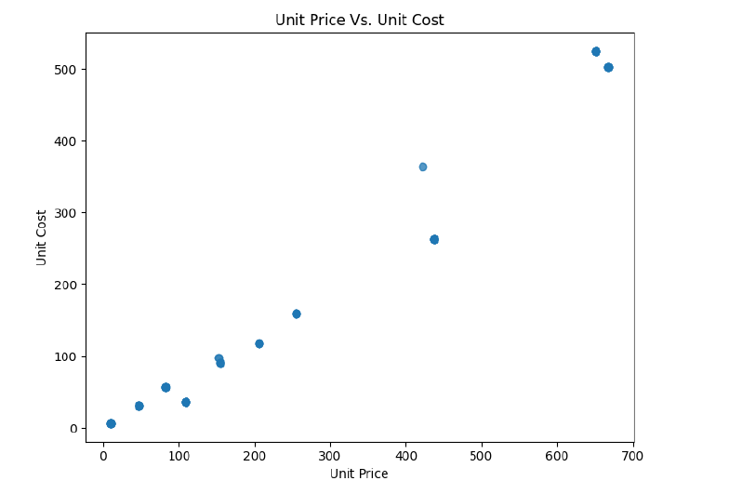
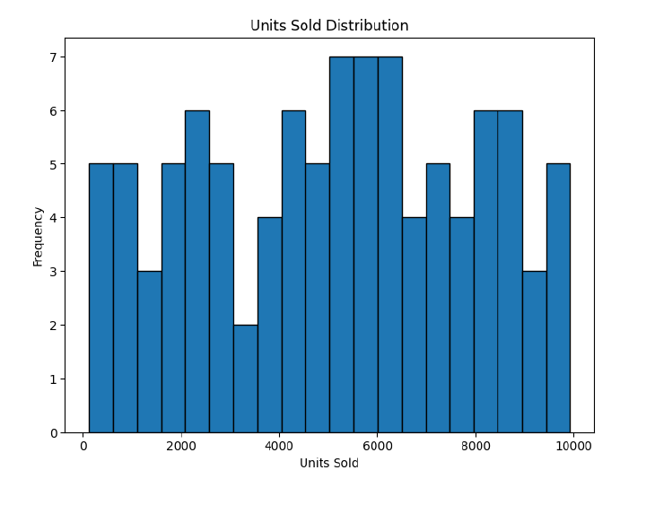
UNIT PRICE vs COST PRICE
DISTRIBUTION OF UNITS SOLD

Slide 11
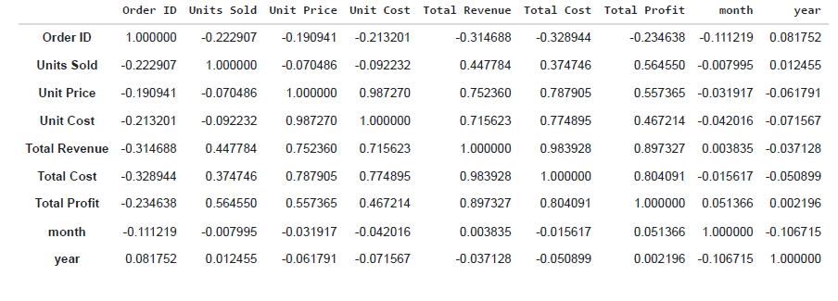
REALATION BETWEEN THE ATTRIBUTES

Slide 12
conclusion
In conclusion, the analysis of Amazon sales data using Python in Google Colab has yielded valuable insights into sales trends, regional variations, and key metrics influencing profitability.
The project successfully employed data cleaning techniques, temporal processing, and visualization methods to uncover patterns and relationships within the dataset. The identified insights, ranging from month-wise and year-wise trends to the impact of different factors on sales, can inform strategic decision-making and contribute to business optimization.
Moving forward, there is immense potential for further exploration, such as advanced predictive modeling to forecast future sales trends, incorporating machine learning algorithms for more nuanced insights, and exploring additional dimensions of the dataset for a comprehensive understanding.
The robust methodology employed in this project lays the foundation for ongoing analyses and enhancements, positioning it as a valuable resource for continuous improvement and adaptation to the dynamic landscape of Amazon sales.

Slide 13
THANK YOU
M POOJA​
poojaofficial968@gmail.com
www.linkedin.com/in/pooja-m-083556284

