Slide 1
Credential Proofs & Attestations
OID4VCI · SD-JWT VC · Key Binding
This deck walks through three progressive levels of proof assurance when issuing a Verifiable Credential (VC) over the OID4VCI protocol using the SD-JWT VC format:
Part 1 — No Proof
Part 2 — JWT Proof (no attestation)
Part 3 — Attested Proof
Credential request carries no proof. Issuer cannot bind the credential to a key. Verifier has no holder binding to verify.
Wallet generates a key pair and proves possession in the credential request. Issuer binds the credential to that key. Verifier can verify holder binding.
An Attester (trusted third party) countersigns the proof key, giving the Issuer assurance that the key lives in a trusted device or environment. Issuer validates both the proof and the attestation before issuing.
Slide 1 / 11

Slide 2
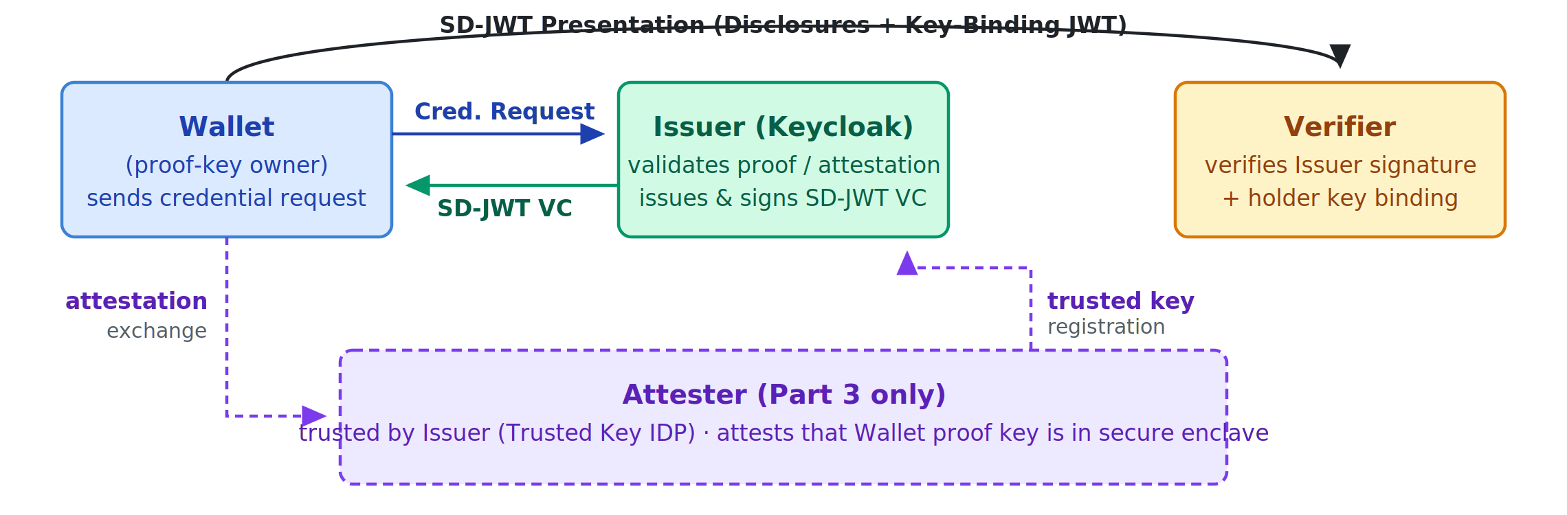
Slide 2 / 11
Parties Involved

Slide 3
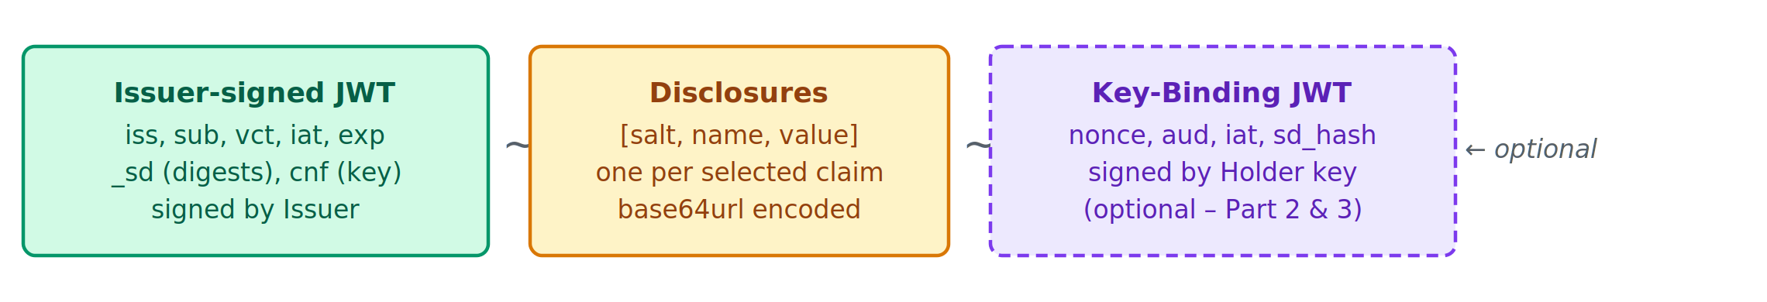
Slide 3 / 11
SD-JWT VC Structure
An SD-JWT Verifiable Credential is a compact string of the form:
<Issuer-signed JWT> ~ <Disclosure 1> ~ <Disclosure 2> ~ ... ~ [<Key-Binding JWT>]
The trailing ~ (no key-binding) or the optional Key-Binding JWT distinguishes presentations with and without holder binding.
Part
Content
Signed by
Purpose
Issuer-signed JWT
Header · Payload · Signature
iss, sub, vct, iat, exp, _sd (digests), cnf (key binding)
Issuer (Keycloak)
Credential authenticity; binds public key of holder when cnf present
Disclosures
Base64url-encoded JSON arrays: [salt, claim_name, claim_value]
N/A (integrity by digest in JWT)
Selective disclosure — holder chooses which to reveal
Key-Binding JWT (optional)
Header (typ: kb+jwt) · Payload: nonce, aud, iat, sd_hash · Signature
Holder / Wallet (proof key)
Proves the presenter holds the private key matching cnf in the VC
Key insight: the cnf claim in the Issuer-signed JWT makes a credential key-bound. Without it (Part 1), no holder-binding is possible regardless of what the wallet does at presentation time.

Slide 4
Slide 4 / 11
Credential Request Structure
Sent by the Wallet to the Issuer's credential endpoint after obtaining an access token (OID4VCI spec §8).
Field
Description
Part 1
Part 2
Part 3
credential_identifier
Identifier from credential_identifiers array in token response; replaces format + credential_definition
✓
✓
✓
proofs.jwt[]
Array of JWT proof objects (typ openid4vci-proof+jwt)
absent
✓
— (or with key_attestation header)
proofs.attestation[]
Array of key-attestation proof objects
absent
absent
✓
Example – JWT proof (Part 2)
{
"credential_identifier": "EducationCertificate",
"proofs": {
"jwt": [
"eyJhbGciOiJFUzI1NiIsInR5cCI6Im9wZW5pZDR2Y2ktcHJvb2Yrand0IiwiandrIjp7Li4ufX0
.eyJhdWQiOiJodHRwczovL2lzc3Vlci5leGFtcGxlLmNvbSIsImlhdCI6MTcwMDAwMDAwMCwibm9uY2UiOiJhYmMxMjMifQ
.SIGNATURE"
]
}
}

Slide 5
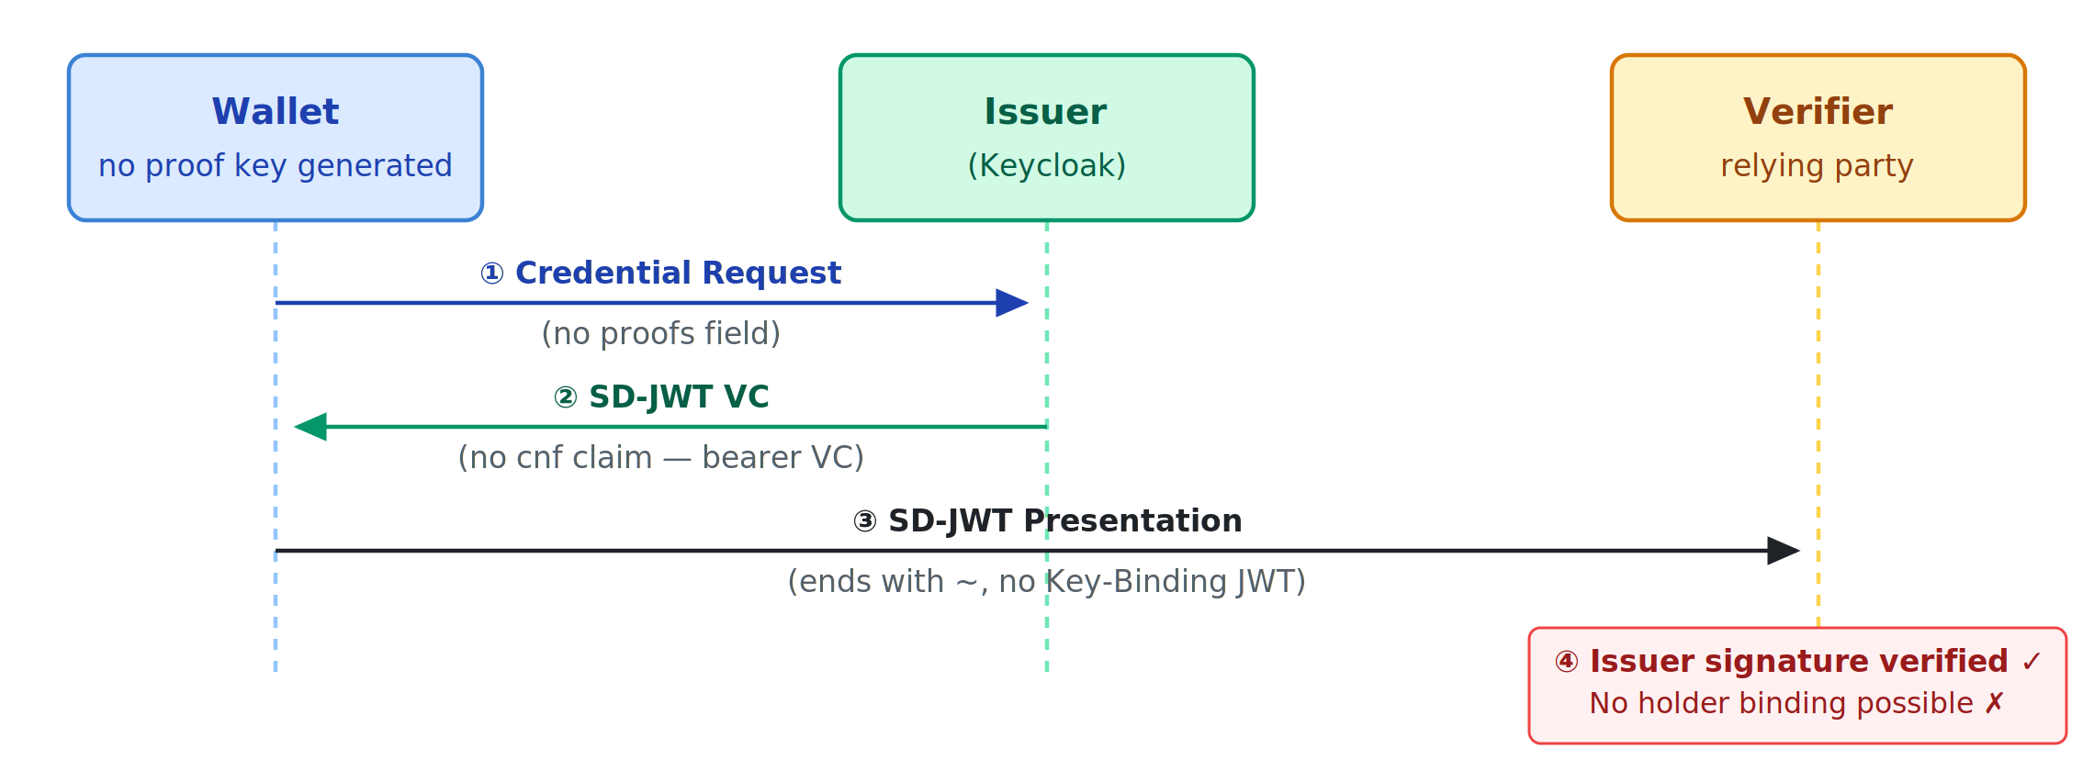
Slide 5 / 11
Verifiable Credential Without Proof
PART 1 — NO PROOF
What happens
Verifier's view
• Wallet sends credential request without a proofs parameter
• Issuer issues the credential but has no key to bind — no cnf claim in SD-JWT payload
• Credential is bearer: anyone who holds it can present it
• Presentation ends with ~ — no Key-Binding JWT appended
• Verifies Issuer's signature on the SD-JWT ✓
• Checks disclosed claims against digests ✓
• Cannot verify holder key binding — no cnf exists ✗
• Cannot distinguish the presenter from anyone else who stole the credential
Risk: credential can be replayed or transferred to a different party.

Slide 6
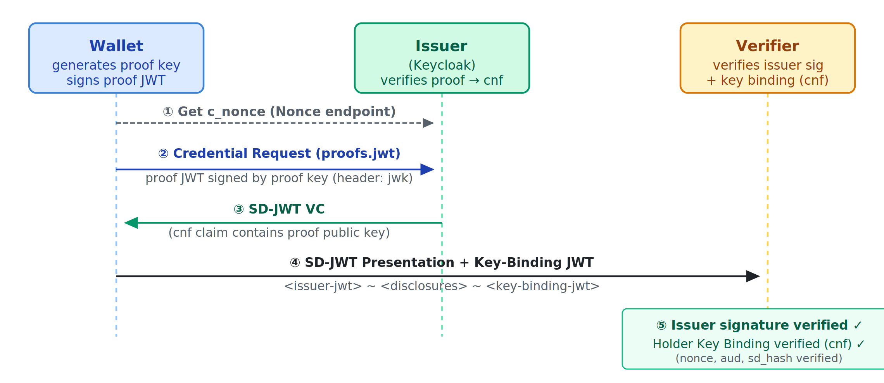
Slide 6 / 11
Verifiable Credential with JWT Proof (No Attestation)
PART 2 — JWT PROOF
What happens
Verifier's view
• Wallet generates a key pair before credential request
• Wallet fetches c_nonce from Issuer's nonce endpoint
• Wallet signs openid4vci-proof+jwt; JWT header carries public proof key inline (jwk)
• Issuer validates proof JWT, extracts public key, embeds as cnf.jwk in issued SD-JWT
• At presentation, Wallet appends a Key-Binding JWT signed with private proof key
• Verifies Issuer's signature ✓
• Extracts cnf.jwk from SD-JWT payload
• Verifies Key-Binding JWT signature against cnf.jwk ✓
• Verifies nonce, aud, and sd_hash in Key-Binding JWT ✓
Benefit: proof that the presenter is the same entity that obtained the credential. Prevents bearer/replay attacks.

Slide 7
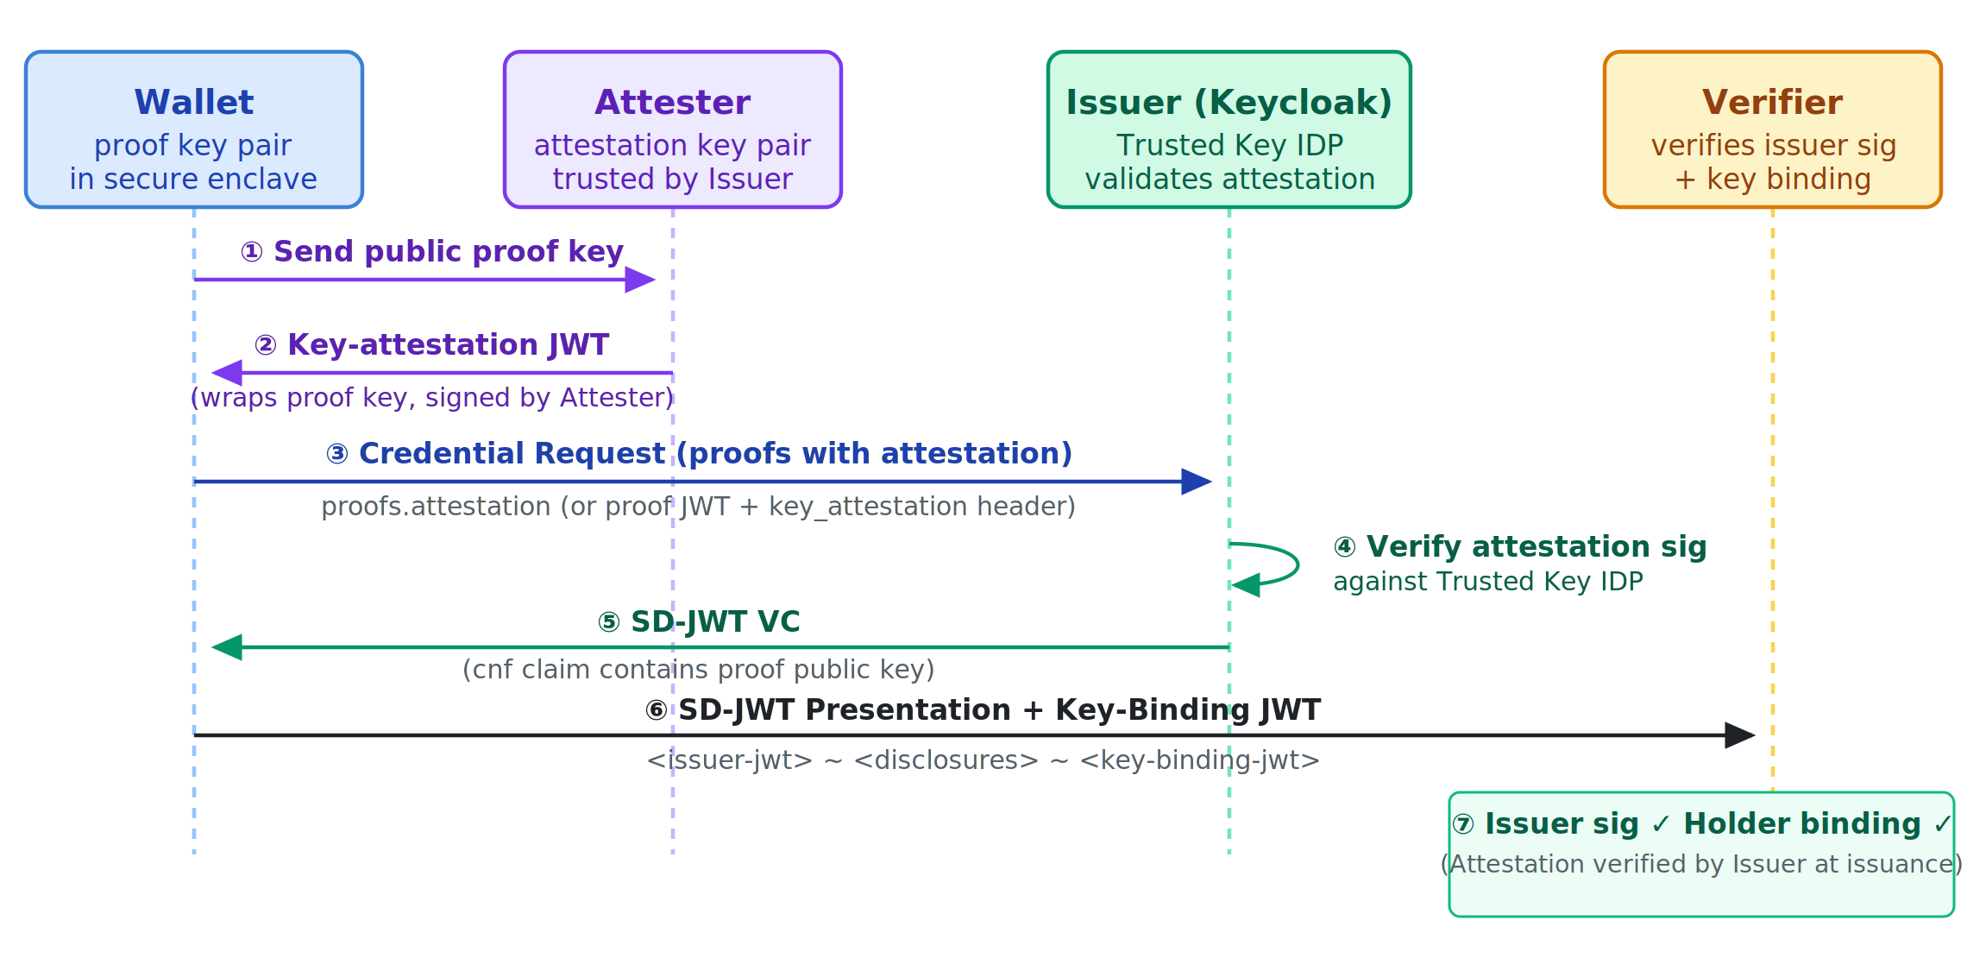
Slide 7 / 11
Verifiable Credential with Attested Proof
PART 3 — ATTESTED PROOF
What happens (extra steps vs Part 2)
Keycloak configuration
• Wallet sends its public proof key to the Attester
• Attester checks the key is in a trusted environment (e.g. hardware-backed); issues key-attestation JWT signed by attestation private key
• Wallet embeds key-attestation JWT in credential-request proof (proofs.attestation or key_attestation header on proof JWT)
• Issuer verifies both the proof JWT and the attestation JWT against Attester's public key (registered in Trusted Key IDP)
• Generate attestation key pair in fapi-playground
• Create a Trusted Key IDP in Keycloak admin console; paste the attestation public JWKS
• Link the Trusted Key IDP to the OIDC client under OpenID for Verifiable Credentials → Trusted Key providers
• Enable Cryptographic binding required on the credential client scope; add attestation to Supported proof types

Slide 8
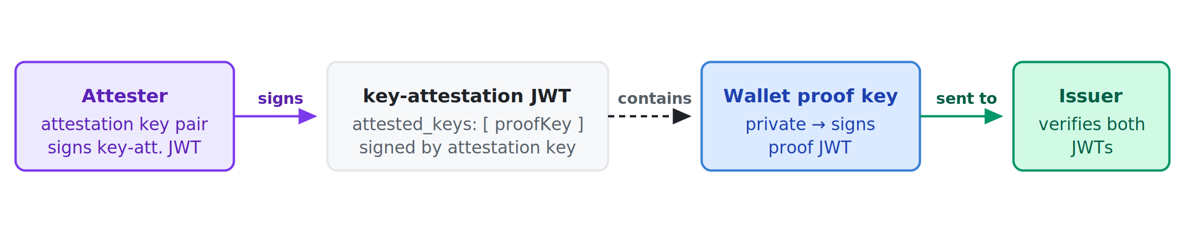
Slide 8 / 11
Key-Attestation JWT — Internal Structure
Used in Part 3 to prove the Wallet's proof key resides in a trusted environment.
Section
Field
Value / Description
Header
alg
Signing algorithm of attestation key (e.g. ES256)
typ
key-attestation+jwt
kid (or x5c)
Reference to the Public attestation key (so Issuer can look it up in Trusted Key IDP)
Payload
iss
Attester identifier
iat / exp
Issuance / expiry
nonce
Freshness nonce from Issuer
attested_keys
Array of JWK objects — the Wallet proof public keys being attested
key_storage / user_authentication
For example iso_18045_high — security level of the attester
Signature
Signed by Attester's private attestation key
Relationship diagram

Slide 9
Slide 9 / 11
Side-by-Side Comparison
Aspect
Part 1 — No Proof
Part 2 — JWT Proof
Part 3 — Attested Proof
Credential request has proofs?
No
Yes – proofs.jwt
Yes – proofs.attestation (or jwt + key_attestation header)
Proof key generated by Wallet?
No
Yes
Yes
Attestation key involved?
No
No
Yes (Attester)
Issuer validates proof?
No
Yes – verifies JWT sig + c_nonce
Yes – verifies proof JWT + attestation JWT
cnf in issued SD-JWT?
No
Yes
Yes
Presentation format
issuer-jwt ~ disclosures ~
issuer-jwt ~ disclosures ~ kb-jwt
issuer-jwt ~ disclosures ~ kb-jwt
Verifier can verify holder binding?
No
Yes
Yes
Verifier sees attestation details?
No
No
No
Security level
Bearer credential – lowest
Holder-bound – medium
Attested holder-bound – highest
Parties involved
Wallet, Issuer, Verifier
Wallet, Issuer, Verifier
Wallet, Attester, Issuer, Verifier

Slide 10
Slide 10 / 11
Demo Walkthrough — fapi-playground + Keycloak
Part 1 — No Proof
Part 2 — JWT Proof
1. Set OID4VCI proof type = none
2. Click Credential request
3. Observe: proofs absent in request body
4. Observe: SD-JWT has no cnf claim
5. Presentation ends with ~
1. Enable Cryptographic binding required on credential scope; add jwt proof type
2. Click Generate proof key
3. Set OID4VCI proof type = jwt
4. Click Credential request
5. Show last verifiable credential — see cnf in payload
6. Create presentation — Key-Binding JWT is appended
Part 3 — Attested Proof
1. Complete Part 2 setup (proof key + jwt in Supported proof types)
2. Also add attestation to Supported proof types on credential scope
3. Click Generate attestation key — copy JWKS shown
4. In Keycloak admin: Identity Providers → create Trusted Key IDP, paste JWKS
5. On OIDC client → Advanced → OpenID for Verifiable Credentials → Trusted Key providers → add IDP
6. Set OID4VCI proof type = attestation
7. Click Credential request — observe proofs.attestation in request body
8. SD-JWT still carries cnf; Verifier sees identical holder binding as in Part 2

Slide 11
Slide 11 / 11
Key Takeaways
Proof serves two purposes
Issuer responsibilities
• Anti-replay: the c_nonce in the proof prevents a captured credential request from being replayed
• Key binding: the public proof key embedded in the SD-JWT ties the credential to the Wallet's key pair
• Configure credential scope to require proofs (Cryptographic binding required)
• Register Attester's public key via Trusted Key IDP (for Part 3)
• Link the IDP to the client (Trusted Key providers)
Attestation adds a third guarantee
Relevant specifications
• The Attester vouches that the proof key lives in a trusted environment (e.g. hardware secure element)
• This is issuance-time assurance — not visible in the issued SD-JWT unless the Issuer explicitly adds claims
• OID4VCI spec — §8.2 Proof Types
• SD-JWT draft — §4.3 Key Binding
• SD-JWT VC draft
• Keycloak docs — OID4VCI proofs
Bottom line: Use no proof only for low-assurance or legacy scenarios. Use JWT proof for standard holder-binding. Add attestation when the Issuer needs to trust the security properties of the Wallet's key storage (e.g. regulated sectors, high-assurance identity).

