Slide 1
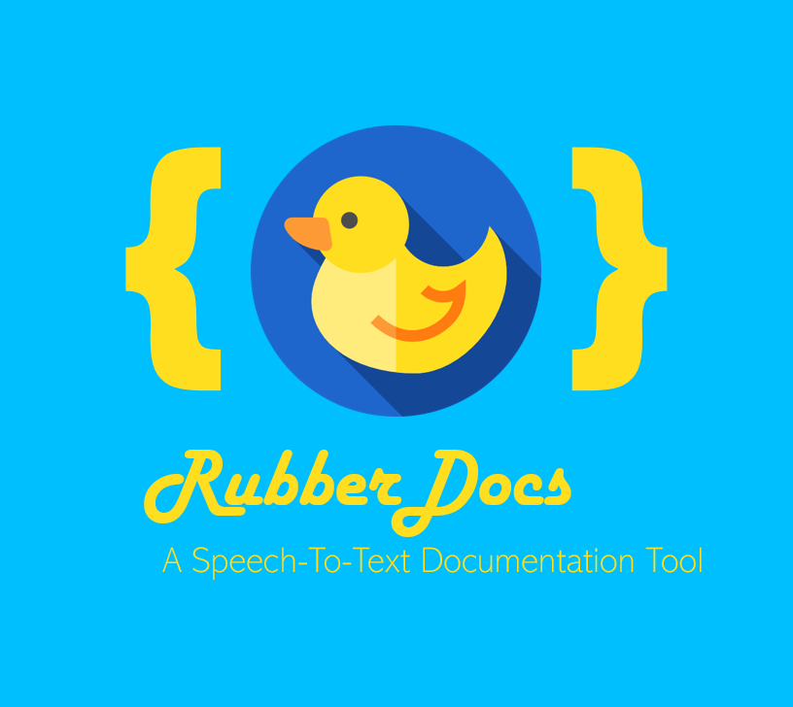

Slide 2
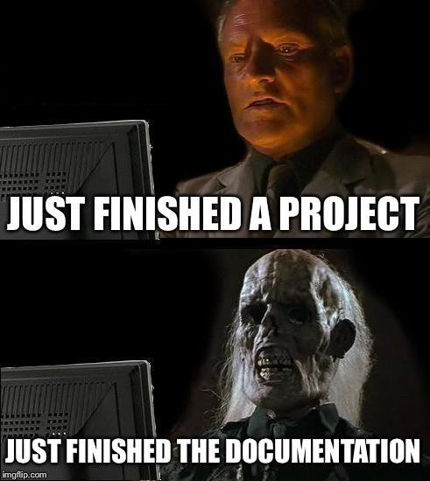
Motivation
{ page2 }

Slide 3
Motivation
//Writing good documentation is often tedious
//Probably that‘s why a lot of people don‘t like it
//But in fact, we talk about our code…
…all the time
{ page3 }

Slide 4

lnspiration
//“Rubberduck-Debugging“
/*Explain your code line by line to an outsider
*e.g. a rubberduck
*can only be done with good knowlegde of code
*helps you keeping it simple and well structured
*-> less annoying (and avoidable) bugs
*/
{ page4 }

Slide 5
But what if the duck would actually…
listen?
What if it…
wrote everything down?
{ page5 }

Slide 6
RubberDocs…
//…provides a virtual duck to rubberduck-debug with
//…parses your files and makes suggestions where documentation is needed
//…listens to your explanations
//…translates your speech into usable documentation
//…commits the explanations to your documentation of choice, or directly as comment to the sourcecode.
{ page6 }

Slide 7


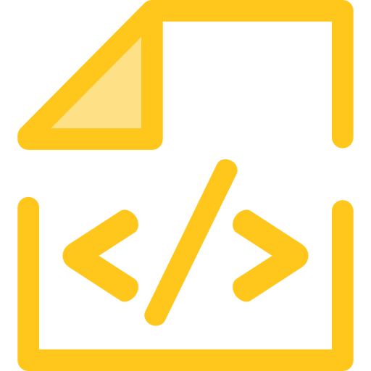
RubberDocs
+
=
{ }
debugging talk
speech-to-text & processing
documentation
{ page7 }

Slide 8

Further Development
Implementation as IDE Plugin, with refurbished lightweight GUI
specifically trained ML Model for processing of special keywords
Cross-Platform implementation
„mood“ recognition via Speech-To-Text API
Support for various Programming languages
Git Integration
Javadoc Integration
{ page8 }

Slide 9

{ }
RubberDocs
A Speech-To-Text Documentation Tool
//Almo Sutedjo //Constantin Geier
//Lorenz Huber
//Maria Pospelova @hackaTUM2019

