Slide 1

Capstone 1
TractorTek – Sales Tracking System
Presented by: Sai Prashanthi Manicka Premchand
03/11/2022

Slide 2
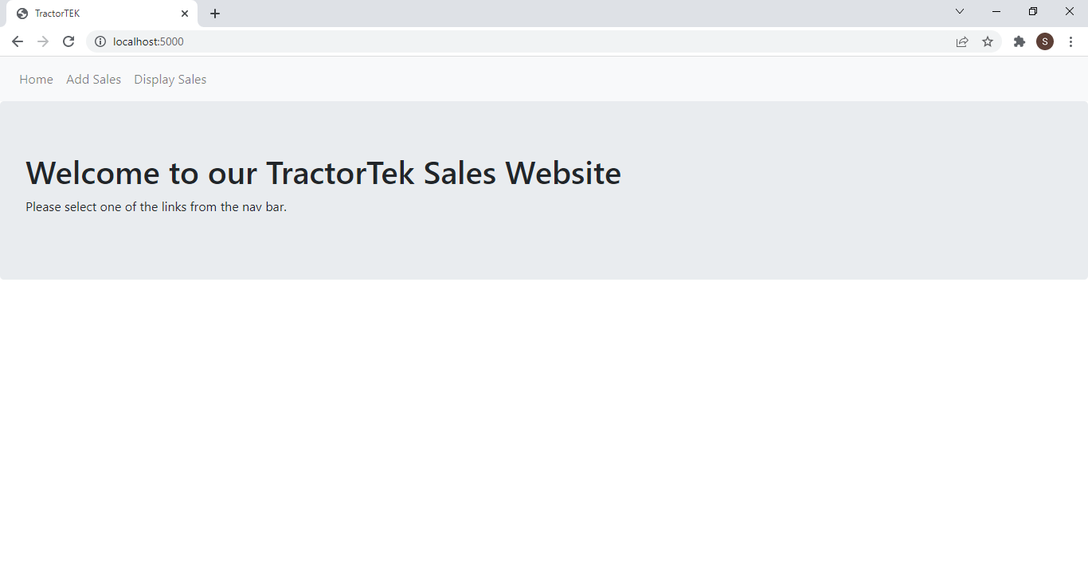
TractorTek Website for Sales Information
This website is designed to capture real time sales data needed for the TractorTek Company.
It also has the capability to display the sales data stored so far in the system.
The website has the following web pages
Home Page
Sales Data Entry Page
Sale Data Display Page

Slide 3
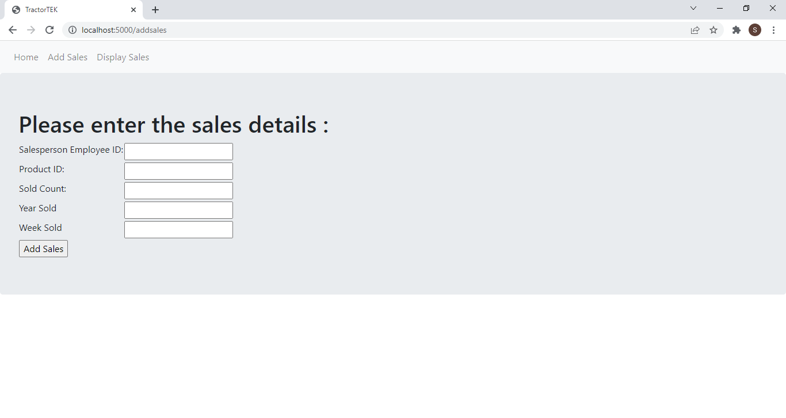
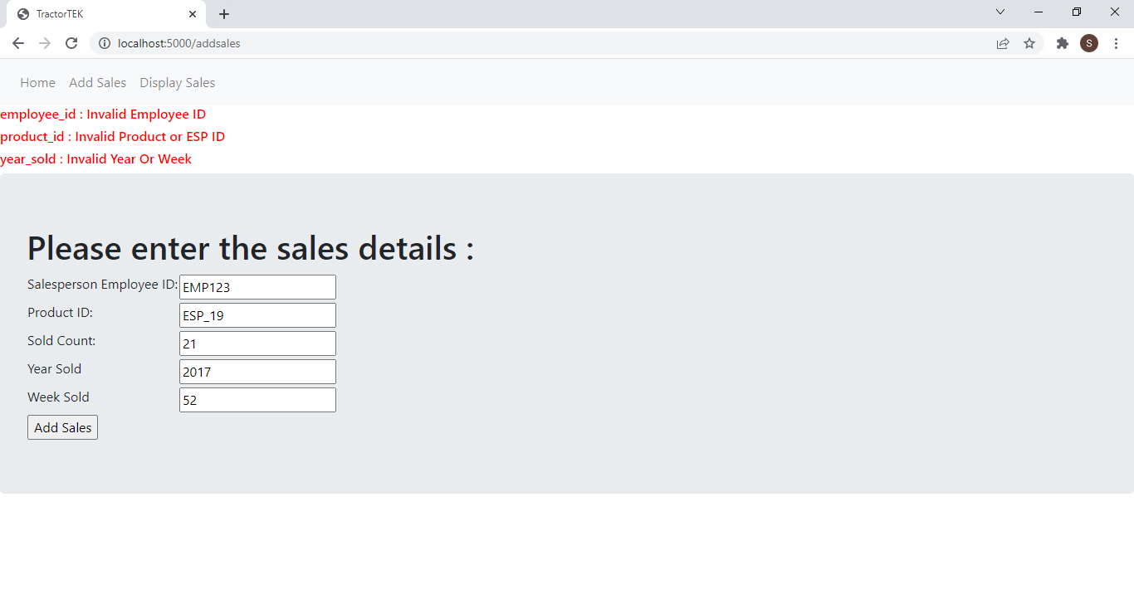
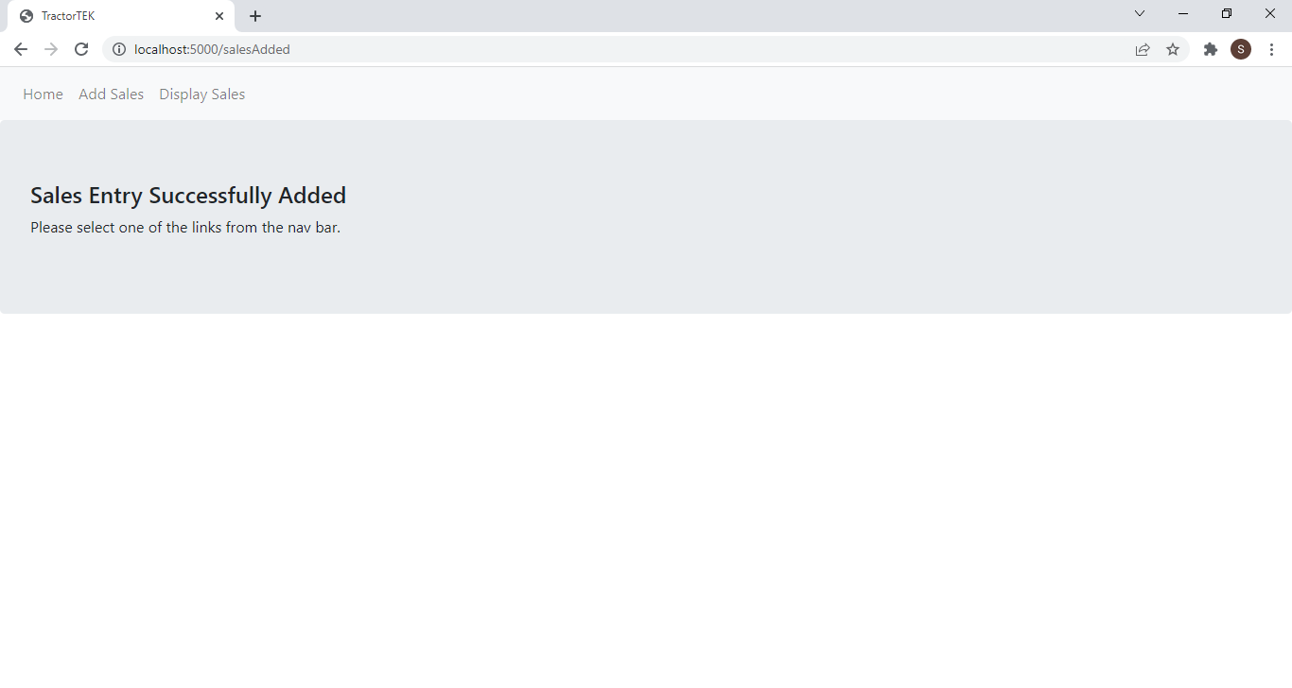
TractorTek Website for Sales Entry
The Sales Data Entry page(Screenshot 1) will be displayed when the Add Sales Menu is clicked.
All the fields are verified against the reference data and error messages will be displayed if not valid as shown in screenshot 2.
If all fields are valid then the data is stored in the database and Sales Added page is displayed as shown in screenshot 3

Slide 4
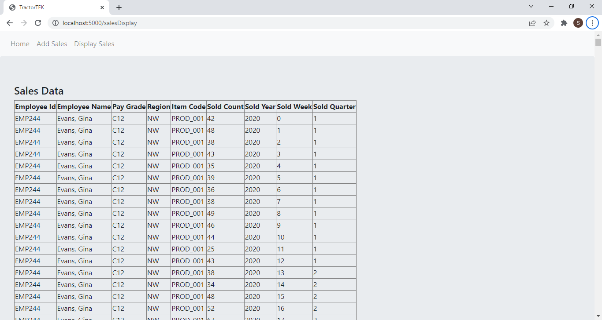
TractorTek Website for Sales Display
The website also has the capability to display all the sales data in tabular format.
It will be displayed as shown below when the Display Sales Menu is clicked.

Slide 5
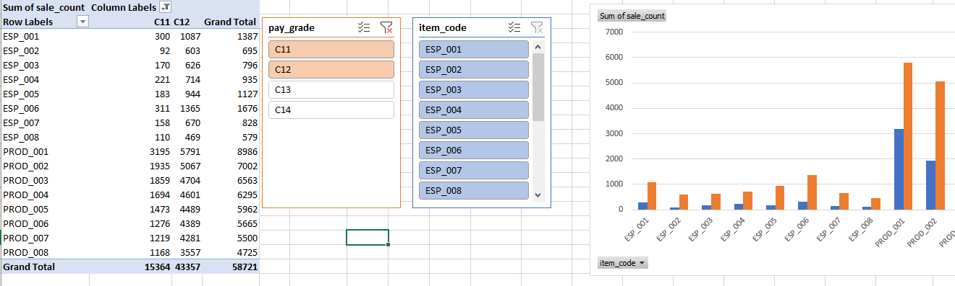
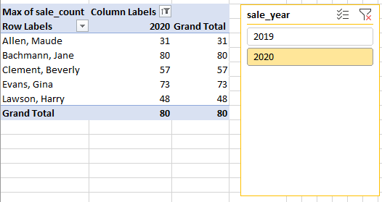
TractorTek Sales Dashboard
The following Excel dashboards help the sales manager to get various insights about the sales to track its performance & enhance decision making process.
These have been generated using the Pivot table & charts with adding few slicers on them.

Slide 6
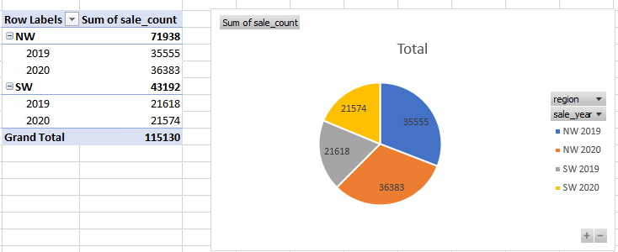
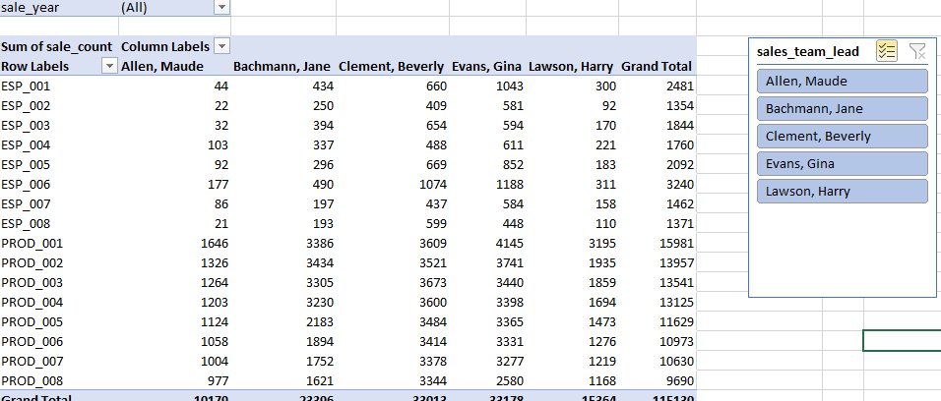
TractorTek Sales Dashboard (Contd.)
The sales dashboard provides information about the sales using aggregation and helps user to get insight about the sales from different perspective

Slide 7
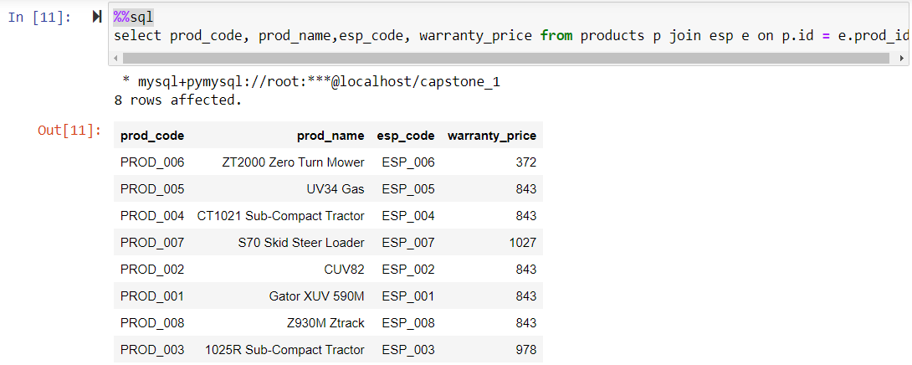
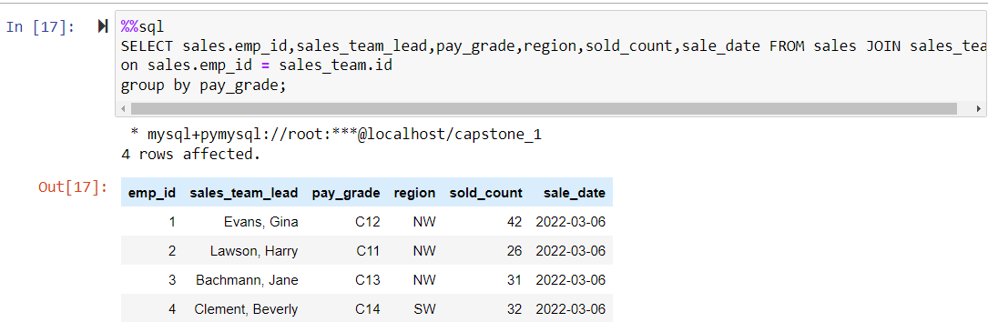
Tractor Tek – Analysis using Jupyter

Slide 8
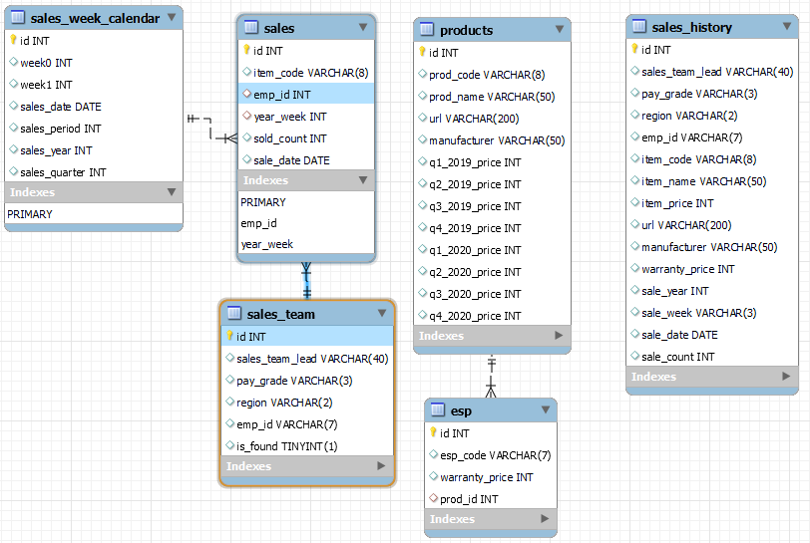
TractorTek – Database Design

Slide 9
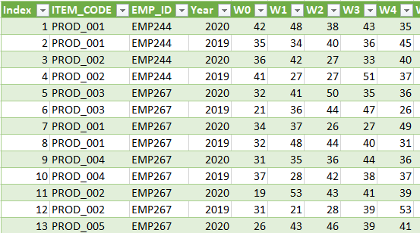
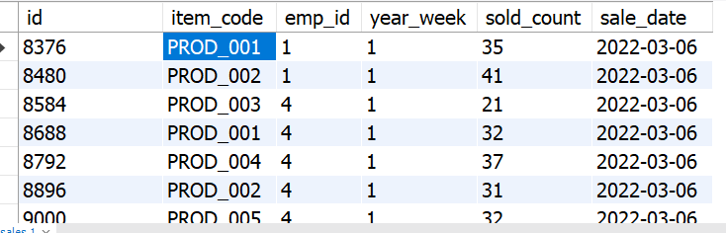
TractorTek – Data Restore from backup file (CSV File)
Since the previous system had crashed, the new system is restored from the backup data that was stored in CSV file and used pandas library along with sqlalchemy to read the data from file and store it in the MySQL database used by the new system.
The De-Normalized backup data from file is stored in Normalized form under sales table.

Slide 10
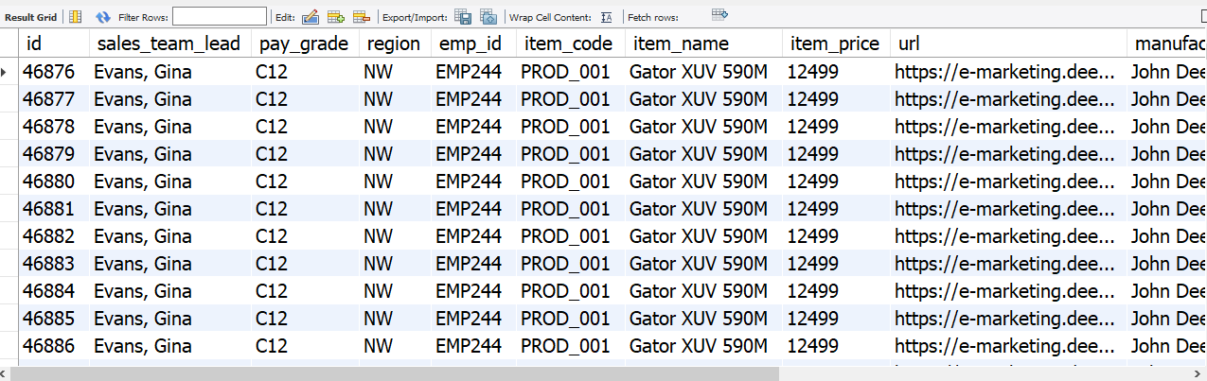
TractorTek – OLTP to OLAP
The OLTP to OLAP program does the following
The real time sales data are read and transformed to get all details from the foreign key relationships and stored in the OLAP normalized table.
Below is the OLAP table that is populated from this operation.

Slide 11

TractorTek – Sales tracking System

