Slide 1

Quantitative Comparison
Who wins in the race of time and space?
17th October 2025

Slide 2
Contents
Introduction
Experiment Setup
Observations & Results - Preprocessing
Observations & Results – Searching
Conclusions & Next steps

Slide 3
Quantitatively assess who does better in the race of time and space.
Introduction
Python
Rust
Interpreted Language
Ease of Use
Memory Management (Uses automatic garbage collection)
Exceptionally rich library support for data science
Faster development and experimentation cycles
Parallelism(Constrained by GIL)
Error Handling
Compiler Language
Suitable for performance-critical applications
Uses an ownership model for safe and deterministic memory handling.
Enforces strong compile-time checks
Concurrency
Growing ecosystem (notably Polars, ndarray, Arrow for data processing).
Best suited for high-performance
Notes:
Python is a high-level, interpreted language known for its simplicity and readability. It's dynamically typed, has extensive library support, and is widely used in data science, web development, and automation. Python prioritizes developer productivity and ease of use, making it an excellent choice for rapid prototyping and applications where development speed is crucial.
emphasizes safety, performance, and concurrency. It's statically typed and compiled, offering memory safety without garbage collection through its unique ownership model. Rust is designed for performance-critical applications where control over system resources is essential, such as operating systems, game engines, and embedded systems.

Slide 4
We are assessing performance and memory in two scenarios
Experimental Setup
Preprocessing
Detect Column types
Missing value detection
Imputation
Normalization
Add / Drop Columns
Filter rows
Sorting
Sampling
Searching Algorithms
Linear Search
Binary Search
Interpolation Search
Jump Search
Notes:
We designed identical algorithms and data structures in both languages to ensure fair comparison. All tests were run multiple times to account for variability, and we measured both execution time and memory consumption across different workload sizes.

Slide 5
Preprocessing
Dataset size
Healthcare claims dataset
Size of Data : (116352, 32)
~14MB in size
Searching Algorithms
Array of size 1 million within a range MIN and MAX
Statistics obtained on scenarios searching
First
Middle
Last
Element < MIN
Element > MAX
Time profiling
Python - line profiler
Rust – Measuring Elapsed time
Hyperfine - Benchmarking for execution time
Memory Profiling
Python – memory_profiler
Rust – using sysinfo

Slide 6
Observations & Results
Preprocessing

Slide 7
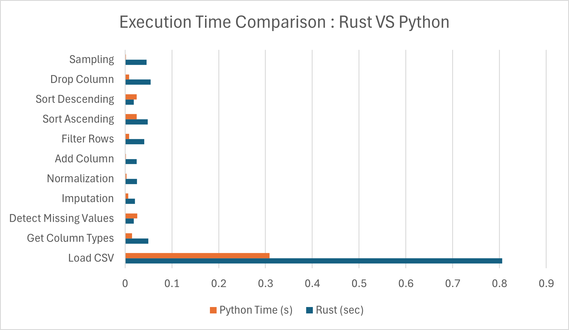
Python wins at each individual task execution time
Time Profiling Comparison
Loading dominated in both
Python dominates in execution time per operation
Visualizations shows Python’s optimization and efficiency in data operations

Slide 8
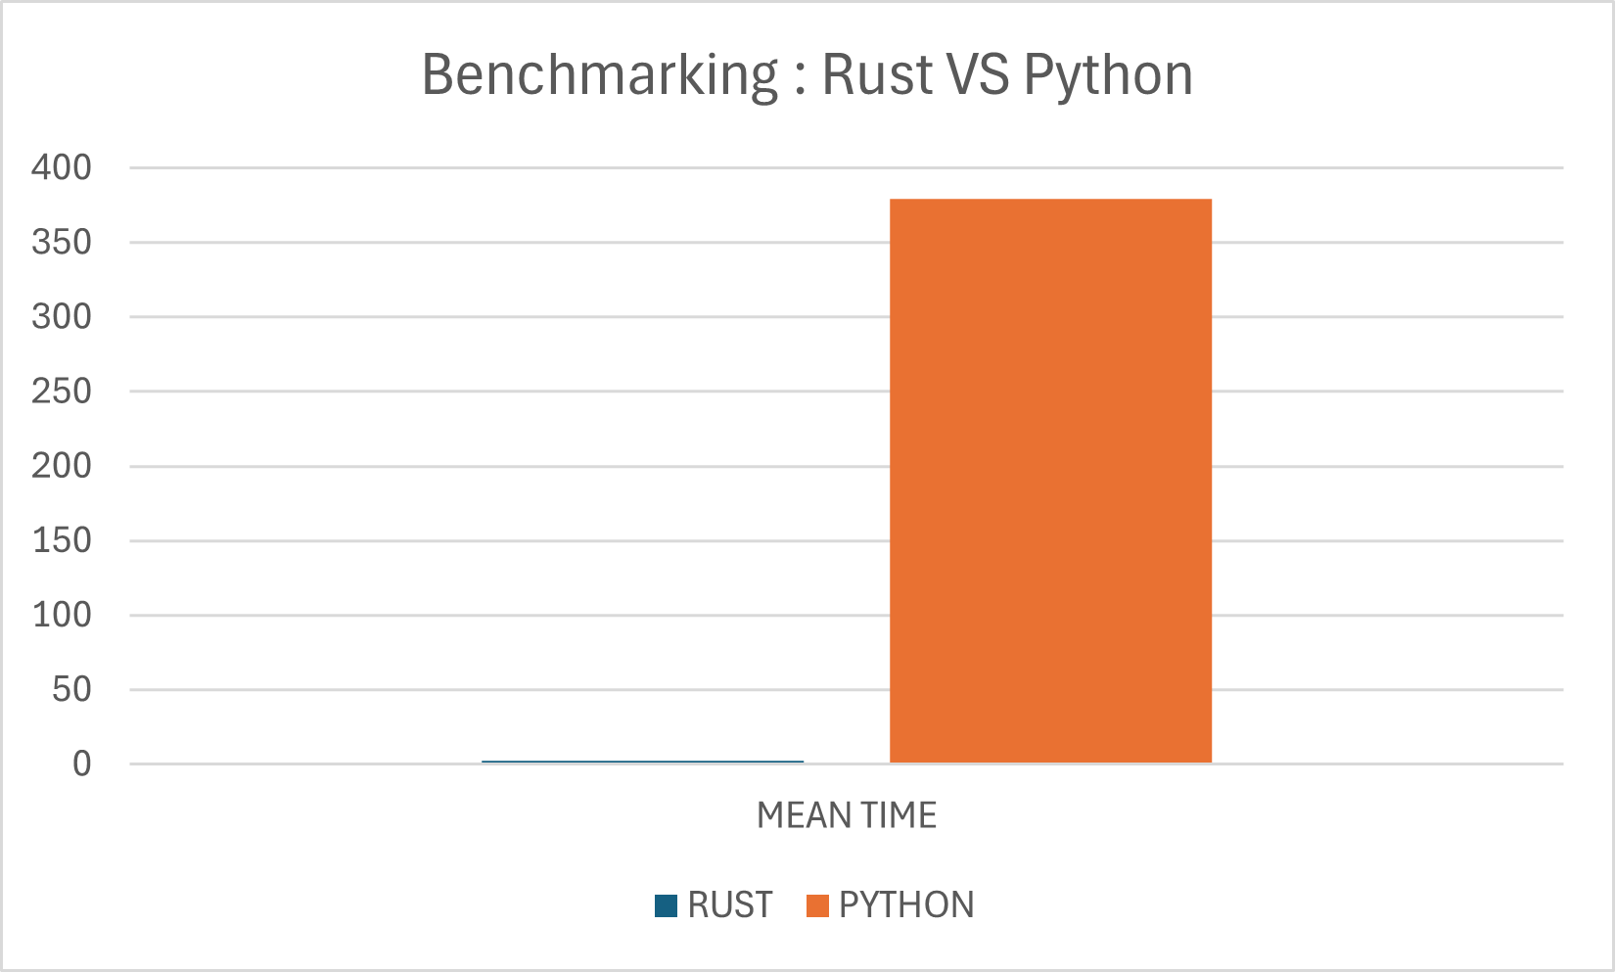
Benchmarking tells us a different story
Rust ████ 2.3ms
Python ████████████████████████ 379.5ms
Warmup Impact
Stability
Warmup (3 runs): Rust stabilized instantly, Python took ~0.39s.
Warmup (10 runs): Rust stable at 0.00s, Python stable around 0.38s.
Improvement due to warmup
Rust : 44%
Python : 4%
This shows that the reason for slow per-operation execution is due to cache misses in course of process execution

Slide 9
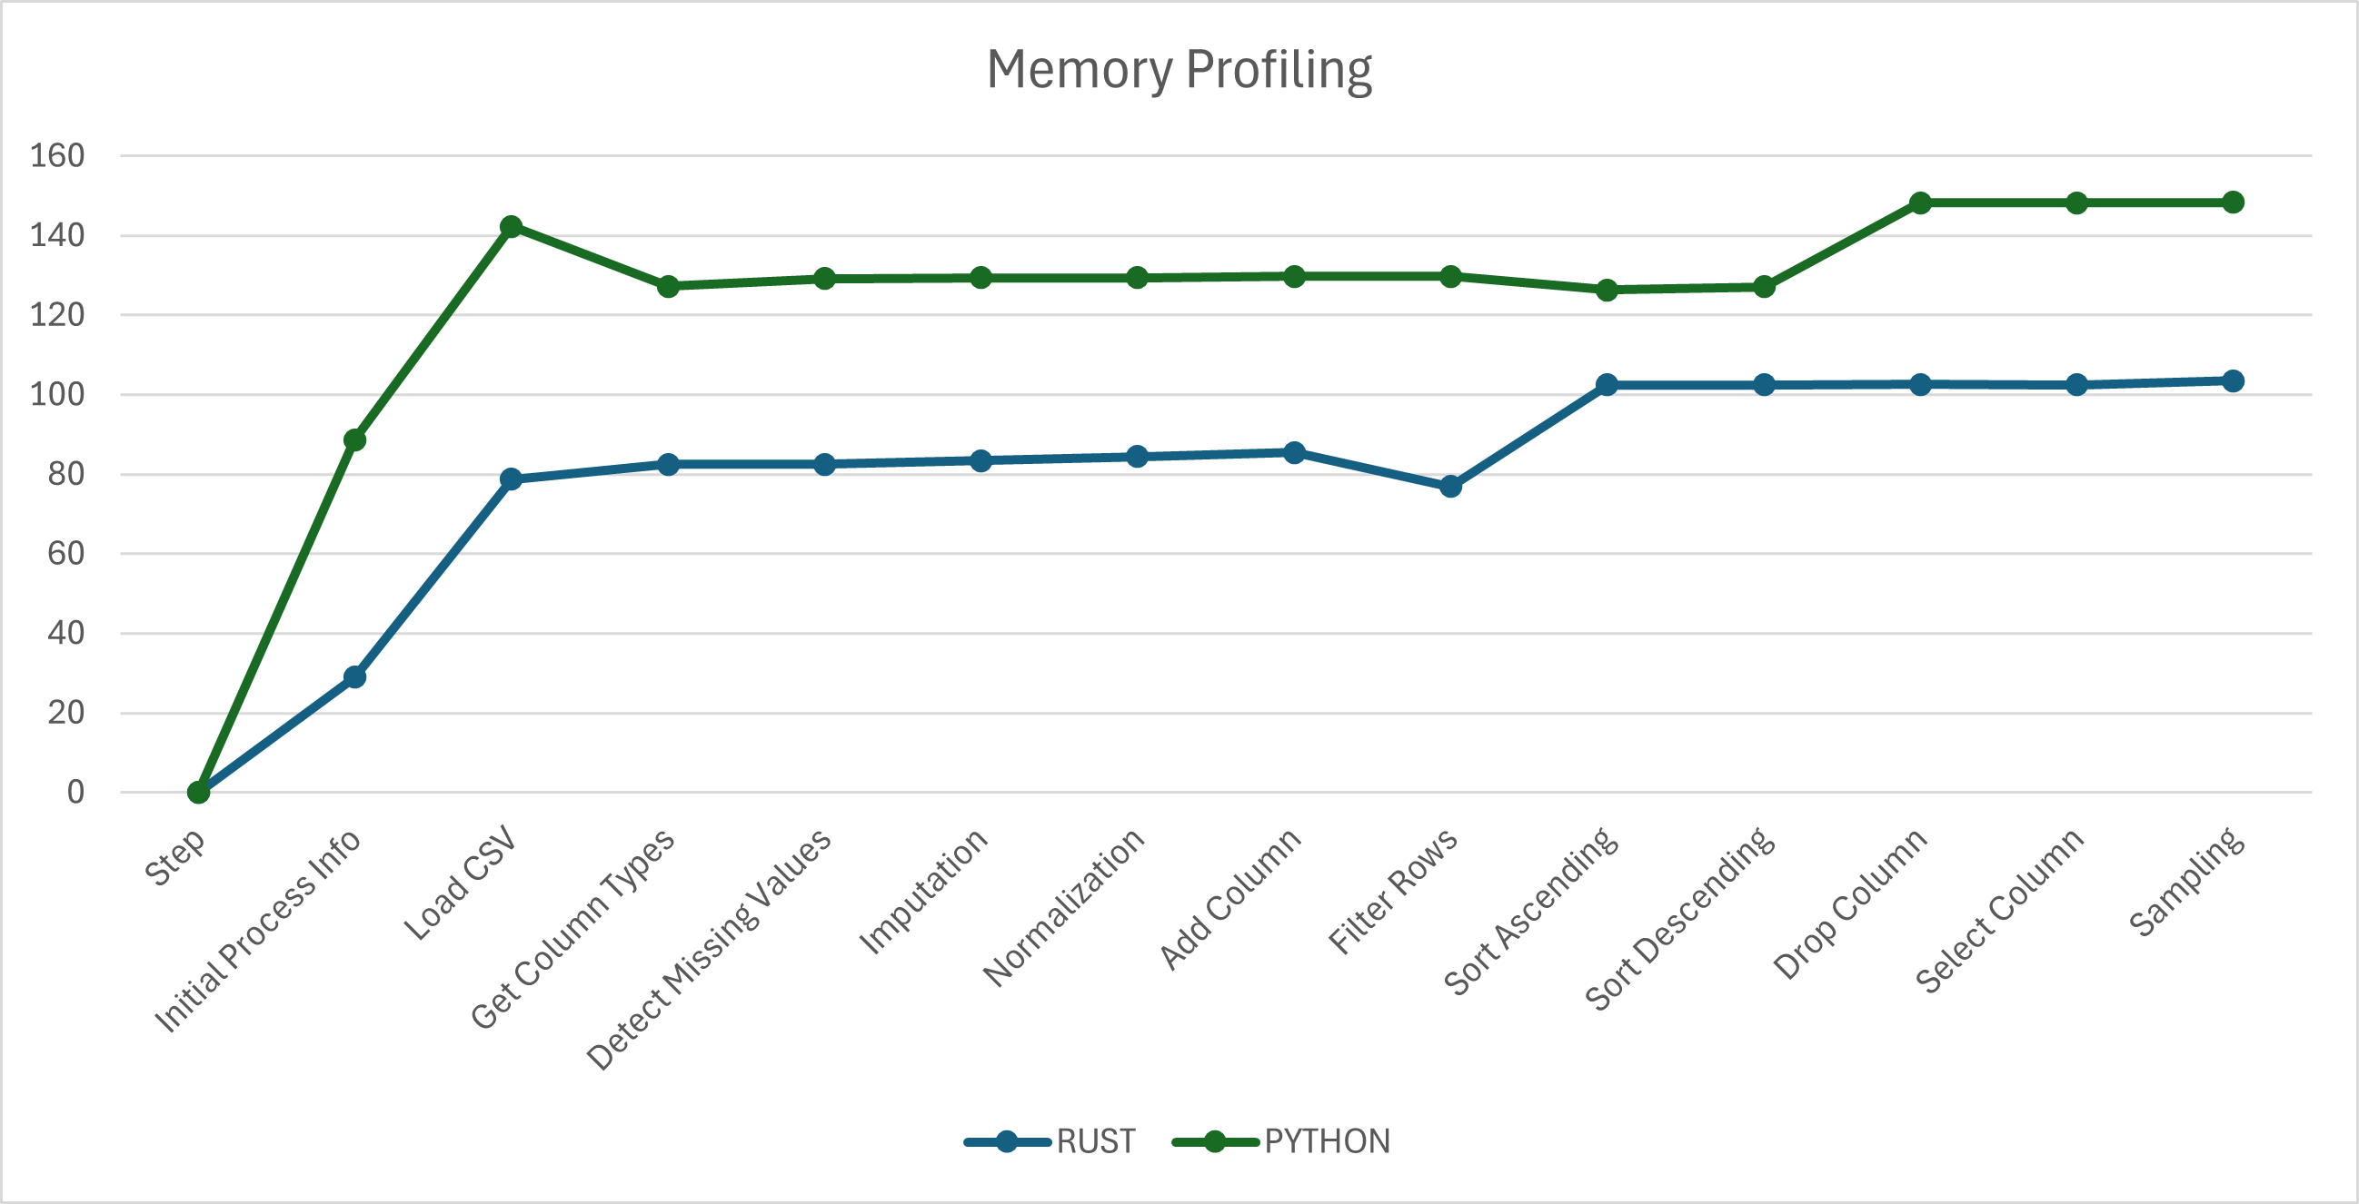
Rust consistently uses less memory than Python
Memory Profiling
Average memory footprint
Rust ~88 MB
Python ~134 MB
Peak Memory
Rust : 103MB
Python : 148MB
What is the use ?
More predictable scaling for large datasets.

Slide 10
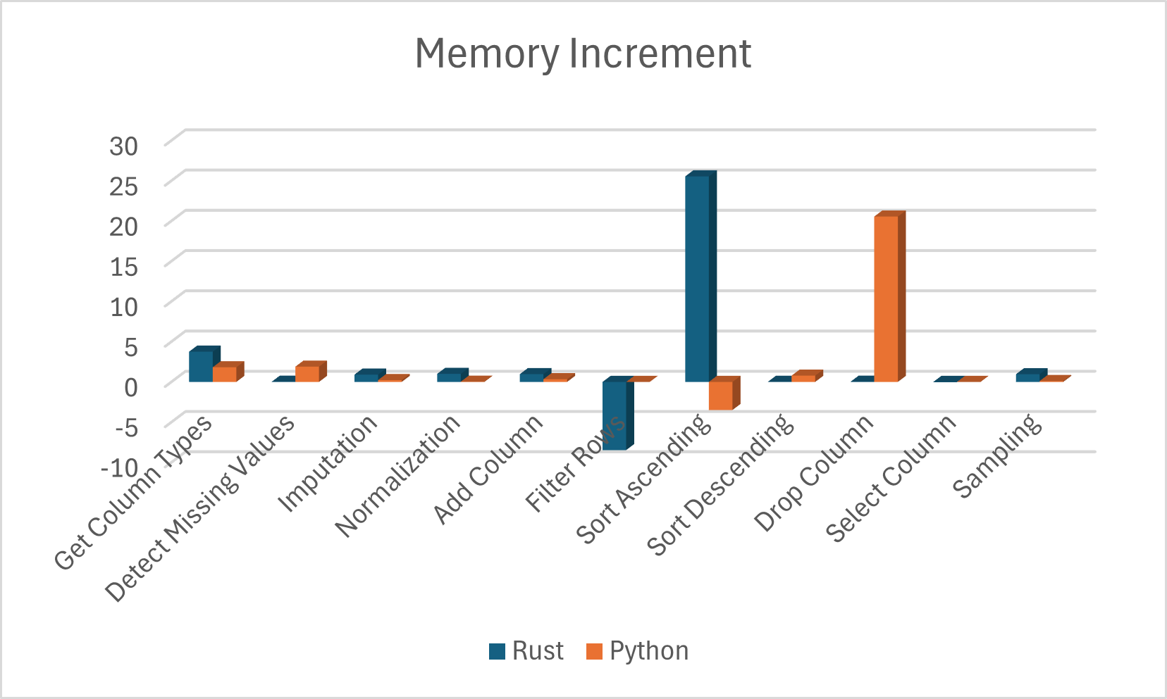
Rust shows controlled memory reuse (drops after filtering), while Python retains buffers.
Could be the result of selected rows getting dereferenced.(Ownership & Borrowing)

Slide 11
Observations & Results
Searching Algorithms

Slide 12
We observe that Python performs significantly better than Rust
Time Profiling
 | Rust | Python
Search Algorithm | Time sec | Time sec
Binary | 1.124155 | 0.26
Interpolation | 1.07282 | 0.32126
Jump | 1.024465 | 0.321994
Linear | 1.041261 | 1.04
These are results of benchmarking on hyperfine
There is no help even after warmup

Slide 13
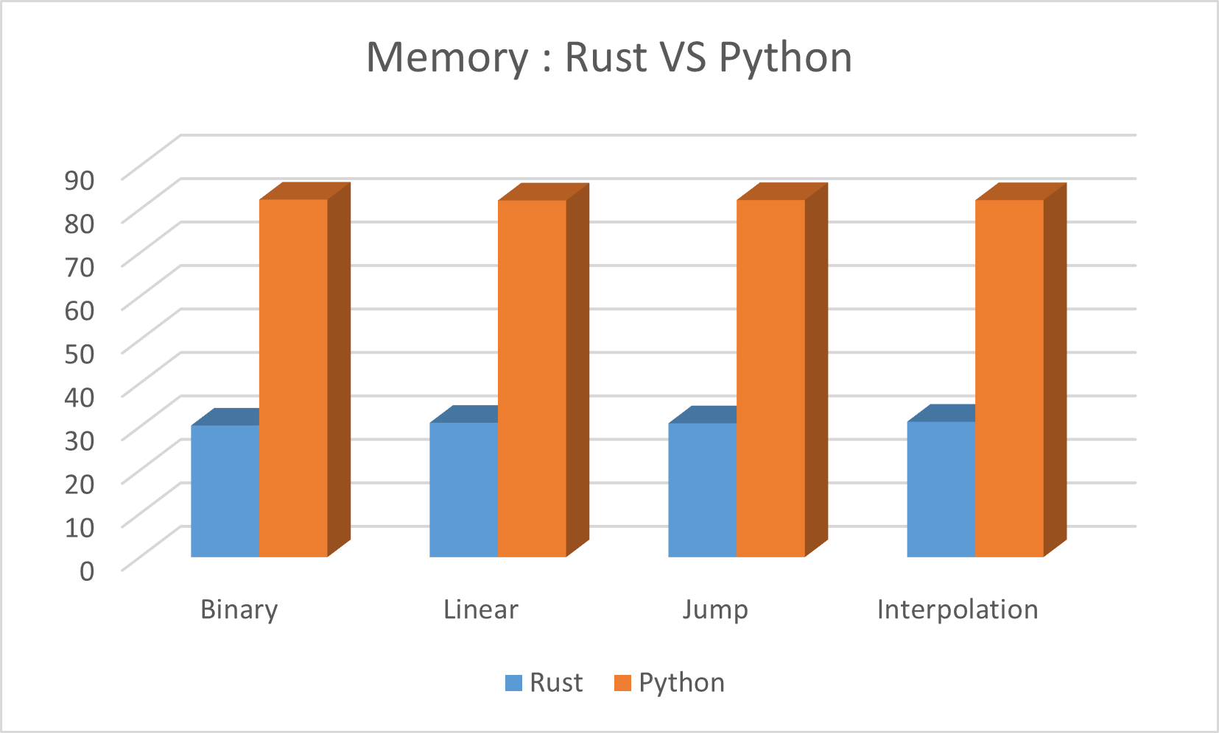
Memory Profiling
Rust is much more memory-efficient — roughly 2.7× less memory than Python across all algorithms
The difference across algorithms within the same language is minimal
The variation (max–min) within:
  Rust: ~0.9 MB (very stable)
  Python: ~0.2 MB (also stable)

Slide 14
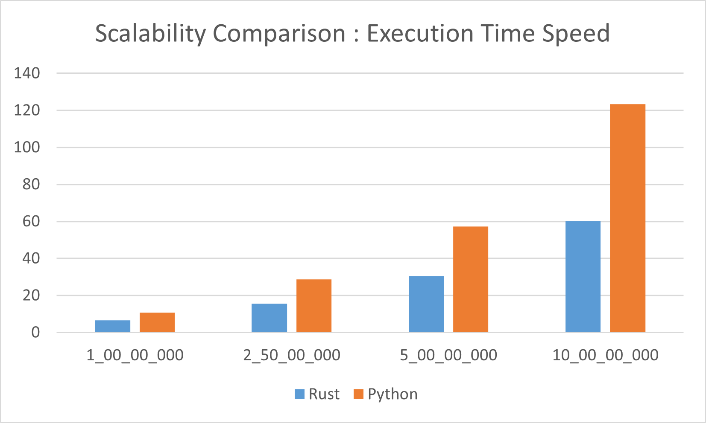
Scalability
What happens when we increase array size?
Who scales better?
Consider the search algorithm with max time complexity
The comparative study shows that Rust consistently outperforms Python in both execution time and memory efficiency

Slide 15
Conclusions
Time Performance
  Rust outperforms Python in both preprocessing and searching speed.
  Shows better scalability and is ideal for high-performance ETL and real-time data processing.
  Python remains stronger for rapid prototyping and flexibility.
Memory Performance
  Rust uses less and more predictable memory across all tasks.
  Its ownership model ensures efficient reuse, unlike Python’s garbage collection.
  Rust offers stable, scalable performance, while Python suits analytical experimentation.

Slide 16
Next Steps
Integrate multi-threading and parallelism in Rust and multiprocessing in Python to evaluate performance gains and CPU utilization under concurrent workloads.
Expand the scope to other algorithmic domains such as sorting, regression, and clustering to generalize the performance trends observed.

Slide 17


Slide 18


Slide 19
Pranav Phanindra Sai Manepalli
pranavphanindrasai.manepalli@zelis.com
7981145597

