Slide 1
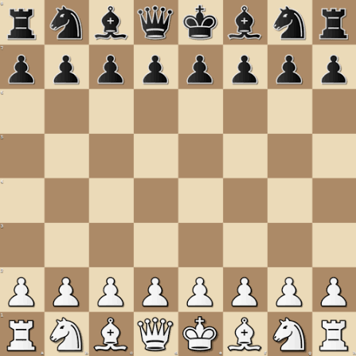
rnbqkbnr/pppppppp/8/8/8/8/PPPPPPPP/RNBQKBNR
FROM PIXELS TO POSITIONS
Chess FEN Generation via Machine Learning
Mahidas Prabhanjan
TECH 27, Summer 2026
Instructor: Ms. Ishaani Priyadarshini

Slide 2


THE CHALLENGE OF CHESS
Defining the core objective and the unforgiving nature of FEN.
Why standard metrics fail
98.4% square accuracy is 0% board accuracy.
Core Objective
One hallucinated pawn ruins the entire game state.
Accurately translate a raw 2D chessboard image into its standardized Forsyth-Edwards Notation (FEN) state.
FEN generation requires absolute structural perfection.

Slide 3


EVALUATION CRITERIA
Success Metrics
Failure Triggers
>80%
<50%
Exact Board FEN Accuracy
Exact Board FEN Accuracy
Real-time inference latency suitable for live application.
High square accuracy driven entirely by "empty square" bias.

Slide 4






PIPELINE METHODOLOGY
Breaking down full-board complexity into square-level classification.
linkDataSet Source: https://www.kaggle.com/datasets/koryakinp/chess-positions
1. Preprocessing
2. Grid Slicing
3. Model Inference
4. Reconstruction
Resize raw image to 200x200x3.
Isolate 64 distinct 25x25 squares.
Classify 13 piece types per square.
Compile sequence back to FEN.
For Basic Models

Slide 5

DATA ENGINEERING
Resampling
Target Parsing
Grid Slicing
Lanczos algorithm compresses raw images to a standardized 200x200 canvas.
Python scripts expand alphanumeric FEN strings into 13 distinct integer classes.
Mathematical cropping yields 64 isolated 25x25x3 training squares per board.

Slide 6


ENSURING MODEL INTEGRITY
Handling statistical bias and preventing data leakage.
Class Balancing
Maximum 32 squares occupied. Strict random sampling forces equal piece-to-empty ratios to prevent baseline guessing.
Data Isolation
The Inference Vault
Training squares strictly segregated from full-board test pools.
Unused full-board images mathematically quarantined to prevent evaluation leakage.

Slide 7

SCALE & METRICS :: Basic Models
80K
20K
200
TRAINING SQUARES
TESTING SQUARES
PRISTINE BOARDS
Tracked Evaluations:
Exact Board FEN Accuracy • Per-Class F1-Score • Inference Latency

Slide 8
TRADITIONAL ML BASELINE
1,875 flattened features extracted from 25x25x3 RGB squares.
Logistic Regression: 200 max iterations.
k-Nearest Neighbors: Optimized at k=5.
Random Forest: 100 deep estimators.
Support Vector Machine: Non-linear RBF kernel.
Histogram Gradient Boosting: Scale-optimized for >10K data.

Slide 9


THE LATENCY TRADE-OFF
Synthetic Success
All 5 baseline models achieved near 100% accuracy exclusively because the synthetic data lacked shadows, noise, and angle distortion.
Massive Inference Lag
k-NN and SVM required up to 689 seconds to predict the test set, failing real-time latency requirements.

Slide 10

Moving to the Neural Networks ….
Neural Networks
Three distinct model architectures were evaluated to find the optimal trade-off:
Multilayer Perceptron (MLP)
Convolutional Network (CNN)
Advanced CNN (Adv CNN)
Dataset Split
Structured partitions ensuring balanced training and rigorous evaluation:
80K Training Samples
20K Testing Samples
200x20x3 Resolution
Inference & Validation
Tested against real-world, out-of-distribution environments:
Additionally, a few external images sourced from the Internet was used to perform sampling inferencing.

Slide 11
THE MLP’s CEILING
120K Flat Features → Dense(512, 256, 128) → Softmax
63.6%
MAXIMUM TEST ACCURACY STALLED
Flattening spatial data destroyed structural context. The neural network minimized loss by blindly guessing "empty" (74.8% accuracy on blanks, ~0% on pieces).

Slide 12



BASE CONVOLUTIONAL NETWORK
Architecture
Result
Constraint
3 Convolutional blocks (32, 64, 128) coupled with Max Pooling.
Accuracy immediately jumped to ~99% by preserving 2D geometry.
Minor F1 bleed between structurally similar pieces (Kings and Queens).

Slide 13

ADVANCED CNN OPTIMIZATION
Architecture Scaling
99.99%
4th Conv Block (256 filters)
Expanded Dense Logic (1024 nodes)
Exact Board Accuracy
Aggressive Dropout (0.4)
Near-perfect F1-scores across all 13 classes.
Dynamic Learning Rate Decay

Slide 14
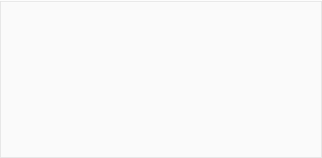
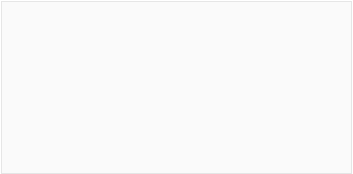
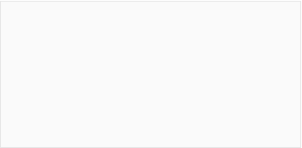
COMPUTER VISION PIPELINE
Bridging real-world photos to rigid CNN inputs.
1. OpenCV Processing
2. Perspective Warp
3. Dynamic Cropping
Grayscale conversion, Gaussian Blur, and Canny Edge Detection locate the outer boundary.
Mathematical flattening transforms angled photos into strict top-down matrices.
Fallback logic shaves 4% margins to bypass disruptive coordinate borders.

Slide 15
CHALLENGES & SOLUTIONS
The CV Trap
Grid Misalignment
Issue: OpenCV contour logic latched onto single internal squares.
Issue: Coordinate borders pushed physical squares inward, misaligning CNN receptive fields.
Solution: Area thresholding forced OpenCV to reject polygons under 40% image footprint.
Solution: Dynamic fallback cropper shaves precise margins before resampling.

Slide 16




ETHICS & LIMITATIONS
Ethical Exposure
Training Bias
Visual Constraints
Automated extraction facilitates direct integration with cheating engines online. But IMO, benefits outweigh cheating considerations!!
Struggles generalizing to 3D physical boards with wood textures and lighting variants.
Requires full visibility. Model fails against heavily occluded states.

Slide 17
A Fantastic Exposure!!
ML Discipline is not just Model Training!
Data Engineering can be more complex/challenging in some cases such as the FEN Prediction on a Chessboard
Merely Looking at Accuracy can Fool you!
Gradually leveling up from basic Models to Advanced ones demonstrate Training Complexity v/s Usefulness, and many other Tradeoffs!
GPU Acceleration and UMA on Mac M5 Pro MAX made it 6 Times Faster!! GPU Acceleration is REAL!! :-)
Memory Hungry: My Mac M5 Pro MAX w/ 128GB was NOT Sufficient!! MAX Memory Usage Shot up to 150GB for CNNs!!

Slide 18
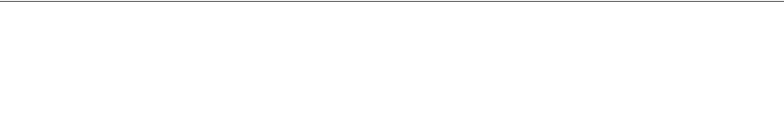
Next Steps….
Next Step: Augmentation
Next Step: Edge Deployment
Introduce rotation, noise, and synthetic shadows to generalize to 3D physical play.
Optimize model weights (TensorFlow Lite) for real-time mobile app inference.
Next Step: Memory Optimization
Next Step: Solve Inferencing Challenges
Mac M5 Pro MAX with 128GB NOT Enough! Tuning batch_sizing; more gc.collect()
How to detect and remove borders & other ‘Noise’ from the images before Inferencing
Next Step: Improve Model Efficiency for Real-world Inferencing
Next Step: FEN To Image
Reverse: FEN To Chessboard Image Generation!
Feeding a real-world Chessboard image, Adv-CNN model still misses few Pieces!

Slide 19


THANK YOU
From Pixels to Positions: Chessboard State Reconstruction

