Slide 1
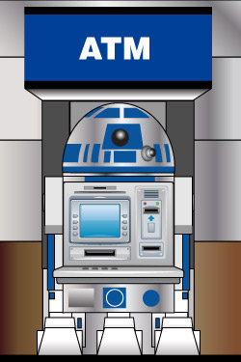
SMART AUTOMATED TELLER MACHINE(ATM)
PRADEEP RAJA MOHAN
Internal Guide – Dr.K.Balasubadra
Department of Information Technology,
RMD Engineering College
1
Notes:
1

Slide 2
OBJECTIVE
In this project, a Bio-metric system is proposed for secure remote ATM transaction.

Slide 3
ABSTRACT
To prevent fraudulent activities by detecting and identifying the person automatically.
This machine can also collect images of individuals who use their devices as a means to better catch criminals.
Once a fraudulent transaction is committed, law enforcement officials can go back into a catalogue of facial images and find who used particular banking devices at certain times.

Slide 4
TECHNOLOGY INVOLVED
Iris recognition is an automated method of biometric identification that uses mathematical pattern-recognition techniques on images of the iris of an individual's eyes.
Iris complex random patterns are unique and can be seen from some distance.
Iris Recognition analyzes the characteristics of a person's iris images input through a digital video camera.
This camera will capture images of the individuals at the transaction terminal.

Slide 5
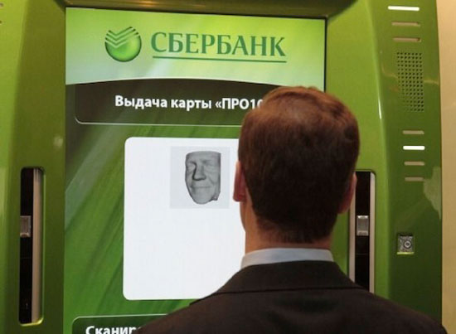
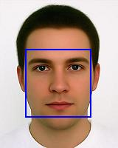
CAPTURED IMAGE
Fig:The image of an individual captured at the
transaction terminal

Slide 6
Image Details CONTD...
First it measures the inner and outer boundaries of the iris (pupil and limbus).
Further subroutines detect and exclude eyelids, eyelashes, and specular reflections that often occlude parts of the iris.
Also these measurements are already retained in a database.
This is used for comparison when a user stands before the camera each time which provides authentication.

Slide 7
FEATURES
Simplest method for obtaining high security.
A key advantage of iris recognition is its speed of matching and its extreme resistance to false matches.
Supports easy installation method.
This biometric solution needs a very easy and simple maintenance.
An iris scan is similar to taking a photograph and can be performed from about 10 cm to a few meters away.

Slide 8
METHODOLOGY
The following four-stage process illustrates the way biometric systems operate,
Capture - Physical or behavioral sample is captured by the system during enrollment
Extraction - Unique data is extracted from the sample and a template is created
Comparison - The template is then compared with a new sample
Matching - The system then decides if the features extracted from the new sample are matching or not

Slide 9
PROCEDURE
The steps involved in Smart ATM :
User places the ATM card in the slot and enters the 4 digit PIN.
The iris of the user is imaged and corresponding iris code is generated using the image.
The PIN and iris code is compared with the those already in the database.

Slide 10
Procedure CONTD...
In the database the iris code will be present and also the PIN is kept hidden inside the image.
This encrypted hidden PIN and the iris code is compared with those generated at the terminal.
When both matches, the individual is authorized to perform transactions with the machine else the user is not authorized

Slide 11
ALGORITHM USED
The algorithm used to extract the iris portion from an image is Canny’s Edge Detection Algorithm.
This algorithm is known to many as the optimal edge detector.
The following criterion are considered :
The first and most obvious criteria is low error rate. It is important that edges occurring in images should not be missed. Also there be NO responses to non-edges.

Slide 12
Algorithm CONTD...
The second criteria is that the edge points be well localized. In other words, the distance between the edge pixels as found by the detector and the actual edge is to be at a minimum.
A third criteria is to have only one response to a single edge. Based on these criteria, the canny edge detector first smoothes the image to eliminate noise.

Slide 13
STEPS IN THE CANNY’S EDGE DETECTION ALGORITHM
Step 1: The first step is to filter out any noise in the original image before trying to locate and detect any edges.
the Gaussian filter can be computed using a simple mask. After calculating a suitable mask, the Gaussian smoothing can be performed using standard convolution methods.
The larger the width of the Gaussian mask, the lower is the detector's sensitivity to noise. The localization error in the detected edges also increases slightly as the Gaussian width is increased.

Slide 14
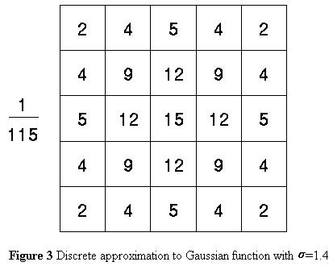
Algorithm Steps CONTD...
The follwing ahows the sample Gaussian mask,

Slide 15
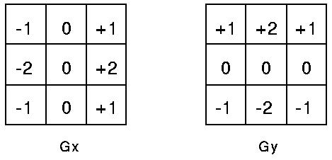
Algorithm Steps CONTD...
Step 2: After smoothing the image and eliminating the noise, the next step is to find the edge strength using sobel operator.
The Sobel operator uses a pair of 3x3 convolution masks along x-direction (columns) and y-direction (rows). They are shown below:

Slide 16
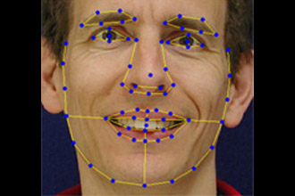
Fig: Canny’s Edge Detection Algorithm

Slide 17
Algorithm Steps CONTD...
Step 3: The magnitude, or edge strength, of the gradient is then approximated using the formula:
|G| = |G_{x}| + |G_{y}|
The direction is found using the formula,
Theta = tan⁻¹ (G_{y} / G_{x})
Also, when the gradient in x direction is zero , the edge direction has to be to 90ᵒ or 0ᵒ.
If G_{y} value is zero, the edge direction will be 0ᵒ. Otherwise the edge direction will equal 90ᵒ.

Slide 18
Algorithm Steps CONTD...
Step 4: After calculating the edge direction, the next step is to relate them with the image,
x x x x x x x x x x x x a x x x x x x x x x x x x
By looking at pixel "a", there are four possible directions 0ᵒ (in the horizontal direction), 45ᵒ (along the positive diagonal), 90ᵒ (in the vertical direction), or 135ᵒ (along the negative diagonal).

Slide 19
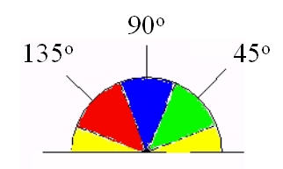
Algorithm Steps CONTD...
Step 4: So the edge orientation has to be resolved into one of these four directions as shown below,
Any edge direction falling within the yellow range (0ᵒ to 22.5ᵒ & 157.5ᵒ to 180ᵒ) is set to 0ᵒ, green range (22.5ᵒ to 67.5ᵒ) is set to 45ᵒ,blue range (67.5ᵒ to 112.5ᵒ) is set to 90ᵒ.red range (112.5ᵒ to 157.5ᵒ) is set to 135ᵒ.

Slide 20
Algorithm Steps CONTD...
Step 5: After the edge directions are known, nonmaximum suppression has to be applied to trace along the edge in the edge direction to give a thin line in the output image.
Step 6: Finally Hysteresis is used as a means of eliminating streaking which is breaking up of an edge contour caused by the operator output fluctuating above and below the threshold.

Slide 21
STEGANOGRAPHIC STORAGE OF PIN NUMBER
Each Pixel is given an RGB value between 0 and 255
8 Bits Necessary to store pixel values.
The Pin number is represented in terms of binary.
The binary information is stored in the LSB of the image.

Slide 22
AUTHENTICATION MECHANISM
User Input
PIN number
Retinal scanned image
The image is detected using edge detection algorithm and compared with the steganographic image in the database
The original PIN number is extracted from the steganographic image and compared with the input image.

Slide 23
IMAGE SCALING
There are four steps in this stage,
Scaling the image to the number of pixels which is most approximate to and greater than 3350.
Making the number of pixels of the image exactly equal to 3350.
Making the size of the image 80*80 pixels.
Converting the image to grey scale.

Slide 24
STRENGTHS
Prevent card skimming.
Identify criminals(Image Database)
Provides high security
Easy installation and maintenance
Steganography hides the PIN number in the database

Slide 25
OPPORTUNITIES
Opening more joint ventures
Emerging markets
In India alone we have more than millions of ATMs.
International expansion
Favourable demographic
Free market economy

Slide 26
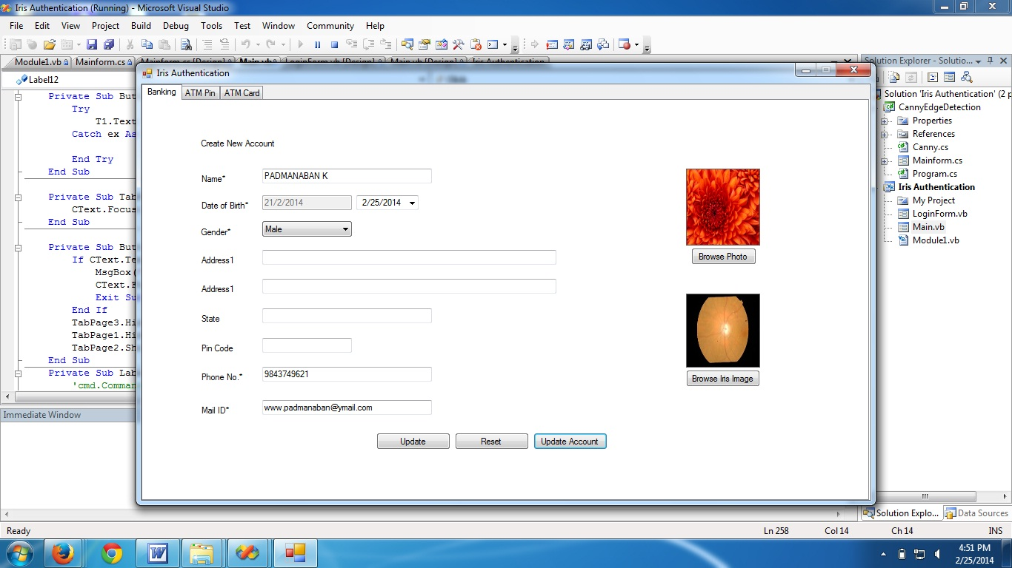
Creating Account

Slide 27
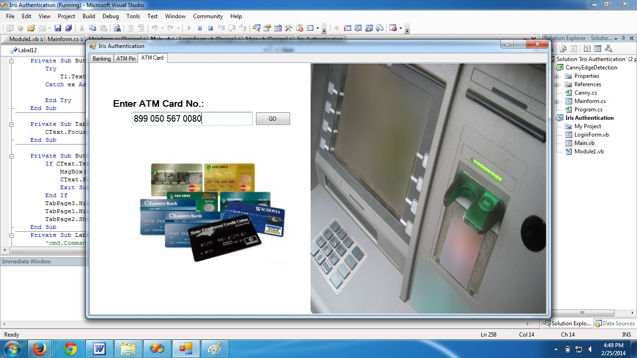
Entering ATM Card Number

Slide 28
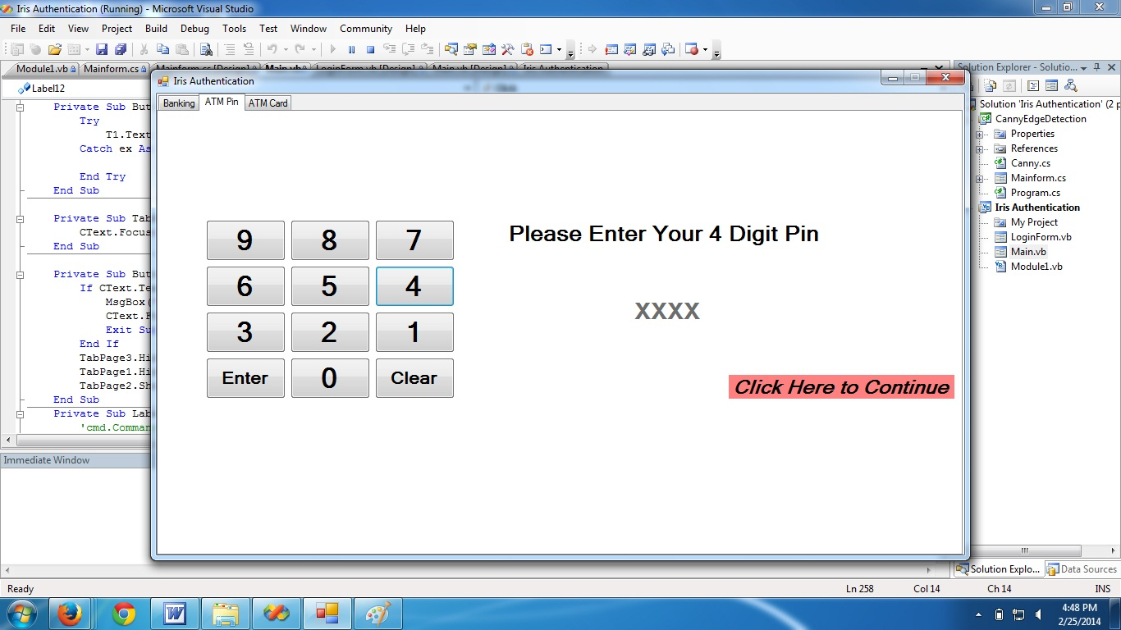
Entering ATM PIN

Slide 29
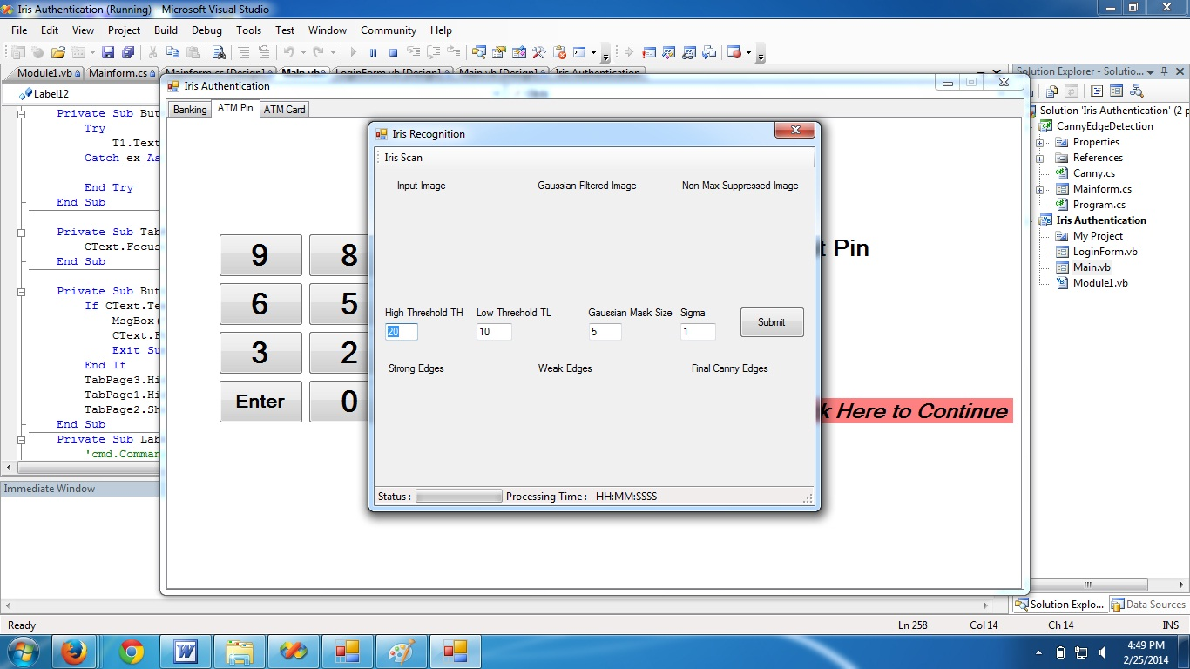
Applying Canny’s Algorithm

Slide 30
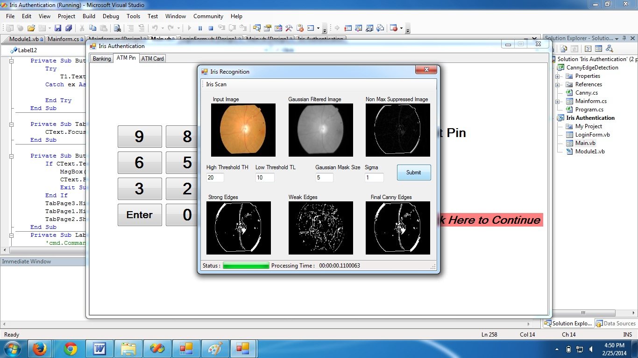
Final Output Image

Slide 31
Conclusion and Future Extension

Slide 32


