Slide 1
SPARK
Introduction:
Apache Spark is a fast and general-purpose cluster computing system. It provides high-level APIs in Java, Scala, and Python. In general, it is a powerful open source and an optimized Processing Engine that is compatible with Apache Hadoop.
Developer:
UC Berkeley AMPLab and later donated to Apache Software Foundation.
Benefits:
Improves efficiency through:
- In-memory computing primitive
- General computation graphs
Improves usability through:
- Rich APIs in Java, Scala, Python
- Interactive shell
Up to 100× faster
Often 2 - 10x less code
©Aswin Ramakrishnan

Slide 2
SETUP
Download Site:
http://spark.apache.org/downloads.html
Configuration:
tar xzf spark-x.y.z-bin-distro.tgz
mv spark-x.y.z-bin-distro.tgz spark
export SPARK_HOME=~/home/vagrant/spark
export PATH=$PATH:$SPARK_HOME/bin
Perfect Installation:
$spark-shell
scala>
scala>sc
res0:org.apache.spark.SparkContext=org.apache.spark.SparkContext@1d0dc1b3

Slide 3
SCALA
Introduction:
Scala is a general-purpose programming language providing support for functional programming and a strong static type system. Apache Spark is primarily written in Scala. Also, it has many features like lazy evaluation, immutability, less complexity and its scalability on JVM.
REPL – Read Evaluate Print Loop:
REPL starts expressions at the prompt, wraps them in executable template and compiles then show the results
1+2
res1: Int = 3
2/3.0
res2: Double = 0.6666666666666666
1==2
res0: Boolean = false
"aswin" == "aswin“ (or) "aswin".equals("aswin")
res1: Boolean = true

Slide 4
REPL - Variable Declaration
There are 2 ways to store the values in the reserved memory. One is Var(Mutable) and other is Val (Immutable ~ Final in java).
val b = 1 (or) val b:Int = 1
b: Int = 1
Immutable:
val a = "hello"
a: String = hello
a = "change"
<console>:27: error: reassignment to val
a = "change"
Mutable:
var a = "hello"
a: String = hello
a = "change"
a: String = change

Slide 5
CLASS
Class is a building block of an Object-oriented language.
class Animal(name: String){
println("my name : "+name)
}
val a = new Animal("horse")
my name : horse
a: Animal = $iwC$$iwC$Animal@f00adef
In order to check the details of the class we can use Javap command as below to see the constructors, setters, getters, etc..
class aswin(val I: Int)
Javap -p <classname=aswin>
Public class aswin{
Private final int I;
Public int I();
Public aswin(int);
}

Slide 6
FUNCTIONS
A function is a group of statements that perform a task.
SYNTAX:
def methodname(arg1: arg1Type , arg2: arg2Type) : ReturnType = {expressions}
def m1(a: Int,b: Int): Int ={
a + b
}
val temp = m1(2,3)
temp: Int = 5
def m1(a:Int,b:Int) : Int = a+b
m1: (a: Int, b: Int)Int
val c = m1(2,3)
c: Int = 5

Slide 7
COLLECTIONS - LIST
List is a collection of homogeneous elements
val l = List(1,2,3)
l: List[Int] = List(1, 2, 3)
val l = List(1,"aswin",2)
l: List[Any] = List(1, aswin, 2)
val l:List[Float] = List(1,2,3)
l: List[Float] = List(1.0, 2.0, 3.0)
val l = List(1,2,3)
l.head
res7: Int = 1
l.tail
res8: List[Int] = List(2, 3)
l.take(2)
res9: List[Int] = List(1, 2)
l.zip(List(4,5,6))
res10: List[(Int, Int)] = List((1,4), (2,5), (3,6))
(0 to 10).toList
res11: List[Int] = List(0, 1, 2, 3, 4, 5, 6, 7, 8, 9, 10)
List.apply(0 to 10)
res20: List[scala.collection.immutable.Range.Inclusive] = List(Range(0, 1, 2, 3, 4, 5, 6, 7, 8, 9, 10))
0::l
res13: List[Int] = List(0, 1, 2, 3)

Slide 8
COLLECTIONS - SET
Set is an unsorted collection of objects in which duplicate values cannot be stored.
val a = Set(1,2,3,4,5,2)
a: scala.collection.immutable.Set[Int] = Set(5, 1, 2, 3, 4)
a+2
res14: scala.collection.immutable.Set[Int] = Set(5, 1, 2, 3, 4)
a+6
res14: scala.collection.immutable.Set[Int] = Set(5, 1,6, 2, 3, 4)
a-2
res14: scala.collection.immutable.Set[Int] = Set(5, 1, 3, 4)

Slide 9
COLLECTIONS - TUPLE
Tuple is a Collection of heterogenous elements. There is no definite keyword to use.
val a = (1,"hello")
a: (Int, String) = (1,hello)
val b = ("hello","how","are","you")
b: (String, String, String, String) = (hello,how,are,you)
List of Tuples:
val c = List((1,"hello"),("asc","abc"))
c: List[(Any, String)] = List((1,hello), (asc,abc))
c(1)
res4: (Any, String) = (asc,abc)
c(0)._1
res9: Any = 1

Slide 10
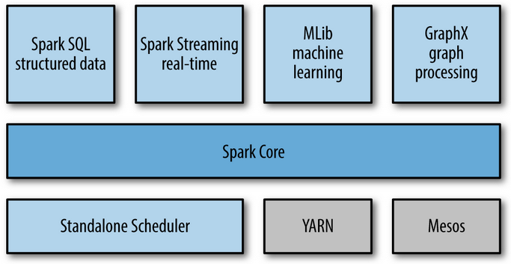
SPARK COLLECTIONS
We can do basic data analysis in spark-shell using 3 different ways.
RDD
Data Frames and Datasets
SPARK SQL
Spark Stack:

Slide 11
RDD – Resilient Distributed Dataset
Spark - RDD is a fault-tolerant collection of elements that can be operated on in parallel.
There are three ways of creating RDDs:
From an in-memory collection of objects (known as parallelizing a collection)
Using a dataset from external storage (such as HDFS)
RDD Operations - Transforming an existing RDD.
Parallelize:
val data = Array(1, 2, 3, 4, 5)
data: Array[Int] = Array(1, 2, 3, 4, 5)
val distData = sc.parallelize(data)
distData: org.apache.spark.rdd.RDD[Int] = ParallelCollectionRDD[0] at parallelize at <console>:29
TextFile:
val a1 = sc.textFile("file:///home/cloudera/text")
a1: org.apache.spark.rdd.RDD[String] = file:///home/cloudera/text MapPartitionsRDD[6] at textFile at <console>:27

Slide 12
RDD OPERATIONS - TRANSFORMATIONS
RDDs support two types of operations:
Transformations -> Create a new dataset from an existing one.(map, flatMap, filter, reduceByKey, groupByKey, join, etc..)
Actions -> Return a value to the driver program after running a computation on the dataset.(count, collect, etc..)
TRANSFORMATIONS:
Map Transformation:
Return a new distributed dataset formed by passing each element of the source through a function func.
List>>
val a = (0 to 100).toList
val a1 = a.map(x => x+1)
a1.size
res37: Int = 101
val b = List((1,"hi"),(2, "how"),(3, "are"),(4, "you") )
val c = b.map(x => x._1)
res39: List[Int] = List(1, 2, 3, 4)

Slide 13
RDD OPERATIONS - TRANSFORMATIONS
RDD >>
val a1 = sc.textFile("file:///home/cloudera/text")
a1
hello world
how are You
val b1 = a1.map(_.toLowerCase())
hello world
how are you
flatMap Transformation:
Similar to map, each input item can be mapped to 0 or more output items.
val a3 = sc.textFile("file:///home/vagrant/text3")
a3
hello
val b3 = a3.flatMap(_.toLowerCase())
b3.collect().foreach(println)
h
e
l
l
o

Slide 14
RDD OPERATIONS - TRANSFORMATIONS
filter Transformation:
Return a new dataset formed by selecting those elements of the source on which func returns true
List>>
val a = (0 to 100).toList
val b = a.filter(x => (x)<=20)
b: List[Int] = List(0, 1, 2, 3, 4, 5, 6, 7, 8, 9, 10, 11, 12, 13, 14, 15, 16, 17, 18, 19, 20)
val b = a.filter(x => (x%2)==0)
b: List[Int] = List(0, 2, 4, 6, 8, 10, 12, 14, 16, 18, 20, 22, 24, 26, 28, 30, 32, 34, 36, 38, 40, 42, 44, 46, 48, 50, 52, 54, 56, 58, 60, 62, 64, 66, 68, 70, 72, 74, 76, 78, 80, 82, 84, 86, 88, 90, 92, 94, 96, 98, 100)
RDD>>
val a1 = sc.textFile("file:///home/vagrant/text")
val b1 = a1.filter(x => x.contains("hello"))
b1.collect().foreach(println)
hello world
hello again

Slide 15
RDD OPERATIONS - TRANSFORMATIONS
reduceByKey Transformation:
Dataset needs to be in (K,V) pairs,
Then when called, it returns a dataset of (K, V) pairs where the values for each key are aggregated using the given reduce function func, which must be of type (V,V) => V. Like in groupByKey, the number of reduce tasks is configurable through an optional second argument
val a = sc.textFile("file:///home/vagrant/text")
val b = a.flatMap(x => x.split(" ") )
val c = b.map(x => (x,1))
val d = c.reduceByKey((x,y) => (x+y))
d.collect().foreach(println)
(are,1)
(how,1)
(hello,2)
(again,1)
(world,1)
(You,1)

Slide 16
RDD OPERATIONS - TRANSFORMATIONS
Join Transformation:
Dataset needs to be in (K,V) pairs,
When called on datasets of type (K, V) and (K, W), returns a dataset of (K, (V, W)) pairs with all pairs of elements for each key. Outer joins are supported through leftOuterJoin, rightOuterJoin, and fullOuterJoin.
val e = sc.textFile("file:///home/vagrant/text3")
val f = sc.textFile("file:///home/vagrant/text4")
val erdd = e.map(x => (x.split(',')(3).toInt, (x.split(',')(0).toInt,x.split(',')(1).toString,x.split(',')(2).toInt )))
val frdd = f.map(x => (x.split(",")(0).toInt,x.split(",")(1).toString ))
val efjoin = erdd.join(frdd)
efjoin.take(5).foreach(println)
(2,((2,keyboard,100),Laptop))
(2,((3,Mouse,10),Laptop))
(1,((1,Laptop,900),Laptop_Accessories))
(3,((4,Samsung_tab,200),Tablets))
(3,((5,Ipad,250),Tablets))

Slide 17
RDD OPERATIONS - ACTIONS
collect() :
Return all the elements of the dataset as an array at the driver program. This is usually useful after a filter or other operation that returns a sufficiently small subset of the data.
val a1 = sc.textFile("file:///home/vagrant/text")
val b1 = a1.filter(x => x.contains("hello"))
b1.collect().foreach(println)
hello world
hello again
count() :
Return the number of elements in the dataset.
val t = (0 to 100).toList
t.count(_ %2 == 0)
res89: Int = 51
saveAsTextFile(path):
Write the elements of the dataset as a text file in Hadoop File system.
val a1 = sc.textFile("file:///home/vagrant/text")
b1.saveAsTextFile("/user/cloudera/test")
©Aswin Ramakrishnan

Slide 18
RDD OPERATIONS - ACTIONS
takeOrdered(n, [ordering]) :
Return the first n elements of the RDD using either their natural order or a custom comparator.
val d = sc.textFile("file:///home/vagrant/text2")
val d1 = d.flatMap(x => x.split(" ")).map(x => (x,1)).reduceByKey(_+_)
val d2 = d1.takeOrdered(10)(Ordering[Float].reverse.on(x => x._2))
d2.take(3).foreach(println)
(,76)
(of,21)
(the,18)
count() :
Return the number of elements in the dataset.
val t = (0 to 100).toList
t.count(_ %2 == 0)
res89: Int = 51
saveAsTextFile(path):
Write the elements of the dataset as a text file in Hadoop File system.
val a1 = sc.textFile("file:///home/vagrant/text")
b1.saveAsTextFile("/user/vagrant/test")

Slide 19
DATAFRAMES
A Dataset is a distributed collection of data. Dataset is a new interface added in Spark 1.6 that provides the benefits of RDDs (strong typing, ability to use powerful lambda functions) with the benefits of Spark SQL’s optimized execution engine.
A DataFrame is a Dataset organized into named columns. It is conceptually equivalent to a table in a relational database or a data frame in R/Python, but with richer optimizations under the hood.
DataFrames can be constructed from a wide array of sources such as: structured data files, tables in Hive, external databases, or existing RDDs.
The DataFrame API is available in Scala, Java, Python, and R.

Slide 20
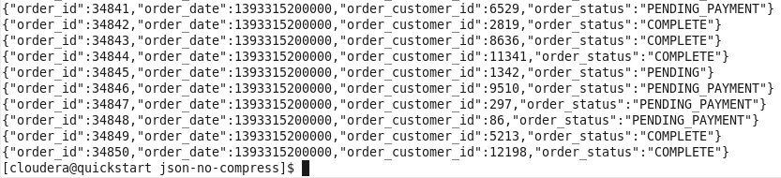
DATAFRAMES
Constructing DataFrames from an RDD:
val ardd = sc.textFile("file:///home/vagrant/data/retail_db/departments/p*")
ardd.toDF()
val rdf = ardd.map(x => (x.split(",")(0),x.split(",")(1) ) )
rdf.take(5).foreach(println)
(2,Fitness)
(3,Footwear)
(4,Apparel)
(5,Golf)
(6,Outdoors)
Constructing DataFrames from a File:
In Spark, some file formats like Json, avro, etc. can be read in Dataframes by default.
val bdf = sqlContext.read.json("file:///home/vagrant/data/json-no-compress/p*")
bdf.printSchema()
root
|-- order_customer_id: long (nullable = true)
|-- order_date: long (nullable = true)
|-- order_id: long (nullable = true)
|-- order_status: string (nullable = true)

Slide 21
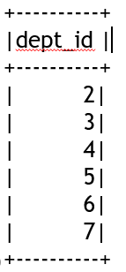
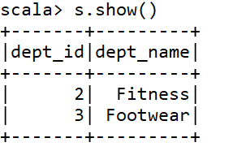
DATAFRAMES - OPERATIONS
Select():
rdf.select("dept_id")
res21: org.apache.spark.sql.DataFrame = [dept_id: string]
res21.show()
Filter():
val s = rdf.filter($"dept_id" < 4)
s: org.apache.spark.sql.DataFrame = [dept_id: string, dept_name: string]
s.show()

Slide 22
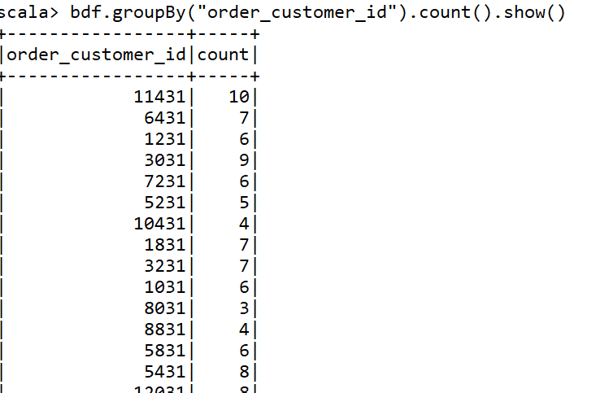
DATAFRAMES - OPERATIONS
GroupBy() :
bdf.groupBy("order_customer_id").count().show()
bdf.groupBy(col("order_customer_id")).count().show()

Slide 23
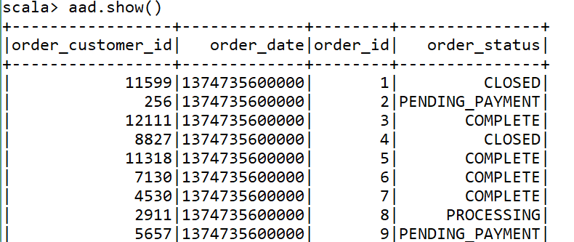
SPARK - SQL
SPARK_SQL is used to Run SQL Queries as it is – Mainly for Data analysts
val aas = bdf.registerTempTable("ordersss")
aas: Unit = ()
val aad = sqlContext.sql("select * from ordersss")
aad: org.apache.spark.sql.DataFrame = [order_customer_id: bigint, order_date: bigint, order_id: bigint, order_status: string]

Slide 24
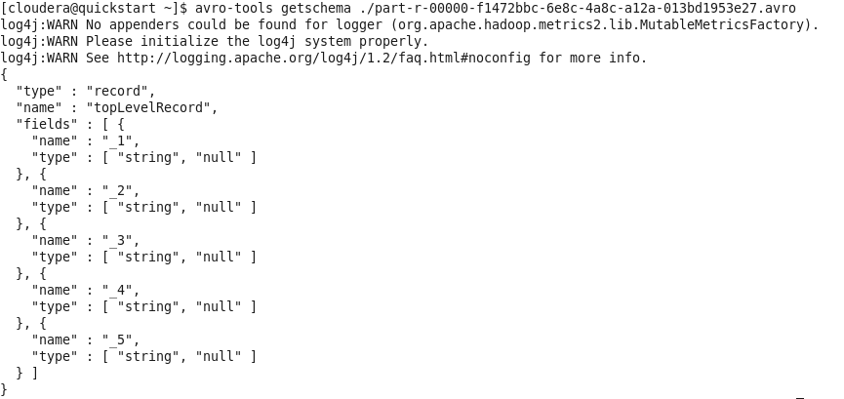
ASSIGNMENT - AVRO
Avro stores the data definition in JSON format making it easy to read and interpret, the data itself is stored in binary format making it compact and efficient.
To get schema:
avro-tools getschema ./part-r-00000-f1472bbc-6e8c-4a8c-a12a-013bd1953e27.avro

Slide 25
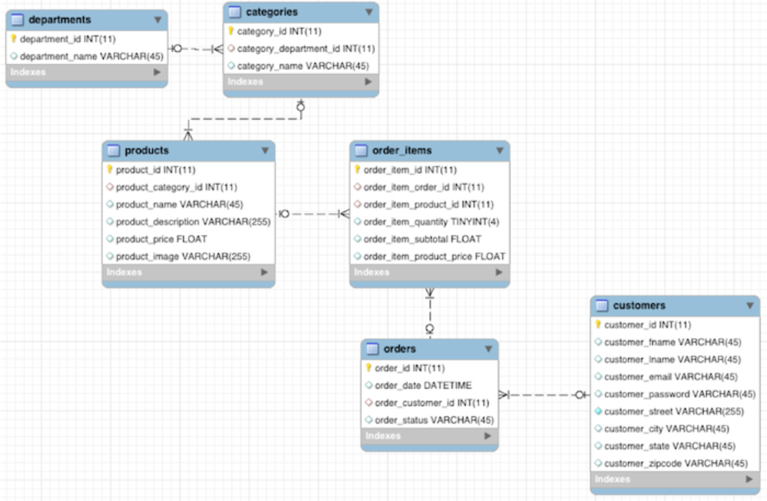
ASSIGNMENT - SCHEME

