Slide 1
An Introduction to NS-2*
NISHA SHETTY

Slide 2
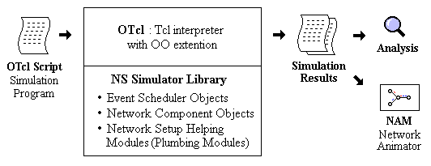
What is ns?
Object-oriented, discrete event-driven network simulator
Written in C++ and OTcl
By VINT: Virtual InterNet Testbed

Slide 3
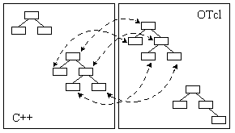
ns Architecture
Separate data path and control path implementations.

Slide 4
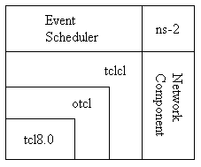
ns Architecture

Slide 5
Hello World – Interactive mode
bash-shell$ ns
% set ns [new Simulator]
_o3
% $ns at 1 “puts \“Hello World!\””
1
% $ns at 1.5 “exit”
2
% $ns run
Hello World!
bash-shell$

Slide 6
Hello World – Batch mode
simple.tcl
  set ns [new Simulator]
  $ns at 1 “puts \“Hello World!\””
  $ns at 1.5 “exit”
  $ns run
bash-shell$ ns simple.tcl
Hello World!
bash-shell$

Slide 7
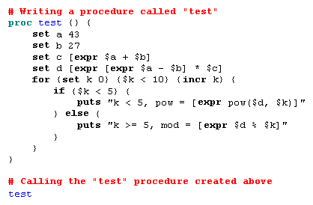
Basic Tcl: ex-tcl.tcl

Slide 8

Basic OTcl
Class Mom
Mom instproc greet {} {
$self instvar age_
puts “$age_ years old mom: How are you doing?”
}
Class Kid -superclass Mom
Kid instproc greet {} {
$self instvar age_
puts “$age_ years old kid: What’s up, dude?”
}
set mom [new Mom]
$mom set age_ 45
set kid [new Kid]
$kid set age_ 15
$mom greet
$kid greet

Slide 9
Elements of a Simulation
Simulator
  Main class
  Configuration of the simulation
  Creating objects
  Creating events and their scheduling
Nodes
  Nodes in a network (end or intermediate)
  Attached list of agents (~protocols)
  Attached list of neighbors (=> Links)
  Unique ID (~address)

Slide 10
Elements of a Simulation
Links
  connecting nodes (“physically”)
  simplex-, duplex links
  multiple access LANs, including wireless
  bandwidth
  delay
  queue object
  different trace-objects
    enqueue, dequeue,
    drop
    receive (implemented in next node)

Slide 11
Elements of a Simulation
Queues
  “part of” link
  store, drop packets if necessary
  Decide which packet is dropped
    Drop-tail (FIFO)
    Random Early Detect (RED)
    Class Based Queuing (CBQ, priority + Round Robin)
    Several Fair Queuing mechanisms (SFQ, DRR,...)

Slide 12
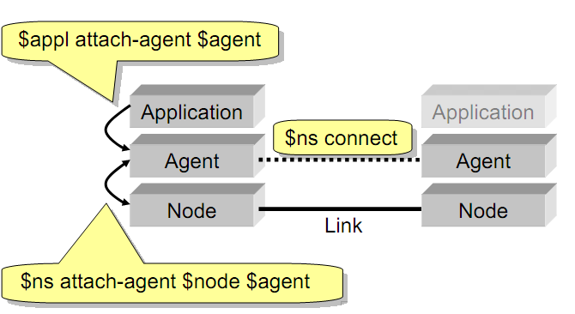
Elements of a Simulation

Slide 13
NS-2 Generic Script Structure
Create Simulator object
[Turn on tracing]
Create topology
[Setup packet loss, link dynamics]
Create routing agents
Create application and/or traffic sources
Post-processing procedures (i.e. nam)
Start simulation

Slide 14
Step1: Create Simulator Object
Create event scheduler
  set ns [new Simulator]
  Main class
  Configuration of the simulation
  Creating objects
  Creating events and their scheduling

Slide 15
Step 2: Tracing
Open file for NS tracing
  set f [open out.tr w]
  $ns trace-all $f
Open file for nam tracing
  set nf [open out.nam w]
  $ns namtrace-all $nf

Slide 16
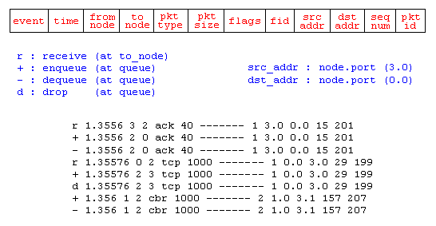
Step2: Tracing

Slide 17
Step 3a: Create Network Node
Nodes
  set n0 [$ns node]
  set n1 [$ns node]
  Nodes in a network (end or intermediate)
  Attached list of agents (~protocols)
  Attached list of neighbors (=> Links)
  Unique ID (~address)
n0
n1

Slide 18
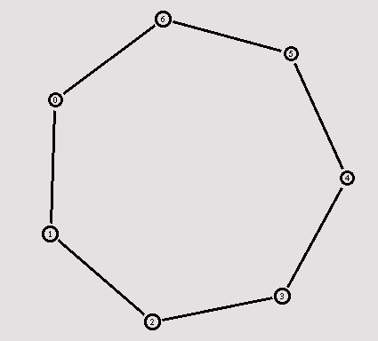
Creating a Larger Topology
  For {set i 0} {$i < 7} {incr i} {
    set n($i) [$ns node]
    }
    for {set i 0} {$i < 7} {incr i} {
    $ns duplex-link $n($i) $n([exp($i+1)%7]) 1Mb 10ms RED
    }

Slide 19
Step 3b: Create Network
n0
Nodes
  set n0 [$ns node]
  set n1 [$ns node]
Links and queuing
  $ns duplex-link $n0 $n1 1Mb 10ms RED
  $ns duplex-link $n0 $n1 <bandwidth> <delay> <queue_type>
  <queue_type>: DropTail, RED, etc.
n1

Slide 20
Creating a larger topology
  for {set i 0} {$i < 7} {incr i} {
    set n($i) [$ns node]
    }
    for {set i 0} {$i < 7} {incr i} {
    $ns duplex-link $n($i) $n([expr ($i+1)%7]) 1Mb 10ms RED
    }

Slide 21
Step 4: Define Link and Queue
Links and queuing
  $ns duplex-link $n0 $n1 1Mb 10ms RED
  $ns duplex-link/simplex-link $n0 $n1 <bandwidth> <delay> <queue_type>
  <queue_type>:
    DropTail
    RED – Random Early Discard
    FQ – Fair Queuing
    DRR – Difict Round Robin
    SFQ – Stochastic Fair Queuing, etc
n0
n1

Slide 22
Create Network Dynamics
Link failures
  $ns rtmodel-at <time> up|down $n0 $n1
For example:
  $ns rtmodel-at 1.0 down $n0 $n1
  $ns rtmodel-at 2.0 up $n0 $n1

Slide 23
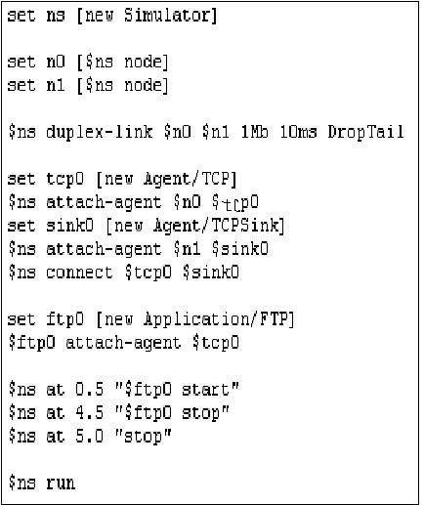
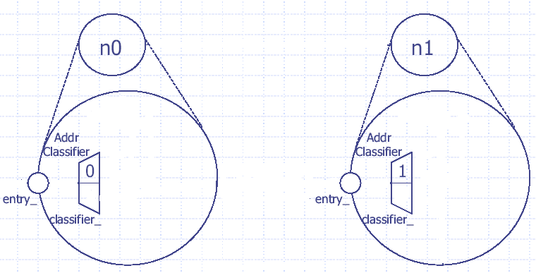
Create TCP Network Node

Slide 24
Step 5: Creating UDP connection
  set udp [new Agent/UDP]
  set null [new Agent/Null]
  $ns attach-agent $n0 $udp
  $ns attach-agent $n1 $null
  $ns connect $udp $null
udp
n0
n1
null

Slide 25
Step 6: Creating Traffic
(On Top of UDP)
cbr
CBR
  set cbr [new Application/Traffic/CBR]
  $cbr set packetSize_ 500
  $cbr set interval_ 0.005
  $cbr attach-agent $udp
udp
n0
n1
null

Slide 26
Creating TCP connection
  set tcp [new Agent/TCP]
  set tcpsink [new Agent/TCPSink]
  $ns attach-agent $n0 $tcp
  $ns attach-agent $n1 $tcpsink
  $ns connect $tcp $tcpsink
tcp
n0
n1
sink

Slide 27
Step 6: Creating Traffic
(On Top of TCP)
ftp
FTP
  set ftp [new Application/FTP]
  $ftp attach-agent $tcp
Telnet
  set telnet [new Application/Telnet]
  $telnet attach-agent $tcp
tcp
n0
n1
sink

Slide 28
Post-Processing Procedures
Add a 'finish' procedure that closes the trace file and starts nam.
proc finish {} {
global ns nf
$ns flush-trace
close $nf
exec nam out.nam &
exit 0
}

Slide 29
Run Simulation
Schedule Events
$ns at <time> <event>
  <event>: any legitimate ns/tcl commands
$ns at 0.5 "$cbr start"
$ns at 4.5 "$cbr stop“
Call ‘finish’
$ns at 5.0 "finish"
Run the simulation
$ns run

Slide 30
Trace File Analysis

Slide 31
Trace Fields
Type Identifier:
    “+”: a packet enque event
    “-”: a packet deque event
    “r”: a packet reception event
    “d”: a packet drop (e.g., sent to dropHead_) event
    “c”: a packet collision at the MAC level
Time: at which the packet tracing string is created.
Source Node
Destination Node:
  Denote the IDs of the source and the destination nodes of the tracing object.
Packet Name: Name of the packet type

Slide 32
Trace Fields
Packet Size: Size of the packet in bytes.
Flags: A 7-digit flag string
    “-”: disable
    1st = “E”: ECN (Explicit Congestion Notification) echo is enabled.
    2nd = “P”: the priority in the IP header is enabled.
    3rd = Not in use
    4th = “A”: Congestion action
    5th = “E”: Congestion has occurred.
    6th = “F”: The TCP fast start is used.
    7th = “N”: Explicit Congestion Notification (ECN) is on.
Flow ID
Source Address
Destination Address
  The format of these two fields is “a.b”, where “a” is the address and “b” is the port.
Sequence Number
Packet Unique ID

Slide 33
Visualization Tools
nam-1 (Network AniMator Version 1)
  Packet-level animation
  Well supported by ns
xgraph
  Simulation results

Slide 34
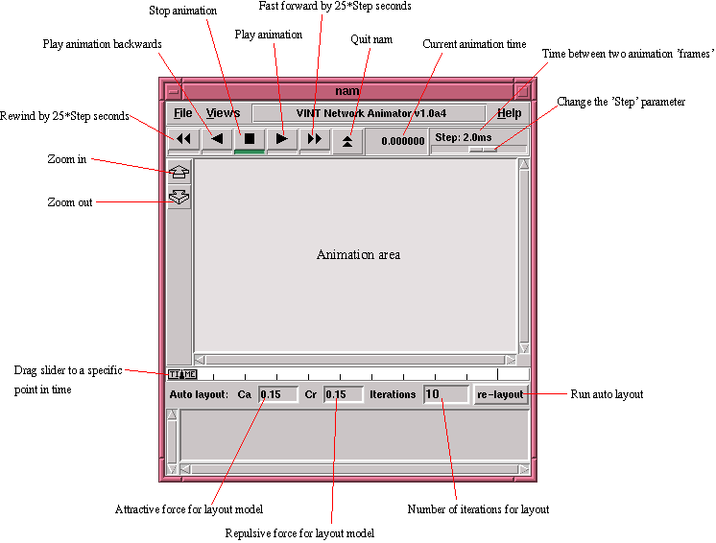

Slide 35
nam Interface: Nodes
Color
  $node color red
Shape (can’t be changed after sim starts)
  $node shape box (circle, box, hexagon)
Label (single string)
  $ns at 1.1 “$n0 label \”web cache 0\””

Slide 36
nam Interfaces: Links
Color
  $ns duplex-link-op $n0 $n1 color "green"
Label
  $ns duplex-link-op $n0 $n1 label “backbone"

Slide 37
nam Interface: Topology Layout
“Manual” layout: specify everything
  $ns duplex-link-op $n(0) $n(1) orient right
  $ns duplex-link-op $n(1) $n(2) orient right
  $ns duplex-link-op $n(2) $n(3) orient right
  $ns duplex-link-op $n(3) $n(4) orient 60deg
If anything missing → automatic layout

Slide 38
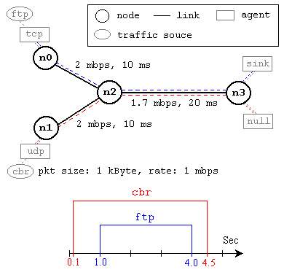
Simulation Example

