Slide 1
Microsoft Azure: Infrastructure as a Service (IaaS)

Slide 2
Module 1: Microsoft Azure Overview
Section 1: Cloud Computing Introduction
Notes:
Overview
This module includes the following sections:
Overview of Cloud Computing
Cloud Computing Patterns
Compute Components of Microsoft Azure
Other Microsoft Azure services
Objective
After this module, you will be able to:
Objective 1:
Objective 2:
Objective 3:
After this lesson, you will be able to:
Objective
Objective
Why should you learn this material?
<Insert a paragraph explaining why it is useful to learn this material.>
[EDITOR] TWB_Shalini:
Thursday, October 03, 2013 Please update the placeholder content.

Slide 3
How to View This Presentation
All slides have two styles of PDF documents:
Full View – full page view per slide
Notes View – 3 slides per page with ruled lines used to take notes
Use Adobe Reader or other PDF viewing tools to review the PDF slides
All PDF slides are located in your AzureIaaSWS.zip file

Slide 4
Introduction and Logistics
Your trainer
You
Your role
Your company
Your experience in this technology area
Your goals for this workshop
Start and end times
Facilities (bathrooms, smoking)
Meals
Computers, phones, tablets, etc.
Please set to vibrate
What’s on your desk?

Slide 5
Prerequisites
Windows 7 - 10, Windows Server 2008 R2 and Windows Server 2012 (R2)
Microsoft Azure PowerShell
Microsoft Visual Studio 2015 Update 2 (for ARM labs)
Active Azure Subscription
Notes:
Slide Objectives
To understand what is required to develop with Microsoft Azure
Since this slide is used for all of our Microsoft Azure workshops, you have to adjust the conversation with the amount of developer focus you may have. Infrastructure as a Service (IaaS), for example, may be less developer-focused and more IT-focused
Speaker Notes
To perform Microsoft Azure development, first install the latest version of the Software Development Kit (SDK)
The training kit is essential, but you need to pick the right labs according to what you want to learn. You will not have time to learn it
[EDITOR] TWB_Shalini:
Thursday, October 03, 2013 Should this be:
“You may not have time to complete all the labs”?
Please confirm.
[EDITOR] TWB_Trevor:
04 October 2013 Is “labs” here a reference to a supporting document that accompanies this course? Given that no documents have been provided yet, this seems a little out of context.

Slide 6
Cloud Computing Patterns
On and Off
Inactivity
Period
On and off workloads (e.g. batch job)
Over provisioned capacity is wasted
Time to market can be cumbersome
Compute
t
Growing Fast
Compute
Successful services needs to grow/scale
Keeping up with growth is a big IT challenge
Cannot provision hardware fast enough
t
Unpredictable Bursting
Compute
Unexpected/unplanned peak in demand
Sudden spike impacts performance
Cannot over provision for extreme cases
t
Predictable Bursting
Compute
Services with micro seasonality trends
Peaks due to periodic increased demand
IT complexity and wasted capacity
t
Notes:
The cloud computing patterns about why someone would want to shift from on-premises solutions into Microsoft Azure are self-explanatory. Have customers think about the applications that they currently have, to determine if they fit into this picture.
Understand, though, that just because a customer wants elasticity, it does not mean that their app is built for it.

Slide 7



Cloud Computing
IaaS
PaaS
SaaS
Infrastructure as a Service
Platform as a Service
Software as a Service
Host
Build
Consume
Notes:
Slide Objectives
Explain the three established terms in the industry for cloud services
Speaker Notes
There is a lot of discussions in the industry about different terms like PaaS, IaaS, and SaaS
Since PDC08, when we first announced Microsoft Azure, our focus has been on delivering:
A PaaS offering with which you can build applications
An offering in which the platform abstracts you from the complexities of building and running applications
We fundamentally believe that the future path forward for development is by providing a platform. In fact, as you will see in a few minutes, we believe that there are a number of new capabilities that should be delivered as services to the platform
Notes
There is a lot of uncertainty in the industry when it comes to the cloud
It is important that you understand:
What is happening in the industry
What we think about the cloud
The industry has defined three categories of services, which is the most commonly used taxonomy for differentiating between the types of cloud services
IaaS: A set of infrastructure-level capabilities, such as an Operating System (OS) and network connectivity, that are delivered as pay-for-use services and can be used to host applications
PaaS: Higher-level sets of functionality that are delivered as consumable services for developers who are building applications. PaaS is about abstracting developers from the underlying infrastructure to enable applications to be composed quickly
SaaS: Using a service delivery model, applications are delivered for organizations to consume and use. Typically, an organization would pay for the use of the application. Alternately, the application could be monetized through ad revenue
[EDITOR] TWB_Trevor:
04 October 2013 What does “PDC08” refer to? Is it a reference to the Professional Developers Conference held in 2008?

Slide 8


Cloud Computing (continued)
Packaged Software
Infrastructure
(as a Service)
Platform
(as a Service)
Software
(as a Service)
You manage
Applications
Applications
Applications
Applications
Data
You manage
Data
Data
Data
Runtime
Runtime
Runtime
Runtime
Managed by vendor
You manage
Middleware
Middleware
Middleware
Managed by vendor
Middleware
O/S
O/S
O/S
O/S
Virtualization
Virtualization
Managed by vendor
Virtualization
Virtualization
Servers
Servers
Servers
Servers
Storage
Storage
Storage
Storage
Networking
Networking
Networking
Networking
Notes:
Slide Objectives
Explain the differences and relationship between IaaS, PaaS, and SaaS in more detail
Speaker Notes
Another way to look at the cloud services taxonomy and how this taxonomy maps to the components in an IT infrastructure is as follows:
Packaged software: With packaged software, a customer would be responsible for managing the entire stack, ranging from the network connectivity to the applications
IaaS:
With IaaS, the lower levels of the stack are managed by a vendor. Some of these components can be provided by traditional hosters. In fact, most of them have moved to a virtualized offering
Very few actually provide an OS
The customer is still responsible for managing the OS through the applications
An obvious benefit with IaaS is that it frees the developer from many concerns when provisioning physical or Virtual Machines (VMs)
This was one of the earliest and primary use cases for Amazon Web Services Elastic Cloud Compute (EC2)
Developers were able to readily provision VMs (Amazon Machine Images, abbreviated as AMIs) on EC2, develop and test solutions and, often, run the results in production
The only requirement was a credit card to pay for the services
PaaS:
With PaaS, everything from the network connectivity through the runtime is provided and managed by the platform vendor
Microsoft Azure fits best in this category today
In fact, because we do not provide access to the underlying virtualization or OS today, we are often referred to as not providing IaaS
PaaS offerings further reduce the developer burden by additionally supporting the platform runtime and related application services
With PaaS, the developer can immediately begin creating the business logic for an application
Potentially, the increase in productivity is considerable. In addition, since the hardware and operational aspects of the cloud platform are also managed by the cloud platform provider, applications can quickly be taken from an idea to reality
SaaS:
Finally, with SaaS, a vendor provides the application and abstracts you from all of the underlying components
[EDITOR] Biju
04 October 2013 Kindly provide substantiation for the claim made against third-party software.

Slide 9
Module 1: Microsoft Azure Overview
Section 2: Microsoft Azure

Slide 10
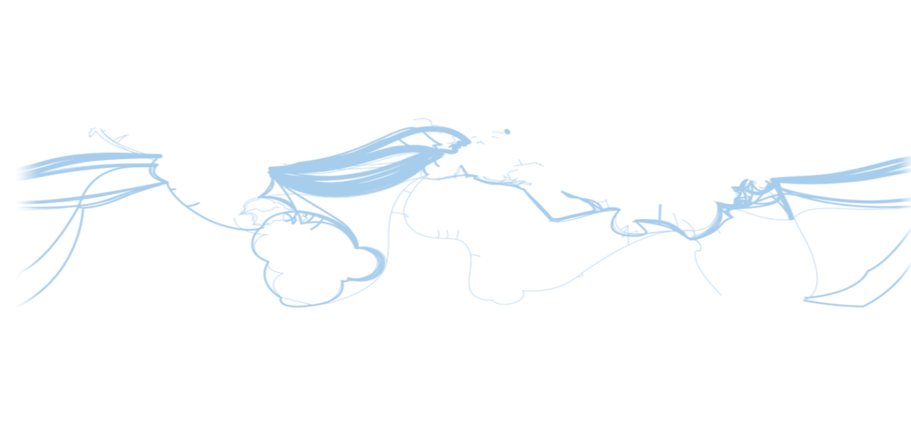
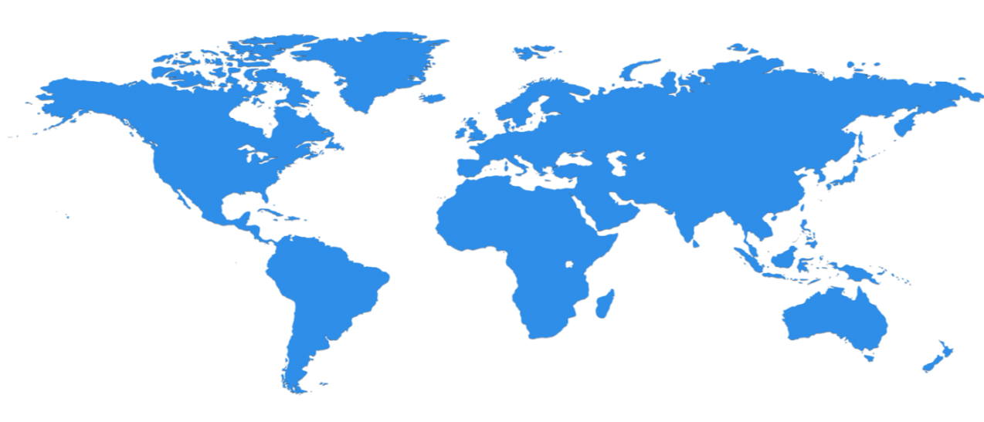

Hyper scale Infrastructure is the enabler
27 Regions Worldwide, 22 ONLINE…huge capacity around the world…growing every year
North Central US
Illinois
United Kingdom
Regions
West Europe
Netherlands
Central US
Iowa
Canada Central
Toronto
Canada East
Quebec City
Germany North East
Magdeburg
China North *
Beijing
US Gov
Iowa
North Europe
Ireland
Germany Central
Frankfurt
China South *
Shanghai
Japan East
Tokyo, Saitama
West US
California
East US
Virginia
India Central
Pune
Japan West
Osaka
South Central US
Texas
East US 2
Virginia
US Gov
Virginia
India South
Chennai
India West
Mumbai
East Asia
Hong Kong
SE Asia
Singapore
Australia East
New South Wales
Brazil South
Sao Paulo State
Australia South East
Victoria
100+ datacenters
Top 3 networks in the world
2.5x AWS, 7x Google DC Regions
G Series – Largest VM in World, 32 cores, 448GB Ram, SSD…
Operational
Announced/Not Operational
* Operated by 21Vianet
Notes:
This slide was taken from Azure EBC Deck FY16 v1.3.pptx
Speaker Notes
Microsoft Azure itself is deployed around the world
Microsoft Azure involves the concept of regions, which is where you select to place and run your code
Each region has a Microsoft Azure data center
These data centers are massive facilities that host tens of thousands or, in some cases, hundreds of thousands of servers
As shown on this slide, we also have a number of Content Delivery Network (CDN) edge points. They can be used to cache your content and deliver it even faster to customers
What you are
Once you build an application, you can choose any location in the world where you want to run it and you can move your workloads from region to region.
You can also:
Run your application in multiple regions simultaneously
Just direct traffic and customers to whichever version of the app is closest to them
That gives you a
Notes
Microsoft Azure services, such as compute and storage are now available in eight worldwide data centers with an additional 24 CDN endpoints
You cannot have a real cloud without a data center global footprint and a chance to reach a bigger customer base or audience in new markets
going to see in the next couple months and years is that we will rapidly expand our data center footprint around the world. As a result, you will have more options for running your applications

Slide 11
How are Microsoft Azure Charges Incurred?
Pay only for what you use*
VM usage is by the minute
VMs (IaaS only) that are stopped in Microsoft Azure, only storage charges apply
*Microsoft Azure Enterprise Agreement (EA) billing process differs
Notes:
Speaker Notes
Before we dive into the tour of services is the approach we are taking with paying for services
This may be different for many of you who are familiar with hosting providers and on-premises systems
With Microsoft Azure, you pay only for what you use
There are no upfront costs
There is no need to buy any upfront server licenses; this is included in the price
Likewise, if you use a SQL database, through our SQL Database feature in Microsoft Azure, you do not have to buy a SQL Server license—this is also included in the price
For compute services, such as VMs and websites you only pay by the hour
This gives you the flexibility to run your applications very cost effectively
You can scale up and scale down your solutions or even turn them on and off as necessary
This also opens up a wide range of possibilities in terms of the new types of apps you can build
As of 6/3 charges are by the minute and stopped VMs do not incur charges
Pay only for what you use — The asterisk pertains to the fact that if you have a Microsoft Azure Enterprise Agreement (EA), charges are applied differently because you are purchasing a set number of Microsoft Azure hours per month ahead of the usage.
[EDITOR] TWB_Trevor:
04 October 2013 Should “compute services” be changed to “cloud services” as per the guidelines for Microsoft Azure in MSStyle?
[EDITOR] TWB_Trevor:
04 October 2013 Kindly change this date reference to mmm-dd-yyyy. Depending on the audience of the training, this date format may be interpreted incorrectly.

Slide 12


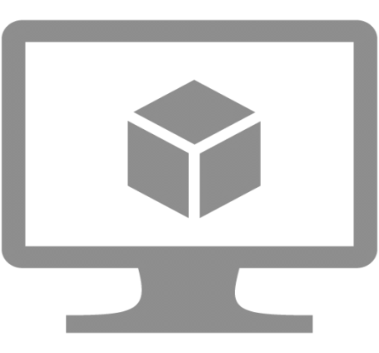
Microsoft Azure Compute
App Service
Cloud Services
Virtual Machines (VMs - IaaS)
Notes:
This is just the header slide for the three sections that we will discuss next.

Slide 13
Microsoft Azure App Service
App Service – fully managed platform in Azure for web, mobile and integration scenarios. This includes
Web Apps – Enterprise grade web applications
API Apps – API apps in Azure App Service are used to develop, publish, manage, and monetize APIs.
Mobile Apps - Build native and cross platform apps for iOS, Android, and Windows apps or cross-platform Xamarin or Cordova (Phonegap) apps
Logic Apps (preview) - Allows developers to design workflows that articulate intent via a trigger and series of steps, each invoking an App Service API app
Notes:
The purpose of this slide is NOT to do a demo, either functional or through the portal of all these features. You only need to give a brief description of what each piece does, reminding the students that we are focused on IaaS, nothing else
Web Apps Overview – Video http://azure.microsoft.com/en-us/services/app-service/web/, other info http://azure.microsoft.com/en-us/documentation/articles/app-service-web-overview/
Azure App Service and existing Azure services http://azure.microsoft.com/en-us/documentation/articles/app-service-changes-existing-services/
Mobile Apps – Video http://azure.microsoft.com/en-us/services/app-service/mobile/, other info http://azure.microsoft.com/en-us/documentation/articles/app-service-mobile-value-prop-preview/
API Apps – Video http://azure.microsoft.com/en-us/services/app-service/api/, other info http://azure.microsoft.com/en-us/documentation/articles/app-service-api-apps-why-best-platform/
Logic apps – Video - http://azure.microsoft.com/en-us/services/app-service/logic/, other info http://azure.microsoft.com/en-us/documentation/articles/app-service-logic-what-are-logic-apps/

Slide 14
Microsoft Azure Cloud Services
Role – a configuration passed to Azure to tell Azure how many machines of which size and configuration to build for you
Web Role – Virtual machine with IIS installed
Worker Role – Virtual machine without IIS installed
Ability to mix together multiple role configurations within a single Cloud Service
Package – Source code binaries are packaged and sent with the configuration file to Azure
Highly scalable – can exceed number of machines capability of App Service Web Apps
Allows RDP into individual VMs
Cloud Services are also used to contain IaaS virtual machines (Classic)
Notes:
These are the basic points of what a Cloud Service is and what it does. General questions people want to know are about how does it compare to App Service Web Apps (typically limited to less VMs).
Cloud Services are also used to contain IaaS virtual machines (V1- Classic) – we will explain more about ‘classic’ and V2 later in the workshop

Slide 15
High Level view of Virtual Machine Services
Compute resources
Virtual Machines
VM Extensions
Storage Resources
Blobs, tables, queues and Files functionality
Storage accounts (blobs) – Standard & Premium Storage
Networking Resources
Virtual networks
Network interface cards (NICs)
Load balancers
IP addresses
Network Security Groups
Notes:
This is the 10,000 ft view of IaaS. You do not need to go in to detail for these items, this will all be performed as you progress through the workshop.
A. The IaaS machines are compute resources. In these compute resources you can deploy extensions
B. VMs are stored in Azure storage blobs in a storage account. There are both standard and premium storage accounts
C. VMs can be put into networks and the virtual machines have NICs that communicate on the network. Machines can be secured by Network security groups. V1-Classic VMs do not require a virtual network

Slide 16
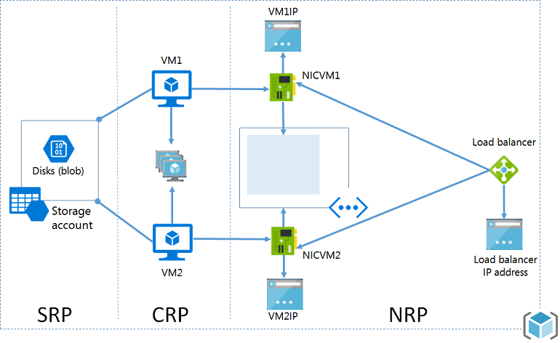
Management model for PaaS/IaaS
ARM with Resource Providers
Notes:
Purpose of Slide
This slide is used to discuss at a high level the different management model for PaaS/IaaS
NOTES:
The new Resource Group management method
VMs reside in a storage account
You MUST have a virtual network
All resources are logically part of a group, unlike in the classic model
SRP – Storage Resource Provider
CRP – Compute Resource Provider
NRP – Network Resource Provider

Slide 17
Demo: Management Portals
Notes:
Speaker Notes
Browse to the Current Microsoft Azure Management Portal
For developers, we have a rich set of developer centers
We offer development centers in multiple languages
If you are a .NET developer
If you are a Node developer, you can do the same thing
All of the SDKs are released as an open source under an Apache 2 license
Sign up for a free trial
Navigate to different portal areas, focusing on the dashboard
Next, go to the new Azure portal to show pre-existing resource groups or to create a resource group
[EDITOR] TWB_Trevor:
04 October 2013 Content seems to be missing from the bullet about .NET developers. Please update.
[EDITOR] TWB_Trevor:
04 October 2013 Kindly follow LCA guidelines on usage of the term “Free” and the claim made against third-party software.

Slide 18
Module Knowledge Check

Slide 19
Answers – Module Knowledge Check

Slide 20


