Slide 1
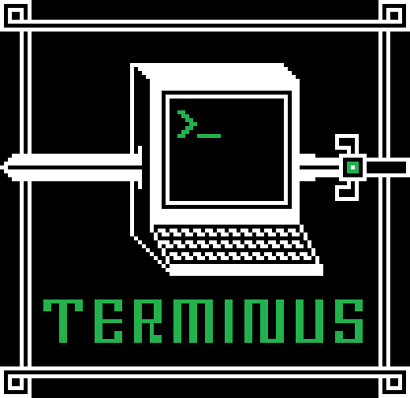


Terminus: A Linux Learning Game
Shawn Conrad
EECS, BS 2011, MEng 2013
shawnrad@mit.edu
Michele Pratusevich
EECS, BS 2013
mprat@mit.edu
Notes:
MIT computing environment is Debathena (Ubuntu Linux)
Students come to MIT without prior command-line knowledge (don't need it, but it's useful. Especially since Debathena has a whole host of resources that are powerful and accessible by command-line)

Slide 2
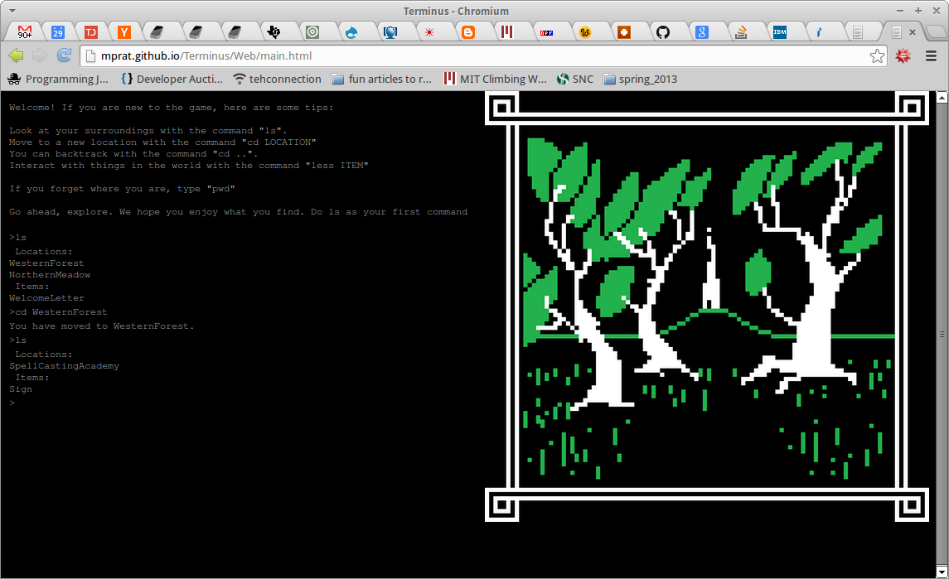

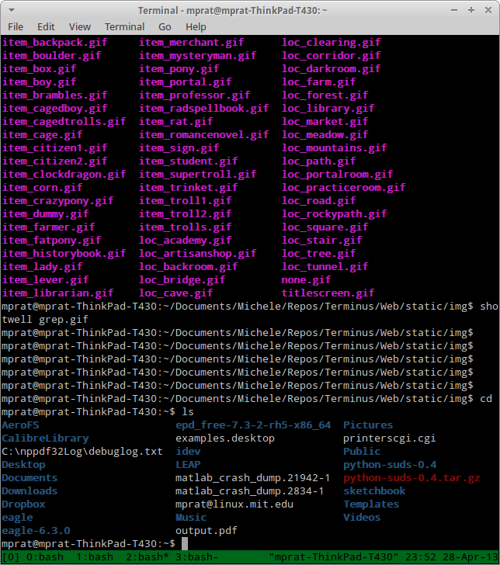
Gamification
Exploration
Demystification
Safe practice
Terminal to Terminus
Notes:
Terminus is an engaging, explorative game that teaches players basic terminal commands (both generic and MIT-specific) by drawing on metaphors, scenarios, and a safe practice environment
Rm can happen here and not destroy your files
It's more fun with graphics
Linux commands are seemingly arbitrary, so fill in some of the magic
Reading man pages is hard – here it is cryptic, but you get to pick up on hints dropped at you

Slide 3
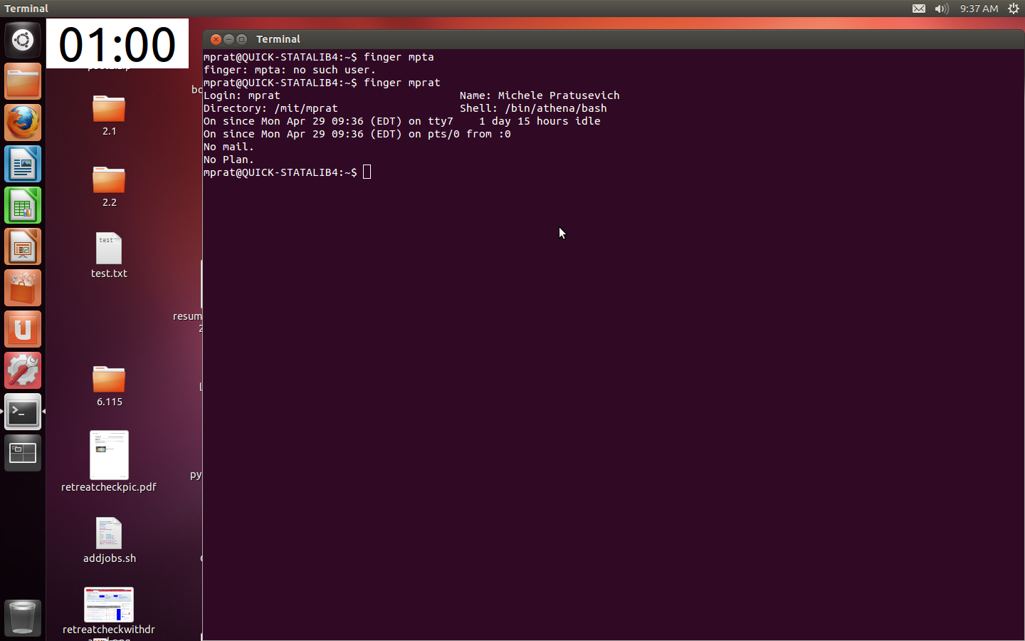
terminusgame.mit.edu
MIT-specific terminal commands!
Notes:
New freshman on campus gets to an Athena cluster and is confronted with this
You go to terminusgame.mit.edu to learn basic commands
Explore through the world, learn at your own pace
Saves progress so you can come back later and it will remember what you did and where you are
Graphics on the right pane make the locations and scenarios silly and memorable
Can go back and repeat MIT-specific commands
“Home” directory hooked up to various degrees of difficulty
MIT, low-level, high-level
World simulates a computer file system with all it's quirks

Slide 4
tellme combo
Do this in the game to enter the AthenaCluster
mv, cp, less
Get past obstacles
(rm UglyTroll and reveal a room)
man pages
An OldMan you ask for help
Re-open browser → remember your progress!
Exploration → your own pace!
Notes:
Athena-specific commands have their own scenarios that reinforce what the commands do
Common Linux commands are explained and practiced with guided directions in the text-based adventure format, but you discover them at your own pace
Cookies save progress

Slide 5
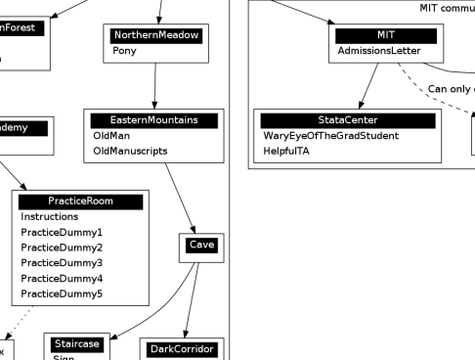
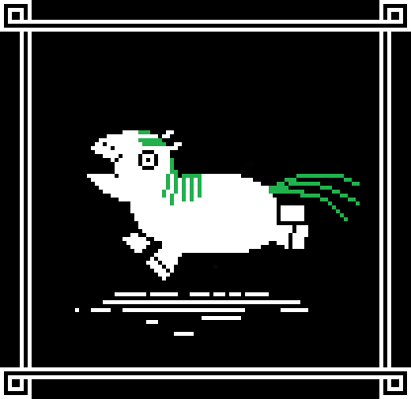

Target audience
Static JavaScript
Real command-line features
Open-source, MIT mirror
Easy to add new modules
Notes:
No server required – all static JavaScript
Open-source code with MIT domain mirror to the live production copy from GitHub
Terminal features implemented: tab completion, up-arrow-ing, slashes to denote movement, etc.

Slide 6
Gamification
Terminus: A Linux Learning Game
Terminus: A Linux Learning Game
Exploration
Demystification
Safe practice
Terminal to Terminus
Notes:
Terminus is an engaging, explorative game that teaches players basic terminal commands (both generic and MIT-specific) by drawing on metaphors, scenarios, and a safe practice environment
Rm can happen here and not destroy your files
It's more fun with graphics
Linux commands are seemingly arbitrary, so fill in some of the magic

