Slide 1
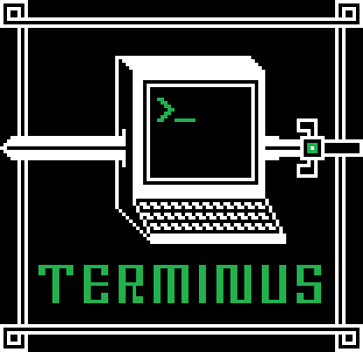



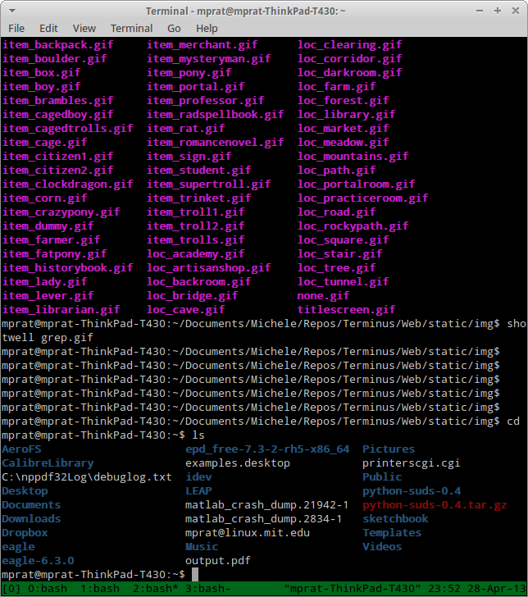
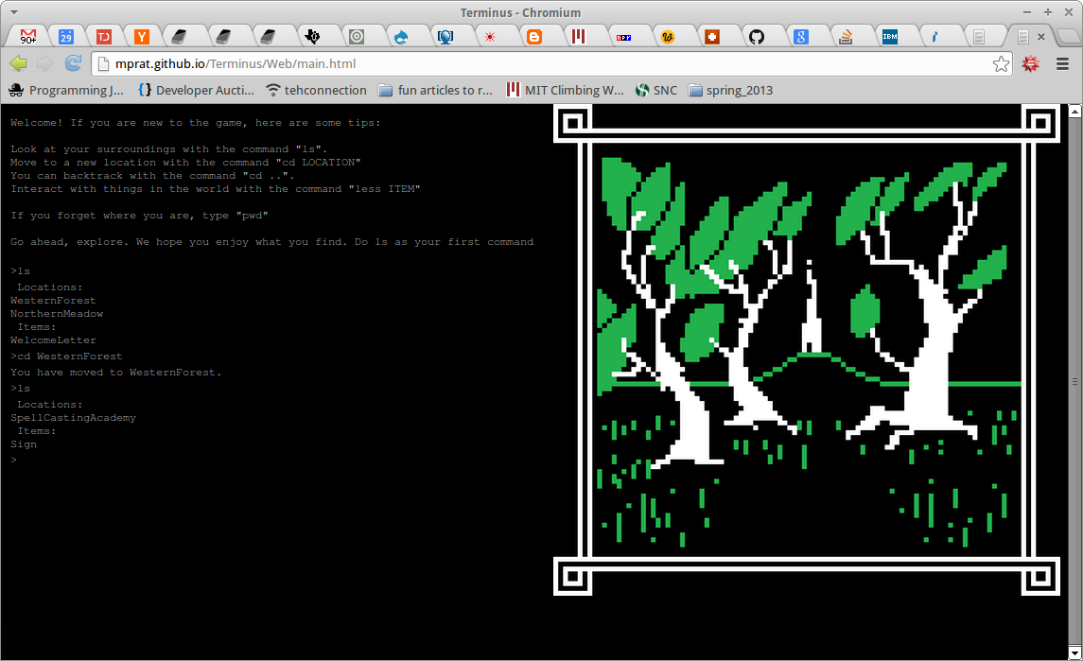
Terminus:A Linux Learning Game
Michele Pratusevich, Shawn Conrad
mprat@mit.edu, shawnrad@mit.edu
Student life and learning at MIT
Effective learning game techniques
Debathena: Ubuntu Linux
    Extremely powerful, but requires some command-line knowledge
    Printing management (lpr, lpq)
    finger, tellme combo
    AFS lockers, permissions, SSH
Gamification
Reward system
      Unlock rooms
      Meet characters
Nostalgia of text-based adventure
Save progress, return later
Problem: a computing environment only a few can use effectively
Command line
Text-based adventure
Impact / Effectiveness
File system
Rooms
Learning through exploration and discovery
Integrate into MIT infrastructure
More efficient use of (MIT) computing
    Student group AFS lockers
    Debathena capabilities
Worldwide audience of Linux novices
“Where do I start?” – high barrier to entry
No chance to practice – high cost of failing
      e.g.: rm can accidentally delete all files
“man” pages
An Old Man's voice
Commands
Spells
High cost of failure
No cost to failure
Technical Feasibility
Boring text
Interesting graphics
Static JavaScript – no server support needed
MIT website mirror to live site
      GitHub
        Issue tracking
        Version control
Open-source license
No motivation to learn
Rewards and story
Only words
Image feedback
Terminal to Terminus
Target audience
MIT Debathena users
Incoming students
Novices to command-line and Debathena

