Slide 1
Applying Machine Learning Techniques to Improve Quality
Approved for Public Release; Distribution Unlimited. Case Number 16-0509
Richard F. Eng
PRINCE2, PMP, CSQE, CRE, CQE, SAFe Agilist
reng@mitre.org
r22eng@yahoo.com
703-201-9112

Slide 2
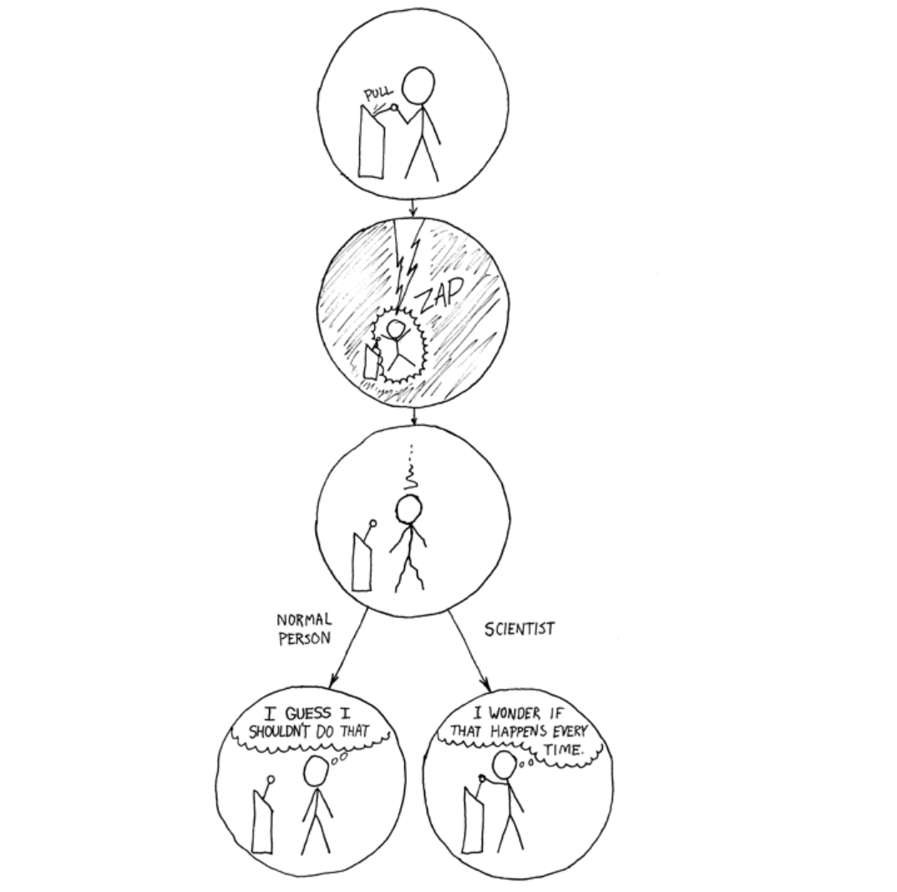
Acknowledgements
Special thanks to Professors Steve Knode and Jon McKeeby, University of Maryland University College, for their support, collaboration, and guidance to become a scientist
Retrieved from: https://xkcd.com/242

Slide 3
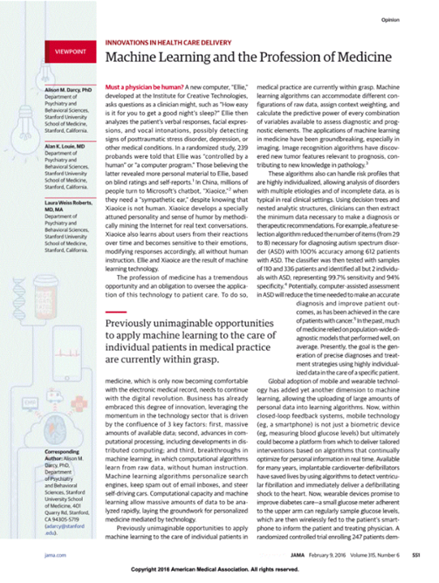
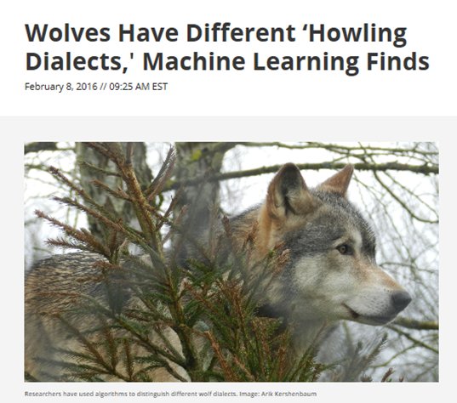
Cliff Notes on Machine Learning
Purely human judgement comes with its own set of biases and errors
Big data is long (multiple rows) and/or wide (lots of columns)
Machine learning is a branch of statistics designed for big data
Focus is on prediction rather than causality
Common application is to make predictions
Personalized recommendations on Amazon
Forecasting employee turn-over
Predict loan applicant default
Retrieved from: http://jama.jamanetwork.com/article.aspx?articleid=2488315
Prerequisites:
A pattern exists
No known mathematical model exists
You have data!
Retrieved from: http://motherboard.vice.com/read/wolves-have-different-howling-dialects-machine-learning-finds

Slide 4
Cliff Notes on Machine Learning (cont.)
Feature extraction
Process for figuring out what independent variables (“features”) the predictive models should use
Keep useful features and discard less useful features
Cluster analysis, consult experts, etc.
Regularization
Coming up with the least complex model that generalizes well
Include important features & minimize effects of less important features
Avoid overfitting the data
Cross-validation
Test prediction accuracy
Training data set
Test data set (data held back to test model accuracy)

Slide 5

Research Problem: Predicting Software Project Outcomes
Knowing whether to proceed or cancel a complex software acquisition
Knowing what to focus on fixing
Program reviews are subjective and prone to reviewer confirmation bias
Current software project assessments fail to take into account objective lessons learned from previous successful and unsuccessful efforts

Slide 6
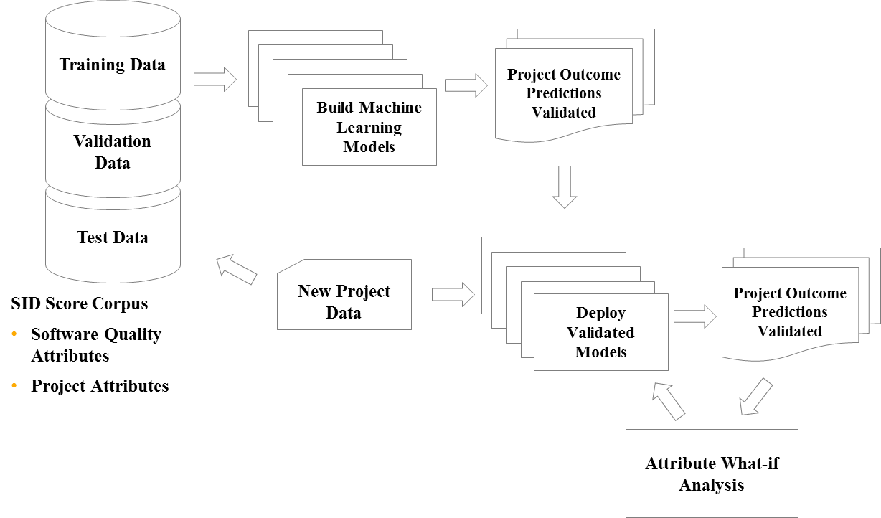
Research Idea: Machine Learning to Predict Project Outcomes
Use machine learning to create predictive models to:
Identify key software quality and project attributes to control and improve
Predict software project success, cost, and duration
Provide decision makers with additional data to make software project investment decisions
Identify attributes and quantify their impact on project outcomes
Prediction accuracy improves with growing corpus of software project attribute data

Slide 7




Technical Progress
Data Collection
Data Exploration
&
Preparation
Data Analysis &
Visualization
Predictive Models
Results
Data Collection
82 SQAE Reports
MITRE Information Resources
MII/Google
SMEs
Missing Data
Recovered Lost SQAE Data
ETL
Statistics
Data Transformations
Fill Gaps in Data
Understand Data
Visualize data
Identify data set biases
Identify & select key attributes
Data preparation
Machine Learning
Several predictive models
Predict Project Fielding
Success
Results biased due to small & skewed data
~80% accurate
Brief to academia, industry & sponsors
Next Steps
Gather more data & observations
Refine predictive models
What-if analysis
Iterative Process
Progress
100
100
60
60
40

Slide 8
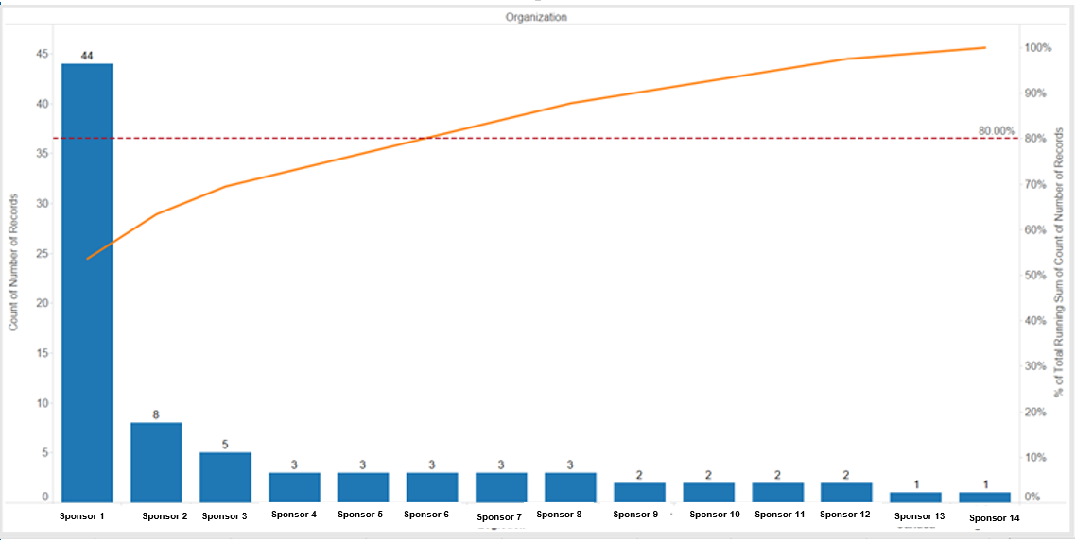
Pareto Analysis of Sponsor Projects
Greater confidence predicting Sponsors 1 through 6 80% of the cases in the corpus.

Slide 9
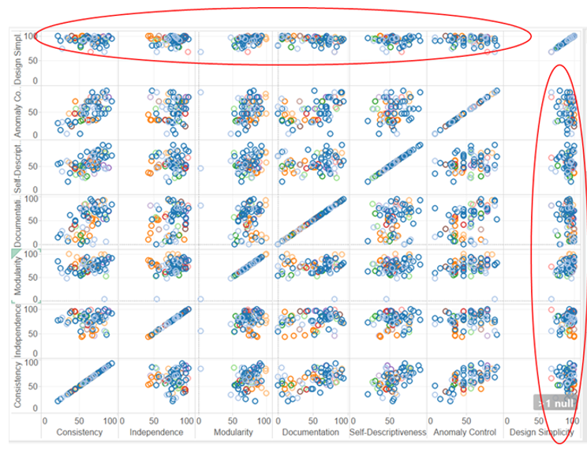
Potential Good Predictors
Matrix scatter plot of SQAE seven software quality attributes consistency, independence, modularity, documentation, self-descriptiveness, anomaly control, and design simplicity.

Slide 10
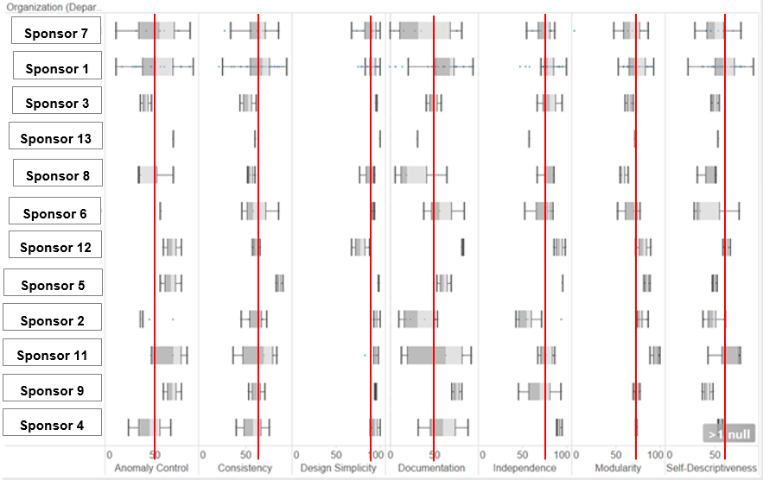
SQAE Seven Sub Software Quality Scores Evenly Distributed Across Observations
Predictions should be good. All software project data contained in the range of Sponsor 1 data
Box and whisker plot of seven software quality scores by sponsor. The plots show that the distribution of scores among the data set is uniform

Slide 11
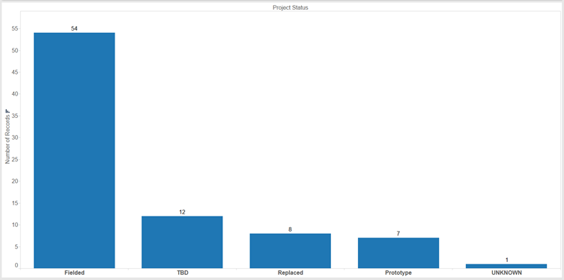
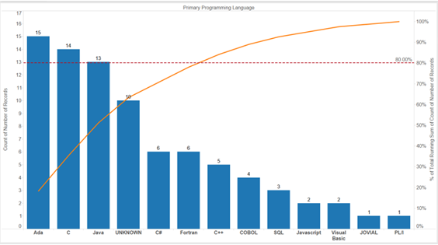
Data Set Bias: Fielded Projects and Programming Languages
Data skewed toward Successful projects
Data skewed toward projects using Ada, C, and Java

Slide 12
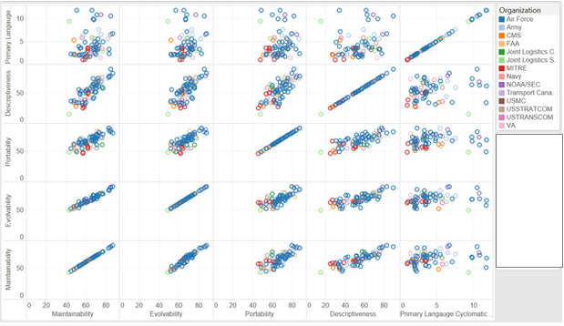
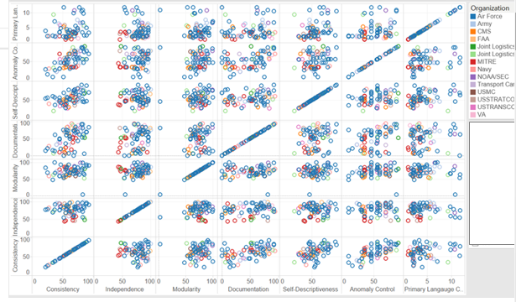
Preliminary Data Indicates that Cyclomatic Complexity Was Not a Factor in Project Success!
Matrix scatter plot of composite software quality scores and cyclomatic complexity index. The cyclomatic complexity index are not strongly correlated to the composite software quality scores
Cyclomatic Complexity Index not a good predictor of project success
Matrix scatter plot of the sub software quality scores and cyclomatic complexity index. None of the attributes seem to be highly correlated

Slide 13
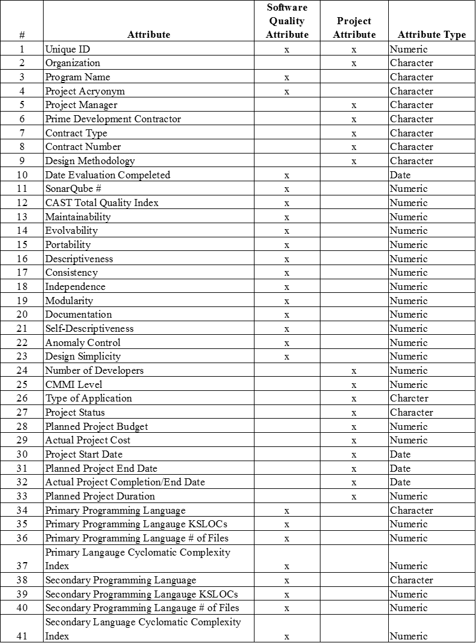
Software Quality and Project Attributes

Slide 14
Association Rules Findings
For all three association rule models the Support was mostly 2.44
Confidence measure for most of the rules was 100%
Lift ranged from 41 to 13.87
Low Risk to Moderate Risk software attribute transactions seemed to occur on projects that used programming languages like Ada, Java, C++, and FORTRAN
High to Moderate Risk software quality attributes appeared to be associated with the programming languages like JavaScript
Caveat: Results based on 82 SQAE observations in the training corpus. Future results may change as corpus grows
That’s interesting!
More modern techniques and languages don’t guarantee software project success or high quality.

Slide 15
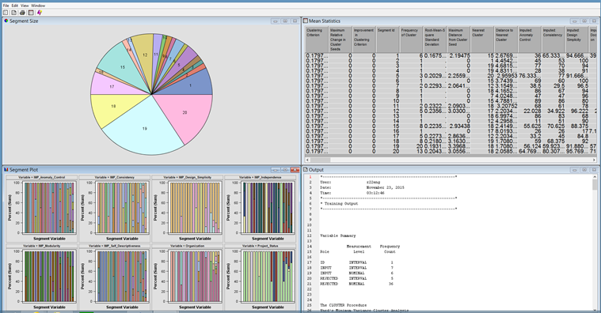
Cluster Analysis Findings
Cluster analysis used to determine whether the 82 observations fit into one or more segments
Four cluster analysis models created to determine like groupings
Design Simplicity does not appear to be a factor in projects failing
Projects were “Success” even if they had one or more High Risk sub software quality attributes
“Unsuccessful” projects possess four High Risk software quality attributes: Modularity, Self-Descriptiveness, Design_Simplicity, and Independence
That’s interesting!
Software projects can still succeed if they have less than four High Risk Quality scores!

Slide 16
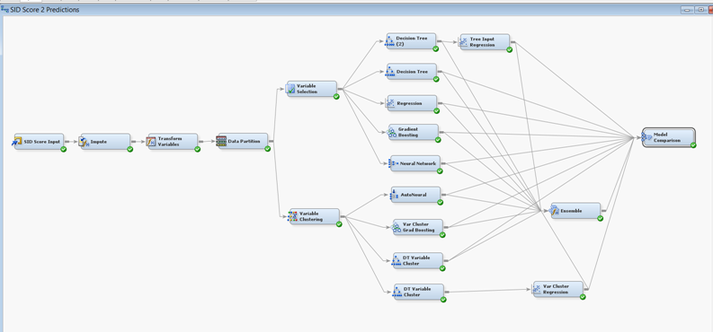
Machine Learning Models Trained, Validated, and Tested – It Worked!
Predict whether software project is Fielded
Variable Cluster Gradient Boosting, Variable Cluster Logistic Regression, Decision Tree Input to Logistic Regression, and Autoneural network models:
Performed well
Lowest misclassification
Misclassification rate was 0.1428 for the validation data and 0.1875 for the test data for all the models
Preliminary predictive models ~80% accurate
Need more data to refine models and increase confidence

Slide 17
Success Criteria and Status
Can predict project success
Collecting data to predict project cost and schedule
Machine Learning Models Predict
Project Success/Failure
Predictive models ~80% accuracy
Skewed data may cause biased predictions
Collect more cases and find missing data
Project Cost
Sponsors reluctant to provide cost data
Cost data never collected when software quality assessments were performed
Most projects didn’t account for software cost data!
Collecting cost data with new software quality assessments
Project Duration
Sponsors reluctant to share planned and actual schedule data
Data never collected
Collecting with new assessments

Slide 18

Results and Next Steps
Results
Next Steps
Predicting Project Success
~80% accuracy
Low misclassification rate
Collaborating with University of Maryland
Potential new collaboration with Monmouth University and industry
Researching the power of reversing software quality and project attribute values on project outcomes
Research is on going
Opportunities for academia, government, and industry collaboration to expand corpus of data
Refining predictive models
Research use of Static Code Analysis tools to improve predictions

Slide 19

Biography
Associated Department Head, Applied Software Engineering, The MITRE Corporation
Previous companies: Lucent Technologies, Noblis, IBM, Pfizer, Medical start-up, and Cobble Hill Nursing Home
Adjunct Professor of Computer Science and Software Engineering at Monmouth University
Over 20 years of experience in telecommunications, defense, healthcare, and IT
Areas of interests
Data analytics and quality improvement
Strategic planning
Applying quantitative methods to improve business, IT, and software processes
Education:
M.S. in Data Analytics, University of Maryland
MBA, Georgetown University
Quality Engineering Certificate, Virginia Polytechnic Institute
M.S. in Bioengineering, Brooklyn Polytechnic Institute
B.S. in Chemistry, Brooklyn Polytechnic Institute

