Slide 1
Applying Process Mining to IT Big Data
Richard F. Eng
PRINCE2, PMP, CSQE, CRE, CQE
14 March 2014
The author’s affiliation with The MITRE Corporation
is provided for identification purposes only, and is
not intended to convey or imply MITRE’s
concurrence with, or support for, the positions,
opinions, or viewpoints expressed by the author.

Slide 2
Agenda
Biography
Big Data Definitions
Process Mining
Quantitative Analysis Stages and Steps
Applying Process Mining
Lessons Learned

Slide 3

Biography
Principal Software Systems Engineer at the MITRE Corporation
Over 20 years of industry experience in telecommunications and software systems
Areas of interests
Solving systems level problems
Applying quantitative methods to improve business , IT processes, and software quality
Education:
M.S. in Data Analytics, University of Maryland (Expected 2015)
MBA, Georgetown University
M.S. in Bioengineering, Brooklyn Polytechnic Institute
B.S. in Chemistry, Brooklyn Polytechnic Institute

Slide 4
Big Data Definitions
Big data is data which “exceed(s) the capacity or capability of current or conventional methods and systems.” In other words, the notion of “big” is relative to the current standard of computation.
The National Institute of Standards and Technology
“… the increasing size of data, the increasing rate at which it is produced and the increasing range of formats and representations employed. This report predated the term “big data” but proposed a three-fold definition encompassing the “three Vs”: Volume, Velocity and Variety. This idea has since become popular and sometimes includes a fourth V: Veracity, to cover questions of trust and uncertainty.”
Gartner. In 2001, a Meta (now Gartner) report

Slide 5
Big Data Definitions (continued)
“Big data is the term increasingly used to describe the process of applying serious computing power—the latest in machine learning and artificial intelligence — to seriously massive and often highly complex sets of information.”
Microsoft
“Big data opportunities emerge in organizations generating a median of 300 terabytes of data a week. The most common forms of data analyzed in this way are business transactions stored in relational databases, followed by documents, e-mail, sensor data, blogs, and social media.
Intel
The Method for an Integrated Knowledge Environment open-source project. The MIKE project argues that big data is not a function of the size of a data set but its complexity. Consequently, it is the high degree of permutations and interactions within a data set that defines big data.

Slide 6
Process Mining
Data analytics technique
System agnostic
Examines large amounts of process data
Provides the ability to
Evaluate and understand actual process flows
Compare actual against expected process flows from a
Policy, procedures, and/or Information Technology perspective
Impact of visualizing actual process flows
Detection of process patterns
Identification of process inefficiencies
Identification of anomalous behavior

Slide 7
Quantitative Analysis 3 Stages and 6 Steps
Frame the Problem
Problem recognition
Solving the Problem
Modeling and variable selection
Communicating and Acting On Results
Results presentation and action
Review previous results
Data collection
Data analysis
Source: Keeping up with the Quants: Your Guide to Understanding and Using Analytics – Davenport, T. and Kim, J. (2013).

Slide 8
Frame the Problem
Problem recognition
Figure out where the problems are with the SYSTEM & fix them fast
E-Commerce site experiencing significant operational availability issues
Site performance degrades and crashes as more customers access services
No current documentation (e.g., Systems requirements, design specifications, applications software, test procedures, test scripts, etc.)
We were Agile. We didn’t have time to …
Review of previous results
Ad hoc problem solving huddles
It’s not my system. It must be your …
Try this, it should/might fix it …
No tracing of business processes to software applications to IT infrastructure
Manual review of system logs
“Furious activity is no substitute for understanding.”
- H. H. Williams

Slide 9
Solving the Problem
Modeling and variable selection
Apply process mining to model end user transactions through the E-commerce site
Variables needed
Unique Transaction ID, Start and Stop Time Stamp, and Activity
Data collection
Gain access to system log files
Normal operations
During outages and low operational availability
Data analysis
Run process model
Review results
Provide feedback to stakeholders that own the processes, application software, and IT infrastructure

Slide 10
Communicating and Acting on Results
Results presentation and action
Demonstrate process mining results to stakeholders
Capture process mining visualization as a video and e-mail to stakeholders so they can see the process bottlenecks and deviations
Explain the findings

Slide 11
Applying Process Mining to IT Big Data
Modeling and variable selection
Process mining
Visualize normal and anomalous operations
Transaction process flows
Application process flows
IT Infrastructure process flows
Variables needed
Unique Transaction ID
Start and End Time Stamps
Business Process
Application Software
IT Infrastructure
IP Address

Slide 12

Applying Process Mining to IT Big Data (Continued)
Data collection
Talk with system administrators to capture log data
Explain the data fields and formats you want
Transform the log files into the format that the process mining system needs
Data analysis
Load the data into the process mining model
Run the process mining models
Visualize and analyze data
Transaction business process flows
Application software process flows
IT infrastructure process flows
Review the results
Data Collection
Transform Data
Run the Model &
Data Analysis

Slide 13
Applying Process Mining to IT Big Data (Continued)
Communicate results
Provide feedback to stakeholders
Process owners
Application software team
IT Infrastructure team
Benefits
Visualization of the actual process flows
Comparison of normal and anomalous operations - rather than manually reviewing individual system logs
More rapidly identify spurious processes

Slide 14
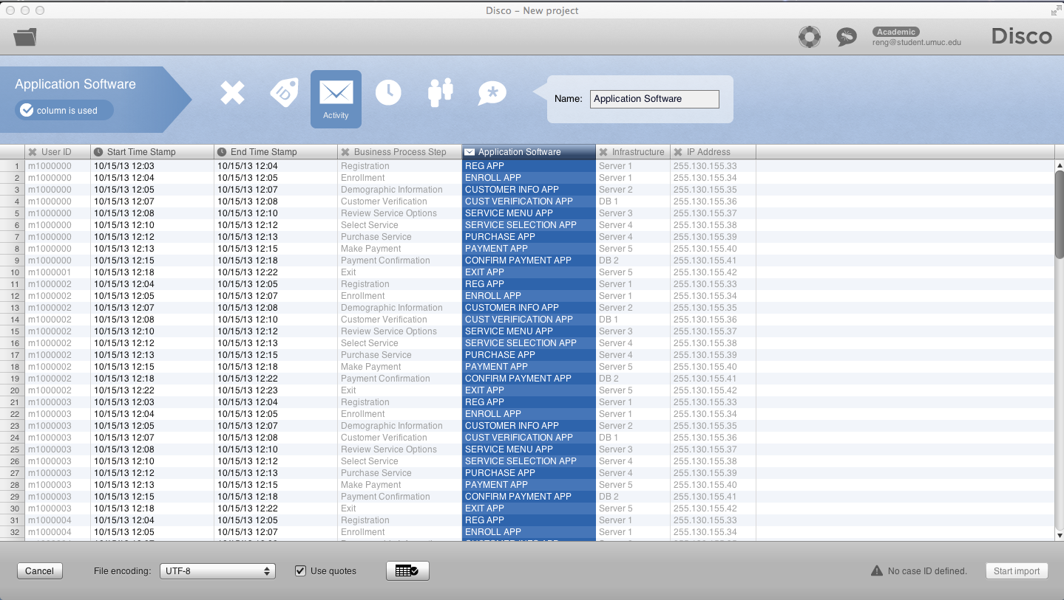
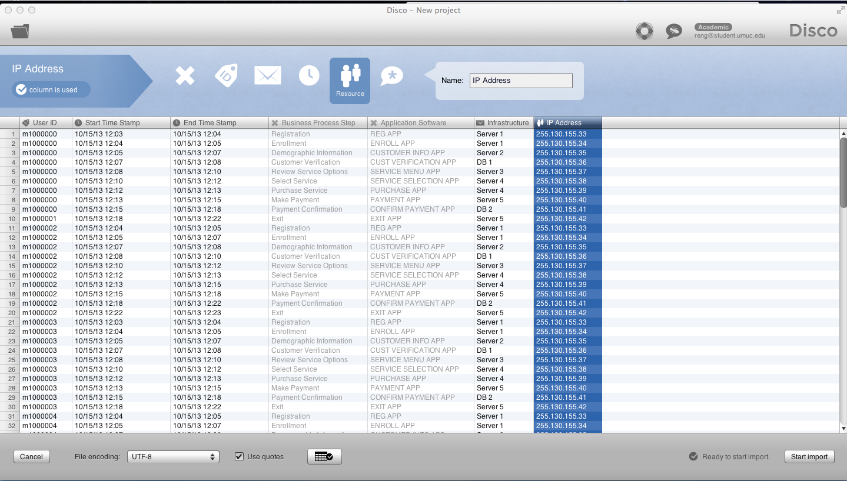
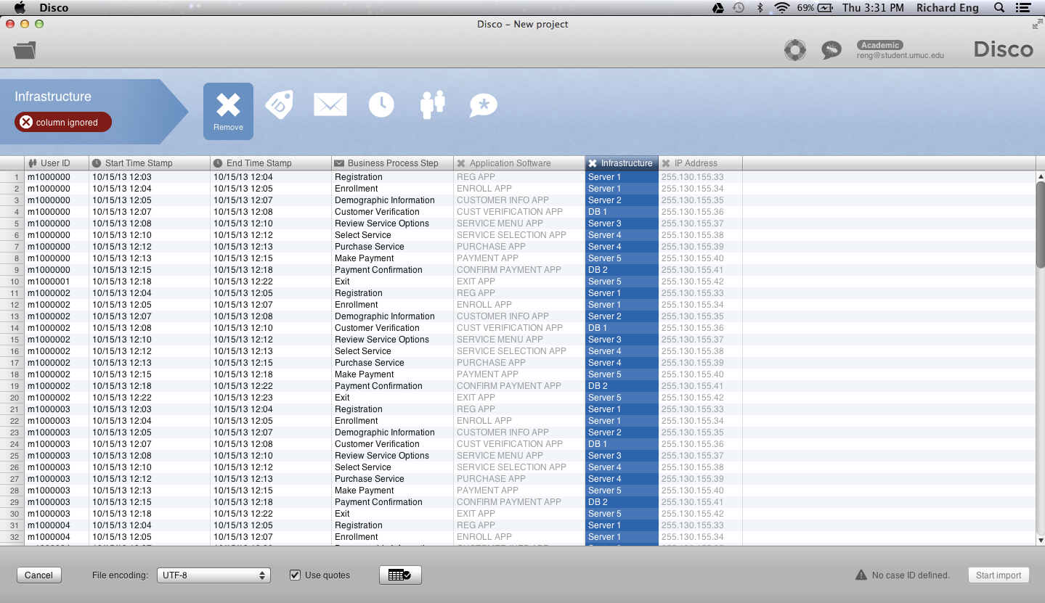
Illustration of Process Mining Data
DUMMY DATA

Slide 15
Process Mining Demo (Using DUMMY DATA)
Transaction Business Process Flow
Application Software Process Flow
IT Infrastructure and IP Address Process Flow

Slide 16
Lessons Learned
Good news
Process mining concept works
Bad news
Not all of the IT infrastructure was instrumented to collect log data
In some cases the log data was aggregate rather than per transaction
Some logs lacked unique transaction IDs
System time was not synchronized across the IT infrastructure
IaaS provider never contracted to provide system log data
Parting thoughts
Make sure the network and system time for all of your infrastructure are synchronized
Require all XaaS providers to provide system log data
Plan for process mining at the start of the project

Slide 17
Should You Consider Process Mining?
“The most difficult subjects can be explained to the most slow-witted man if he has not formed any idea of them already; but the simplest thing cannot be made clear to the most intelligent man if he is firmly persuaded that he knows already, without a shadow of doubt, what is laid before him.” – Leo Tolstoy

Slide 18
Contact Information
Richard F. Eng
reng@mitre.org
reng@student.umuc.edu
703-201-9112

