Slide 1

Working in 21st Century
A Few Tips to Survive & Thrive
Bala Prasanna
Senior Member, IEEE Region 1 Executive Committee Member,
IBM Program Manager
bprasanna@ieee.org
15 March 2013
IEEE Information Technology Conference – ITPC @ TCNJ
TCF - Trenton Computer Festival - 2013

Slide 2
Great things are not done by impulse,
but by a series of small things brought together. Vincent Van Gogh
Life consists not in holding good cards
but in playing those you hold well. Josh Billings
This time, like all times, is a very good one,
if we but know what to do with it. Ralph Waldo Emerson
Our problems are many,
but our capacity to solve them is limitless. Ronald Reagan

Slide 3
For the lack of a nail, the shoe was lost.
For the lack of a shoe, the horse was lost.
For the lack of the horse, the message was lost.
For the lack of the message, the battle was lost.
For the lack of the battle, the war was lost.
For the lack of the war, the kingdom was lost.
All for the lack of a horseshoe nail.
Something your grandmother may have taught you

Slide 4

If I have seen
f a r t h e r,
it is by standing on the shoulders of giants.
Isaac Newton

Slide 5
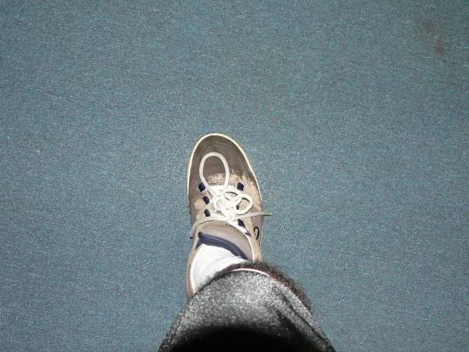

take a step…
…there’ll be a bridge

Slide 6

Once you’re in low Earth orbit (LEO), you’re halfway to anywhere.
Robert Heinlein
Science Fiction Writer
This is due to the mechanics of space launch, where accelerating into LEO is a large portion of your journey.
Storing mass in LEO is a way to make trips beyond LEO easier.

Slide 7
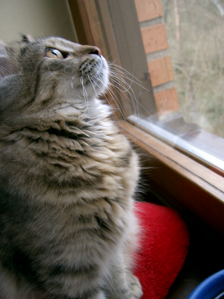

how people perceive you
is under
your control

Slide 8
how people perceive you
is under
your control

Slide 9

Life Management Skills For Success
Career Planning
Balancing work & personal:
leveling the scale
Networking
Interpersonal Skills
Leadership
Volunteering

Slide 10
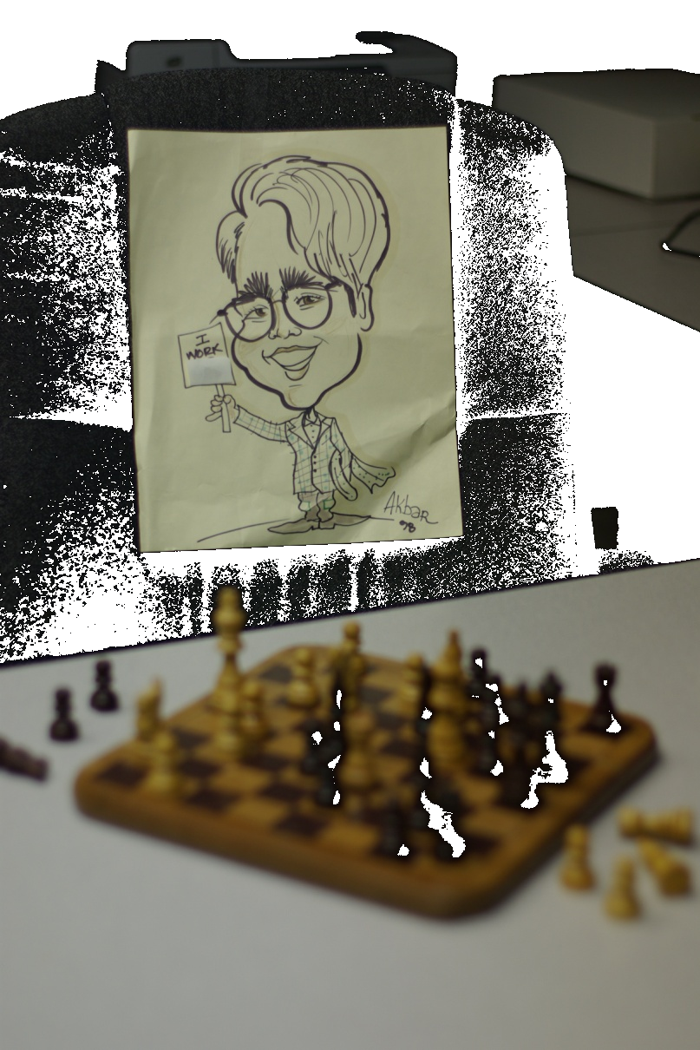
grasp the
big picture
Players
Rules of the Game
Unwritten Rules
What is the Big Idea?
Business Control Practices
Breaking the Rules
Annual Productivity measures
Performance assessment
Strategy and Tactics
Keeping Up Appearances
Be Wary of Seduction of Binary Thinking
Legal & Ethical
  Intent counts in ethics
roll with the punches…
Notes:
trategy

Slide 11
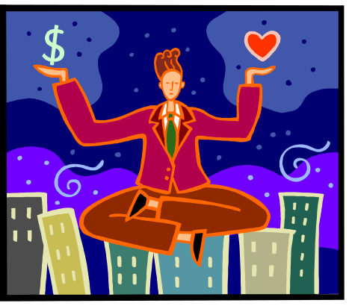
Failing to Plan is Simply Planning to Fail
Health, Family, Vacation, Hobbies/Stress Relief
Deadlines, Workload, Overtime, Training
Work Career Plan - Technical, Management
Work Your Balance Muscles
Head with Heart
Money & Meaning
Top of the Mountain & Journey
Friendly & Firm
To ignore or deny this balance is setting yourself up for disappointment & dis-ease
You must always be training for the next level up if you wish to advance.
. Be willing to experiment with behavior modification
. Train a back-up
. Do not procrastinate – a true stress buster!
. Gain control – Think Time & Think Place

Slide 12

Communicating Skills - CS010
Listening to understand -
Watch your language – Talk Up!
Conveying Ideas –
Different communication styles
Learn to say “NO” without feeling guilty
Negotiated problem solving -
Periodic communication
Life is like a game of tables: the chances are not in our power, but the playing is.

Slide 13

Communicating Skills – CS110
Grasp the under-current
Mating Dance
Set up for traps
  Do your homework; anticipate
  Create wiggle room
Setting traps
  Left to you, but being fair always helps
Elevator speech
Impression management
Communicating with management
Formal vs informal mail

Slide 14
Communicating Skills – CS110
First impressions are often lasting impressions.
Good posture
Neat appearance
Positive non-verbal communication
Eye contact
Confident handshake

Slide 15

NETWORKING
where?
with whom?
why?
what will I be able
to contribute?
when?
gain?
If you help others, they’ll be more likely to help you
Follow up with leads; acknowledge sources
Thank contacts
Do what you promised to do
Keep your antenna up
dig your well before you are thirsty
Is your NET-working for you?

Slide 16

Leadership is not about position; it’s about doing.
Live & work with paradoxes
Push the frontiers rather than follow
Promote innovation
Influence and guide
Act as catalysts
Champion causes
Have that invisible something that attracts followers
Articulate a vision and make it happen
Focus on customers
Anticipate the future
Stick your neck out
Focus on the real work, not the mundane
Deal with ambiguities - can you rationalize fuzzy data
Be transcendent
Own higher levels of confidence

Slide 17


Conflict Holds Creative Potential
win/win: conflict can be healthy when it brings out new ideas & relationships
win/lose: distrust, anger, withdrawal
conflict is unavoidable & common
negotiation is the primary key to resolving it
conflict & negotiation are central parts of organizational life
don’t let conflicts/differences harden into resentment, hate, or anger

Slide 18

Handling Conflict Productively
Competing: assert your position w/o opposing view points
Avoiding: stall, ignore, sense of timing
Collaborating: fully satisfying both sides (relationship is important)
Accommodating: forgoing (your) concerns (selfless)
Compromising: negotiating, finding middle ground
do not overuse anyone

Slide 19
Office Politics
You always have to play politics.
But remember, there is good politics &
there is bad politics.
Managing your boss
Managing your peers: relations with coworkers are often trickier than managers
Who are your angels?
Hustle & Harmonize
Nobody wins unless everybody wins
Don’t just ask for opinions; change them
Everyone expects to be paid back
Success can create opposition
Don’t ignore the aftermath of success

Slide 20
what is your brand?
When you have Joe’s word, you can take it to the bank.
No matter when I go and what question I have, Mary has given me satisfactory answers all the time on this project.
When you see my name on a technical document, it comes with
a 100% guarantee - no equivocation!
Russ’s thought process, judgment & communication at the right time
has never let me down.
When you assign testing to Kumar, good as gold.
Wow, you make a great teacher/mentor/debugger ..!
When in doubt, I always count on Dawn for my answers
You cannot be all things to everybody. Understand your strengths & create a positive branding of you.

Slide 21
Don’t sweat the small stuff…
Avoid weatherproofing
Choose your battles wisely
Praise & blame are all the same
Do one thing at a time
Just for fun, agree with criticism directed towards you (& watch it go away)
Surrender to the fact that life isn’t fair
Look for the extraordinary in the ordinary
Give up on the idea that more is better
… and it’s all small stuff

Slide 22
Now, the big stuff…
Manage for Results
Differentiate & understand Headlines vs. Trendlines
Don’t burn your bridges
Learn to prioritize
“And then more” – Overachieve on expectations
Milk a cow; don’t milk a duck
Time Management - front loading & multi-tasking
Time, Relationship, Career, Anger Management
Money, Money, Money
-Power of Compounding - Save $ .. Did you know ..?
- good credit(student loan, buying a house, …)
& bad credit (car, furniture, …)
Member of a professional society
Quality of life for you and people around you
Disillusionment at work -
  too much idealism gets in the way of progress;
  be philosophical in approach
… if you screw up, go back & ask:
What can I do REGAIN your confidence in me?
… and it is big stuff…

Slide 23
… and some more
Personality amplifiers (bring back that smile on your face)
Managing “self”
    Time, Relationship, Career, Anger
    Wide angle view of the profession
    Read your boss’s mind
Have your elevator speech ever ready (not more than 45 seconds)
Monkey on the back (mine vs. yours)
Presentation skills -
    Breathe from your diaphragm, not your throat
    Slow down when speaking, use shorter sentences, pause in between
    Allow the voice to inflect naturally & think visually when telling a story
    Don’t wear tight clothing
    Body language is as important as what you say
      Smile, relax, & make eye contact
    Strong, clear & simple message
    Start with conclusion first!
Is sloppiness in speech caused by ignorance or apathy? I don't know and I don't care. William Safire

Slide 24

… and some more
Be passionate about deadlines
Be a maintenance-free employee
E-mail etiquette
  Not a private communication between sender/receiver
  Reply-only-sender vs. reply-all
    What court are you playing?
  Writing/expressive skills
  Promptness in response
Be a Professional!
Separate your personal attititudes from professional expectations
Consider PE or PMP training
As a professional, have the stamina of a marathoner, not a sprinter

Slide 25
… and some more
1. Speak up! Make sure the boss hears your ideas at meetings, in emails, in memos - establish yourself as a constant source of bright thinking and good ideas within your team.
2. Work Hard. Be seen as the person on the team that always does their homework. Never come to a meeting unprepared. Think through what the agenda is, and add your insights and ideas, in front of everyone. You'll get recognized.
3. Push yourself to the front. That doesn't mean you have to be "in-their-face," but it does mean that you should seek out opportunities where you can show your abilities to best advantage (e.g. trade shows, trade publications, special committees)
4. Be assertive when speaking with others, not aggressive
5. Ask questions instead of giving direct orders
6. Speak up on behalf of your ideas before someone else willingly does so for you
being assertive is taking responsibility
for one’s needs & interests

Slide 26
It’s all about choosing
how to
spend time
friends
how you interpret
criticism/feedback
how you feel
to nurture peer
& boss relationships
to equip yourself with
occupational armor –
training, networking
assignments
so make the right choices.
Think of Simon Cowell (American Idol) & Dr. House (House). Would you have them on your side?

Slide 27
Responsible Students
Set goals, stay focused on the future
Plan their time:
  Use a calendar to keep all events, due dates in plain sight
Study everyday:
  Do it steadily
Take notes:
  Teachers almost always highlight what is important
Keep their commitments to themselves and others
Get ready ahead of time:
  Being late or early is not something that simply happens;
  it is a choice you make!

Slide 28
Q: “At Auschwitz, tell me, where was God?”
A: “Where was man?”
- from Sophie’s Choice
You have a role to play in this world - a reason for being here. But it is up to you to find your part and direct your future.
You alone determine your destiny through your own efforts. Accept this responsibility - not just for yourself, but for us all. You have the power to change your life and the lives of others as well.
Don’t back away from the exercise of this power or wait for some one else to act. Of course you can get what you want, but part of what you want should be to help others along the way.
The good life is not a passive existence where you live and let live. It is one of involvement where you live and help live.
Whatever you do will be insignificant, but it is very important that you do it. Mahatma Gandhi

Slide 29
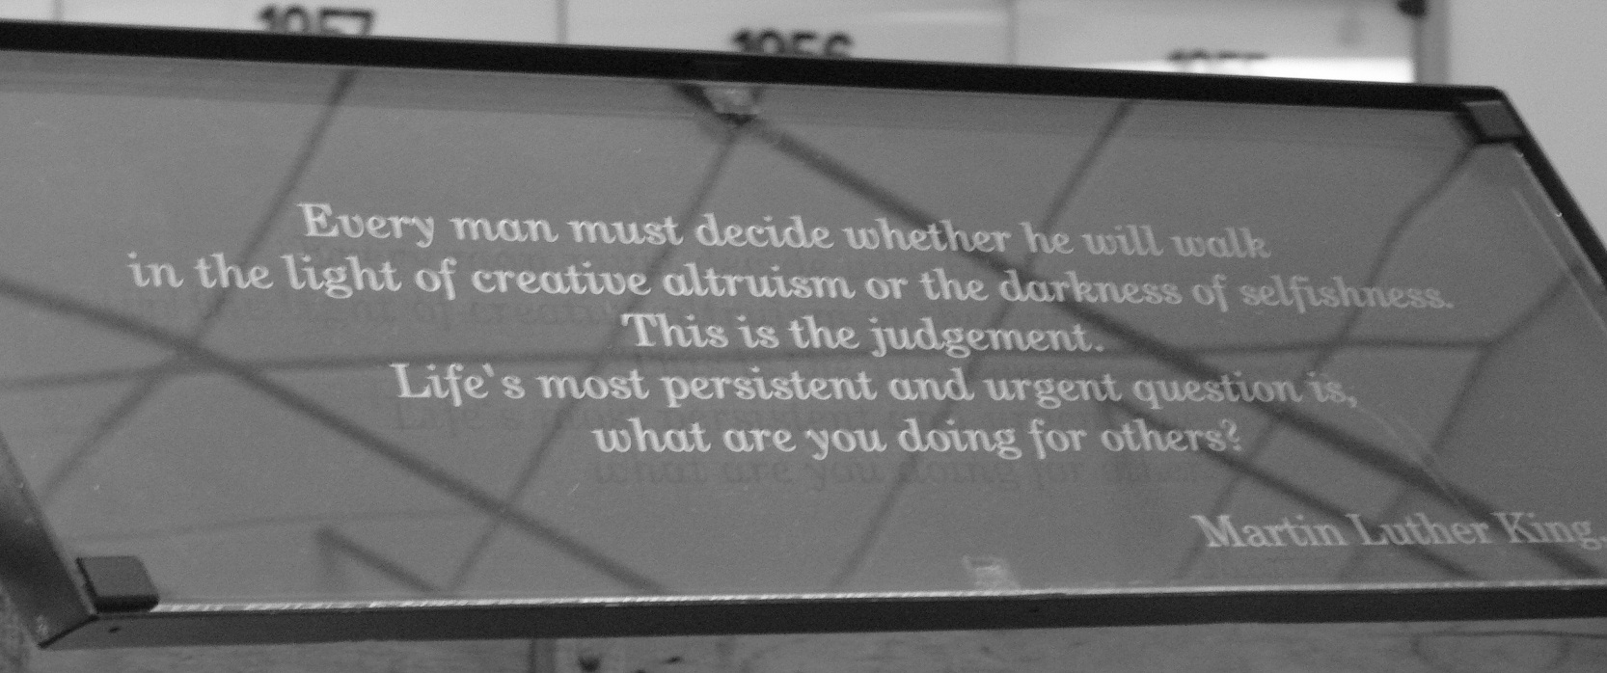
Being a volunteer

Slide 30

Acknowledgments
Success in the New Millennium - IEEE-USA Professional Development Conference ISBN 0-87942-331-5
You Can Negotiate Anything, Any Place - Herb Cohen ISBN 0-8065-0846-9
http://www.fastcompany.com/online/14/politics.html
Don’t Sweat the Small Stuff (and it’s all small stuff): Richard Carlson
http://www.theinstitute.ieee.org/
http://www.officepolitics.com
Carnegie Success Connection
http://money.cnn.com/news/economy/annie/index.html
http://www.nytimes.com/magazine - The Ethicist
and several everyday sources

