Slide 1
SharePoint Object Model
A Basic Overview
Presented by: David Soll
President and CTO
Omicron Development, LLC

Slide 2
Agenda
Introduction
SharePoint Versions
SharePoint Hierarchy
Object Model
Code Example
Questions

Slide 3
Introduction
Presenter: David F. Soll
President and Chief Technology Officer, Omicron Development
Treasurer, PCJS IEEE
Vice Chair, Princeton/Central NJ IEEE Computer Society
Senior Member of the IEEE
Recipient of the IEEE Region 1 Award
Past Chair, Princeton Chapter of the ACM
Senior Member of the ACM
Chair, TCF IT Professional Conference
Over 30 years in computing

Slide 4
Versions of SharePoint
This presentation is valid for:
SharePoint 2007
SharePoint 2010
SharePoint 2013

Slide 5
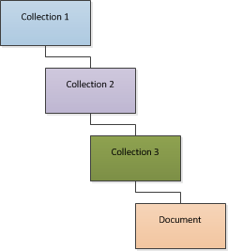
Object Hierarchies
A Collection Object contains other objects
Those objects can be collection objects
Therefore, A collection can contain a collection that contains a collection that contains an object (such as a document)

Slide 6
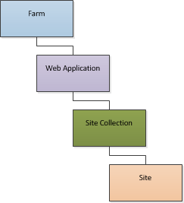
SharePoint Hierarchy
The Web Application Collection contains “Site Collections”
A Site Collection is an object that contains a “Site”

Slide 7
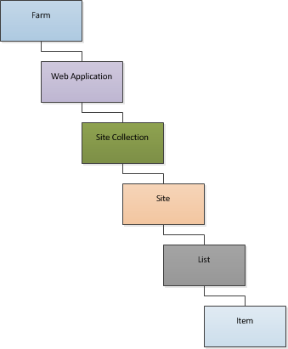
SharePoint Hierarchy
An Item is the bottom level of the hierarchy
An Item contains the data
In a list
It contains the data fields
In a library
It contains the file

Slide 8
SharePoint Hierarchy
The Web Application Object represents a virtual web server
A virtual web server is distinguished by:
IP Address
Port
Host Header
Typically there are at least 2 Web Applications:
SharePoint Central Administration v4
IP Address: All addresses
Port: Randomly assigned
Host Header: none
SharePoint – 80
IP Address: All addresses
Port: 80
Host Header: none

Slide 9
SharePoint Hierarchy
A Site Collection always contains 1 site
That site may other contain many sites
Security Principals for any site are contained in that site’s parent Site Collection
Even if it is up many levels of hierarchy

Slide 10
SharePoint Hierarchy
A Site object contains Lists
Note that a Site itself is a List
Therefore a Site can contain other sites
There are different types of lists including:
Lists
External Lists
Libraries
Sites
An object in the list is called an Item

Slide 11
SharePoint Hierarchy
Farm
Server
Web Application
Web Application
Web Application
Site Collection
Site Collection
Site
Site
Site
Site
List
List
List
List
List
List
List
List
Item
Item
Item
Item
Item
Item
Item
Item
Item
Item
Item
Item
Item
Item
Item
Item
Server

Slide 12
SharePoint Farm
The Farm is the Top Level Object
A Farm contains:
Servers
Service Applications
Feature Definitions
The Farm Object is tied to the Farm’s Configuration Database
It is not tied closely to content

Slide 13
Web Application Collection
SPWebApplicationCollection is the top level object for content
To get the list of Web Applications:
Dim WAC As SPWebApplicationCollection
WAC = SPWebService.ContentService.WebApplications
The SPWebApplicationCollection is a Collection object of SPWebApplication
Dim App As SPWebApplication
For Each App in WAC
…
Next

Slide 14
Web Application Object
SPWebApplication is the Web Application Object
You can use the SPWebApplication.Lookup method to open a Web Application
Dim WA As SPWebApplication = SPWebApplication.Lookup(new Uri("http://MyServer:989"))
Note: Uri is a object that is a member of System

Slide 15
Site Collection Object
The SPSiteCollection Object provides a mechanism for creating Site Collections
It also can be used to retrieve Site Collections based on execution context
Example:
Dim WebApplication As SPWebApplication = SPContext.Current.Site.WebApplication
Dim SiteCollections As SPSiteCollection = WebApplication.Sites
Dim SiteCollection As SPSite
For Each SiteCollection In SiteCollections
...
Next

Slide 16
Site Object (SPSite)
SPSite is a collection of sites in a Web application, including a top-level Web site and all of its sub-sites
Each SPSite object (site collection) is represented within an SPSiteCollection object that consists of the collection of all site collections in the Web application
Note: Watch out for terminology. It seems to change based on the viewpoint. An SPSite is a Site Collection, not a site.

Slide 17
Web Object (SPWeb)
The SPWeb object represents a Site
It contains a Webs property that represents a collection of sub-sites
Example:
Dim SiteCollection As SPSite
Dim RootWebSite As SPWeb
Dim SubSite As SPWeb
SiteCollection = New SPSite("http://www.mySite.com")
RootWebSite = SiteCollection.OpenWeb()
For Each SubSite In RootWebSite.Webs
...
Next

Slide 18
List Object (SPList)
The SPList object represents a SharePoint list
Lists include:
Document Libraries
Calendars
Contact Lists
Custom Lists
Issue Tracking List
Etc. (Basically, anything within a site)
The SPWeb object has a Lists property that is a collection of SPList objects

Slide 19
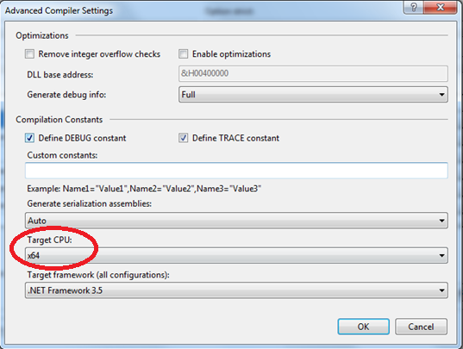
Code Example
Caution:
Ensure target is set to x64

Slide 20
Code Example
Include the following References:
Microsoft.Office.Server
Microsoft.SharePoint
Import the following (“using” in C#):
Microsoft.Office.Server
Microsoft.SharePoint
Microsoft.SharePoint.Administration

Slide 21
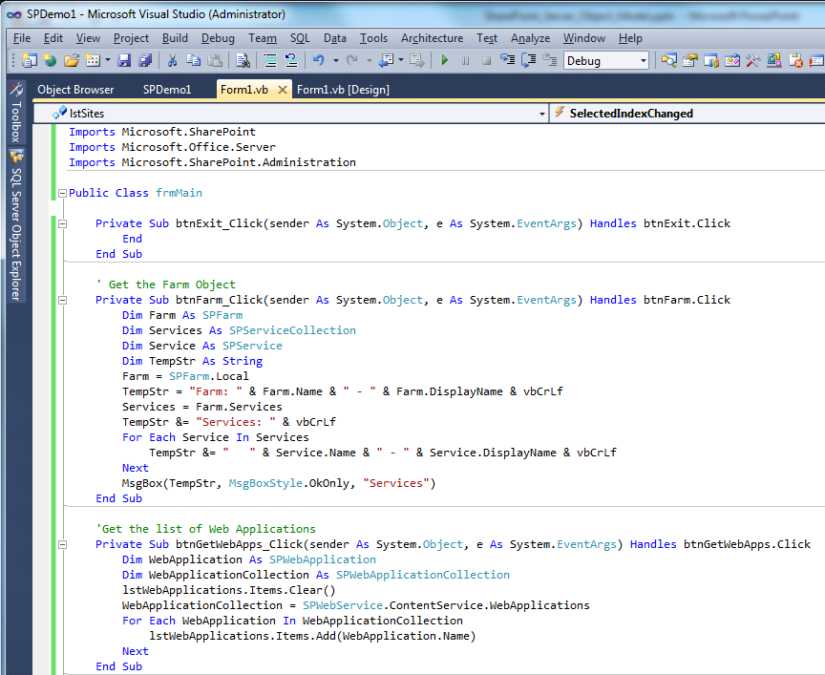
Code Example
Link to demo code

Slide 22

Questions

