Slide 1
Designing the User Experience (UX)
An Introduction to Data-Informed Design
By Josephine M. Giaimo, MS
March 14, 2014

Slide 2
What We’ll Discuss Today
What does a systematic usability process look like?
Some usability methods to reduce risk and improve quality
How to determine how good/bad your UX really is
Some currently documented usability guidelines
How to tell guesses apart from data

Slide 3
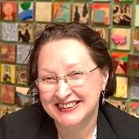
About Me
User Advocate
User Experience Researcher/Strategist
Clients/employers have included AT&T, Lucent, Avaya, IITRI, NJIT, Sarnoff, Proctor & Gamble, Smirnoff, Y&R
Recently performed UX research on peer-to-peer networks and time banking for NSF at Xerox PARC

Slide 4
What Does a Systematic Usability Process Look Like?

Slide 5

Dr. Richard Feynman
“If it disagrees with experiment, it’s wrong.”

Slide 6
The Experimental Process
Declare Assumptions
Create a Minimum Viable Product
Run an Experiment
Feedback and Research

Slide 7

Declare Business Assumptions
I believe my customers need to_____.
These needs can be solved with______.

Slide 8

Declare User Assumptions
Who is the user?
Where does our product fit in his or her work or life?

Slide 9
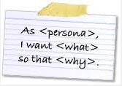
Personas
Our best guess as to who is using our product, and why.

Slide 10
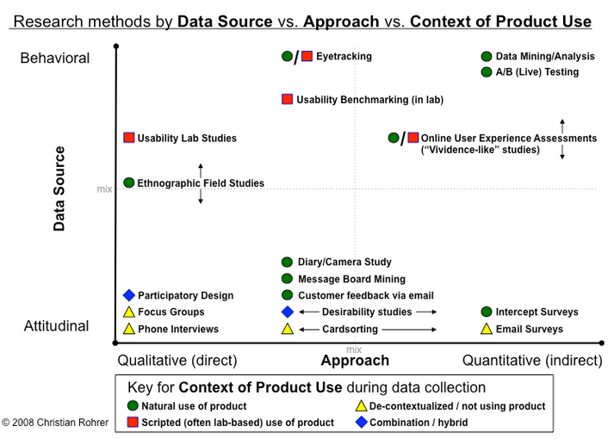

Slide 11
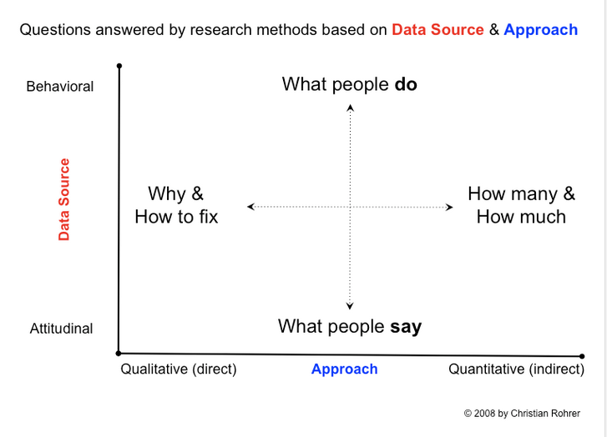

Slide 12

Before Creating Your Hypothesis Statement
List of measurable outcomes
Definition of personas
Features you believe might work

Slide 13

Hypotheses
We believe [this statement is true].
We will know we’re [right/wrong] when we see the following feedback from the market:
[Qualitative feedback] and/or [quantitative feedback] and or [key performance indicator change.]

Slide 14
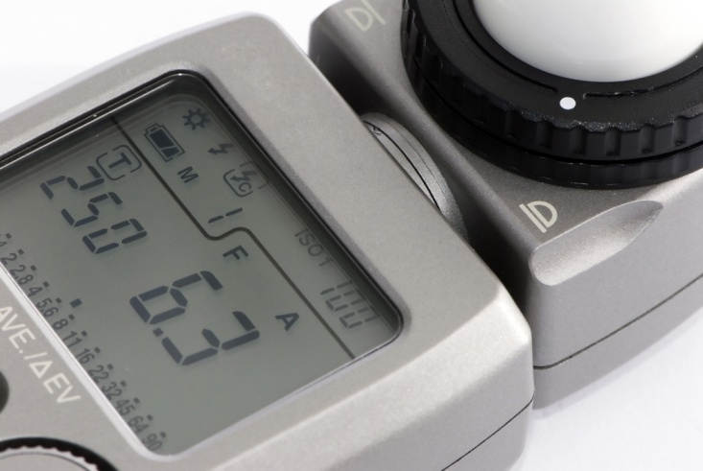
Benchmarks
Benchmarks are the current state of the metrics you’re using to determine your idea’s success
Before writing your hypotheses, have your benchmarks in place

Slide 15

Hypothesis Creation Table
We will | For | In order to achieve
[create this feature] | [this persona] | [this outcome.]
We will create an app that lets time bank users post offers and requests, and record transactions. | Any current time bank member with a smartphone. | Increase the number of transactions by 25% over the coming year, by January 1, 2015.

Slide 16

Create a Minimum Viable Product (MVP)
Is there a need for this solution?
Is there value in the solution/feature?
Is the solution usable?

Slide 17

Low-Fidelity Prototypes: Paper
Quick, crafty, fun
No digital investment
Flaps and windows
A sense of how the workflow starts to coalesce
Inexpensive

Slide 18

Low-Fidelity Prototypes: Clickable Wireframes
Takes fidelity to next level
More realistic feel
Click, tap, gesture
Provides good sense of length of workflow
Reveals major obstacles to primary task completions

Slide 19
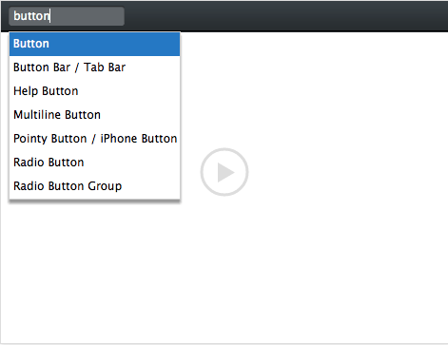
Tools for Low-Fidelity Clickable Wireframes
Balsamiq (shown)
Microsoft Visio
OmniGraffle (Mac only)
Microsoft PowerPoint
Fluid Designer/Pop Prototype on Paper (mobile)

Slide 20
Some Non-Prototype MVPs
Email | Google Ad Words | Landing Page | The Button to Nowhere
Open rates, click-throughs, and task completion rates | Purchase ads that target searches relevant to your business. Monitor what people are searching for, feedback on language | For click-through traffic from Google ads, to further validate your thinking. Wild West movie studio set. Includes call to action. | Button only measures the number of times it is clicked. Give the user some reason as to why feature is not working.

Slide 21

Zora Neale Hurston
“Research is formalized curiosity. It is poking and prying with a purpose.”

Slide 22
Feedback and Research

Slide 23
Collaborative and Continuous Research Techniques
Build a shared understanding with your team, using collaborative research techniques
Build small, informal qualitative research studies into every iteration with continuous research techniques

Slide 24
Collaborative Design and Discovery
Collaborative Design
Gets all involved
Uses low-fidelity artifacts
Builds shared understanding
Collaborative Discovery
Lets you get out into the field with your team
Meeting with and learning from customers
See how hypotheses test out

Slide 25
Monday
Start the recruiting Process
Decide what will be tested
Tuesday
Refine what will be tested
Wednesday
Refine what will be tested
Write the test script
Thursday
Friday
Finalize recruiting
Testing day
Review findings with the entire team
Plan next steps based on findings
Three Users, by Noon, Once a Week

Slide 26
Helpful Hints
Simplify your environment, you don’t need a lab
Use desktop recording/broadcasting software such as Morae, Silverback, or GoToMeeting
Your whole team should watch
Offload participant recruitment to a third-party vendor, including screening, scheduling, and replacing no-shows on testing day ($75-$150 per subject)

Slide 27
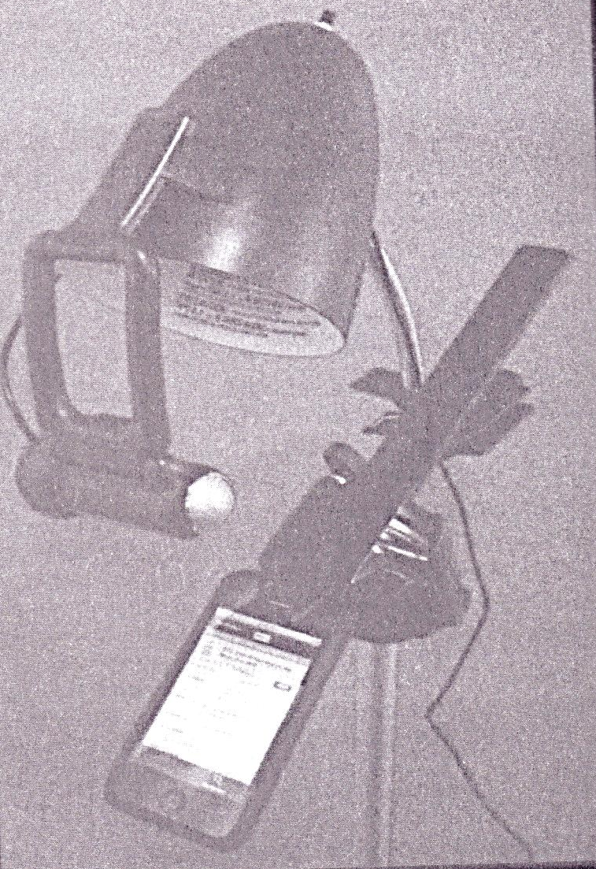
Meetup’s Mobile Usability Testing Rig
Cost: $28.00

Slide 28
Making Sense of the Results You Get
Look for patterns
Park your outliers
Verify with other sources and methods
Test everything
See a small number of users every week, instead of running big studies
Use sketches, static wireframes, high-fidelity visual mockups (not clickable), mockups (clickable), and coded prototypes

Slide 29

Monitoring Techniques
Customer Service
Onsite Feedback Surveys
Search Logs
Site Usage Analytics
A/B and A/Bn Testing

Slide 30
Some Additional Usability Research Methods
Heuristic evaluation
Cognitive walkthrough
Protocol analysis (“thinking aloud” method)
Surveys
Interviews
Ethnographic research
Card-sorting
Task analysis
Interviews
Field studies
User Scenarios
Navigation/Conceptual Model

Slide 31

How to Determine How Good/Bad Your UX Really Is
Experiment
Test
Obtain user feedback using proven research methods
Heuristic evaluation
Collect and analyze data

Slide 32
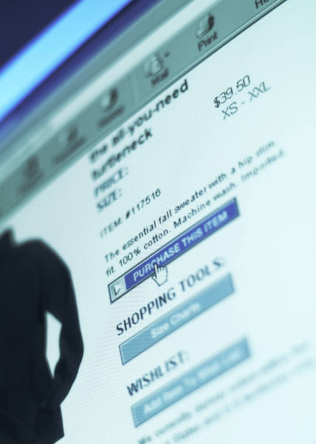
Some Currently Documented Usability Guidelines
113 emerging standards
80% of them have remained unchanged in the past 10 years
Links underlined and displayed in blue, change to violet after being visited

Slide 33

Questions and Answers
Josephine M. Giaimo
josephinegiaimo@gmail.com
@giaimojosephine
123 Johnson Street, Highland Park, NJ 08904
(732) 448-0021, or (732) 501-6312

