Slide 1
Leveraging SharePoint User Profiles
to Enhance Effectiveness and Efficiency
Gary Clayton
Ph: 609-678-0110

Slide 2

Corporate View: Homogeneous but Severable
Notes:
Execs are focused on cashflow and corporate value. They like to think every acquisition, facility or line-of-business will be easily merged into the whole corporation – and can be easily separated from the whole if they decide to sell or discontinue an operation.

Slide 3

Operations View
Limits on Accessibility and Quality
Notes:
In IT, the view is very different. Melding many disparate operations from around the globe is difficult. Different data views, different degrees of accessibility, different degrees of data quality must be dealt with every day. Reducing costs through consolidation while maintaining severability for potential operations sales is a difficult balancing act.

Slide 4
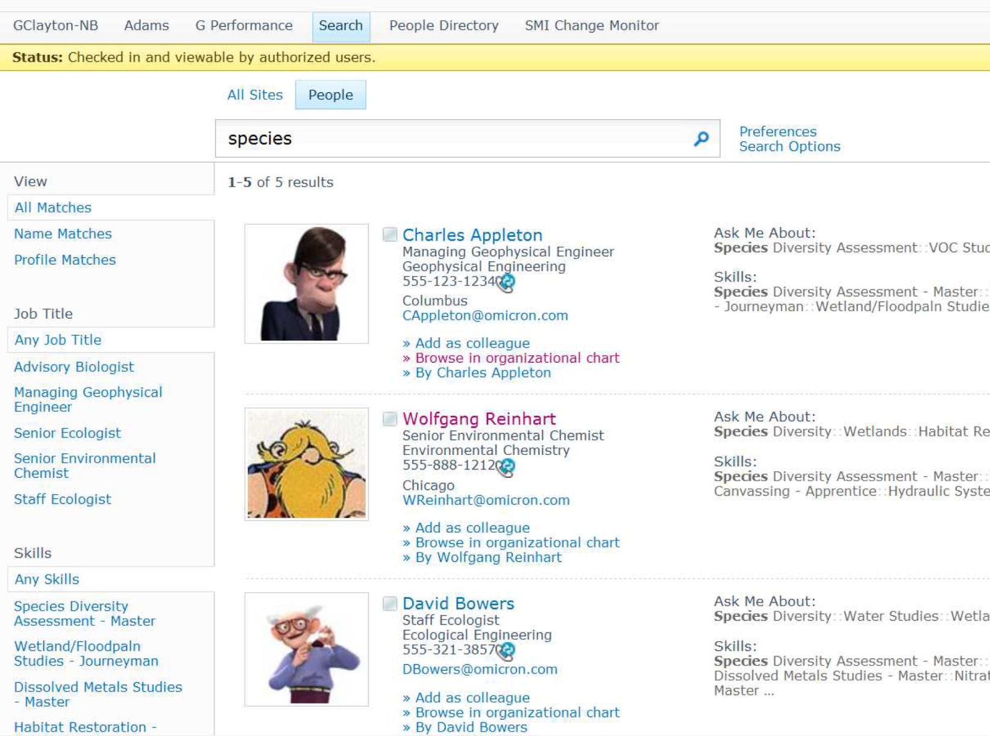
Notes:
A worldwide consolidated picture of a corporation’s human assets is needed to bring the best knowledge and experience to bear on every issue/challenge. A flexible directory is needed that consolidates the corporation’s view of the skills, capabilities and knowledge of each employee and contractor, plus catalogs the personal interests, authored documents and associations for each person.

Slide 5
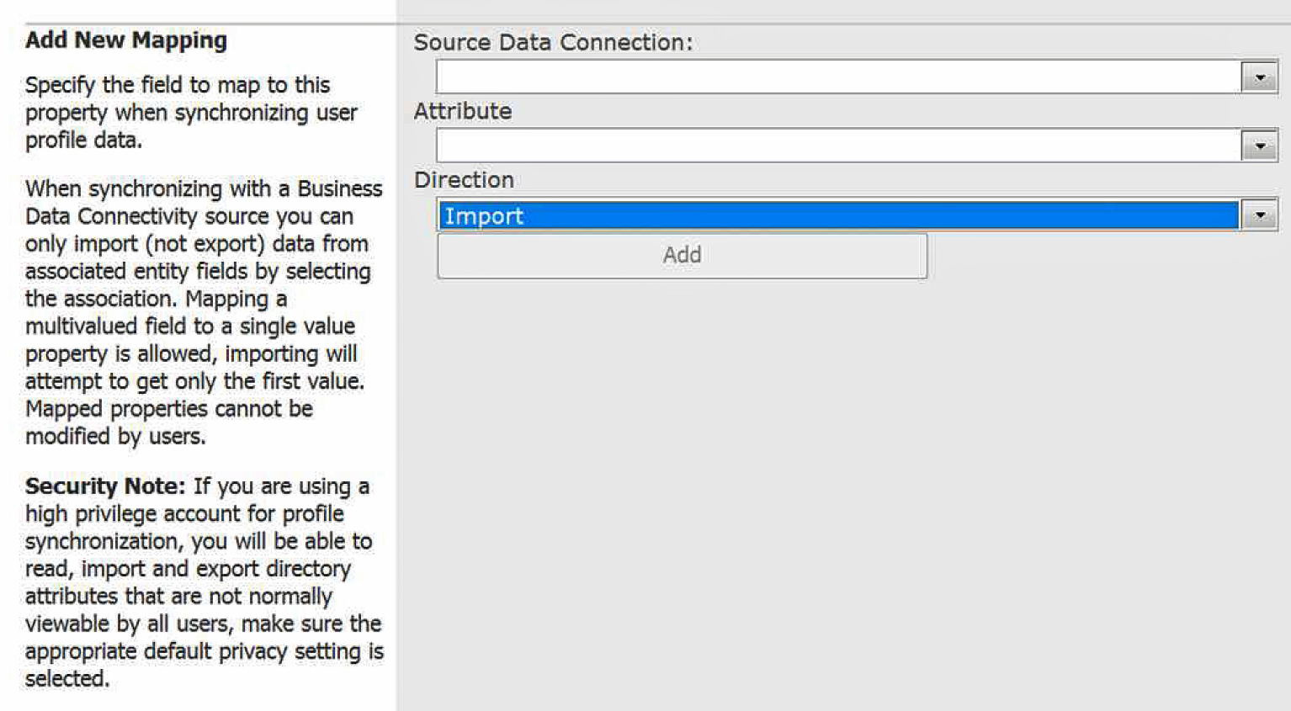
Edit User Profile Property: - Allows only One Source
Notes:
SharePoint is capable of being that directory, but care needs to be taken to get around SharePoint’s limitation of having only one external data source for each attribute included in the directory.

Slide 6

Data Consolidation Approach
Other DBs
Data Cache DB
Buffer
Extended User
Profiles

Slide 7
Five Step Method
Update data from External Lists to Data Cache
Replicate Data from 3rd Party Systems (i.e., Payroll/HR) to the Data Cache
Merge/Manipulate Data into common formats
Data Cache Merge
User Profile Synchronization
Notes:
Best practices

Slide 8

1 SharePoint External Lists update DataCache buffer tables
Create Common Data Formats
SW Package DBs
Data
Cache
DB
External Lists
Profile Merge Routine
Extended User
Profiles

Slide 9
2 SQL Server Integration Services copies data from packages to DataCache buffer tables
Create Common Data Formats
SW Package DBs
Data
Cache
DB
External Lists
Profile Merge Routine
Extended User
Profiles

Slide 10
3 Merge/Manipulate buffer tables into common data column formats
Create Common Data Formats
SW Package DBs
Data
Cache
DB
External Lists
Profile Merge Routine
Extended User
Profiles

Slide 11
4 sp_MergeAllColumns consolidates all data sources based on priority
Create Common Data Formats
SW Package DBs
Data
Cache
DB
External Lists
Profile Merge Routine
Extended User
Profiles

Slide 12
SharePoint User Profile Sync can now access a single source
Notes:
The Data Cache DB provides a single consolidated data source.

Slide 13
Finale: SharePoint User Profile Sync brings in A/D and DataCache
Create Common Data Formats
SW Package DBs
Data
Cache
DB
External Lists
Profile Merge Routine
Extended User
Profiles

Slide 14
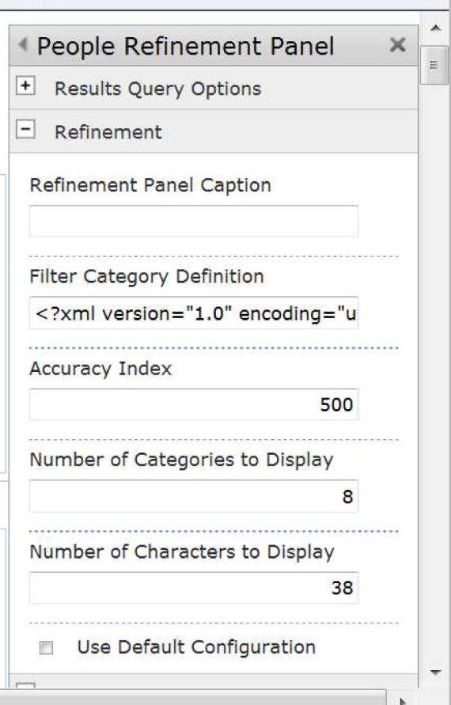
People Search Refinement Panel
- Add Categories in Display Order
- Set Parameters
Max is 500 => Use It!
Set Larger as Needed
Uncheck box

Slide 15
People Refinement Panel Add Categories in Display Order
<Category Title="spshjobtitle"
Description="Use this filter to restrict results to a specific job title" Type="Microsoft.Office.Server.Search.WebControls.TaxonomyFilterGenerator" MetadataThreshold="3" NumberOfFiltersToDisplay="10" MaxNumberOfFilters="50" ShowMoreLink="True" MappedProperty="ows_MetadataFacetInfo" MoreLinkText="show more" LessLinkText="show fewer“/>

Slide 16
People Refinement Panel Adjust Category Properties
<Category Title="Managed Metadata Columns"
Description="Managed metadata of the documents" Type="Microsoft.Office.Server.Search.WebControls.TaxonomyFilterGenerator"
MetadataThreshold=“1" NumberOfFiltersToDisplay="10" MaxNumberOfFilters="50"
ShowMoreLink="True" MappedProperty="ows_MetadataFacetInfo" MoreLinkText="show more" LessLinkText="show fewer“
/>

Slide 17

Presented by:
Gary Clayton

