Slide 1

UX design for mobile devices: an introduction
Josephine M. Giaimo, MS

Slide 2
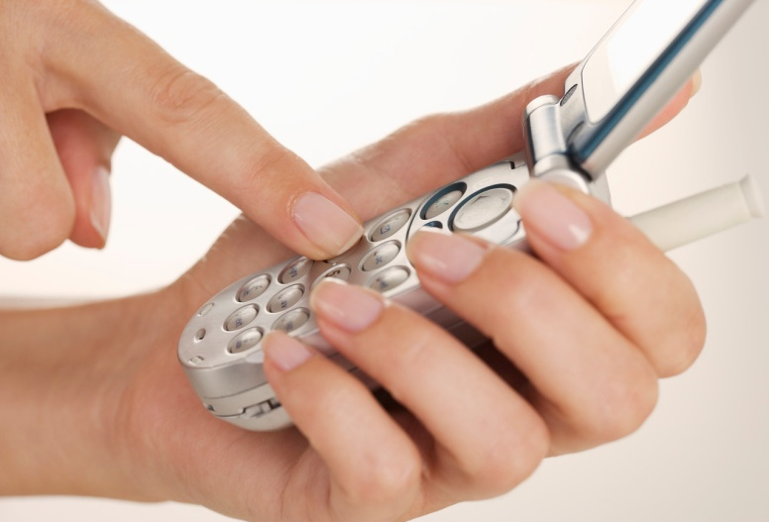
What we’ll look at today:
UX design for mobile devices

Slide 3

UX researcher and user advocate
Principal, jg interactive designs

Slide 4

Who I’m Not:
An “evangelist”
A “rock star”
A foosball player at work
“Passionate”

Slide 5

Who I am:
Someone who sees problems ahead of the game
Cool, chilly, and objective
An experienced UX researcher
Focused on users, data, and results

Slide 6
What we’ll look at today:
Why mobile is different
The research
Mobile strategy
Designing for the small screen
Writing for mobile
Tablets and E-readers
Looking toward the future
A bit of history

Slide 7
Why mobile is different
Is researching the mobile user experience worth the investment?

Slide 8
Monetate 2012 study
100 million e-commerce client web site visits
Why the big difference in conversion rates?
Is the mobile user experience horrible? Yes.
Is it worth investing in mobile design? Yes.
Device | Conversion Rate
Desktop | 3.5%
Mobile | 1.4%
Tablet | 3.2%

Slide 9
The research on mobile
A little goes such a long way…

Slide 10

Not opinions
Based on a broad spectrum of average users around the world
User likes and dislikes
Easy to use or troublesome?

Slide 11

Two diary studies use a variant of the snippet technique
Each time a subject used their mobile device, users tweeted a reminder
Questionnaires detailed the context
Plus interviews and usability-testing sessions

Slide 12

Usability testing
Used the “think-aloud” methodology
US, Australia, Hong Kong, Netherlands, Romania, and UK
One-on-one sessions with one test user at a time
Not focus groups!

Slide 13

Usability testing (Cont’d….)
Own phone/tablet
Tasks to complete
Open-ended
Directed
Users commented on:
What they were looking for
Likes/dislikes
Ease/difficulty of accomplishing tasks

Slide 14

Qualitative User Research
We study behavior, not opinions.
“Once you’ve seen a problem in real life, you know it’s there. You don’t need to measure it.”
--Jacob Nielsen

Slide 15
Mobile strategy
Numerous similarities in the UX of mobile in 2009 and desktop for the web in 1998 (back to the future?)

Slide 16
Mobile 2009 and desktop 1998 similarities
Unfamiliarity with browser’s user interface limited options
JavaScript crashes
Reluctance to use
Search dominated behavior
Old-media (wrong) design for mobile
Abysmal success rates were the norm
Download times were too long
Scrolling caused major problems
Bloated pages made users feel lost

Slide 17

Usability varies by mobile device category
Success rates in usability studies
Wireless Access Protocol (WAP)
A separate mobile experience is best

Slide 18
Devices and test results (2009)
Regular cellphones (feature phones)
horrible usability
minimal interactions with websites
Smartphones (e.g., early Blackberry)
bad usability
users struggle to complete website tasks
Full-screen phones (iPhones, Android, Windows Phone)
suboptimal user experience
success with sites or apps optimized for mobile

Slide 19
Mobile site vs. full site
Mobile-optimized sites
Why full sites don’t work for mobile use
Mobile is less forgiving than desktop
Mouse vs. fingers as an input device (no clear winner)
Responsive design
Usability guidelines are rarely dichotomies

Slide 20
Main guidelines for mobile-optimized websites
Build a separate mobile site
Even better, build a mobile app
Make sure mobile users who arrive at your full site see your mobile site instead
Offer a clear link from full to mobile site despite redirect
Offer a clear link from mobile to full site

Slide 21
Designing mobile-optimized sites
Cut features that are not core use
Cut content to reduce word count
Enlarge interface elements to reduce “fat-fingering”

Slide 22
A separate mobile experience is best
The smaller the screen, the fewer the features
Rich sites should build two mobile designs:
low-end feature phones
big-screen phones
For most sites, the realistic choice is to supplement the main site with a single mobile site

Slide 23
The design challenge
“The design challenge is to place the cut between mobile and full-site features in such a way that the mobile site satisfies almost all the mobile users’ needs.”
--Dr. Jacob Nielsen

Slide 24
Responsive design
Means optimizing the layout of a Web page for the screen dimensions and screen orientation.
Can work well for sites where all features and content are equally likely to be accessed on mobile.
Consider amount of business conducted with mobile vs. desktop users before choosing.
Involves creating distinct UIs for each platform.

Slide 25
Usability guidelines are rarely dichotomies
Squeeze that text “orange” even more with mobile than for the Web
When considering which content to move to secondary pages, move the cut-off point even more than for the Web
In all UX areas, mobile usability requires stricter and more scaled-back design than desktop—not just responsive design.

Slide 26
Mobile sites vs. apps: the coming strategy shift
Current mobile strategy: apps are best
Future mobile strategy: sites are best
Physical vs. virtual (soft) buttons
When will the strategy shift happen? (or has it already)
Native apps, web apps, and hybrid apps

Slide 27
Why ship mobile apps now
Users perform better with apps than sites
74% success with apps vs. 64% for mobile-specific sites
Mobile apps are more usable
An app can target specific limitations and abilities of each device better than sites
Mobile devices provide an impoverished user experience, and are weaker devices

Slide 28
Why will mobile sites dominate in the future?
Cost-benefit trade-offs for apps vs. sites will change
Future phones will be faster, better
Download times will be cut 57 times
Expense of mobile apps will increase—more platforms to develop will emerge
iOS forked into iPad vs. iPhone
Amazon forked Kindle Fire into two platforms
4.0 v. of Android, Ice Cream Sandwich, one more

Slide 29
Physical vs. soft buttons
Soft or virtual buttons are part of the touch screen
Kindle Fire replaced four physical buttons with soft ones
Android v. 4.0 (Ice Cream Sandwich) replaced physical buttons with soft ones
Buttons can be overloaded
Back can mean cancel, back to app, or back to previous app, causing design/user problems

Slide 30
When will change from apps to sites happen?
Nobody knows
Researchers suggest that mobile sites will “win” over mobile apps in the long run
Today, the advice is to develop apps

Slide 31
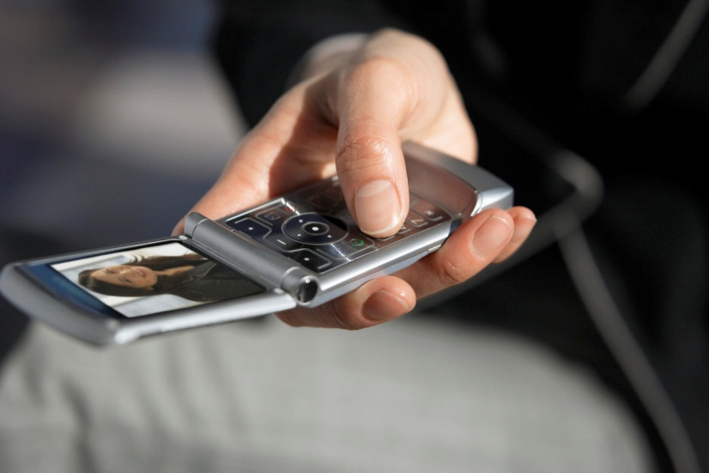
Mobile apps
Mobile apps are intermittent-use apps
People install more than they use
Ephemeral applications on websites
Low commitment

Slide 32
Half-speed progress, but hope ahead
Why do users spend more time on these tasks in 2009?
The usage environment has changed
Search dominant
Task | WAP (2000) | Modern Phones (2009)
Find the local weather tonight | 164 sec. | 247 sec.
Find what’s on BBC TV tonight at 8 p.m. | 159 sec. | 199 sec.

Slide 33
Mobile intranets
Lack of traction—why?
No budget or resources for mobile
Difficult for intranet teams to choose one mobile device, so they choose none
Resources needed for a version that works on any mobile device are not available

Slide 34
Designing for the small screen
Set priorities, make trade-offs, find the balance

Slide 35
Wasted mobile space
Two interfaces for the same data
Chrome
Edward R. Tufte was the data display genius
Progressive disclosure
Overloaded vs. generic commands
Case study: optimizing a screen for mobile use
Information scent

Slide 36
Two interfaces for same data
Two = one too many
Usually indicate a “lazy” design
Only justified when two view emphasize significantly different aspects of the data.
iBooks has a bookshelf and list view—not ok
Yelp has a list and a map view--ok

Slide 37
What is chrome?
The visual design elements that give users information about the screen’s content or provide commands to operate on that content
Takes up space, chrome obesity eats pixels
Chrome can “come and go” on screen with:
Simple and reliable operations and consistency
Contextual tips (e.g., which gesture to use)
Progressive disclosure
Chrome is good in moderation, don’t overdo

Slide 38
Progressive disclosure
Addresses two contradictory requirements
Power, features, and options
Simplicity
Shows:
Initially only a few steps
A larger set of options on request only
Gets the split between initial/secondary features right

Slide 39
Mobile users face hurdles
Small screens
Awkward input for typing
Download delays--may diminish in future
Mis-designed sites—hope for redesign

Slide 40
Overloaded vs. generic commands
Generic commands—same command in different contexts for same result
Pinch-zoom
Overloaded commands—variants of same command to achieve different outcomes
Often confuses users
E.g., websites with multiple search fields

Slide 41
Examples of overloaded commands
Two different Home buttons in Conde Nast’s Kindle Fire app
Back on Zappos app for Android:
Undo on product page
Takes user out of app on homepage
Back on New York Times Kindle Fire
One step back or two, depending…

Slide 42
Reusing commands effectively
Do people:
Recognize that two contexts are different?
View the outcomes as similar or different?
Criteria depend on how users interpret the user interface.
Use empirical testing to judge and decide.

Slide 43
Information scent to forage
Users:
Estimate a given hunt for information (via foraging) and its likely success from its spoor (scent)
Assess whether the path exhibits cues related to desired outcome
Ask: do links and categories explicitly describe what users will find at the end?
Don’t use made up words or slogans as navigation options; feedback “on the path”

Slide 44
Case study: AllKpop.com
Things done right
Redesign (partial list)
Supports right task
Separate mobile
Server auto-senses mobile or desktop
Touch targets
Content-carrying keywords
Fewer features
Bigger touch targets
Full headlines
Enhanced scannability
More info scent

Slide 45
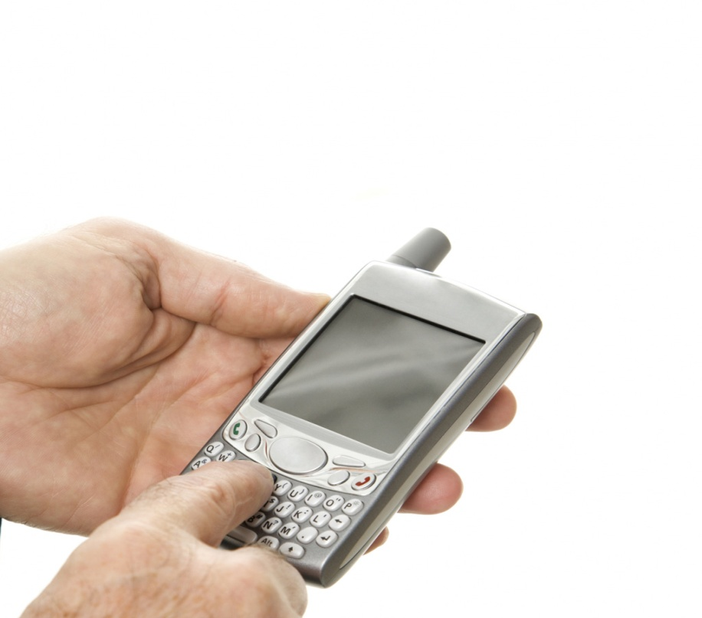
Typing forms on mobile
Let them use abbreviations
Compute info
Support cut/paste
Prepopulate known values
Make it short

Slide 46
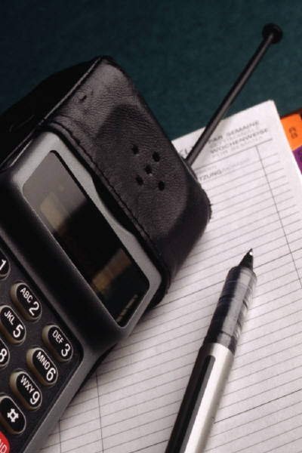
Getting around download times
Streamline the interaction
Include only needed information
Don’t abuse images
Give users feedback

Slide 47
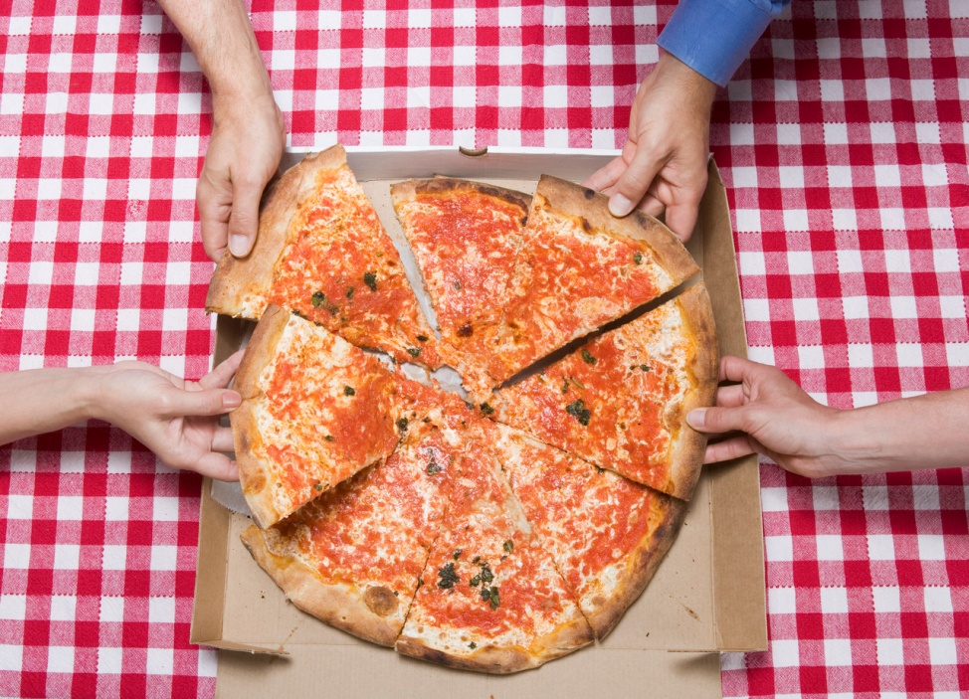
Early registration must die
Example: pizza ordering application
Why ask users to register on the first screen (“take before you give”)?
Don’t abuse your emerging relationship with the users.

Slide 48
What should sequence be?
Show the list of basic pizzas
Let users customize their order
Show the price
Can ask for zip code to give delivery time
Take the order
Ask for personal info, now that users are sufficiently committed

Slide 49
Case study: the WSJ mobile app
The 90-9-1 rule
Confusing startup screen
Degrading the brand
A better design
A new WSJ workflow
Better next year
Workflow design

Slide 50
The 90-9-1 rule
90% are lurkers
9% are contributors occasionally
1% are participants who account for most of the contributions

Slide 51
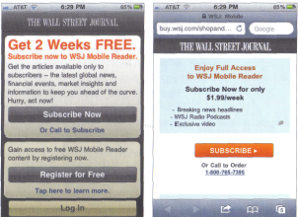
Example: confusing startup screen

Slide 52
Why is this a two-star mobile app?
The left screen is the WSJ iPhone app startup screen (2011)
The right screen is what you see after tapping the Subscribe Now button in the left screen.

Slide 53
Why are subscribers upset?
In the first screen, the strongest call to action was the two weeks free offer.
It seems obvious that it would cost $1.99 per week to use the mobile app after two weeks.
Incorrect. If you click Subscribe on the second screen, access is free for current website subscribers.
Most users never saw this third screen.

Slide 54
How bad design degrades the brand
Even though WSJ has subscribers’ money, they should not disregard existing customers:
Subscribers feel insulted by paying twice (subscription and online access)
Those who pay for website access are most loyal fans who should be treasured, not treated like garbage
WSJ needs to retain credibility, and deepen relationships

Slide 55
A better design would eliminate this usability problem
Spell out the three possible scenarios
FREE limited access
FREE full access for existing subscribers
First two weeks FREE for new subscribers
Place buttons side by side to reduce confusion
Simplify the workflow

Slide 56
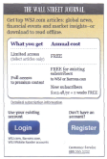
WSJ screen redesign
All three options shown on one screen

Slide 57
Better next year
WSJ released a new design in 2012
They also changed their business model
The lesson:
UI design is only part of a total experience
Are designers allowed to alter the business model in your company?
What is the impact of the business model on the user experience?

Slide 58
Workflow Design
Big issue in application usability
Flawed workflows are confusing
Tighten or loosen? It depends…
Workflow should allow user inspection
Consider interruptions during process

Slide 59
Writing for mobile
Focus, focus, focus

Slide 60

Mobile content is twice as difficult
Cloze test
Cloze test solution—don’t peek
Why mobile reading is challenging

Slide 61
Cloze test
Common empirical comprehension test.
Replace every nth word with blanks, e.g., n =6
Ask test participants to read modified text and fill in the blanks w/best guesses
Score is % of correctly guessed words
If score is > 60%, assume reasonable comprehension
Compare readability and comprehension

Slide 62
E.g., Facebook’s privacy policy:
Site activity information. We keep (1) of some of the actions (2) take on Facebook, such as (3) connections (including joining a group (4) adding a friend), creating a (5) album, sending a gift, poking (6) user, indicating you “like” a (7), attending an event, or connecting (8) an application. In some cases (9) are also taking an action (10) you provide information or content (11) us. For example, if you (12) a video, in addition to (13) the actual content you uploaded, (14) might log the fact that (15) shared it.

Slide 63
About the full text
Before inserting the blanks, text scored at the 14th grade level (2 years college)
Higher level than for most of FB audience
Should leisure sites feel like textbooks?

Slide 64
Cloze test solution is…
On the next slide…

Slide 65
Missing words in the sample
track
you
adding
or
photo
another
post
with
you
when
to
share
storing
we
you

Slide 66
Did you get at least nine?
Nine out of fifteen corresponds to 60%
If you got a lower score, it’s likely to be a lack of contextual knowledge of Facebook
E.g., the use of the work “poking” makes its meaning incomprehensible in context unless you are a user

Slide 67
Mobile reading is challenging
Smaller screen
Means users can see less
Users must move around page, scrolling
Takes more time, degrades memory
Diverts attention from problem at hand
Introduces new problem of requiring previous location on the page

Slide 68
In doubt? Leave it out!
Killing time is the killer app of mobile
Mobile users are in a hurry
What a paradox!
Filler = bad
Cut the fluff
Defer background material to secondary screens

Slide 69
What’s the diff?
Readability
Comprehension
A property of actual text
Predicts educational level of those reading content w/ease
Combines text property with a user segment
Shows whether target audience understands text meaning

Slide 70

If in doubt, leave it out
Filler = bad
Ditch the blah-blah text
Old words are best
Bylines for mobile content?
Author bios dos and don’ts

Slide 71
Old words and Bylines
Old words are best
On bylines
Speak the user’s language
Against
Keep it short
Cut more in mobile
For
Famous, cred author
Individual’s take
Intranet

Slide 72

Defer secondary information to secondary screens
Example 1: mobile coupons
Example 2: progressive disclosure in Wikipedia
Deferring information = initial info is read more

Slide 73

Mini-IA: structuring the information about a concept
Linear paging? Usually bad
Don’t chop up an article into pages
Alphabetical sorting must (mostly) die
Lazy design team?
Use an inherent logic

Slide 74
Examples of structure
Usage-relevant
Usage-driven
Organize physical exercises from easiest to hardest
Options
One long page
Mini-IA
Split into chunks
Distributed info (see usage-relevant)
Blends together subtopics

Slide 75
Tablets and E-readers
iPad and Kindle Fire as most interesting

Slide 76

iPad usability
Tablets are shared devices
What are iPads used for?
The triple threat of iPad design
Perceived affordance: can you see me now?
Recognition-based user interfaces

Slide 77

iPad usability (Cont’d….)
Inconsistent interaction design
The print metaphor
Card sharks vs. holy scrollers
Swipe ambiguity
Too much navigation

Slide 78

iPad usability (Cont’d….)
Splash screens and startup noises
Orientation
Toward a better iPad user experience

Slide 79
iPads are used mostly for
Playing games
checking email/social networking sites
Watching videos/movies
Reading news

Slide 80
The iPad UI “triple threat”
Low discoverability (hidden UI)
Low memorability (ephemeral gestures)
Accidental activation (touch by mistake)

Slide 81
Perceived affordance
Affordance means what you can do with something
But…users first have to know that a gesture can be used to perform an action
Two ways: by remembering or inferring
Perceived affordance = visible in advance
Can You See Me Now?

Slide 82
Recognition based interfaces
E.g., gestures
Also handwriting recognition
Computer must interpret raw input
Problem: misrecognized input = user frustration
99% accuracy is not good enough

Slide 83
Inconsistent interactive design
Touching a picture (across/within apps)
Nothing special happens
Enlarging the picture
Showing a more detailed page about item
Flipping the image, reveals more info
Popping up a set of navigation choices
Showing tips about interacting with picture

Slide 84
The Print Metaphor
Swiping
Sequential navigation
Strategic issue: user empowerment or author authority?

Slide 85
Card Sharks vs. Holy Scrollers
Cards
Fixed-size presentation canvass
Scrolls
Room for as much information as you want
Make the swipe more discoverable

Slide 86
Swipe Ambiguity
Users won’t hit a specific spot, necessarily
Swiping is usually executed close to the sides of the screen
Like turning the pages of a book

Slide 87
Too Much Navigation
Many apps squeeze information into very small areas
Harder to recognize and manipulate it

Slide 88
Splash Screens and Startup Noises
Splash screens are revived super vampires
Users do not expect to hear noises

Slide 89
Orientation
Landscape or portrait
Slight preference for landscape
Depends on use of iPad cover, app, etc.

Slide 90
Better iPad
Add dimensionality to increase discoverability
Loosen up the etched-glass aesthetic
No value-added through weirdness
Support standard navigation, Back feature, search, clickable headlines, and a homepage for most apps

Slide 91
Kindle usability
Kindle: the E-reader
Kindle reader on the iPhone
Kindle Fire usability

Slide 92
Kindle Usability
One command, two buttons to turn page = good
Kindle iPhone app has poor usability
E-books are good
less weight, no dirty fingers, easier page turns

Slide 93
Kindle Fire Usability
“Fat finger” problem
Everything is much too small on the screen
A heavy object
Magazine apps have issues, e.g., no homepage
Seven-inch tablets will have to make do for now with repurposed content

Slide 94
Looking toward the future
A broader view of mobile, other types of interfaces

Slide 95

Transmedia design for the three screens
PCs will remain important
The third screen: TV
Screens 4 and 5: tiny, huge will be more important
Transmedia user experience

Slide 96
Transmedia UX Design Strategy
Visual continuity
Feature continuity
Data continuity
Content continuity

Slide 97

Beyond flatland

Slide 98
Beyond flatland
The world becomes computational
“The invisible computer” (Norman)
Augmented vs. virtual reality

Slide 99

In the future, we’ll all be harry potter
Next-generation magic
Don’t harm the muggles
Every non-conforming screen undermines users’ ability to build a conceptual model

