Slide 1
Learning from Others: Top 10 Mistakes in Web Design, Information Architecture, and Application Design
Josephine M. Giaimo, MS
March 14th, 2014

Slide 2
What We’ll Discuss Today
Top 10 mistakes in design in EACH of the following categories:
Web Design;
Information Architecture;
Application Design.

Slide 3

About Me
User Advocate
User Experience Researcher/Strategist
Clients/employers have included AT&T, Lucent, Avaya, IITRI, NJIT, Sarnoff, Proctor & Gamble, Smirnoff, Y&R, etc.
Recently performed UX research on peer-to-peer networks and time banking for NSF at Xerox PARC

Slide 4

A Big Thank You!
To Jakob Nielsen, Ph.D.
User Advocate, Researcher
Co-founder, Nielsen Norman Group
Described as the “Guru of Web Page Usability” (New York Times)

Slide 5
Top 10 Mistakes in Web Design
Data collected in 2011 by Jakob Nielsen, et al.

Slide 6
1. Bad Search
Search engines that are overly literal
Can’t handle typos
Search engines that prioritize on number of query terms instead of importance
Simple search works best
For example: No results for “youcrane”; No results for “Ukrane”; No results for “Ucrane”; Oh, forget it. Let’s just search “Russia.”

Slide 7

2. PDF Files for Online Reading
Users report hating PDFs which break flow
With PDFs, standard browser commands don’t work
A blob difficult to navigate
Reserve it for manuals
Convert the rest to a browse-able Web page

Slide 8

3. Not Changing the Color of Visited Links
Helps reader grasp site navigation
Prevents unintentional revisiting of same page over and over
Standard
Unvisited: blue
Visited: violet

Slide 9
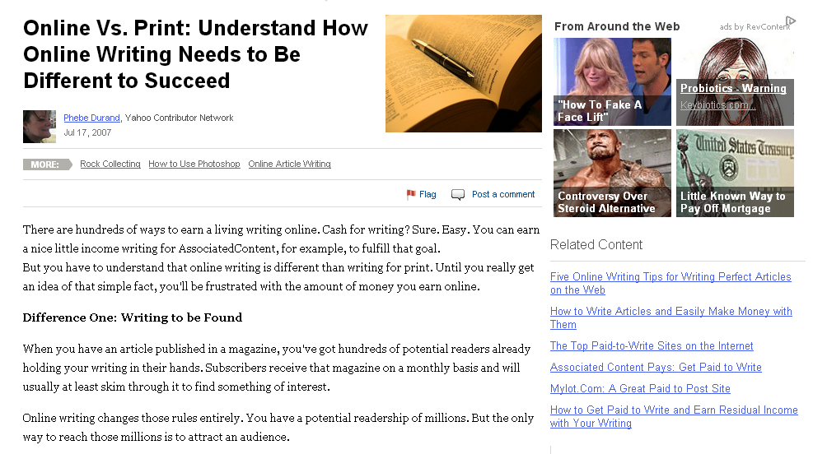
4. Text that Cannot Be Scanned (by a Human Being)
Write for online, not print, using
Subheads
Bulleted lists
Highlighted keywords
Short paragraphs
Inverted pyramid
Simple writing style
De-fluffed language, devoid of marketese

Slide 10
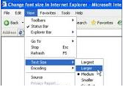
5. Fixed Font Size
CSS style sheets empower websites to disable the browser's “change font size” button
Let users resize text, and respect their preferences
Specify font size not as absolute number of pixels, but in relative terms

Slide 11
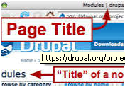
6. Page Titles with Low Search Engine Visibility
Page title is contained within HTML <title> tag
Page title is default entry when users bookmark a site
Start title with most salient, information-carrying words

Slide 12

7. Anything That Looks Like a Advertisement
Users have selective attention
Users ignore legit design elements if they look like ads
Banner blindness
Animation
Pop-up purges

Slide 13

8. Violating Design Conventions
When you break the users’ expectations, they will feel insecure
Jakob’s Law of the Web User Experience: “users spend most of their time on other websites.”
When you deviate, your users will leave

Slide 14
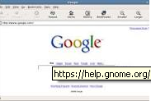
9. Opening New Browser Windows
Do not pollute the user’s screen with more windows
Taking over the user’s machine sends a user-hostile message
Misbehaving links undermine users’ understanding of their own system

Slide 15

10. Not Answering Users’ Questions
Users are goal-driven
If you are not specific, users will assume your product/service does not meet their needs
Do you avoid listing the price of products/services?

Slide 16
Top 10 Information Architecture (IA) Mistakes
Structure is the invisible way the site is structured. Navigation is the visible way the site is structured. Both need to work together.

Slide 17

1. No Structure
One big swamp search
Commonly found on
News sites
Catalog-based e-commerce sites
Users leave these sites quickly, and there is no wonder as to why

Slide 18
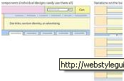
2. Search and Structure Not Integrated
Users exhibit search-dominant behaviors
When a user searches and finds a target, does your site help the user learn the structure of the site?
What is user’s current location?

Slide 19
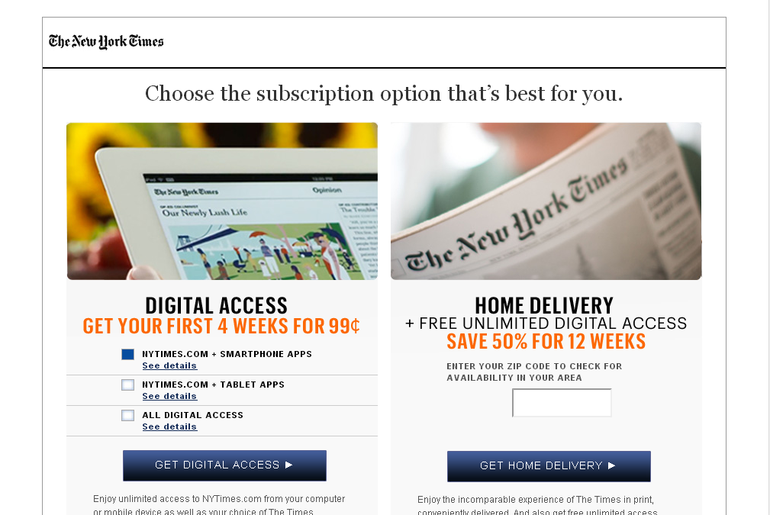
3. Missing Category Landing Pages
Does your site have a series of categories that each link to their own landing pages?

Slide 20

4. Extreme Polyhierarchy
Too many classification options
Can become a crutch
Too many structured dimensions
Results in low confidence early in the site experience, thwarting later experiences

Slide 21
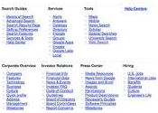
5. Subsites/Microsites Poorly Integrated with Main Site
Subsites must be integrated within the overall site structure

Slide 22

6. Invisible Navigation Options
If a user cannot see the feature, it may as well not exist
Make navigation permanently visible on the page
Minesweeping (passing the mouse to see what is hidden)
Children like it
Teenagers don’t
Adults hate it

Slide 23

7. Uncontrollable Navigation Elements
Things that bounce/move detract from usability
Overly sensitive rollovers
Elements that move, spin, or rotate of their own accord

Slide 24

8. Inconsistent Navigation
Is it a puzzle?
Do options come and go?
Global navigation’s persistence serves a key purpose—a beacon to help users understand where they are and how they can get back to the top of the site if lost.

Slide 25
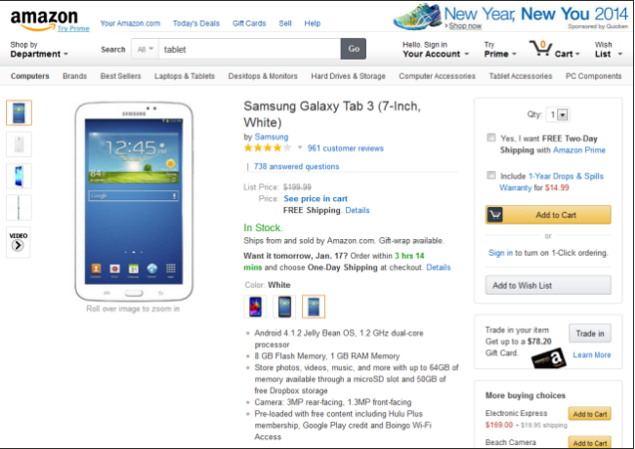
9. Too Many Navigation Techniques
Nielsen identified 25 different website navigation techniques
Each has pros/cons
If you use all of them, you get a mess!

Slide 26
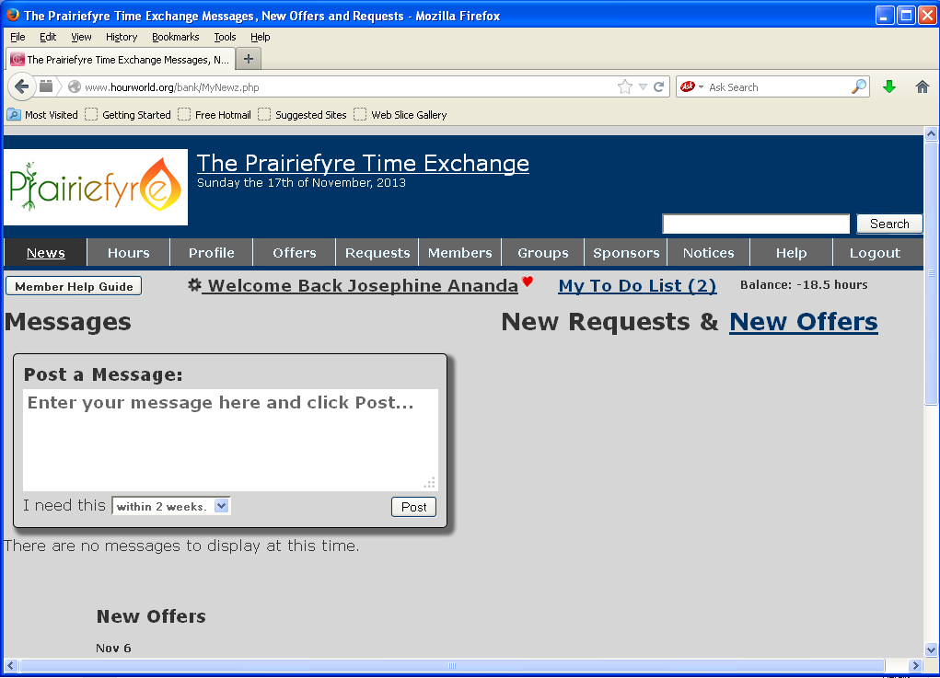
10. Made-Up Menu Options
Make up their own terminology for labels and other navigation choices
Less dominant than it used to be
Hurts search
Old words are better

Slide 27
Top 10 Application Design Mistakes
Worst mistakes are domain-specific, solving the wrong problem, having the wrong features, or making the right features too complicated.

Slide 28
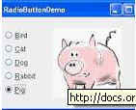
1. Non-Standard GUI Controls
May include
Command links
Radio buttons
Checkboxes
Scrollbars
Close boxes, etc.
“Users have several thousand times more experience with standard GUI controls than with any individual new design.”—Jakob Nielsen

Slide 29
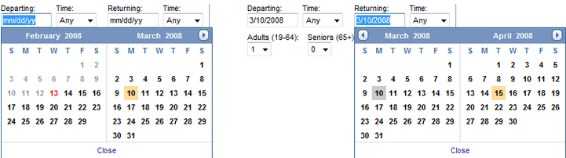
2. Inconsistency
When an application uses different words or commands for the same thing, confusion results.
What happens in Expedia when you want to book a trip that starts on March 10 and ends on March 15?

Slide 30
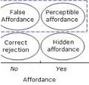
3. No Perceived Affordance
“Affordance” means what you can do to an object
Users don’t have time for a minesweeping game
Symptoms
Users say, “What do I do here?”
Users miss features
Verbose explanations

Slide 31
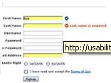
4. No Feedback
Show current state
Tell users how their commands have been interpreted
Tell users what’s happening
Don’t keep them guessing

Slide 32
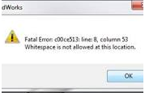
5. Bad Error Messages
The guidelines for error messages have been around for nearly 30 years
Explain how and why the user can fix the problem
Use error message as a teachable moment

Slide 33
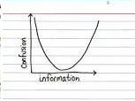
6. Asking for the Same Info Twice
Computers are pretty good at remembering data!

Slide 34
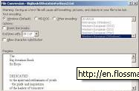
7. No Default Values
Defaults
Speed up the interaction
Free user from having to specify a value
Teach by example
Direct novice users towards a safe or common outcome

Slide 35
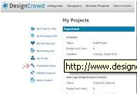
8. Dumping Users Into the App
Users don’t have a pre-conceived conception of how something works
Provide a setup to give them an idea of what’s going to happen
Tell them what you are going to tell them

Slide 36
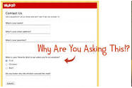
9. Not Indicating How Info Will Be Used
Asking users to enter info without telling them what you’ll use it for
Use of the nickname field for bulletin board applications
Users don’t know the purpose and enter something inappropriate

Slide 37

10. System-Centric Features
Do you offer features that reflect the system’s view of data, or the user’s understanding of the problem space?
Reallocation of savings about various investments
Confusion re existing investments vs. future investments

Slide 38
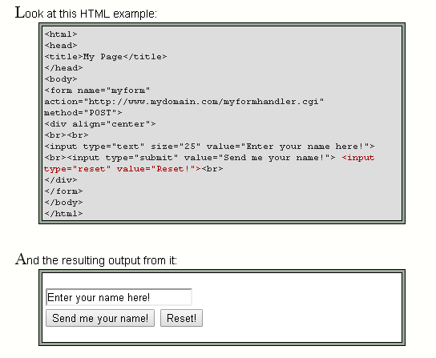
Bonus Mistake: Reset Button on Web Forms
Almost always wrong to have a Reset button on a Web form
Clear’s the user’s entire input, and returns the form to its pristine state
Facebook ad application, 2014
Destroys user’s work in a single click!

Slide 39

Questions and Answers
Josephine M. Giaimo
josephinegiaimo@gmail.com
@giaimojosephine
123 Johnson Street, Highland Park, NJ 08904
(732) 448-0021, (732) 501-6312

