Slide 1
2016 11TH IEEE/ACM Information Technology Professional Conference
Software as a Service (SaaS)
Fredrick Dande, MBA, PMP

Slide 2
Outline
My Intro
Cloud Computing Defined.
Cloud computing Service Models.
Cloud Service Models.
SaaS Introduction.
SaaS Benefits.
Making the case for SaaS.
Saas Challenges.
SaaS Market Leaders.
Demo (If time Allows)
Q&A
Notes:
Intro 2.5
Background of Cloud. 5min
PaaS (Intro. , Trends & Leaders) 15 min
IaaS (Intro. , Trends & Leaders) 15min
Q&A 10 min

Slide 3
Biography
IT Manager at a leading financial service company in the Philadelphia Region.
Over Ten years experience in IT within the Financial Services Industry.
Former Board of Directors Junior Achievement of New Jersey.
Reviewer Associated Computing Machinery (ACM).
Education:
PhD Student, Technology Management; Indiana State University,
MBA; University of Massachusetts Amherst
M.S., Management of Technology; New Jersey Institute of Technology
B.S., Engineering Technology; New Jersey Institute of Technology
Research Interests: Cloud Computing, Cloud Risk Assessment.

Slide 4
Cloud Computing Defined:
IBM defines Cloud computing (“the cloud”) as the delivery of on-demand computing resources, everything from applications to data centers—over the Internet on a pay-for-use basis.
National Institute of Standards and Technology (NIST) defines Cloud as a model for enabling convenient, on-demand network access to a shared pool of configurable computing resources (e.g., networks, servers, storage, applications, and services) that can be rapidly provisioned and released with minimal management effort or service provider interaction.

Slide 5
Cloud Characteristics & Models:
The cloud has five essential characteristics:
On-demand self-service.
Broad network access.
Resource pooling.
Rapid elasticity (expansion)
Measured Service
The three cloud service models are:
Cloud Software as a Service (SaaS).
Cloud Platform as a Service (PaaS).
Cloud Infrastructure as a Service (IaaS))

Slide 6
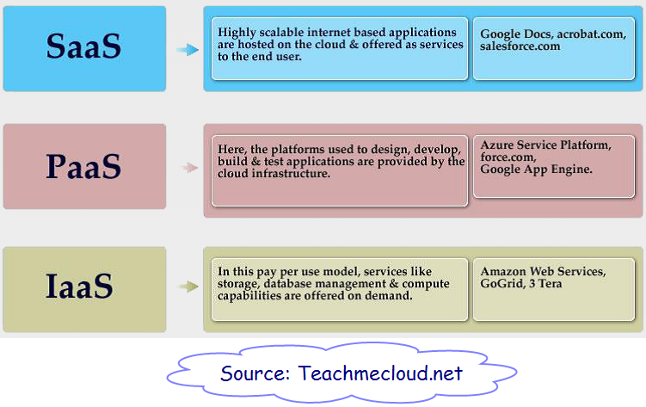
Cloud Service Models:

Slide 7
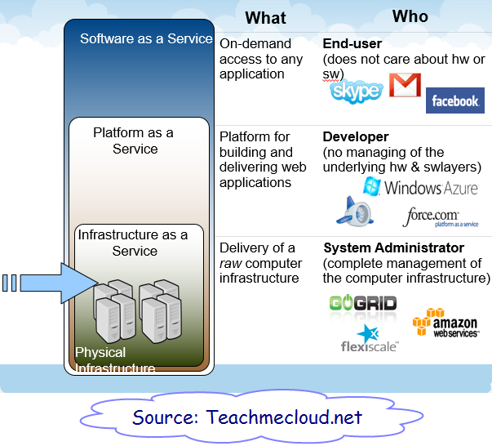
Cloud Service Models:

Slide 8
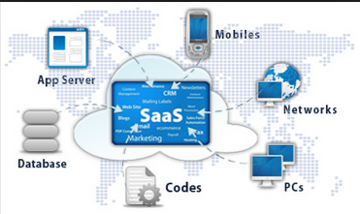
What is SaaS ?
Per (NIST), SaaS, provides capability to the consumer to use the provider’s applications running on a cloud infrastructure.
SaaS = Consume

Slide 9
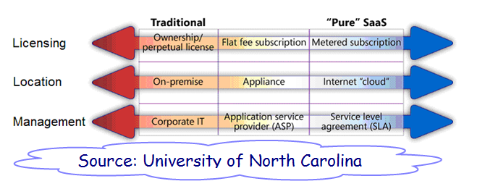
Hosted Vs SaaS

Slide 10

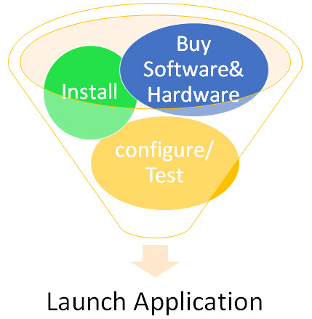
Why SaaS ?
None SaaS Steps to Deploy:
SaaS Steps to Deploy:

Slide 11
SaaS benefits
You can sign up and rapidly start using innovative business apps.
Apps and data are accessible from any connected computer.
No data is lost if your computer breaks, as data is in the cloud.
The service is able to dynamically scale to usage needs

Slide 12
Making the case for SaaS:
Skills needed for implementation & support phases.
Criticality of the data stored/ Security.
Size & culture of the organization.
Nature of integration requirements.
Control over the environment for customizations.
Budget
Regulatory constraints.

Slide 13
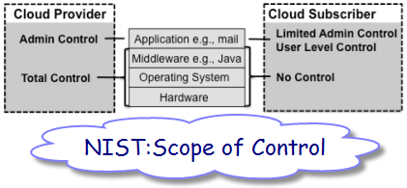
SaaS Provider &Consumer Control
Cloud Provider
Admin Control.
Total Control OS & Hardware
Cloud Consumer
User level Control Only.(Gmail)

Slide 14
SaaS challenges:
Security.
Data Privacy.
Integration with other platforms.
Vendor Lock in/ data Mobility.
Outages.

Slide 15
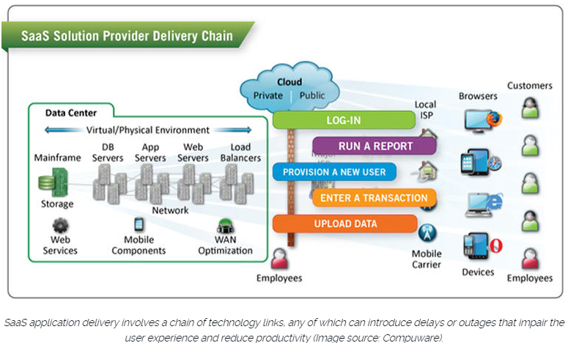
SaaS “Network” = Outages

Slide 16
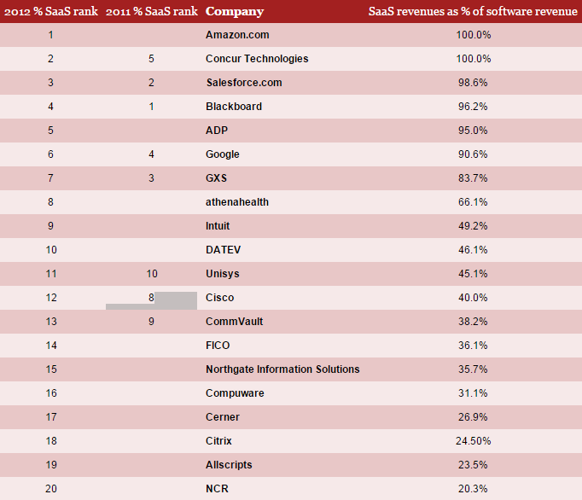
2012-Top 20 SaaS Vendors By revenue (PWC)

Slide 17
2015 –TOP 10 Saas Companies
1. Salesforce, 3.05 Billion - CRM
2. Linkedin, 972 million –Social Media
3. Concur Technologies, 349.49 -Business Travel
4. Ultimate Software Group, 332.3 -HR
5. Athenahealth, 324.1 million –eHealth Records
6. Netsuite 308 million -ERP
7. Medidata Solution, 218.3 million
8. ServiceNow 198.4 million ServiceNow -ITSM
9. Workday 119.5 million Workday, Inc..

Slide 18
SaaS Market Trends 2016
Cisco:By 2018, 59% of the total cloud workloads will be (SaaS) workloads, up from 41% in 2013.
Centaur Partners: Forecasts the market growing from $13.5B in 2011 to $32.8B in 2016.
Forbes: Global SaaS software revenues are forecasted to reach $106B in 2016, increasing 21% over projected 2015 spending levels.

Slide 19
Time for Demo ?
Any SaaS offering Gmail/Salesforce etc. test.
Disclaimer: The author has no affiliation with any of the vendors, the use of their websites is provided for demo purposes only, and is not intended to convey or imply any vendor’s concurrence with, or support for, the positions, opinions, or viewpoints expressed by the author.

Slide 20

The End Q& A

