Slide 1

Should I Build With
Open Source Software?
Joe Levy
IEEE/ACM Information Technology Professional Conference
at TCF
March 14, 2014
Copyright 2014 by Joseph Levy. This work is licensed under a Creative Commons Attribution-NonCommercial-NoDerivatives 4.0 International License. To view a copy of this license, visit: http://creativecommons.org/licenses/by-nc-nd/4.0/
(Photos not licensed for redistribution removed from this file.)

Slide 2

Open Source Myths
Open Source software isn't in the mainstream
You have to give away your secrets to meet license requirements
You can't make a profit if you use Open Source

Slide 3
Introduction
What is Open Source?
Open Source: Ready for Prime-time
Building with Open Source software
Business models

Slide 4
Disclaimer
I am not an attorney!
I am not an Intellectual Property expert!
  Discussion of licensing, copyright and other Intellectual Property issues in this presentation is illustrative, and not to be taken as legal advice
No Warranty

Slide 5
What is Open Source?
One of many protocols for the management of Intellectual Property (IP)
  Trade Secret
  Patent
  Copyright
  License
  Open Source
  Public Domain

Slide 6
What is Open Source?
A protocol for managing intellectual property, combining copyright and licensing
“Something that can be modified because its design is publicly accessible” [1]
  And permitted by license
Also called FOSS
  Free / Open Source Software
  Free, as in “Free Speech”, not “Free Beer” [2]

Slide 7
What is Open Source?
An Open Source license is permission to develop & extend
Open Source licensing promotes continuous improvement of software
Rights and obligations under licenses
  Right to modify
    Right to obtain source code
  Obligation to preserve those rights for downstream users

Slide 8
Where did it come from?
Richard M. Stallman
GNU Project (1983)
Free Software Foundation (1985)
  Ideological
Open Source Initiative (1998)
  Pragmatic
Photo of Richard M. Stallman from
http://static.fsf.org/fsforg/img/rms-web.jpg

Slide 9
Introduction
What is Open Source?
Open Source: Ready for Prime-time
Building with Open Source software
Business models

Slide 10
Where is Open Source?
Photo of U.S.S. Zumwalt from:
http://cdn.arstechnica.net/wp-content/uploads/2013/10/ddg1000-ready-640x426.jpg
Photo of U.S.S. Zumwalt from:
http://farm6.staticflickr.com/5505/10563518254_81b4653962.jpg
U.S.S. Zumwalt (DDG-1000)

Slide 11
Where is Open Source?
U.S.S. Zumwalt IT Infrastructure
  The Navy moves from custom to COTS, in shock isolated ruggedized Electronic Modular Enclosures (EMEs)
    IBM “Blade” servers
    Red Hat Linux, Lynx OS (Open Source)
Applications on Open Source infrastructure need not be Open Source, themselves

Slide 12
Where is Open Source?
Photo of U.S.S. Zumwalt Electronic Modular Enclosure, from:
http://cdn.arstechnica.net/wp-content/uploads/2013/10/EME-1.jpg

Slide 13
Where is Open Source?
Photo of U.S.S. Zumwalt OPS Center, from:
http://cdn.arstechnica.net/wp-content/uploads/2013/10/zumwalt-ops-center.jpg
Tactical applications can be proprietary, classified, or open source

Slide 14
Who Uses Open Source?
Photo of Commanding Officer, U.S.S. Zumwalt, Capt. James A. Kirk:
http://www.public.navy.mil/surfor/ddg1000/PublishingImages/CO_Kirk.jpg
Photo of Richard M. Stallman, from:
http://commons.wikimedia.org/wiki/File:Jadwisin_2009_Richard_Stallman.jpg
Captain James A. Kirk
Richard M. Stallman

Slide 15
Risk-Adverse Management
1970's:
  "Nobody ever got fired for picking IBM." -anon.
1990's:
  "Nobody ever got fired for picking Microsoft." -anon.
2012:
  "You'd be a fool to use anything but Linux."
    -Thomas Bushnell, Google desktop tech lead[3]

Slide 16
Google's Standard Desktop
Ubuntu LTS, tailored by & for Google (Goobuntu)
  Not just for the techies
  Admins, Marketing & Sales, Graphics, HR
  Security waiver required for Windows
  Google buys “Ubuntu Advantage” support
Countless servers & web-facing applications

Slide 17
Who Uses Open Source?
You use Open Source!
  Android phones & tablets
  Many routers / devices with browser access
  Firefox web browser
  E-commerce sites: The LAMP stack
    Linux - Apache - MySQL – PHP
  Wikipedia
  Google

Slide 18
Open Source In Orbit
"We migrated key functions from Windows to Linux because we needed an operating system that was stable and reliable -- one that would give us in-house control. So if we needed to patch, adjust, or adapt, we could." [4]
Astronomy Picture of the Day (APOD) photo of the ISS, from:
http://apod.nasa.gov/apod/image/0904/iss_sts119_big.jpg
[4] Manager of Space Operations Computing (SpOC) for NASA Keith Chuvala

Slide 19
Open Source Myths
Open Source software isn't in the mainstream
You have to give away your secrets to meet license requirements
You can't make a profit if you use Open Source

Slide 20
Introduction
What is Open Source?
Open Source: Ready for Prime-time
Building with Open Source software
Business models

Slide 21
Building With Open Source
Rights and obligations under licenses
  Right to modify
    Right to obtain source code
  Obligation to preserve those rights for downstream users
Obligations apply when, and if you distribute your product

Slide 22
Building With Open Source
No downstream obligation for internal products
  Custom internal systems
    Laboratory
    Test Equipment
  Content creation
  Internal systems that support business processes and services, even services sold externally
    Special case for Affero GPL software

Slide 23
Actiontec Router
Obligations apply when you distribute your product
Stock photo of Actiontec consumer routers

Slide 24
Actiontec Router
Hardware
  Single board computer, RAM
  Flash non-volatile storage
  Ethernet ports, Wi-Fi transceiver
Software
  Operating system, device drivers
  Switching / routing / control
  Web server for configuration

Slide 25
Actiontec Router
Benefits of Open Source development
  Operating system, device drivers, web server available immediately and easily tailorable for custom use
  Significant development effort required only for switching / routing / control
Don't re-invent the wheel
  Increased reliability
Shorter development cycle / lower cost

Slide 26
Actiontec Router
Business Need, Architecture and Licensing
  Must Actiontec make switching / routing / control source code available under an Open Source license?
    Yes, if integrated with Open Source operating system
    No, if loaded as an application by the operating system
Architecture may affect downstream obligations

Slide 27
Actiontec Router
Implications of using Open Source components
  Modifications to operating system, device drivers, web server must be made available under Open Source license
  Proprietary applications on Open Source platforms are permitted under most licenses
  Actiontec's switching / routing / control software may be kept proprietary, or distributed under an Open Source license

Slide 28
Actiontec Router
Does license compliance put Actiontec's secret family recipe at risk?
  Switching / routing / control software remains proprietary
  Little new code is released to meet Open Source license requirements
  Actiontec sells routers, not software
  Verizon sells Internet access, not software

Slide 29
Actiontec Router
Actiontec meets their obligations on the installation CD
  Open Source license
  Collection of Open Source product components
    Original
    From Actiontec's suppliers – Ralink, Jungo...
    From Actiontec, itself

Slide 30
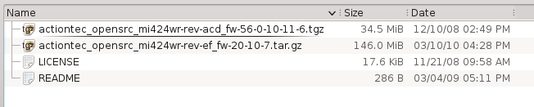
Actiontec Router

Slide 31
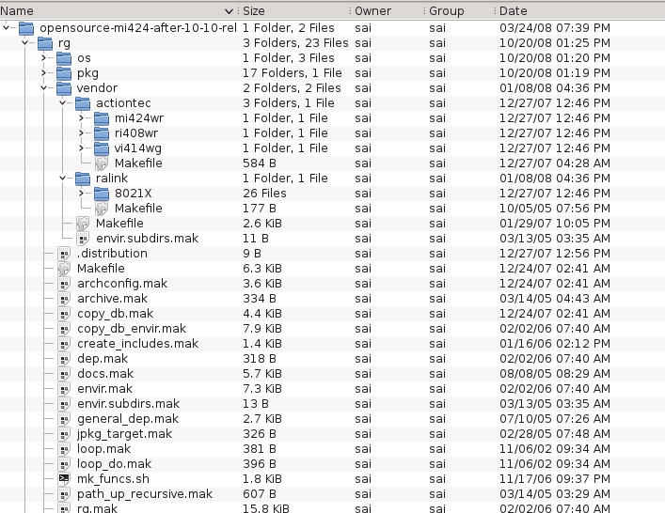
Actiontec Router

Slide 32
Open Source Licenses
Major Open Source licenses
  GNU General Public License v2, v3
  GNU Lesser GPL v2.1, v3
  GNU Affero General Public License v3
  Apache License version 2.0
  GNU Free Documentation License
Many more...
Compatibility varies, but usually not a problem

Slide 33
Distributing With Open Source
Provide an Open Source license
Provide unmodified Open Source components as received
  All licenses, copyright notices intact
Provide modified Open Source components under their license of origin
Provide original Open Source components under a compatible license of your own choosing

Slide 34
Distributing With Open Source
Don't provide source code for proprietary components
  If permitted by your architecture, and licenses
  Proprietary applications can run on Open Source infrastructure under major licenses

Slide 35
Open Source Myths
You have to give away your secrets to meet license requirements
You can't make a profit if you use Open Source

Slide 36
Introduction
What is Open Source?
Open Source: Ready for Prime-time
Building with Open Source software
Business models

Slide 37
Business Models
Sell support, not software
  e.g.: Canonical (Ubuntu Advantage)
  e.g.: Red Hat Enterprise Linux
Sell a subscription-based service
  Running on your servers
    (Presumes no Affero licensed S/W)
  ...or sell data
Sell advertising

Slide 38
Business Models
Use Open Source software for internal productivity
  Google's Goobuntu desktop
  Servers
Sell a whole product, not just the software
  Actiontec, Linksys
  Countless other consumer products

Slide 39
Open Source Myths
You can't make a profit if you use Open Source

Slide 40
Bad Business Models
Sell shrink-wrapped software
Depend on unmodified product for revenue
  Early TiVo products

Slide 41
Linksys Comes Around
Stock photo of Linksys WRT54G
Introduced WRT54G in 2002
  Developed with Open Source
  Linksys met obligations only under pressure
Linksys ultimately benefited
  Longer market lifetime and extra sales

Slide 42
Linksys Comes Around
Photo of Linksys WRT1900AC from:
http://cdn.arstechnica.net/wp-content/uploads/2014/01/Linksys_WRT1900AC_Router_Front_Final1-640x353.jpg
Introducing WRT1900AC in 2014
  High-end hardware
Encouraging participation of third-party developers
  Providing early hardware, SDKs, APIs

Slide 43
Credits
This presentation was prepared with Open Source desktop tools
  OpenSUSE Linux desktop distribution
  Firefox web browser
  LibreOffice “Impress” presentation application
  Ksnapshot screen grabber

Slide 44
Footnotes
[1] Red Hat's “opensource.com”
[2] “What is free software?”, at “www.gnu.org”
[3] Google Desktop Lead Thomas Bushnell, as quoted in ZDNet, August 29, 2012
[4] Manager of Space Operations Computing (SpOC) for NASA Keith Chuvala, as quoted by Adrian Bridgwater in “computerweekly.com” on May 13, 2013

Slide 45
Resources
30+ links to source material in one place, on my “Your Life, Your Tech” blog, here:
http://yourlifeyourtech.blogspot.com
(e-mail through the “Contact Joe” box on the blog page)
...and thank you for attending!
Questions?

Slide 46
Creative Commons License
"Should I Build WIth Open Source Software?" by Joseph Levy is licensed under a Creative Commons Attribution-NonCommercial-NoDerivatives 4.0 International License. To view a copy of the license, visit:
http://creativecommons.org/licenses/by-nc-nd/4.0/

