Slide 1
Are you a polyglot?
Cole Clark, Kovit Nisar, Michael Santos IBM Research

Slide 2
Creating Backend Services
Performance
Handling multiple requests at once
Scalability
Package Management
Libraries
Controlling package versions
Vulnerability management
Ease of use
Codebase is easily understood
Documentation and Community
Testing Frameworks

Slide 3
Python
Dynamically typed, object-oriented, interpreted language
Large library of extensions through PIP package manager
Uses less lines of code
In general, runs slower than compiled code
Flask
Micro web framework for Python that implements WSGI protocol
Includes routing and templating tools for serving web requests
Very little overhead and is easily extensible
Synchronous
Should not be used in production (uWSGI is needed)

Slide 4
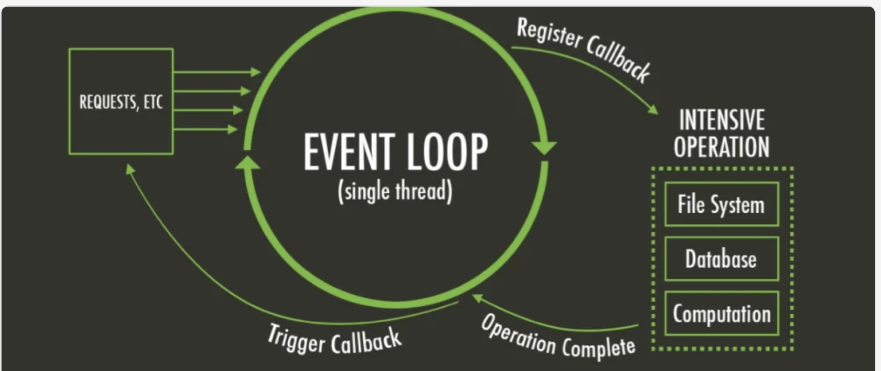
Node.js
Node.js is an open-source, cross-platform JavaScript runtime environment and library for running web applications outside the client's browser.

Slide 5
Express
Express is a minimal and flexible a back end web application framework for building RESTful APIs with Node.js
Typescript
TypeScript technically is JavaScript with static typing.

Slide 6
GO
Simplified code allows for easy learning
Performance: runs and compiles very fast
Designed for concurrency
Built in tooling: linter, formatting, tester
Gin-Gonic
High performance http web framework
Reduces boilerplate code

Slide 7



Language Comparison
Statically typed
Compiled language
Asynchronous
Multi-threaded
Limited inventory of packages in Go Modules
Dynamically typed
Interpreted language
Asynchronous
Multi-threading limited due to GIL
Large inventory of packages using PIP
Statically typed
Transpiled to JavaScript
Asynchronous
Single-threaded
Large inventory of packages using NPM

Slide 8
So what should I use?
Python
AI and machine learning
Data intensive tasks
Node.js
I/O bound applications
Real time apps
Go
High volume of requests
Small tasks that need high performance

Slide 9
It depends...
1
Business requirements
2
Inheriting a project may require a certain language
3
Improving or learning new skills
4
Personal Preference

Slide 10
Thank you.
© 2023 International Business Machines Corporation
IBM and the IBM logo are trademarks of IBM Corporation, registered in many jurisdictions worldwide. Other product and service names might be trademarks of IBM or other companies. A current list of IBM trademarks is available on ibm.com/trademark.
THIS DOCUMENT IS DISTRIBUTED “AS IS” WITHOUT ANY WARRANTY, EITHER EXPRESS OR IMPLIED. IN NO EVENT, SHALL IBM BE LIABLE FOR ANY DAMAGE ARISING FROM THE USE OF THIS INFORMATION, INCLUDING BUT NOT LIMITED TO, LOSS OF DATA, BUSINESS INTERRUPTION, LOSS OF PROFIT OR LOSS OF OPPORTUNITY.
Client examples are presented as illustrations of how those clients have used IBM products and the results they may have achieved. Actual performance, cost, savings or other results in other operating environments may vary.
Not all offerings are available in every country in which IBM operates.
Any statements regarding IBM’s future direction, intent or product plans are subject to change or withdrawal without notice.

