Slide 1
Modernize your APIs with GraphQL

Slide 2


Hi!
Aditya Gidh Software Engineer at IBM Research
Working on Full Stack Development, DevOps engineering

Slide 3
What is GraphQL?
Specification introduced by Meta
Query language for APIs and a runtime for fulfilling those queries with your existing data
Built around HTTP for how you get and receive resources from a server
Pickup selective information from your endpoints

Slide 4
What GraphQL is NOT?
A client side state management solution
Meta’s Graph API
Limited to specific database(s)
Limited to JavaScript ecosystem
Limited to use with React/ Web technologies
Limited to HTTP

Slide 5
Why use GraphQL?
GraphQL is compositional
GraphQL is declarative, No under or over fetching
Reduced network requests
Typed data schema
Support pagination without unnecessary overhead

Slide 6
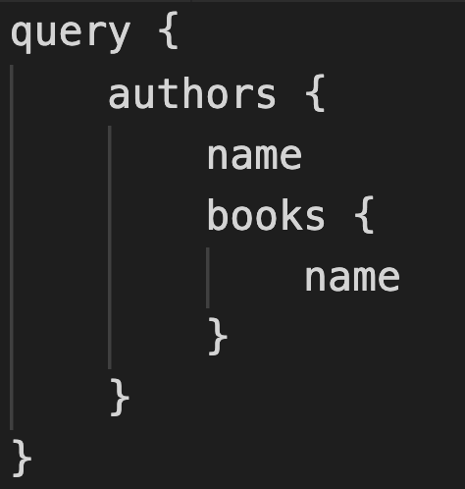
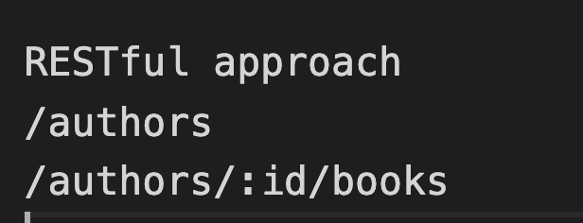
Simple Example
Imagine an application where in you have books and authors as your two resources and each of these resources has like 15 fields in them.
Access author name, and all of the books and their name for that particular author

Slide 7
Compare GraphQL to REST
Data fetching
Multiple endpoints vs single endpoint
/authors
/books v/s /graphql
/authors/:id/books
/books/:id/comments
Route handlers vs resolvers
Conceptual model: resources vs graphs

Slide 8
GraphQL basics
Schema
Resolvers
Query (read)
Fetching and reading data
Mutation (write)
creating, updating, deleting data
Subscription (event observation)

Slide 9
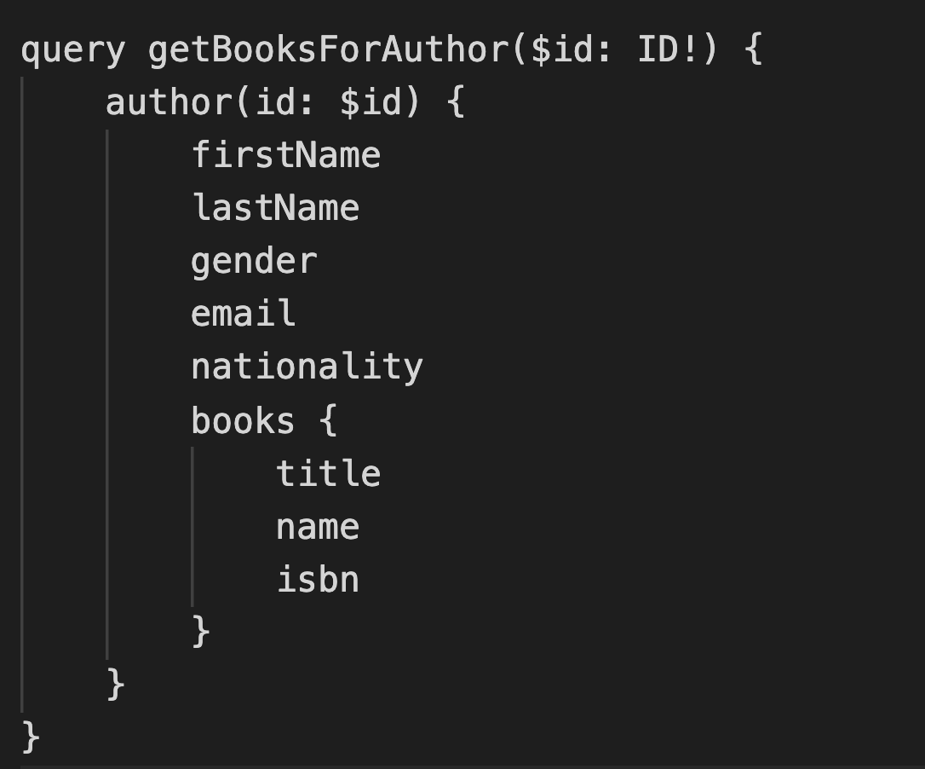
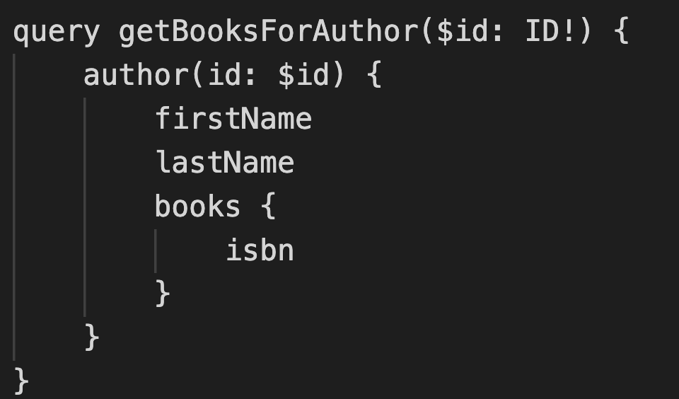
Query structure

Slide 10
GraphQL Benefits
Single Endpoint
Data exchange from single endpoint
Query language
Declarative schemas, type safety and data formats
Dynamic
Less data fetching –> Lower data transfer costs
Less data fetching –> Faster application load times
Less data fetching –> Makes your app work better with slow network connections
GraphQL client libraries
Native integration with React and other client libraries

Slide 11
Demo
https://github.com/adimaniacal/graphql-itpc-2023

Slide 12
Resources
GraphQL: https://graphql.org/
Community Resources: https://graphql.org/community/
Official GraphQL.org discord: https://discord.graphql.org/
Apollo Resources: https://www.apollographql.com/resources/
Public GraphQL APIs: https://github.com/IvanGoncharov/graphql-apis

Slide 13
© 2023 International Business Machines Corporation IBM and the IBM logo are trademarks of IBM Corporation, registered in many jurisdictions worldwide. Other product and service names might be trademarks of IBM or other companies. A current list of IBM trademarks is available on ibm.com/trademark. THIS DOCUMENT IS DISTRIBUTED “AS IS” WITHOUT ANY WARRANTY, EITHER EXPRESS OR IMPLIED. IN NO EVENT, SHALL IBM BE LIABLE FOR ANY DAMAGE ARISING FROM THE USE OF THIS INFORMATION, INCLUDING BUT NOT LIMITED TO, LOSS OF DATA, BUSINESS INTERRUPTION, LOSS OF PROFIT OR LOSS OF OPPORTUNITY.

